Slide 1
New Mexico Board of Pharmacy
Prescription Monitoring Program (PMP)
NMPhA Mid-Winter Meeting
NM BOP Law Update
January 27, 2019
Peter Ryba, PharmD
PMP Director
peter.ryba@state.nm.us

Slide 2
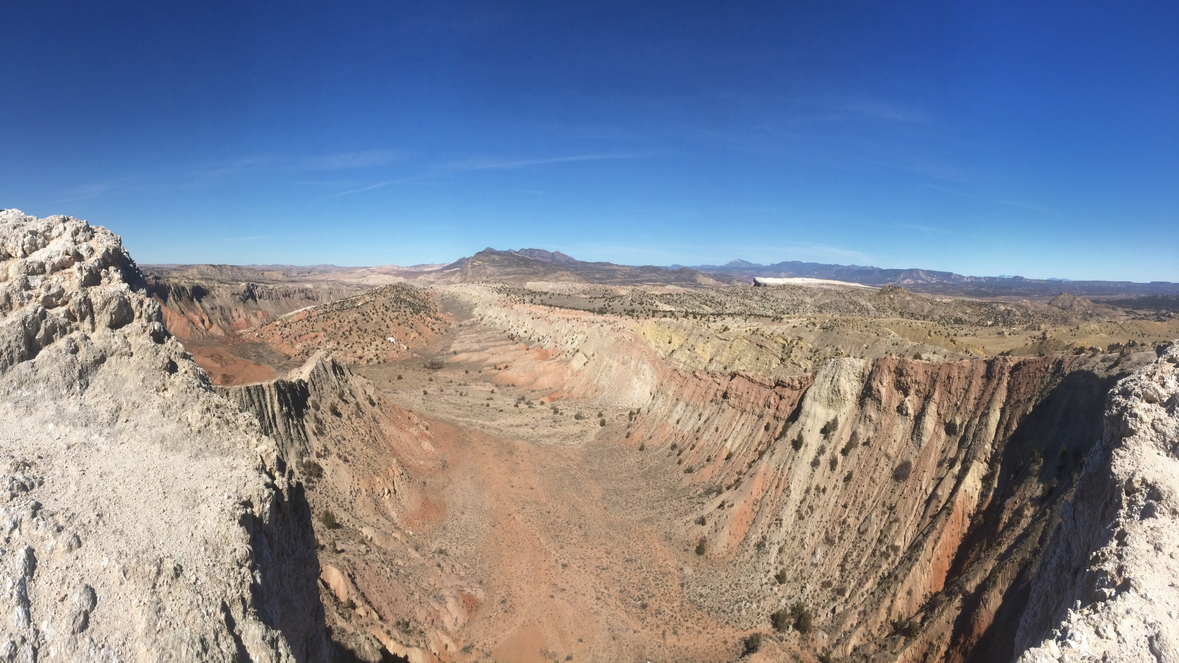
Agenda
Prescription Monitoring Program
New Mexico Board of Pharmacy
Prescription Drug Information and Statistics
What is the PMP?
PMP Registration Process
PMP Regulatory Facts
Information Gained from the PMP Patient Report
Other Features Within PMP AWARxE
Reports Available
Current Projects
Useful Links

Slide 3
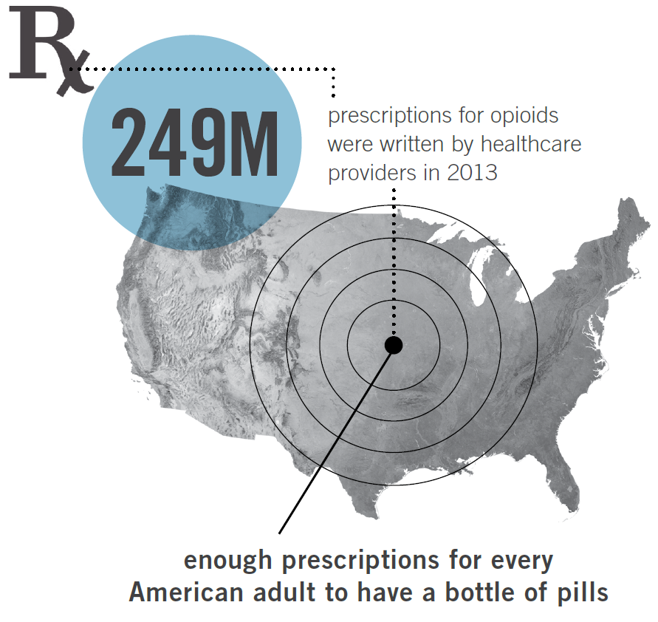
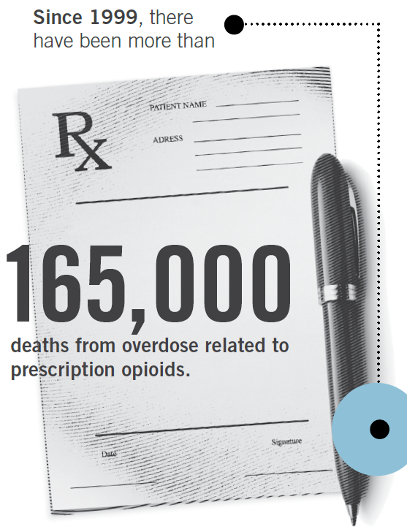
Prescription Drug Information and Statistics
Prescription Monitoring Program
New Mexico Board of Pharmacy
Source: www.cdc.gov/drugoverdose/prescribing/guideline.html
Notes:
1999-2014

Slide 4
Prescription Drug Information and Statistics
Prescription Monitoring Program
New Mexico Board of Pharmacy
The National Epidemic
The United States is in the midst of an epidemic of prescription opioid overdose deaths, which killed more than 63,600 people in 2016 alone.
Source: NCHS Data Brief, Number 294, December 2017 www.cdc.gov/drugoverdose/prescribing/guideline.html
Notes:
14,000 people in 2014 alone.

Slide 5
Prescription Drug Information and Statistics
Prescription Monitoring Program
New Mexico Board of Pharmacy
The State of New Mexico compared to the United States average
In 2014, New Mexico had the second highest drug overdose death rate (27.3 deaths per 100,000 age-adjusted population).
In 2015, New Mexico had the eighth highest drug overdose death rate (25.3 deaths per 100,000 age-adjusted population).
In 2016, New Mexico had the twelfth highest drug overdose death rate (25.2 deaths per 100,000 age-adjusted population).
In 2017, New Mexico had the seventeenth highest drug overdose death rate (24.8 deaths per 100,000 age-adjusted population).
Source: www.cdc.gov/drugoverdose/prescribing/guideline.html

Slide 6
Prescription Drug Information and Statistics
Prescription Monitoring Program
New Mexico Board of Pharmacy
Drug Overdose Death Rates for the 17 States with the Highest Rates in 2017, 2010-2017
Rates are age adjusted to the US 2000 standard population
Source: National Center for Health Statistics, CDC via CDC Wonder
Notes:
Other states: OH, NH, PA, KY, MD, MA, RI, DE, ME, CT

Slide 7
Prescription Drug Information and Statistics
Prescription Monitoring Program
New Mexico Board of Pharmacy
Although New Mexico has been progressing, NM is still statistically higher compared to the United States drug overdose death rate average
(21.7 deaths per 100,000).
  Source: NCHS Data Brief, Number 294, December 2017

Slide 8
Prescription Drug Information and Statistics
Prescription Monitoring Program
New Mexico Board of Pharmacy
Age-Adjusted Drug Overdose Death Rates, by Opioid Category: United States 1999-2016
Source: NCHS Data Brief, Number 294, December 2017

Slide 9
Prescription Drug Information and Statistics
Prescription Monitoring Program
New Mexico Board of Pharmacy
Drug Overdose Death Rates for Selected Drugs, NM, 2012-2017
Non-fentanyl Rx Opioids
Methamphetamine
Heroin
Benzodiazepines
Fentanyl & analogues

Slide 10
Prescription Drug Information and Statistics
Prescription Monitoring Program
New Mexico Board of Pharmacy
Top Prescription Drugs in Overdose Death, NM, 2017
Roughly half of the drug overdose deaths in NM involve a prescription drug. Some of the medications listed are not opioids.
Deaths may involve more than one drug
Source: NM Office of the Medical Investigator

Slide 11
Prescription Drug Information and Statistics
Prescription Monitoring Program
New Mexico Board of Pharmacy
Percentage of Overdose Deaths Involving Prescription Opioids, NM, 2012-2017
Source: Bureau of Vital Records and Health Statistics

Slide 12
Prescription Drug Information and Statistics
Prescription Monitoring Program
New Mexico Board of Pharmacy
Percentage of Overdose Deaths Involving Benzodiazepines, NM, 2012-2017
Source: Bureau of Vital Records and Health Statistics

Slide 13
Prescription Drug Information and Statistics
Prescription Monitoring Program
New Mexico Board of Pharmacy
Percentage of Overdose Deaths Involving Methamphetamine, NM, 2012-2017
Source: Bureau of Vital Records and Health Statistics

Slide 14
Prescription Drug Information and Statistics
Prescription Monitoring Program
New Mexico Board of Pharmacy
Drug Overdose Death Rates, by Selected Age Group: United States, 1999-2016
Source: NCHS Data Brief, Number 294, December 2017

Slide 15
Prescription Drug Information and Statistics
Prescription Monitoring Program
New Mexico Board of Pharmacy
Drug Overdose Death Rates, by Selected Age, Sex and Drug Type, NM, 2013-2017
Drug Categories are mutually exclusive
Source: NM DOH Bureau of Vital Records and Health Statistics death data; UNM/GPS population estimates

Slide 16
Prescription Drug Information and Statistics
Prescription Monitoring Program
New Mexico Board of Pharmacy
Benzodiazepine-Involved Overdose Deaths, by Selected Age and Sex, NM, 2013-2017
Source: NM DOH Bureau of Vital Records and Health Statistics death data

Slide 17
Prescription Drug Information and Statistics
Prescription Monitoring Program
New Mexico Board of Pharmacy
Methamphetamine-Involved Overdose Deaths, by Selected Age and Sex, NM, 2013-2017
Source: NM DOH Bureau of Vital Records and Health Statistics death data

Slide 18
Prescription Drug Information and Statistics
Prescription Monitoring Program
New Mexico Board of Pharmacy
Prescription Opioid Overdose Deaths by the Number of Substances Involved, NM, 2013-2017
Other substances often involved with prescription opioid overdose deaths include benzodiazepines, alcohol, heroin and methamphetamine.
Source: NM DOH Bureau of Vital Records and Health Statistics death data

Slide 19
Prescription Drug Information and Statistics
Prescription Monitoring Program
New Mexico Board of Pharmacy
Benzodiazepine Overdose Deaths by the Number of Substances Involved, NM, 2013-2017
Other substances often involved with benzodiazepine overdose deaths include prescription opioids, alcohol, heroin and methamphetamine.
Source: NM DOH Bureau of Vital Records and Health Statistics death data

Slide 20
Prescription Drug Information and Statistics
Prescription Monitoring Program
New Mexico Board of Pharmacy
Methamphetamine Overdose Deaths by the Number of Substances Involved, NM, 2013-2017
Other substances often involved with methamphetamine overdose deaths include heroin, prescription opioids, alcohol, and benzodiazepines.
Source: NM DOH Bureau of Vital Records and Health Statistics death data

Slide 21
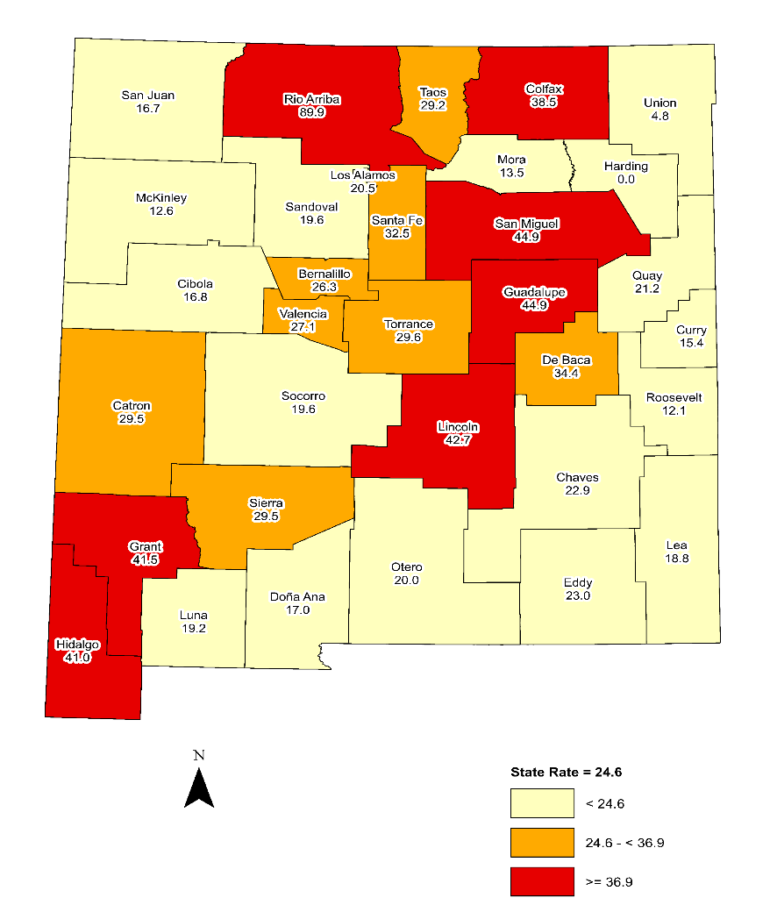
Prescription Monitoring Program
New Mexico Board of Pharmacy
Prescription Drug Information and Statistics
Drug Overdose Death Rate by County, NM, 2013-2017
Rates are age adjusted to the US 2000 standard population
Source: Bureau of Vital Records and Health Statistics, UNM/GPS population estimates

Slide 22
Prescription Drug Information and Statistics
Prescription Monitoring Program
New Mexico Board of Pharmacy
National Comparison of Total ODD and Rate, NM, 2014-2016
Year | National Rank | Total Overdose Deaths | Death Rate per 100,000 (age adjusted)
2014 | 2nd | 540 | 27.3
2015 | 8th | 493 | 25.3
2016 | 12th | 497 | 25.2
2017 | 17th | 493 | 24.8
Source: NM Department of Health

Slide 23
What is the PMP?
Prescription Monitoring Program
New Mexico Board of Pharmacy
The New Mexico Prescription Monitoring Program is a web-based electronic database that aids in the reporting of dispensed controlled substance prescriptions.

Slide 24
What is the PMP?
Prescription Monitoring Program
New Mexico Board of Pharmacy
Mission
To provide practitioners, pharmacists, and other authorized users the ability to review a patient’s controlled substance prescription history and assist in the prevention of diversion, abuse, misuse, and drug overdose deaths associated with controlled substance prescriptions.

Slide 25
PMP Registration Process
Prescription Monitoring Program
New Mexico Board of Pharmacy
Registrants include:
Healthcare Professionals
Delegates
  Up to four (4) delegates per practitioner/pharmacist
  A delegate can have an unlimited number of practitioners/pharmacists
Law Enforcement
Regulatory Board Agents
Medicaid Compliance Officers

Slide 26
PMP Registration Process
Prescription Monitoring Program
New Mexico Board of Pharmacy
Create an account at https://newmexico.pmpaware.net/login.
Verify your email by clicking on the link in the auto-generated email you received when you created an account.
Upload or email a copy of your driver's license, state issued photo ID, or a passport. No other forms of identification will be accepted (for example work badges, Social Security Cards).
Complete the required training at http://nmpmp.org/Training.aspx.

Slide 27
PMP Registration Process
Prescription Monitoring Program
New Mexico Board of Pharmacy
How Delegates Register for PMP AWARxE
Available Delegate User Roles
  Prescriber Delegate – Unlicensed
  Prescriber Delegate – Licensed
  Pharmacist Delegate – Licensed
Enter their supervisor’s email address. The supervisor must already have a registered account with the PMP AWARXE.

Slide 28
PMP Registration Process
Prescription Monitoring Program
New Mexico Board of Pharmacy
How Delegates Add/Remove Supervising Physicians After Registering
A delegate may add and remove a supervising physician at any time.
The delegate must enter their supervisor’s email address and click add.
If the delegate needs to remove a supervisor, click the “x” button next to the supervisor, then click “Save Changes.”

Slide 29
PMP Regulatory Facts
Prescription Monitoring Program
New Mexico Board of Pharmacy
DENTISTRY (DENTISTS, DENTAL HYGIENISTS, ETC.)
16.5.57 NMAC - MANAGEMENT OF PAIN WITH CONTROLLED SUBSTANCES
MEDICINE AND SURGERY PRACTITIONERS
16.10.14 - NMAC MANAGEMENT OF PAIN WITH CONTROLLED SUBSTANCES
MIDWIVES
16.11.2 NMAC - CERTIFIED NURSE MIDWIVES
NURSING AND HEALTH CARE RELATED PROVIDERS
16.12.9 NMAC - MANAGEMENT OF CHRONIC PAIN WITH CONTROLLED SUBSTANCES

Slide 30
PMP Regulatory Facts
Prescription Monitoring Program
New Mexico Board of Pharmacy
OPTOMETRIC PRACTITIONERS
16.16.15 NMAC - MANAGEMENT OF PAIN WITH CONTROLLED SUBSTANCES
OSTEOPATHIC MEDICINE AND SURGERY PRACTITIONERS
16.17.5 NMAC - PRESCRIBING AND DISTRIBUTION OF CONTROLLED SUBSTANCES
PHARMACISTS
16.19.4 NMAC - PHARMACIST
16.19.20 NMAC - CONTROLLED SUBSTANCES
16.19.29 NMAC - CONTROLLED SUBSTANCE PRESCRIPTION MONITORING PROGRAM
PODIATRISTS
16.21.9 NMAC - MANAGEMENT OF PAIN WITH CONTROLLED SUBSTANCES

Slide 31
PMP Regulatory Facts
Prescription Monitoring Program
New Mexico Board of Pharmacy
All Users
Only authorized account holder can access the NM PMP.
Sharing login information is a violation of both federal and state regulations.
Although delegates can pull PMP patient reports on behalf of a practitioner, the practitioner is ultimately responsible to review the PMP patient report.
The practitioner shall document the review of the PMP patient report as required per their licensing board regulation.

Slide 32
PMP Regulatory Facts
Prescription Monitoring Program
New Mexico Board of Pharmacy
Pharmacists
For opioid prescriptions, obtain and review the NM PMP patient report for the previous 12 months and from adjacent states if available.
For a renewal or continuous use of an opioid, obtain and review a NM PMP patient report (and from adjacent states if applicable) no less than once every three (3) months.
Document your review!

Slide 33
PMP Regulatory Facts
Prescription Monitoring Program
New Mexico Board of Pharmacy
Pharmacists
Pharmacists do not have to consult the PMP report before dispensing a prescription for:
an opioid written for a patient in a long term care facility (LTCF); or
for a patient with a medical diagnosis documenting a terminal illness.

Slide 34
PMP Regulatory Facts
Prescription Monitoring Program
New Mexico Board of Pharmacy
Pharmacist Clinicians
For the initial controlled substance II-IV prescription and if the day supply is greater than four (4) days, or if there is a gap in prescribing the controlled substance for 30 days or more, obtain and review the NM PMP patient report for the previous 12 months and from adjacent states if available.
For a renewal or continuous use of a controlled substance, obtain and review a NM PMP patient report (and from adjacent states if applicable) no less than:
  once every three (3) months for opioids, benzodiazepines, and carisoprodol;
  and every six (6) months for controlled substances II-IV.

Slide 35
PMP Regulatory Facts
Prescription Monitoring Program
New Mexico Board of Pharmacy
Pharmacist Clinicians
PhCs do not have to consult the PMP report before prescribing, ordering, or dispensing a controlled substance II, III, or IV:
If the dispensed quantity is for a period of 4 days or less, or
To a patient in a nursing facility, or
To a patient in hospice care.

Slide 36
PMP Regulatory Facts
Prescription Monitoring Program
New Mexico Board of Pharmacy
Dispensers
All dispensers (e.g. pharmacies, dispensing practitioners) must report within one business day if more than 12 doses within a 72 hour period was dispensed.
If a dispenser did not dispense any controlled substances, a “zero report” must be submitted within one business day.
If a dispenser becomes aware of an data entry error, the correction must be submitted to the PMP within five (5) business days.

Slide 37
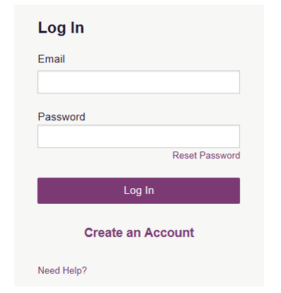
How to Request a PMP Patient Report
Prescription Monitoring Program
New Mexico Board of Pharmacy
Access the PMP website at https://newmexico.pmpaware.net

Slide 38
How to Request a PMP Patient Report
Prescription Monitoring Program
New Mexico Board of Pharmacy
Once logged in, My Dashboard is your home page:
Recent Requests – This lists the most recent PMP patient requests your and your assigned delegates (if applicable) queried.
Delegates – This lists your delegates if you are a supervising practitioner (if applicable).

Slide 39
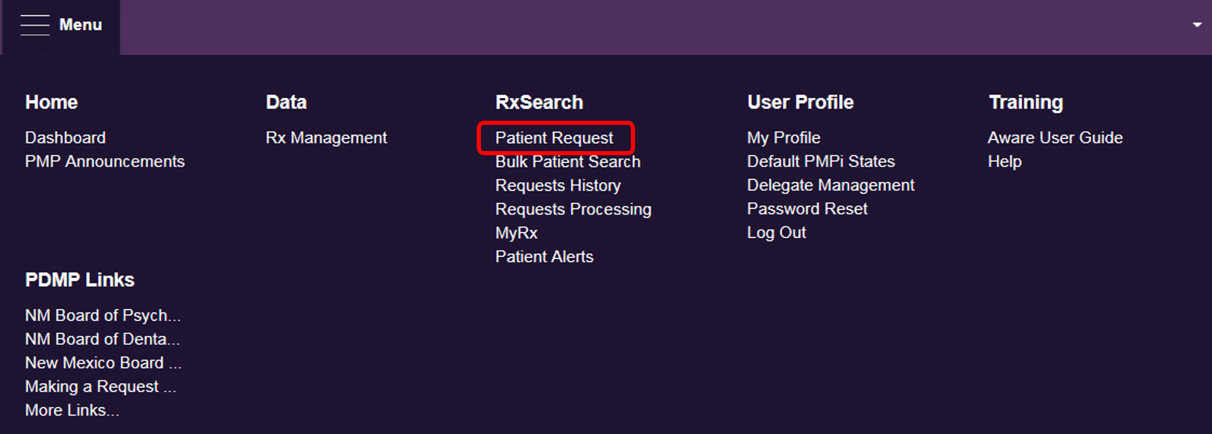
How to Request a PMP Patient Report
Prescription Monitoring Program
New Mexico Board of Pharmacy
Click Menu, then click Patient Request to start a PMP patient request.

Slide 40
How to Request a PMP Patient Report
Prescription Monitoring Program
New Mexico Board of Pharmacy
If you are a delegate, select the correct supervisor. If you do not select the correct supervisor, that practitioner may appear on an outlier report and their respective licensing board may choose to investigate that practitioner if it is determined that PMP utilization did not meet their board’s requirement.

Slide 41
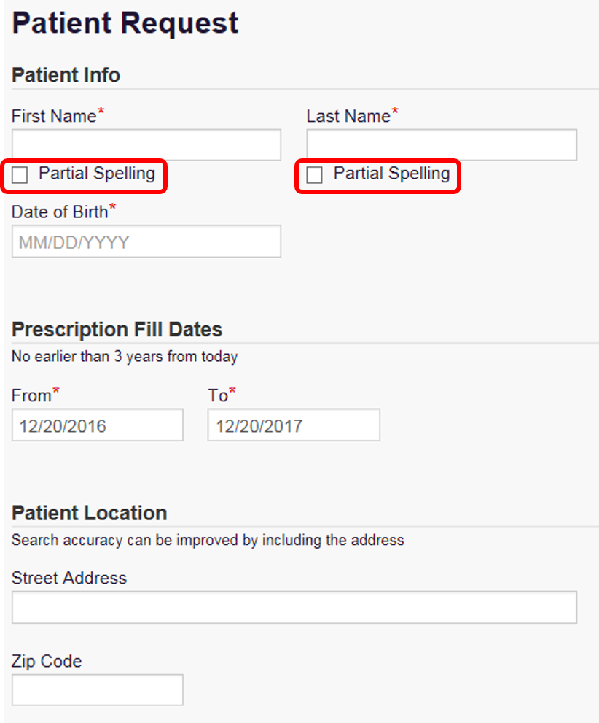
How to Request a PMP Patient Report
Prescription Monitoring Program
New Mexico Board of Pharmacy
Enter the patient’s:
First name
Last name
Date of birth
Partial spelling is recommended to determine if there are multiple patient profiles that are not linked/consolidated. If using partial spelling, the first three (3) characters of the first and last name are required at a minimum.

Slide 42
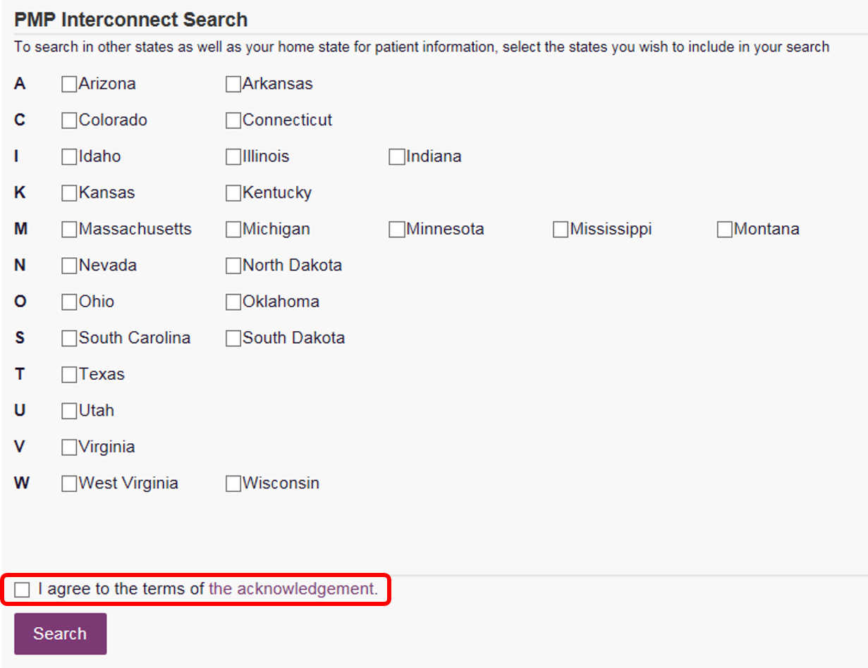
How to Request a PMP Patient Report
Prescription Monitoring Program
New Mexico Board of Pharmacy
If multiple states are being requested, you will need to search by a patient’s full first name and full last name.
Keep in mind any additional profiles that were provided during a partial name search. You may have to search multiple times if the patient has multiple profiles.

Slide 43
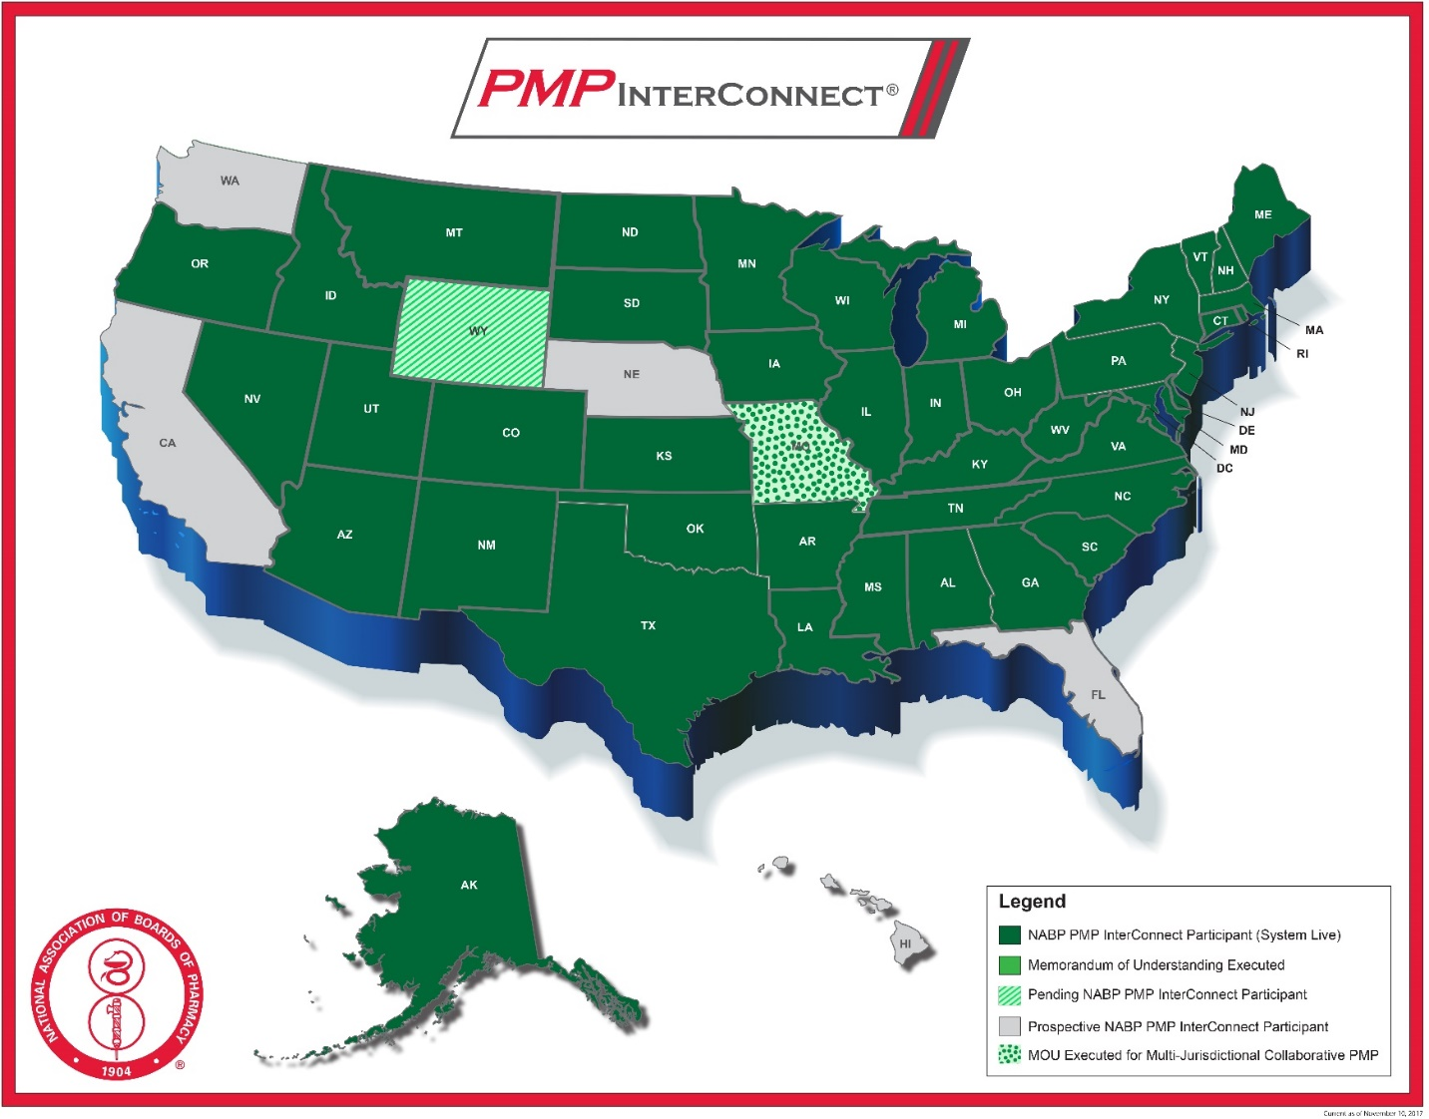
How to Request a PMP Patient Report
Prescription Monitoring Program
New Mexico Board of Pharmacy
The PMP InterConnect (PMPi) facilitates the transfer of PMP data across state lines.
PMPi allows participating states across the United States to be linked, providing a more effective means of combating drug diversion and drug abuse nationwide.
Currently, 45 states and jurisdictions have agreed to securely share PMP data through PMPi.
Source: https://nabp.pharmacy/initiatives/pmp-interconnect/

Slide 44
Sample PMP Patient Report
Prescription Monitoring Program
New Mexico Board of Pharmacy

Slide 45
Sample PMP Patient Report
Prescription Monitoring Program
New Mexico Board of Pharmacy

Slide 46
Information Gained from PMP Reports
Prescription Monitoring Program
New Mexico Board of Pharmacy
Multiple providers and/or pharmacies
Prescriptions obtained from nonlocal providers and/or pharmacies
High doses of opioids
Opioids in combination with other sedating substances (e.g. benzodiazepines)
Early refill requests
Cash payments when insurance is available

Slide 47
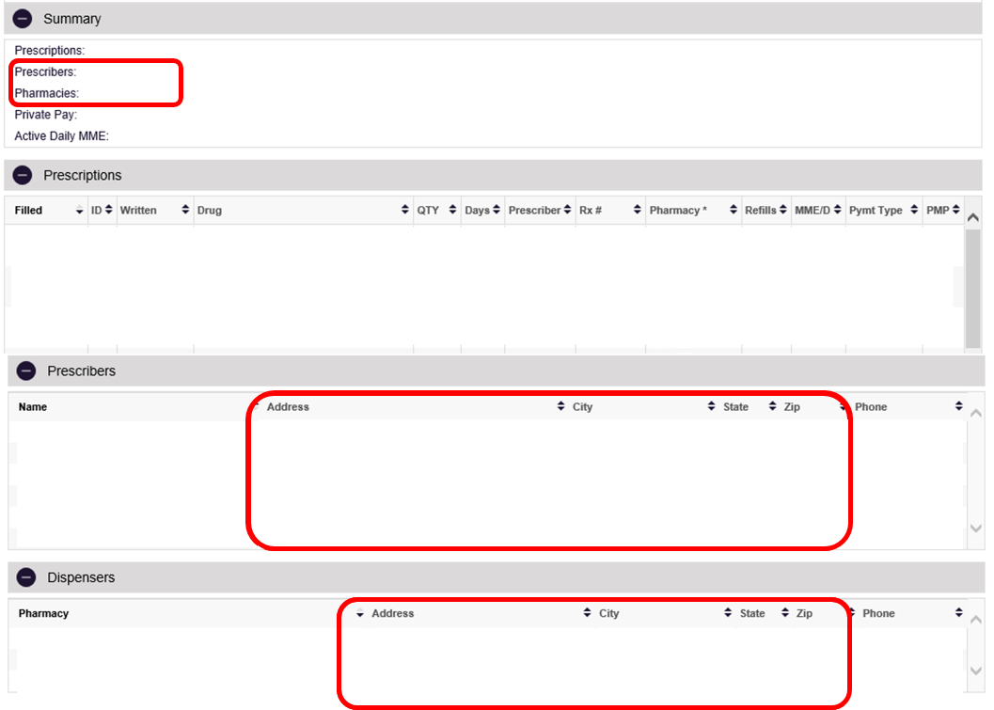
Prescription Monitoring Program
New Mexico Board of Pharmacy
Information Gained from PMP Reports
Multiple Providers, Nonlocal Providers

Slide 48
Prescription Monitoring Program
New Mexico Board of Pharmacy
Information Gained from PMP Reports
Relative Risk of Prescription Opioid Overdose Death by Days of Overlap from Different Prescribers
The risk for a patient to die from an opioid overdose increases when a patient receives prescriptions from multiple practitioners. Examples include:
Multiple opioids are prescribed
Care is not coordinated or communicated with other providers
Dangerous combinations of medications are prescribed
Source: NM Department of Health

Slide 49
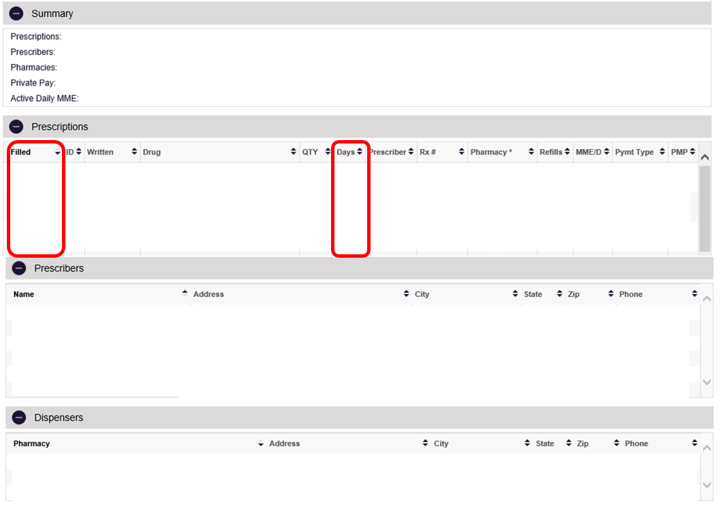
Information Gained from PMP Reports
Prescription Monitoring Program
New Mexico Board of Pharmacy
Early Refill Requests

Slide 50
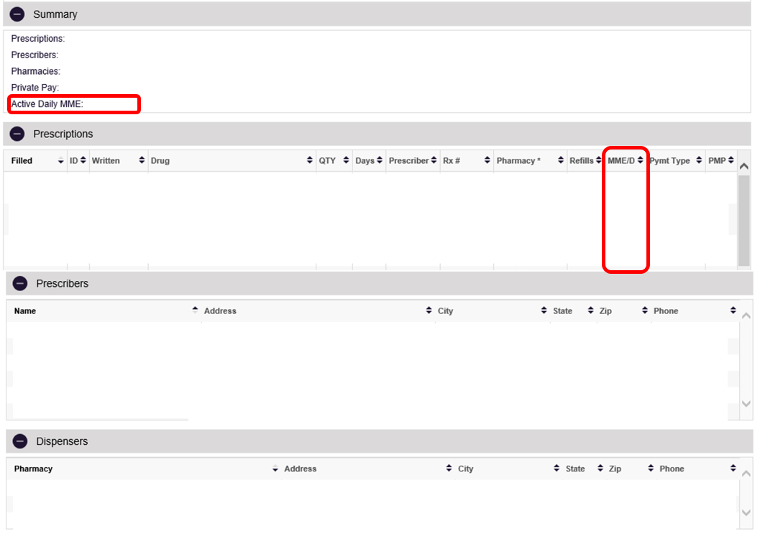
Information Gained from PMP Reports
Prescription Monitoring Program
New Mexico Board of Pharmacy
High Dose

Slide 51
Prescription Monitoring Program
New Mexico Board of Pharmacy
Information Gained from PMP Reports
Relative Risk of Prescription Overdose Death by Opioid Dose Level, 2007-2011
The risk for a patient to die from an opioid overdose increases significantly as their dose increases.
3x greater risk at 80-120 MME/d*
6x greater risk at 120-200 MME/d*
17x greater risk at 200+ MME/d*
*morphine milligram equivalent per day
Source: NM Department of Health

Slide 52
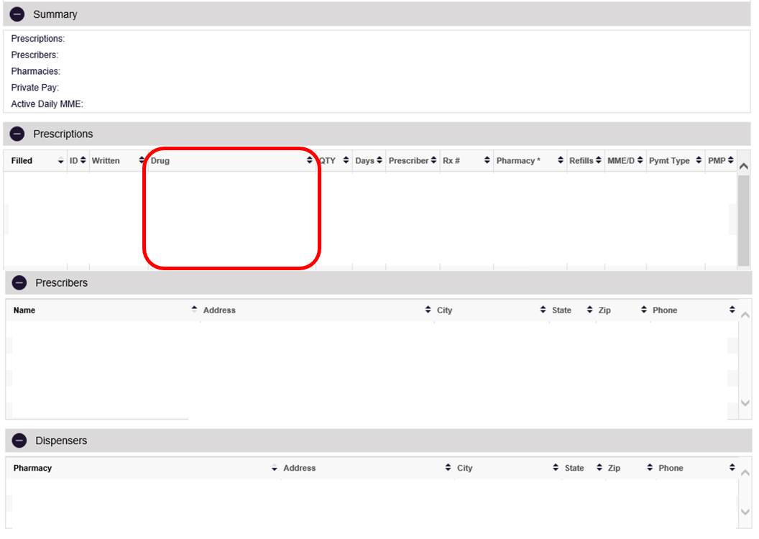
Information Gained from PMP Reports
Prescription Monitoring Program
New Mexico Board of Pharmacy
Opioid Combinations with Other Substances

Slide 53
Prescription Monitoring Program
New Mexico Board of Pharmacy
Information Gained from PMP Reports
Relative Risk of Overdose Death with Opioid/Sedative-Hypnotic Overlap, NM, 2007-2011
The risk for a patient to die from an overdose from an opioid in combination with a sedative increases significantly with more overlap.
Source: NM Department of Health

Slide 54
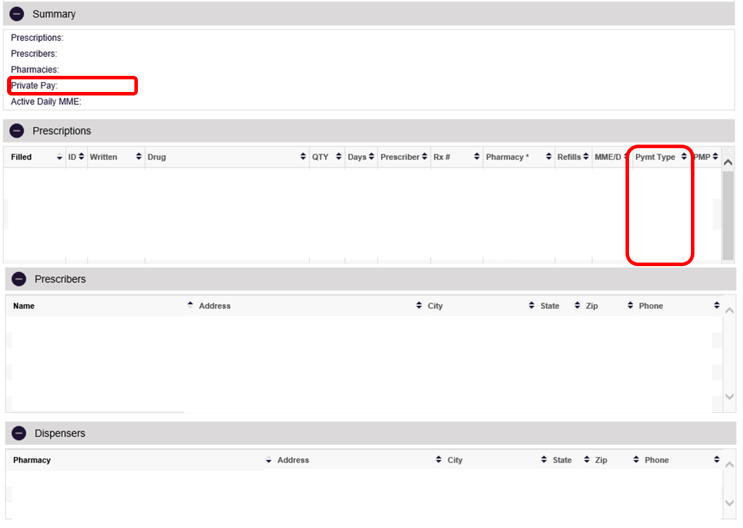
Information Gained from PMP Reports
Prescription Monitoring Program
New Mexico Board of Pharmacy
Cash Payments when Insurance is Available

Slide 55
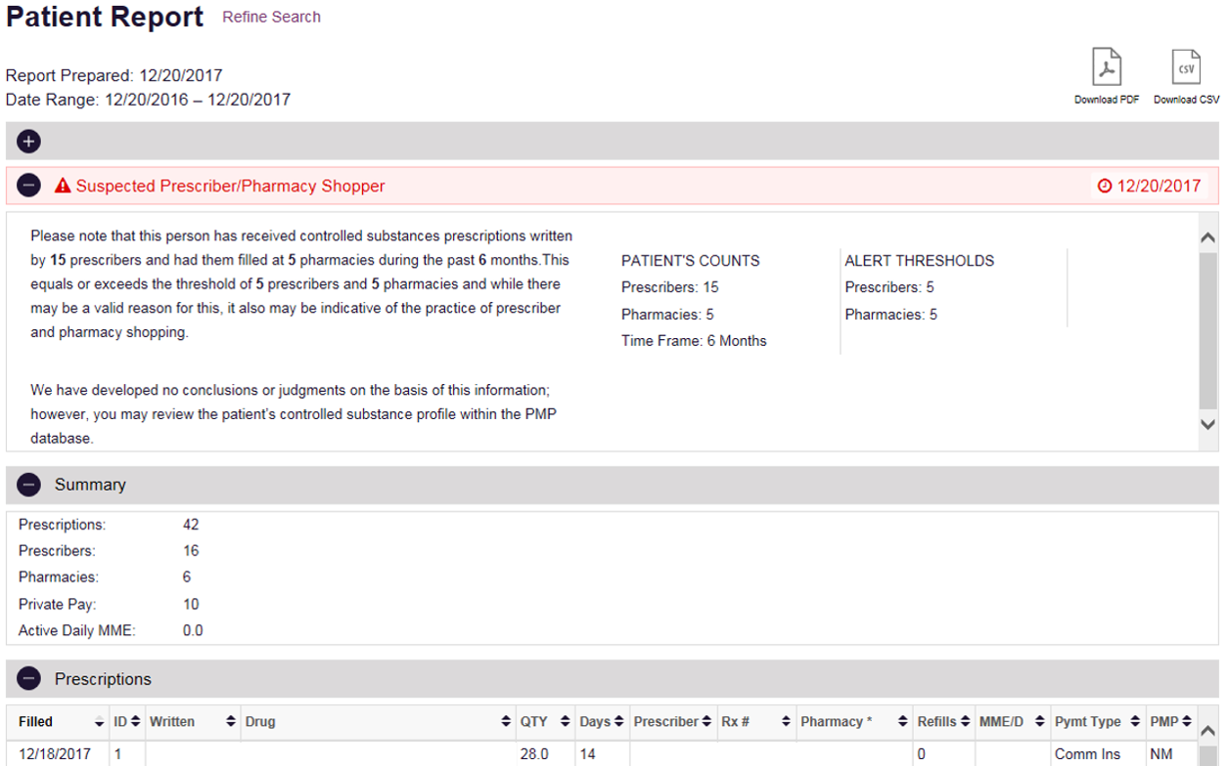
Information Gained from PMP Reports
Prescription Monitoring Program
New Mexico Board of Pharmacy
“Suspected Prescriber/Pharmacy Shopper” Alert
Some patients will have a “Suspected Prescriber/Pharmacy Shopper Alert”
Do not stop here!
Continue reading and analyzing the PMP patient report.
Provide appropriate care (e.g. contact providers and/or dispensing pharmacy, referral to SAMHSA treatment centers, contracts, etc.)

Slide 56
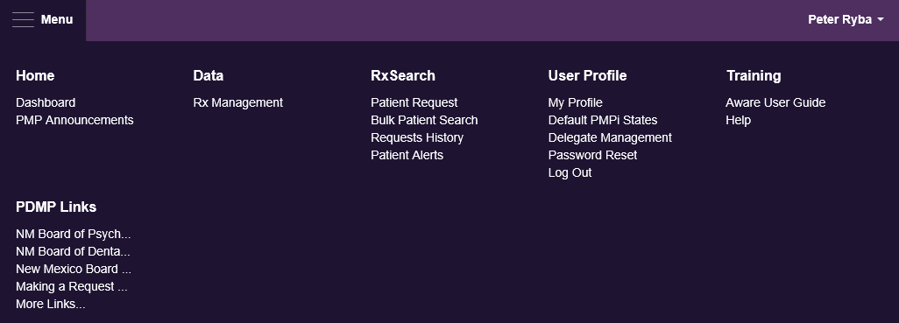
PMP Data Correction
Prescription Monitoring Program
New Mexico Board of Pharmacy
Click Menu, then click Rx Management to correct PMP submission data.

Slide 57
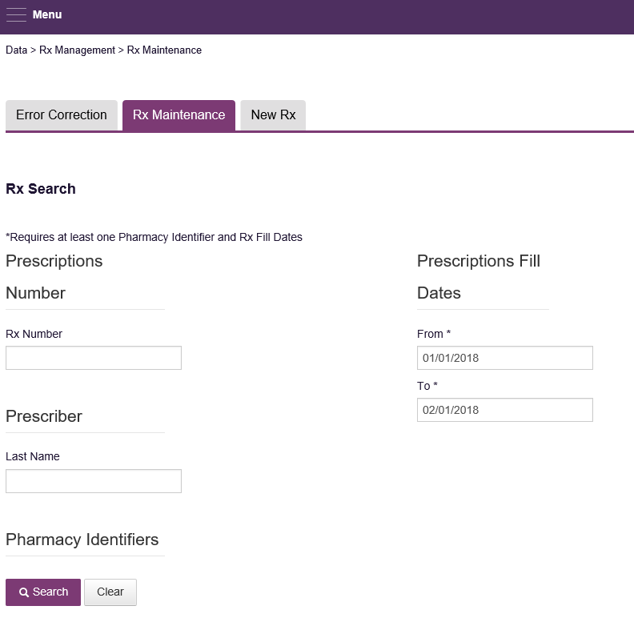
PMP Data Correction
Prescription Monitoring Program
New Mexico Board of Pharmacy
Rx Maintenance allows the user to correct inaccurate information on a prescription, for example, incorrect patient or prescriber information.
Recommend finding the prescription by Rx Number, but it is not necessary.
The default date range is 1 month, but this can be adjusted.

Slide 58
PMP Data Correction
Prescription Monitoring Program
New Mexico Board of Pharmacy
Click Search, then click the appropriate prescription. This will allow the pharmacist to make the necessary adjustments or void the prescription.

Slide 59
PMP Data Correction
Prescription Monitoring Program
New Mexico Board of Pharmacy
The pharmacist makes all necessary adjustments, then click Submit.
If a prescription needs to be removed from the PMP, click Void. Voiding cannot be undone and a reason is required.

Slide 60
MyRx
Prescription Monitoring Program
New Mexico Board of Pharmacy
MyRx gives users that have a DEA number associated with their account the ability to run a self-report to see what prescriptions have been filled under their prescribing credentials.
This is a tool for prescribers to help identify potential fraudulent use of their name and DEA number, which could help curb forgeries and diversion.
If a prescription is listed in error, the prescriber should contact the dispensing pharmacy first to determine if the prescription was processed correctly. Any confirmed fraudulent activity shall be reported to the NM Board of Pharmacy.

Slide 61
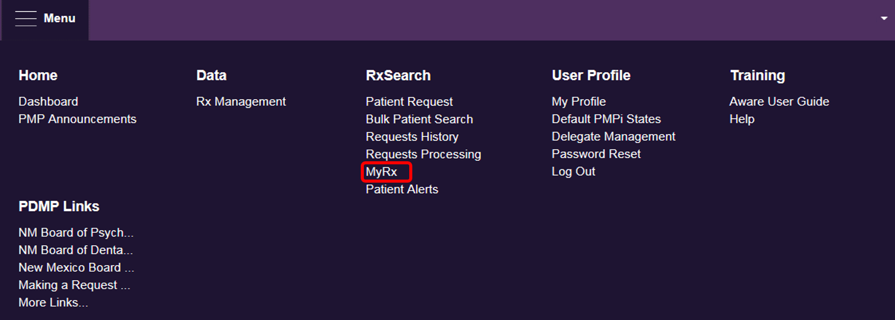
MyRx
Prescription Monitoring Program
New Mexico Board of Pharmacy
Click Menu, then click MyRx to view your dispensing history.

Slide 62
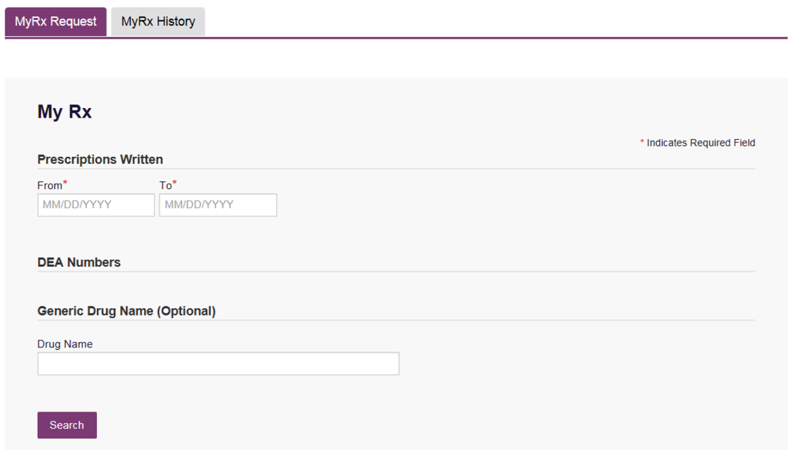
MyRx
Prescription Monitoring Program
New Mexico Board of Pharmacy
Enter a date range, then click Search.
If you have multiple DEA numbers, these will need to be added to your PMP account. Otherwise, you will not get a full report.

Slide 63
Fraudulent Activity
Prescription Monitoring Program
New Mexico Board of Pharmacy
Verify fraudulent activity first. Examples include:
  Suspicious activity on PMP needs to be confirmed with the dispensing pharmacy
  Stolen prescription pads
If confirmed, contact the NM Board of Pharmacy.
  Inspector On Call (Diversion Pager) 505-469-5641
  Albuquerque Office 505-222-9830

Slide 64
Reports Available
Prescription Monitoring Program
New Mexico Board of Pharmacy
Quarterly Reports to Licensing Boards
Prescriber Feedback Report

Slide 65
Reports Available
Prescription Monitoring Program
New Mexico Board of Pharmacy
Quarterly Reports to Licensing Boards
Data elements included on the Quarterly Report
Total number of patients
Total number of opioid patients
Total opioid Morphine Milligram Equivalents (MME) filled
Total number of benzodiazepine (BZD) patients
Total BZD Diazepam Milligram Equivalents (DME) filled
Percent of opioid patients with ≥90 MME/day
Percent of opioid patients with ≥90 days of opioids in 6 months

Slide 66
Reports Available
Prescription Monitoring Program
New Mexico Board of Pharmacy
Quarterly Reports to Licensing Boards
Data elements included on the Quarterly Report
Percent of BZD patients with prescriptions ≥30 DME/day
Percent of BZD patients with ≥90 days of BZDs in 6 months
Percent of opioid patients with concurrent BZDs ≥30 days
Number of “holy trinity” patients
Controlled substance prescriptions per prescribing day, 3 months

Slide 67
Reports Available
Prescription Monitoring Program
New Mexico Board of Pharmacy
Quarterly Reports to Licensing Boards
Data elements included on the Quarterly Report
Percent of estimated required reports requested
PMP reports required under Board rules (estimated)
PMP reports requested on patients
Percent of patients with a total of 5 or more practitioners or pharmacies in 6 months
Does the practitioner have an active PMP account?

Slide 68
Reports Available
Prescription Monitoring Program
New Mexico Board of Pharmacy
Prescriber Feedback Report (PFR)
Reports reflect top 1% of prescribers with 20 or more patients receiving controlled substances within 6 month period
Individual practitioners receive their own PFR
  MDs (63%)
  Nurse practitioners or other advanced practice nurses (23%)
  Osteopathic physicians or physician assistants (5%)
  Dentists (5%)
  Podiatrists, psychologists, pharmacist clinicians, or nurse midwives (all <2%)

Slide 69
Reports Available
Prescription Monitoring Program
New Mexico Board of Pharmacy
Prescriber Feedback Report (PFR)
Data elements included on PFR
Number of opioid and benzodiazepine (BZD) patients
PMP utilization rates for opioids and BZD
High opioid doses
Long term opioid patients
High BZD doses
Long term BZD patients
Number of prescriptions dispensed for opioids and BZDs
Concurrent opioid and BZD treated patients
Multiple provider episodes
Reference to like practitioners in New Mexico

Slide 70
Prescription Monitoring Program
New Mexico Board of Pharmacy
SAMPLE REPORT
SAMPLE REPORT

Slide 71
PMP Measures
Prescription Monitoring Program
New Mexico Board of Pharmacy
18% decrease in patients receiving dangerous combinations of
opioids and benzodiazepine together
20% decrease in patients receiving controlled substances from
multiple providers
66.1% of chronic opioid users with a PMP query
42.1% of chronic benzodiazepine users with a PMP query
20.5% of new opioid patients with a PMP query
22.8% of new benzodiazepine patients with a PMP query
Source: New Mexico Board of Pharmacy Prescription Monitoring Program Data

Slide 72
Current Projects
Prescription Monitoring Program
New Mexico Board of Pharmacy
PMP Integration within Workflow
EDIE
Electronic Health Records
NarxCare
The Narx Report includes a patient’s NarxScores, Predictive Risk Scores, Red Flags, Rx Graph and PDMP Data, as well as access to Resources and Care Team Communications all in a single, easy-to-use interface.

Slide 73
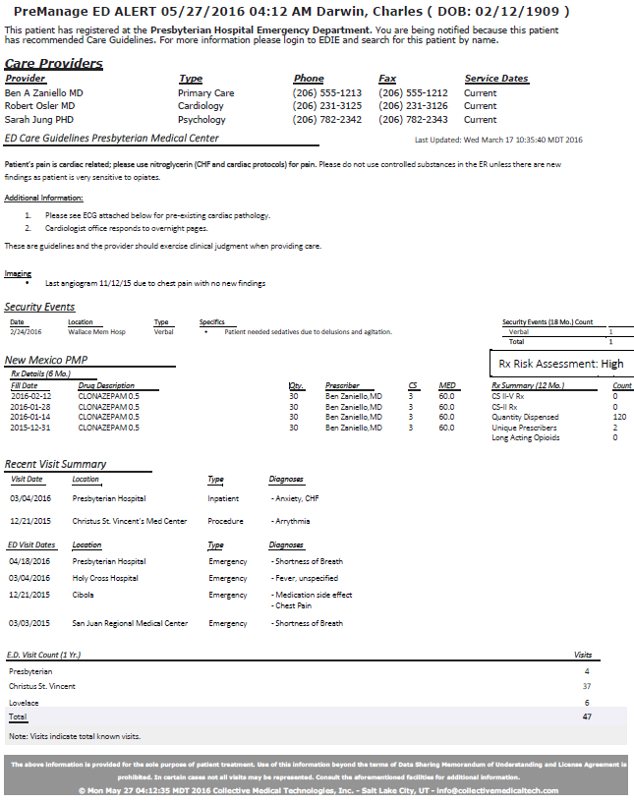
Prescription Monitoring Program
New Mexico Board of Pharmacy
SAMPLE REPORT
SAMPLE REPORT

Slide 74
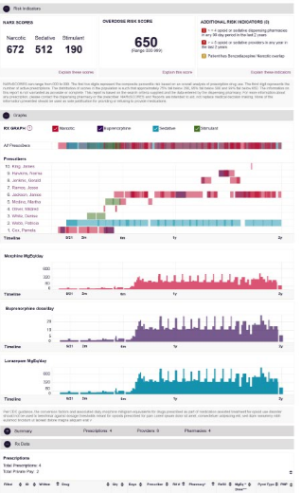
Prescription Monitoring Program
New Mexico Board of Pharmacy
SAMPLE REPORT
SAMPLE REPORT

Slide 75
Useful Links
Prescription Monitoring Program
New Mexico Board of Pharmacy
NM Board of Pharmacy http://www.rld.state.nm.us/boards/Pharmacy.aspx
PMP Registration and FAQs http://www.nmpmp.org/
PMP AWARxE https://newmexico.pmpaware.net/login
Support
Technical Customer Service (24/7/365) 1-844-366-4767
Local Non-Technical (M-F 8a-5p) 505-222-9847
NM BOP PMP Support nm.pmp@state.nm.us

Slide 76
Questions?
Prescription Monitoring Program
New Mexico Board of Pharmacy

