Slide 1

Influenza, Pneumonia, and Shingles, Oh My!
Anna Pentler, MPH, MBA
Executive Director
New Mexico Immunization Coalition
January 26, 2019
NM Pharmacists’ Association Conference
Notes:
The world of Adult immunizations has changed a lot over the past 10 years. It can be confusing and overwhelming, so hopefully through this talk we can explore the recommendations, the new vaccines and the timeframe so that we don’t have to worry so much about Flu Pneumonia and Shingles!

Slide 2

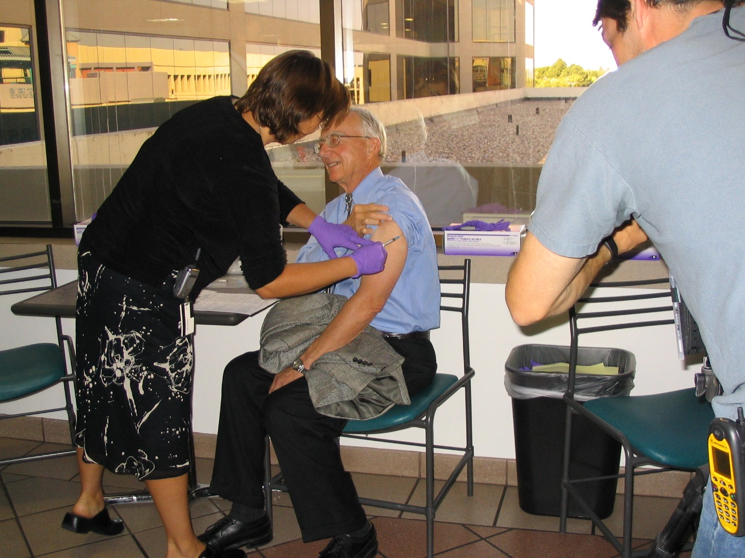
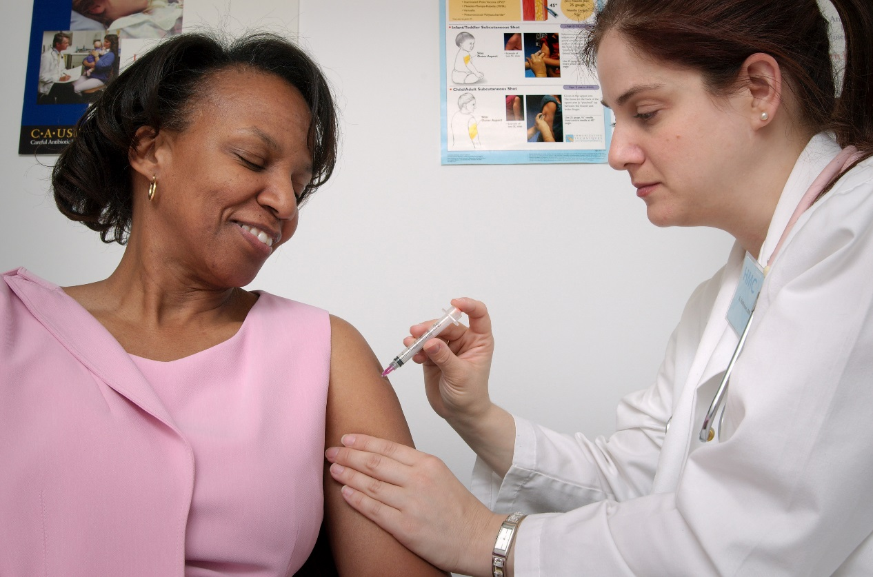
Vaccines for Adults??
I thought they were just for kids. . .
Adults Need Vaccines Too!
How do adults
and others benefit
from vaccine
protection?
What vaccines
are needed?
How many doses
are needed?
What’s the
schedule
Notes:
We will attempt to answer these and all your questions!

Slide 3
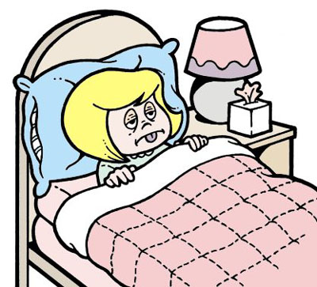
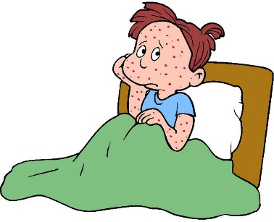
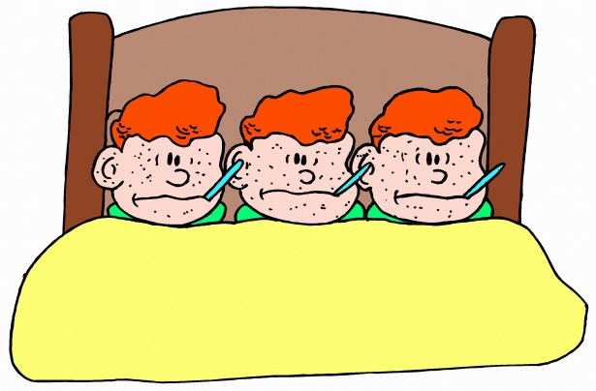
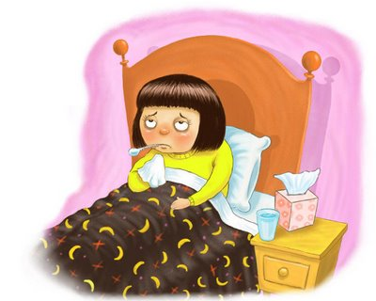
Just 60 years ago
Polio
Rubella
Measles
Mumps
Chickenpox
Influenza
Notes:
Many childhood diseases were a normal part of growing up
Measles, Rubella, Mumps, pertussis, and chickenpox were almost unavoidable
Polio was widely feared
Everyone knew someone who had been permanently harmed by or died from a childhood disease
If children survived, they developed immunity

Slide 4
Notes:
This was a common site 60 years ago.

Slide 5
The Really GREAT News:
Vaccines have dramatically reduced morbidity and mortality from disease for people of all ages
Immunization Works!

Slide 6
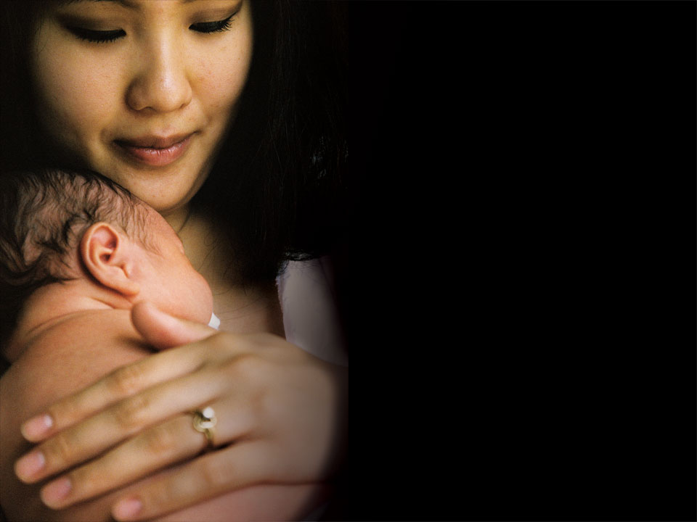
Comparison of Cases Pre-Vaccine
2016
Smallpox | 29,005 | 0
Diphtheria | 175,885 | 0
Measles | 530,282 | 69
Mumps | 162,344 | 5,311
Pertussis | 200,752 | 15,737
Polio (paralytic) | 16,316 | 0
Rubella | 47,745 | 5
Congenital Rubella
Syndrome | 152 | 1
Tetanus | 580 | 33
H. influenzae | 20,000 | 22
Thanks to vaccines!
Data from CDC’s MMWR, Jan 6, 2017

Slide 7
Adult Immunity
By the time a child reaches adulthood, he/she should have received vaccinations for over 16 common childhood diseases
Immunization boosters are needed for some diseases through adulthood
New vaccines are constantly being developed that adults may need

Slide 8
16 Diseases Children are Currently Protected Against
Measles
Mumps
Rubella (German measles)
Varicella (chickenpox)
Hepatitis B
Hepatitis A
Polio
Rotavirus
Influenza
Diphtheria
Tetanus
Pertussis (whooping cough)
Haemophilus Influenzae Type B (bacterial meningitis)
Pneumoccocal Disease
Human Papilloma Virus
Meningococcal Meningitis

Slide 9

Doesn’t Immunity Last Forever?
Boosters
Influenza, new strains
Adults who were never vaccinated as children
New vaccines
With age, people become more susceptible to serious disease caused by common infections like flu and pneumonia
Notes:
Some vaccines must be boosted periodically to maintain immune response
Some diseases, like influenza, require slightly different vaccines each year due to changes in the virus
Some adults were never vaccinated as children
Newer vaccines were not available when some adults were children
As we age, we become more susceptible to serious disease caused by common infections (e.g. flu, pneumococcus)

Slide 10
Vaccines Adults May Need:
Influenza
Tdap booster
Tetanus diphtheria booster (Td)
Pneumococcal: two vaccines
Hepatitis B
Hepatitis A
Measles Mumps Rubella (MMR)
Varicella (chickenpox)
Herpes Zoster (Shingles)
Human Papilloma Virus
Special vaccines
Notes:
Influenza (especially HCW, 50 years and older or high risk)
Tdap booster (currently one dose instead of Td)
Tetanus diphtheria booster (Td) every 10 years
Pneumococcal: two vaccines (65 and older or if at high risk)
Hepatitis B (high risk and HCW)
Measles Mumps Rubella (MMR) if susceptible born before 1957 presumed immune
Varicella (chickenpox) if susceptible
Herpes Zoster (Shingles) (50+)
Human Papilloma Virus (9-26 years old)
Special vaccines for foreign travel or occupational

Slide 11
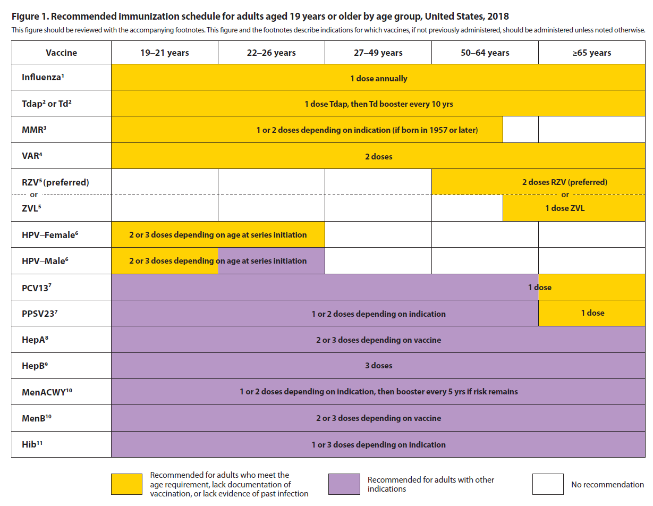
Adult Immunization Schedule 2018

Slide 12
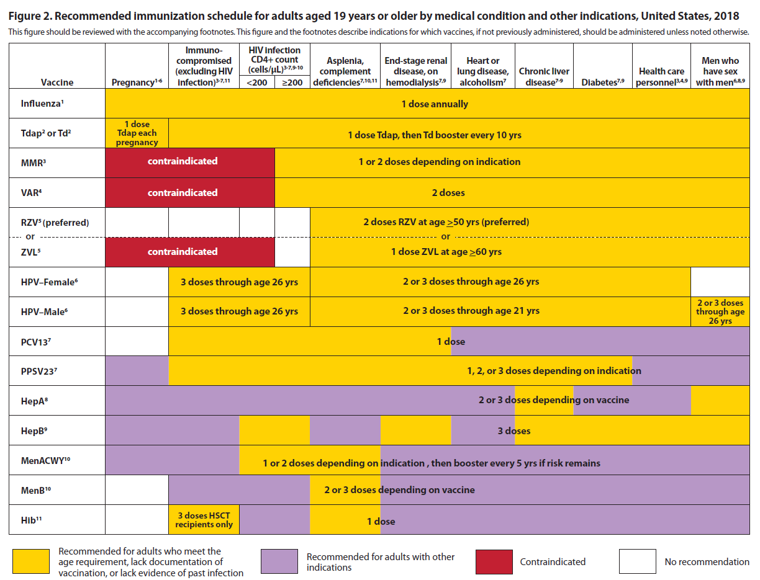

Slide 13




Let’s look closer at these Adult Vaccines
Influenza
Pneumococcal Pneumonia
Herpes Zoster (Shingles)
Tdap

Slide 14
Cost Burden of 4 Adult Vaccine-Preventable Diseases in Persons Age 65 Years and Older, United States, 2013
Vaccine-Preventable Disease | Estimated # of CASES | Estimated COSTS (Medical & Indirect) (in millions)
Influenza | 4,019,759 | 8,312.8
Pneumococcal | 440,187 | 3,787.1
Zoster | 555,989 | 3,017.4
Pertussis | 207,241 | 212.5
 |  | $15,329.8
Additional $11.2 billion in costs if
ages 50 – 64 years included
McLaughlin, JM, Tan L., et al. J Primary Prevent (2015) 36:259 – 273. Slide courtesy of LJ Tan

Slide 15
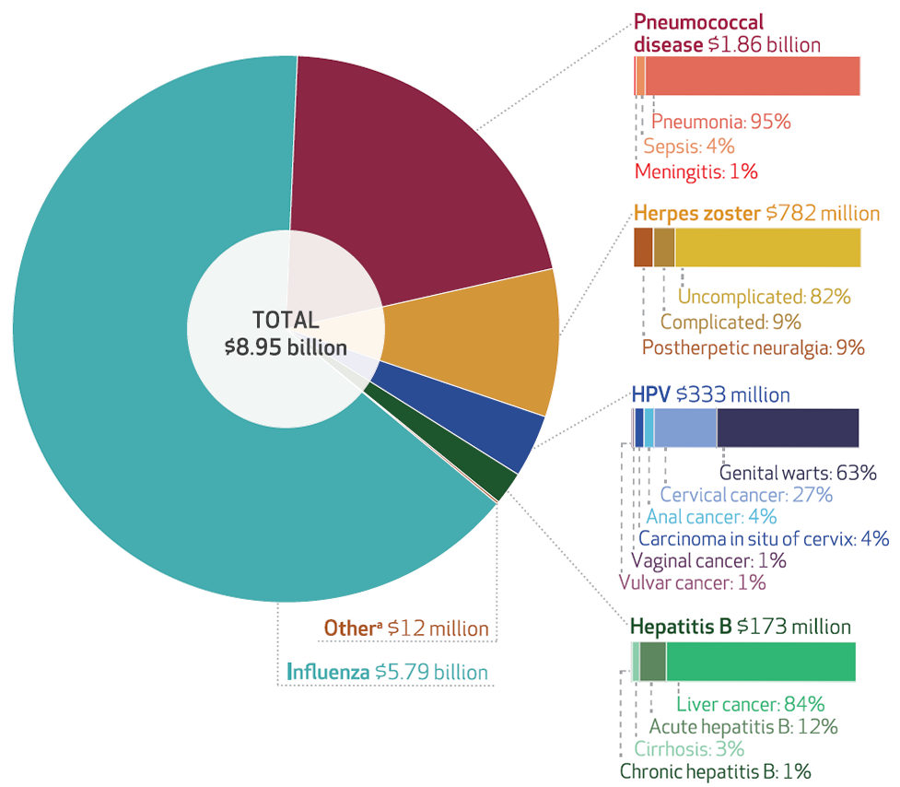
Cost Burden of Adult Vaccine-Preventable Diseases, 50 years and older, 2015
Unvaccinated individuals are responsible for almost
80 percent of the financial burden!
Ozawa et al. 2016. Health Affairs 35(11): 2124–2132. Slide courtesy of LJ Tan
Notes:
3/16 Replaced chart with simpler version from session 1

Slide 16
How do I know which vaccines a patient has had? And when?
NMSIIS
  Online database that tracks vaccines administered in New Mexico (All ages)
Immunization cards
EMRs
Since 2013, in NM, all vaccines administered must be entered into NMSIIS

Slide 17
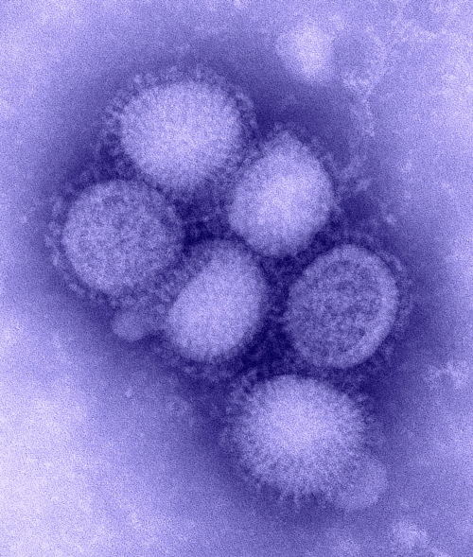
Influenza:
Who needs to get the vaccine?

Slide 18

Influenza Vaccine Recommendations
Recommended every year
for EVERYONE >6 months
who is not medically contraindicated

Slide 19
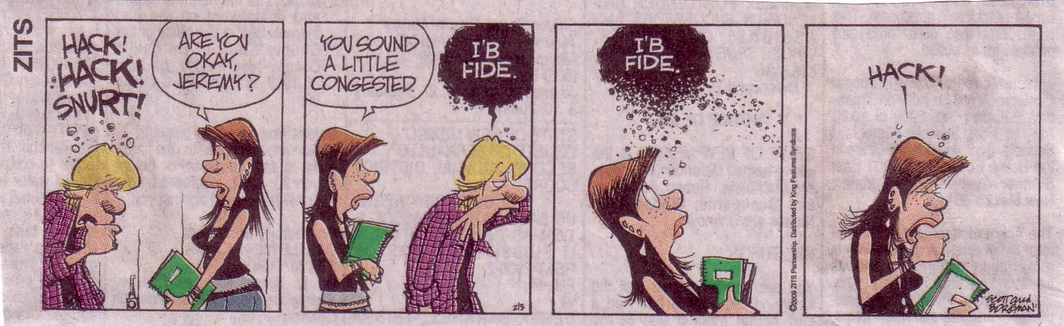
Influenza is contagious to those who are not immune…
Albuquerque Journal, Feb. 3, 2009
Notes:
People with flu can spread it to others up to about 6 feet away. Most experts think that flu viruses are spread mainly by droplets made when people with flu cough, sneeze or talk. These droplets can land in the mouths or noses of people who are nearby or possibly be inhaled into the lungs. Less often, a person might also get flu by touching a surface or object that has flu virus on it and then touching their own mouth or nose.
To avoid this, people should stay away from sick people and stay home if sick. It also is important to wash hands often with soap and water for at least 20 seconds. Linens, eating utensils, and dishes belonging to those who are sick should not be shared without washing thoroughly first. Further, frequently touched surfaces should be cleaned and disinfected at home, work and school, especially if someone is ill.
The Flu Is Contagious
Most healthy adults may be able to infect other people beginning 1 day before symptoms develop and up to 5 to 7 days after becoming sick. Children may pass the virus for longer than 7 days. Symptoms start 1 to 4 days after the virus enters the body. That means that you may be able to pass on the flu to someone else before you know you are sick, as well as while you are sick. Some people can be infected with the flu virus but have no symptoms. During this time, those persons may still spread the virus to others.

Slide 20
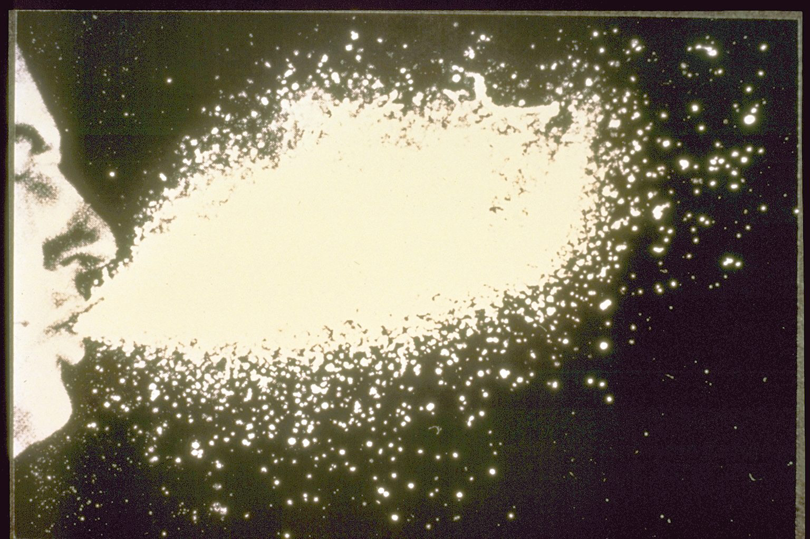
Notes:
5000 droplets spewed up to 12 feet at a speed of 100 ft per second….

Slide 21
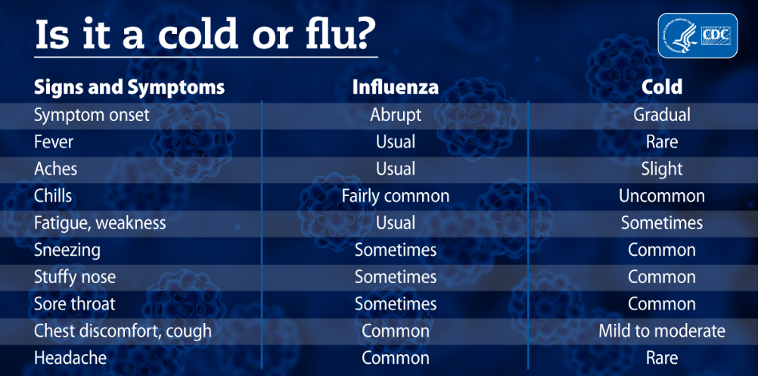
Influenza, How bad is it?

Slide 22
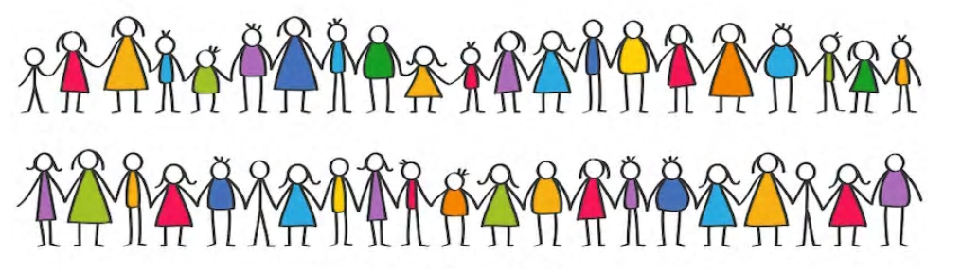
Annual US Influenza Impact
(regular seasonal)
Notes:
5-20% of US population
Highest illness rates in children
Highest complication rates in elderly and infants
>25,000 deaths average per yr in US
>90% in those >64 years
>200,000 hospitalizations
~50% in those >64 years

Slide 23
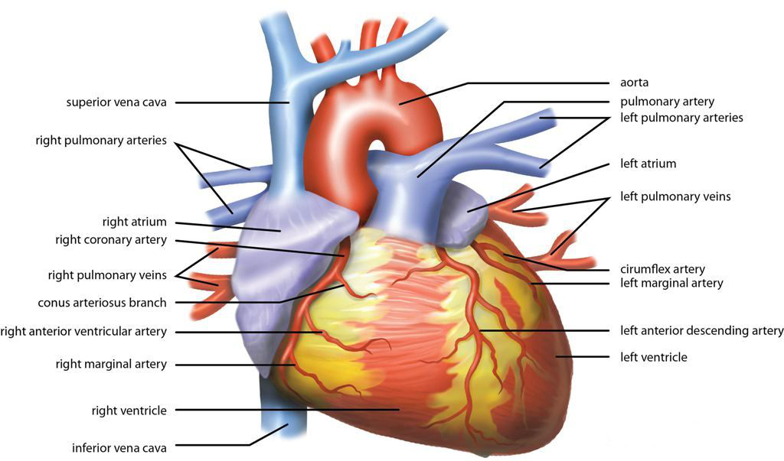
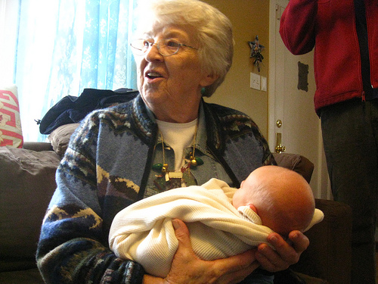
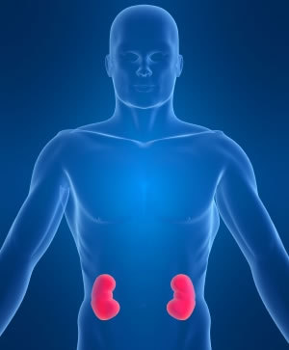
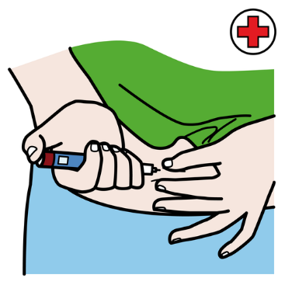
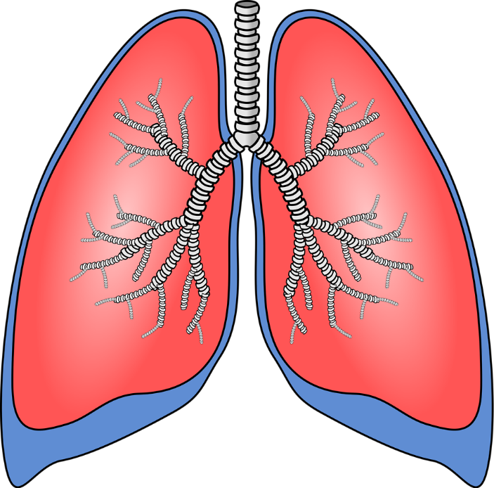
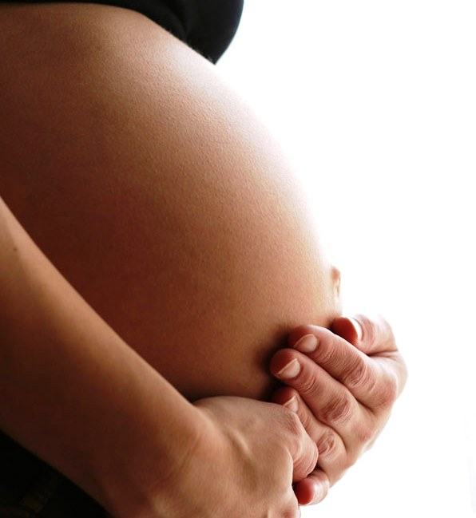
Conditions that increase the risk of influenza complications:
Notes:
65 years and older
5 years and younger
Pulmonary (emphysema, asthma)
Cardiovascular
Metabolic (diabetes)
Renal dysfunction (kidneys)
Pregnancy

Slide 24
Impact of influenza on pregnant women¹
Up to 4X increased risk of hospitalization, especially in third trimester, and for those with co-morbid conditions*
Up to 8X increased risk for influenza-associated complications, including death, particularly for those with co-morbid conditions**
Increased risk for influenza-associated complications among postpartum women
Risk highest during the first postpartum week
* Chronic cardiac disease, chronic pulmonary disease, diabetes mellitus, chronic renal disease, malignancies, and immunosuppressive disorders
** Preexisting diabetes mellitus, pulmonary disease that included asthma, heart disease, renal disease, and anemia
1. Rasmussen, S.A., et al. 2012. American Journal of Obstetrics & Gynecology; 207(3): S3 - S8.
Slide courtesy of LJ Tan
Notes:
Updated to 2016 recs

Slide 25
Average influenza-associated illness rates by age group*
*Low estimate based on Tecumseh community studies. High estimate based on Houston family studies. Adapted from Sullivan KM. PharmacoEconomics 1996;9 Suppl.3:26-33.
Notes:
Who is getting influenza at the highest rates? School aged children, young adults and young children. Those over 60 don’t have as high rates of illness, but they have higher rates of hospitalization and death from flu.

Slide 26
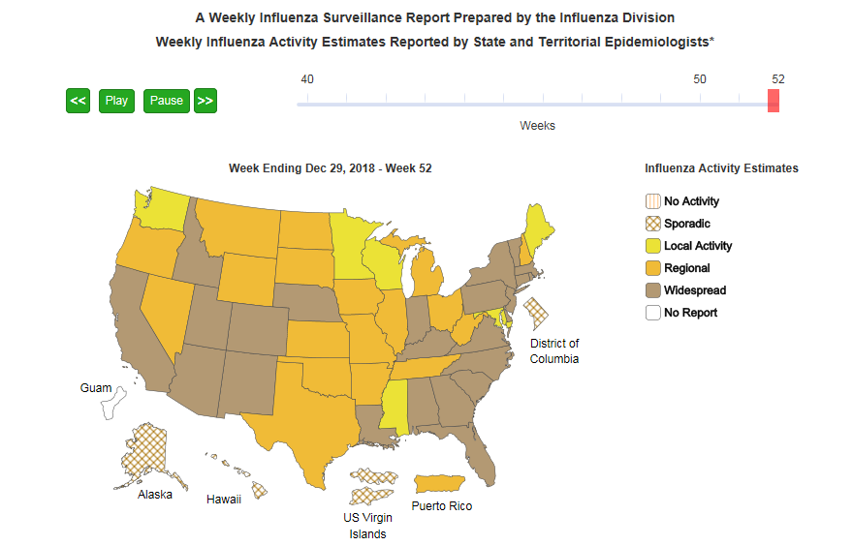
Influenza Surveillance flu.gov

Slide 27
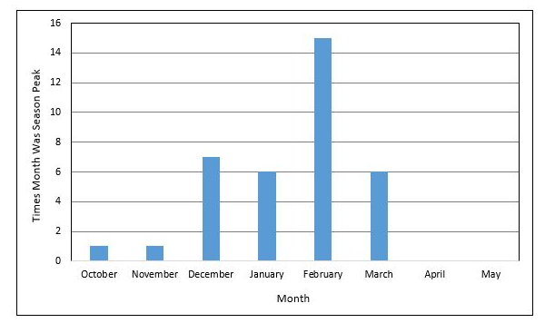
Peak Month of Flu Activity
1982-1983 through 2017-2018
3 out of 4 years, Flu peaks in January or later
https://www.cdc.gov/flu/about/season/flu-season.htm
Notes:
It’s not too late to get immunized even into the spring!
Get vaccinated when you can but maybe not as early as August—you want to still be protected 6-7 months later
It takes about 2 weeks to build an immune response to the flu vaccine

Slide 28
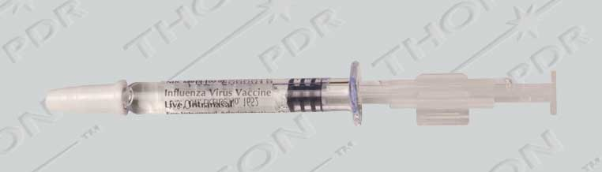
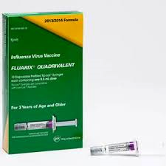
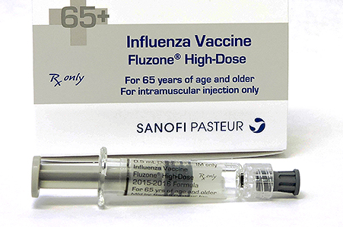
Influenza Vaccine many choices
Stay informed of the current vaccine options so you can counsel your patients about what are the available vaccines for their age and risk group
Notes:
Injectable:
Trivalent, Quadrivalent, high dose, intradermal (micro needle), cell based, preservative-free, egg-free
FluMist:
Quadrivalent

Slide 29
Vaccine Effectiveness
  Influenza vaccine effectiveness varies annually based on
    Antigenic match
    Age and health of person being vaccinated. About 60‒70% in younger adults and about 30% in adults 65 years and older against medically-attended influenza with a good match¹
  Can also prevent the cascading effect in frail seniors
  Vaccine Preventable Disability²!
CDC. MMWR 2013; 62(RR07);1-43.
McElhaney et al. 2016. Eur Geriatr Med; 7:171-75.
Slide courtesy of LJ Tan
Notes:
Influenza vaccine effectiveness varies annually based on antigenic match and also age and health of person being vaccinated – about 60-70% in younger adults and about 30% in adults 65 years and older against medically attended influenza when there is a good match.

Slide 30
Burden of Influenza Disease
Among U.S. Adults
Influenza¹
  3,000 to 49,000 total related deaths per year
  ~90% of deaths are among adults 65 years and older
Ramirez et al. 2017. [Published online ahead of print July 28, 2017]. Clin Infect Dis. doi:10.1093/cid/cix647.
Slide courtesy of LJ Tan

Slide 31

Pneumococcal Disease

Slide 32
Pneumococcal Disease
Accounts for more deaths than any other vaccine-preventable bacterial disease
Can lead to pneumonia, bacteremia and meningitis
Treatment of pneumococcal disease is growing more difficult due to resistance to antibiotics
Prevention through immunizations is best
Notes:
Pneumococcal pneumonia
Symptoms of pneumococcal pneumonia may include:
fever
chills and shaking
chest pain when breathing in or out
shortness of breath
cough
blood-stained or ‘rusty’ sputum (phlegm)
drowsiness (excessive sleepiness) or confusion are common symptoms in the elderly.
Pneumococcal meningitis
People with pneumococcal meningitis often have:
high fever
headache
stiff neck
nausea and vomiting
photophobia (discomfort when looking at light).
The classic symptoms may be difficult to detect in infants and the child may only appear to be inactive, irritable, feeding poorly and may be vomiting.
Incubation period: Usually 3 to 4 days, but can vary from 1 to 10 days

Slide 33
Burden of Vaccine-preventable Disease Among U.S. Adults
Invasive pneumococcal disease (IPD)¹
  30,400 total cases and 3,690 total deaths in 2016
  81% of all IPD deaths in adults 50 and older
  649/100K patients hospitalized annually with community acquired pneumonia (CAP); 6.5% mortality²
CDC. 2016. Active Bacterial Core Surveillance Report, Emerging Infections Program Network, Streptococcus pneumoniae, 2016.
Slide courtesy of LJ Tan

Slide 34
Vaccine Effectiveness in the Adult Population
Vaccine effectiveness (VE) varies by vaccine type, the disease outcome, and the age or health of the person vaccinated
  45% against vaccine-type pneumococcal pneumonia, and 75% against vaccine-type invasive pneumococcal disease among adults age ≥65 years¹
1 Bonten MJ, et al. NEJM 2015;372:1114-25.
Slide courtesy of LJ Tan
Notes:
The impact of vaccination, or vaccine effectiveness, varies by vaccine type, the disease outcome being measured, and the age or health of the person vaccinated. I have listed some examples below. Please keep in mind that many of these diseases are common. So, while the vaccine effectiveness is modest for some vaccines when given to adults, the impact of vaccination overall is high given the high number of cases that can be prevented.
Zoster (Shingles) vaccine is 51% effective against shingles, 66% against post-herpetic neuralgia (PHN), and almost 80% against most prolonged and extreme cases of PHN.
PCV13 (pneumococcal conjugate vaccine) is 45% effective against vaccine-type pneumococcal pneumonia, and 75% effective against vaccine-type invasive pneumococcal disease among adults aged ≥65 years.

Slide 35
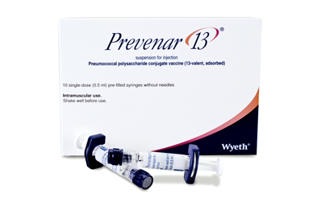
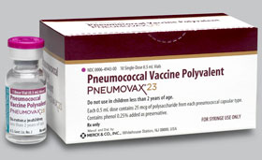
Pneumococcal Vaccine
PCV13 (Prevnar)
PPSV23 (Pneumovax)
Over 65 years old
19-64 with risk factors
Covered by Medicare Part B
Notes:
Don’t try to memorize, it’s complicated! Use available tools to guide you

Slide 36
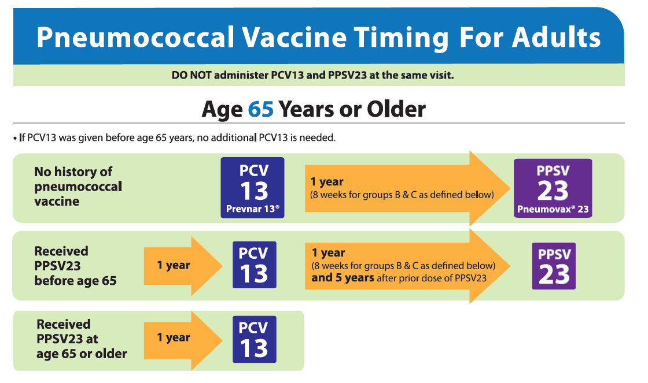

Slide 37
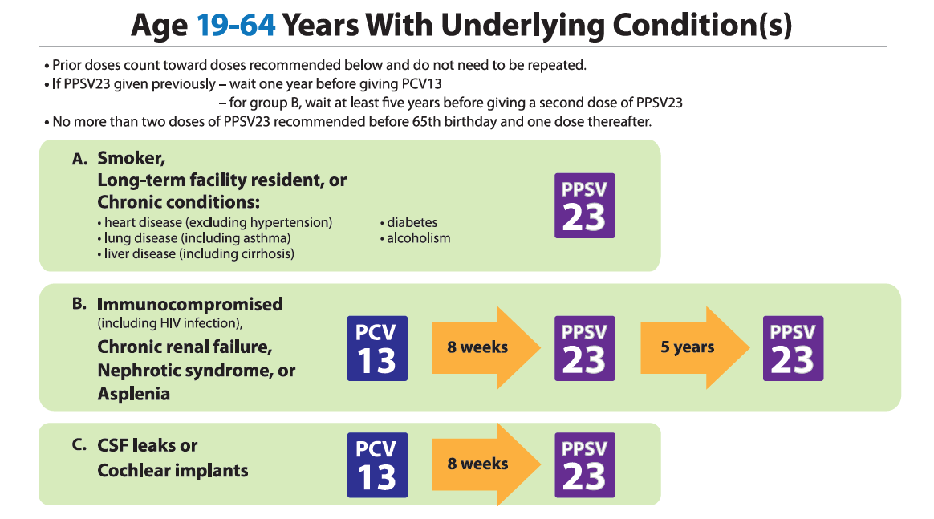
Notes:
Immune suppression, asplenia, chronic Heart disease, lung disease, diabetes, alcoholism, smoking and cochlear implants all increase the risk for pneumococcal disease.

Slide 38
Pneumococcal Polysaccharide Vaccine (PPSV23-Pneumovax)
Protects against 23 types of pneumococcal bacteria
Protection develops within 2-3 weeks of getting the shot for most healthy adults
Elders, children under 2 and people with some long-term illnesses might not respond as well or at all
Notes:
Two kinds of vaccines. Pneumovax has been recommended for many years. PPSV23 released in 1983. Seniors over 65 need a dose of each kind of vaccine, one year apart.

Slide 39
Pneumococcal
Conjugate Vaccine
(PCV13-Prevnar)
Protects against 13 types of pneumococcal bacteria
Better immune response than PPSV23
Notes:
Start with PCV13 first, then a year later get PPSV23
This vaccine has been used in children younger than 2 for about 15 years, but in seniors it’s only been recommended for about 4 years.

Slide 40
Pneumococcal Vaccine
Who should get it?
All adults 65 years or older
Children younger than 2 (PCV13)
Anyone over age 2 who has long-term health problems
Anyone over age 2 who has a compromised immune response or is taking any drug or treatment that lowers the body’s resistance to infection
Notes:
Alaskan Natives, African American, and certain American Indian groups have increased rates of disease.

Slide 41
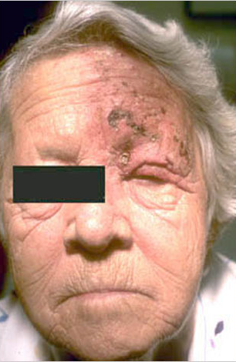
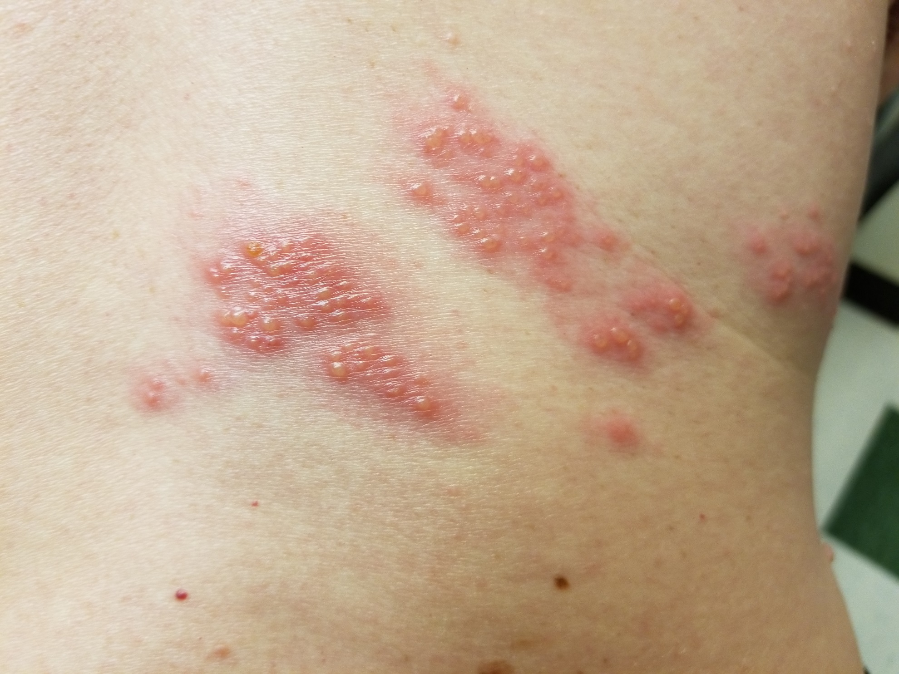
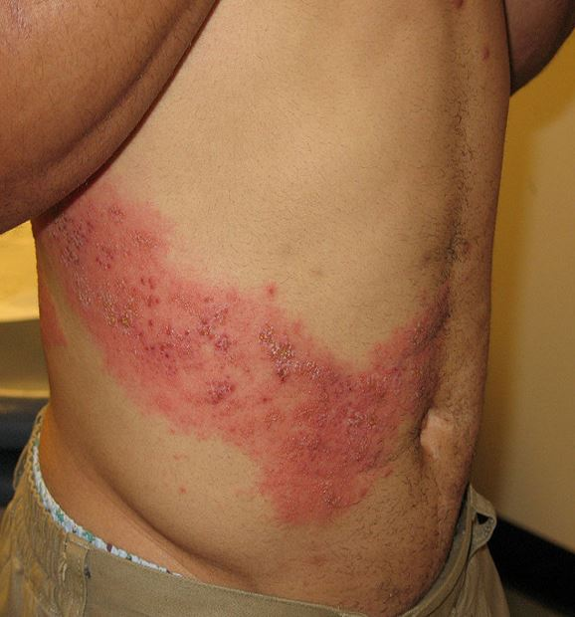
Herpes Zoster (Shingles)
About 1 million cases of zoster annually in U.S.

Slide 42
Herpes Zoster (Shingles)
Shingles is reactivation of chickenpox, so if a person had chickenpox, they are at risk for shingles (almost everyone born before 1980 had chickenpox)
About 20-30% of the population will have shingles in their lifetime. For people over 85 years old, the risk increases to 50%

Slide 43
Herpes Zoster (Shingles)
Painful skin rash caused by the varicella zoster virus
After you have chickenpox, the virus stays in your body and can reactivate and cause shingles later in life
Shingles is PAINFUL!
Post Herpetic Neuralgia syndrome (about 20%)
Can cause chickenpox in non-immune people
Notes:
Painful skin rash, often with blisters, caused by the varicella zoster virus, the same virus that causes chickenpox. After you have chickenpox, the virus stays in your body and can cause shingles later in life
Shingles is PAINFUL! Can lead to post herpetic neuralgia syndrome, which can last for months, even years (about 20%)
Can cause chickenpox in non-immune people
You can‘t catch Shingles from someone who has it, but you can catch chickenpox if you’ve never had it and not been vaccinated.

Slide 44
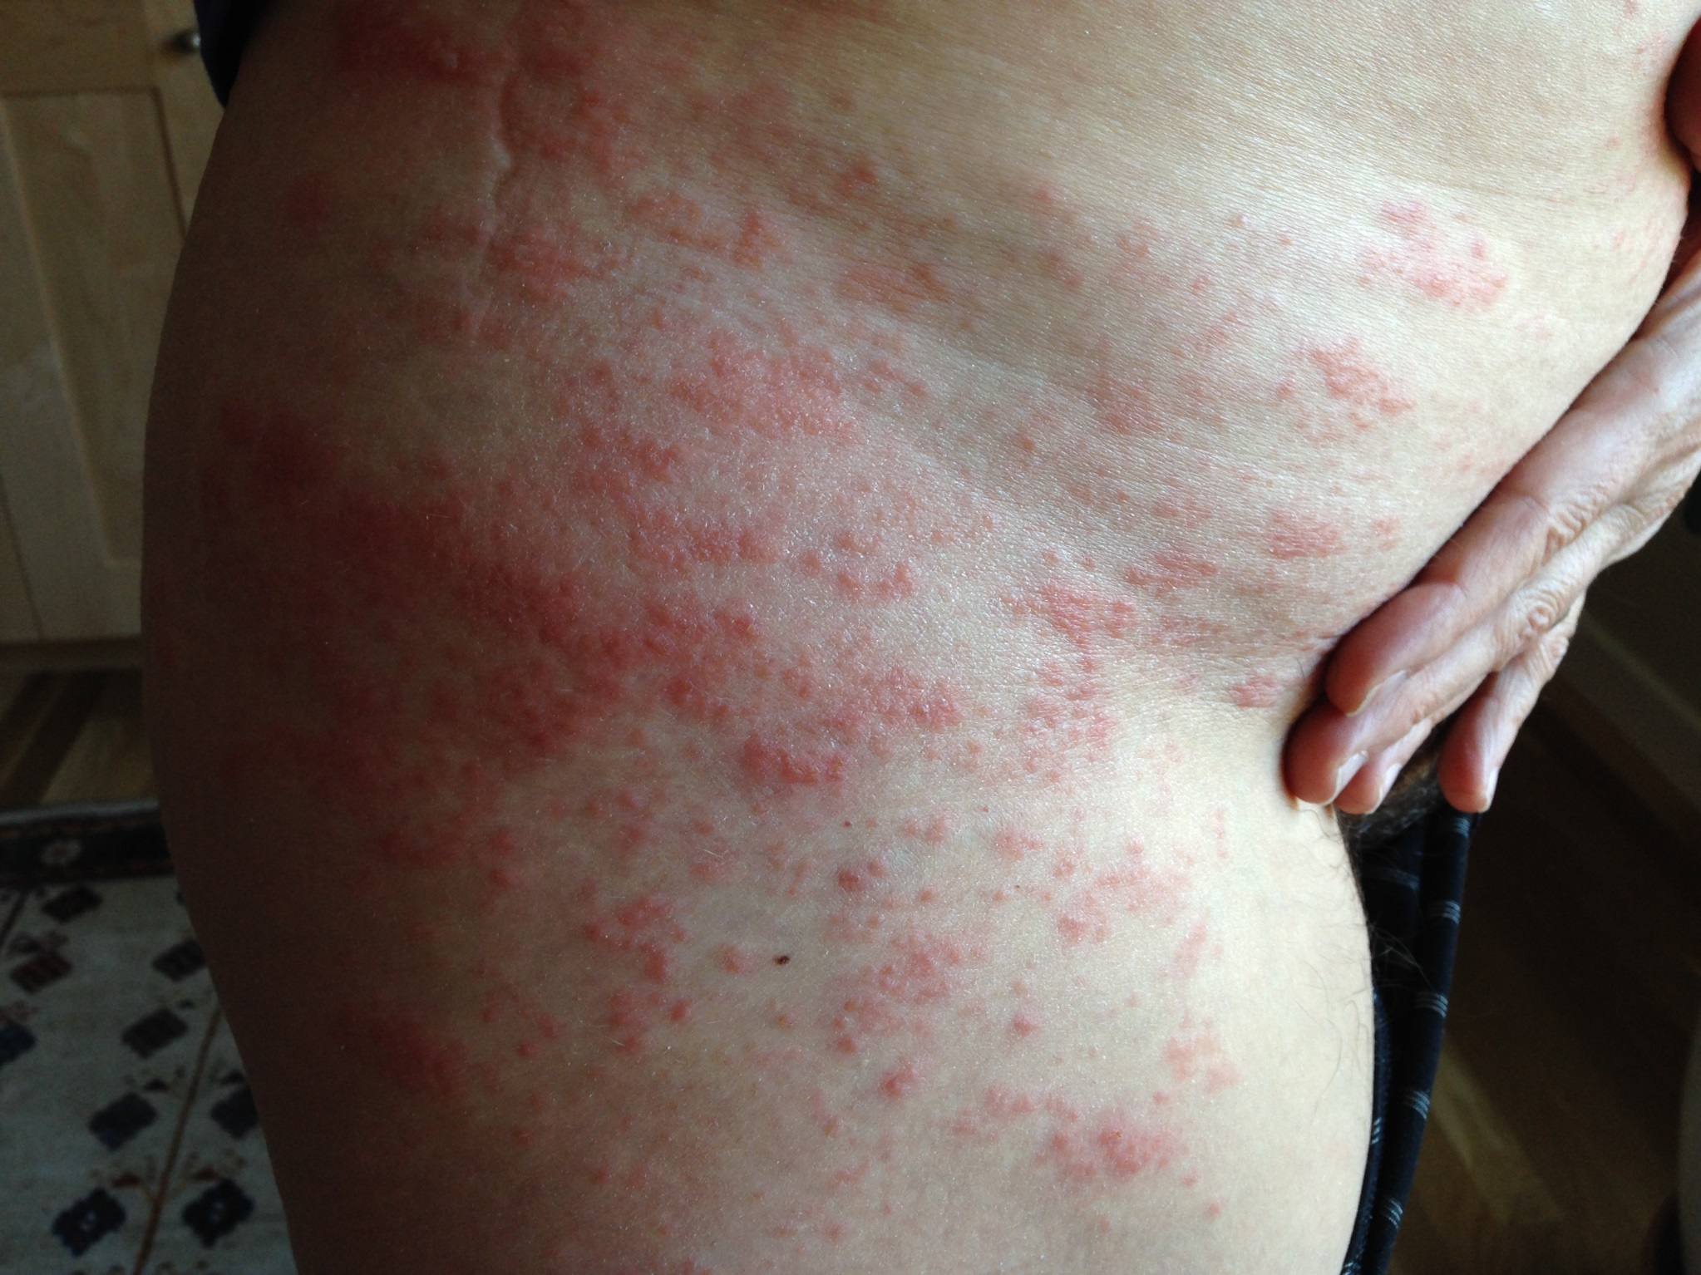
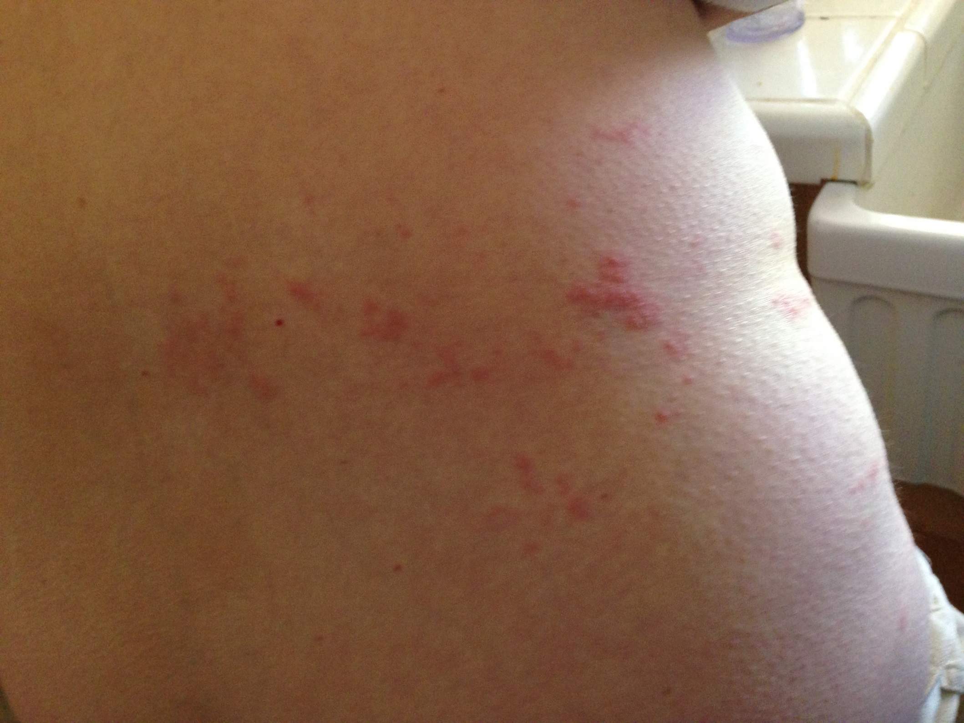
Day One
Day Three

Slide 45
Herpes Zoster Vaccine
Two vaccines:
  Zostavax licensed 2006
  Shingrix licensed 2017
Boosts immunity against Varicella virus
Shingrix is now preferred
  Better protection
Shingrix needs 2 doses, 6 months apart
Notes:
Be aware, Shingrix might cause some side effects. That doesn’t mean you should not get it (or get the second dose—you need to get two doses)

Slide 46
Shingrix
Recommended for people 50 years and over
Immune response is over 90%
Not a treatment if already suffering from Shingles or post herpetic neuralgia

Slide 47
Shingles Vaccine
Covered by Medicare Part D
Should be covered by private insurance for those younger than 65
Revaccinate with Shingrix if received Zostavax previously
Currently delays in getting Shingrix, but should be more readily available by summer of 2019

Slide 48
RZV Zoster Vaccine: Shingrix®
Storage: Store vaccine AND diluent in the refrigerator between 2°C and 8°C (36°F and 46°F)
Preparation: Reconstitute the vaccine with the diluent (adjuvanted) supplied by the manufacturer just before administering
Schedule: 2 doses, 2 to 6 months apart
Route: IM Injection
  Site: deltoid or the thigh may be used if necessary
  Needle gauge: 22–25 gauge
  Needle length: varies by age/weight
May administer during the same clinical visit as other needed vaccines.
  Administer in a separate limb from other vaccines, if possible
MMWR 2018;67(3);103–108
Slide courtesy of LJ Tan

Slide 49
ACIP Zoster Recommendations
Persons 50 years of age and older should be vaccinated with zoster vaccine
Administer 2 doses of Shingrix® to immunocompetent persons
  Regardless of previous history of vaccination with varicella-containing vaccines – Varivax® or Zostavax®
  Separate Shingrix® and varicella-containing vaccines by at least 8 weeks
Shingrix® is preferred to Zostavax® for persons 60 years and older
MMWR 2018;67(3):103–108
Slide courtesy of LJ Tan
Notes:
While the recommended interval between Zostavax >>>>>>>> Shingrix is 8 weeks, the Shingrix dose does NOT need to be repeated if it is administered less than 8 weeks after Zostavax

Slide 50
RZV (Shingrix®) Adverse Reactions
Local reactions | 49%
Local reactions – Grade 3 | 9.4%
Systemic reactions (headache, malaise, fatigue) Systemic reactions (headache, malaise, fatigue) – Grade 3 | 45-78% 11%
MMWR 2018;67(3);103–108
Slide courtesy of LJ Tan

Slide 51
Adverse Reactions after Shingrix®
Educate patients regarding:
  Potential adverse reactions, including injection site and systemic reactions
  The need for a second dose–even if s/he has an adverse reaction
Offer comfort measures and strategies
Slide courtesy of LJ Tan
Notes:
Reactions to the first dose did not strongly predict reactions to the second dose (33); vaccine recipients should be encouraged to complete the series even if they experienced a grade 1–3 reaction to the first dose of RZV

Slide 52
Shingrix® Vaccine Administration Errors (reported to VAERS)
Wrong route: Subcutaneous route rather than IM
Wrong age: Administered to persons less than 50 years of age
Wrong vaccine: Shingrix® instead of varicella (Varivax®) vaccine
Improper storage: Administered after frozen storage
Wrong preparation: Administered the adjuvanted diluent only
Wrong schedule: Interval violations between doses of Shingrix® or a previous dose of varicella-containing vaccine
Other errors we have heard about:
    Staff unaware of the need for a second dose
    Staff thinks Zostavax® can count toward completing the 2-dose Shingrix® series
Slide courtesy of LJ Tan

Slide 53

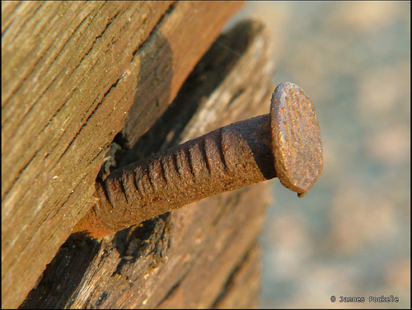
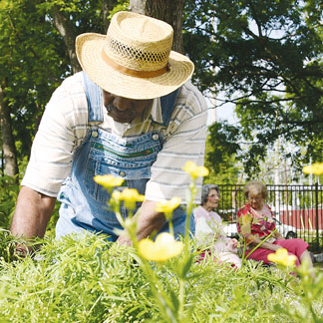
Tetanus
Notes:
Oh My!!
Serious disease caused by a bacterium that enters the body through a cut or wound
Causes painful spasms of the muscles that can lead to “locking” of the jaw so the patient cannot open his or her mouth or swallow
Organism is common in soil and intestinal tracts of animals
Not contagious from person to person
We will never get rid of tetanus since it’s in the environment, therefore must continue to vaccinate!

Slide 54
Tetanus Diphtheria Booster
All adults need a Td booster every 10 years
Adults with a deep wound or dirty abrasion may need a Td booster if it has been >5 years since their last booster
Since 1980, >70% of tetanus cases have been in adults older than 40
About 30 cases each year

Slide 55
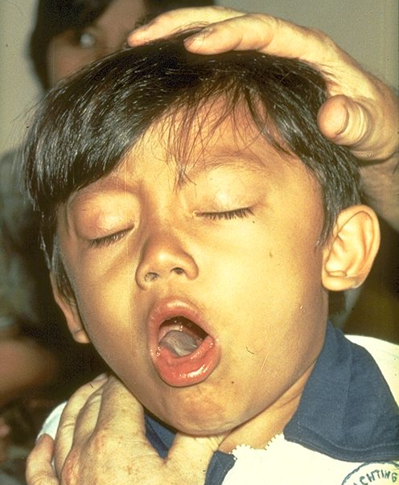
A few words about Pertussis
(Whooping Cough)
It’s not just a problem for children…
Child with paroxysmal cough of pertussis
Photograph courtesy of the WHO

Slide 56
Common Symptoms of Adolescent or Adult Pertussis
Cough 97% ≥ 3 weeks, 52% ≥ 9 weeks
Spasms or coughing fits ≥ 3 weeks in 73%
Whoop in 69%
Vomiting after coughing in 65%
Teens missed average 5 days of school;
Adults missed average 7 days of work
Average 14 days of disrupted sleep
De Serres et al. J Infect Dis. 2000;182:174–9.
Notes:
Special follow-up with adolescents and adults who contracted pertussis in Quebec during 1998 revealed that morbidity is substantial in these age groups:
extended cough;
paroxysms;
whooping;
post-tussive emesis;
missed school and work;
disrupted sleep.
Complications of pertussis also are common in adolescents and adults…

Slide 57
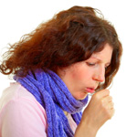
Pertussis in Adults
Accounts for up to 7% of cough illnesses per year
Disease is milder in adults than in children and is often not recognized
Adults are the major source of infection for children

Slide 58
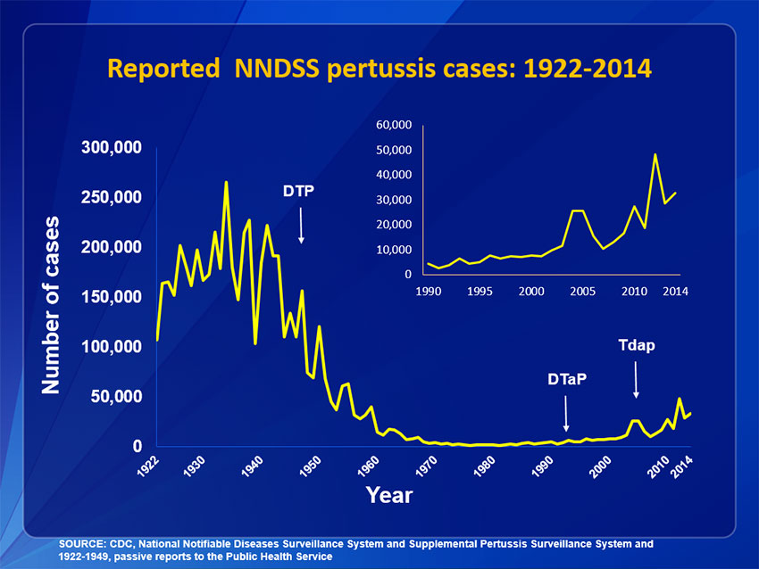
Reported Pertussis Cases by Year
United States, 1922 -2014

Slide 59
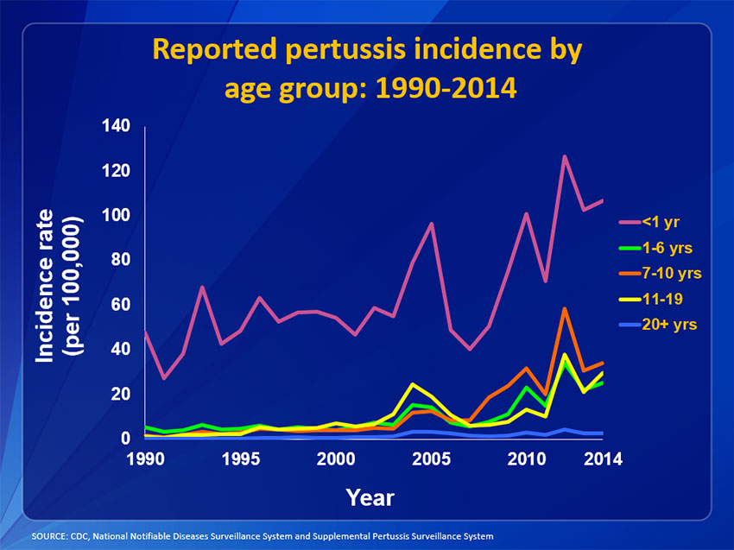

Slide 60
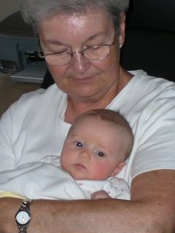
Tdap Vaccine can protect Teens and Adults from Pertussis
**Important side benefit: we protect the most vulnerable too– by immunizing teens and adults we protect infants who are too young to receive vaccine or who have not completed all of the series and are therefore not yet fully immune

Slide 61
Who should get Tdap:
Teens 11-12 years of age should receive a single dose of Tdap instead of Td
Teens 13-18 years who have not received Td should receive a single dose of Tdap as their catch-up booster instead of Td
Notes:
Children and teens spread disease easily and quickly—they should of course be immunized!

Slide 62
Who should get Tdap:
Adults (19+) who are in need of a Td booster (every 10 years) should receive a single dose of Tdap
Anyone who will be around an infant should get Tdap to protect not only themselves, but the vulnerable baby
Healthcare Workers
Pregnant women, one dose during each pregnancy

Slide 63
Burden of Vaccine-preventable Disease Among U.S. Adults
Pertussis¹
  15,808 total reported cases 2017
  3,429 among adults 20 years of age & older
CDC. 2017 Final Pertussis Surveillance Report. http://www.cdc.gov/pertussis/downloads/pertuss-surv-report-2017.pdf.
Slide courtesy of LJ Tan

Slide 64
So how are we doing in terms of vaccinating Adults?
Not so great—LOTS of room for improvement
  Influenza, age ≥65 ~65%
  Pneumococcal Pneumonia, age ≥65 ~64%
  Pneumococcal Pneumonia high risk, ages 19-64 ~23%
  Zoster, age ≥ 60~31%
  Tetanus, age ≥ 65 ~57%
Williams, W.W. et al. MMWR Surveillance Summary 2017;66(11):1–28

Slide 65
How do we increase Adult Vaccine uptake?
Assess patient’s vaccine status at every visit
Educate the patient and make a strong recommendation from the health care provider!
Vaccinate at the same visit and document
Standing Orders
Reminder Recalls
Reduce patient’s out of pocket costs for vaccines

Slide 66

Vaccines Benefit Everyone
Save lives
Save money
Keep us healthy
Protect those who can’t be immunized through “herd immunity”

Slide 67
For more information:
  New Mexico Immunization Coalition
  505-272-3032
  Apentler@unm.edu
  http://hsc.unm.edu/programs/nmimmunization/
  New Mexico Department of Health Immunization Program
  505-827-0219
  http://www.immunizeNM.org
  Centers for Disease Control and Prevention
  http://www.cdc.gov/vaccines/
  800-CDC-INFO

Slide 68

Thank you!
Any Questions?

