Slide 1
Test To Treat CE
Covid, Flu, & Strep; An Interactive Case Series

Slide 2
Objectives
1) Review protocol and state laws around test to treat in New Mexico
2) Define patient case series and treatment guidelines and recommendations
3) Use Interactive "Viewers Choose the Ending" to safely and effectively treat patients

Slide 3
Disclosure
Nothing to disclose
Special thank you to APhA and their Test-to-Treat training program

Slide 4
Test-to-Treat Review
Current Regulations:
1) PEP
2) COVID
3) Influenza
4) Strep Throat
Pending Regulations:
5) Uncomplicated UTI
Future Pending Regulations:
6) STDs
7) PrEP

Slide 5
Large Scale Steps to Test-to-Treat
1) Look to purchase a test-to-treat machine that works best with your pharmacy needs (i.e. CLIA waived, storage, cost/contracts, ease of use, sensitivity, specificity, type of specimen).
2) Apply and receive CLIA Waiver and biohazard pickup.
3) Receive Test-to-Treat NMPhA training and certification.
4) Create billing codes, bar codes, marketing, and business plan.
5) Perform point-of-care test and prescribe as appropriate.
6) Complete 2 hours of Live CE every 2 years for certification to never expire.

Slide 6
Board of Pharmacy Test-to-Treat Regulations
https://www.srca.nm.gov/parts/title16/16.019.0026.html

Slide 7
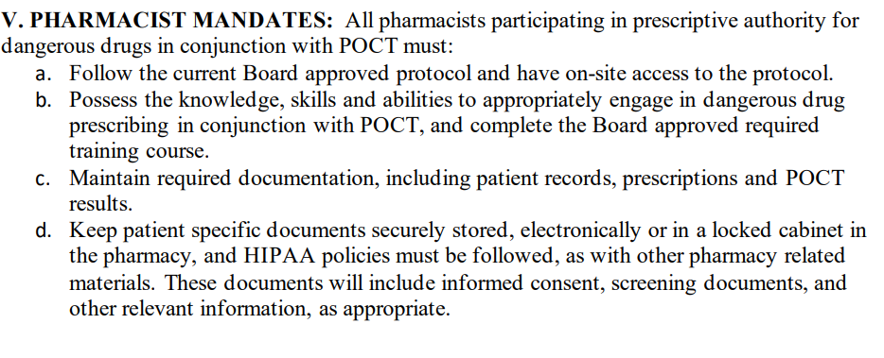
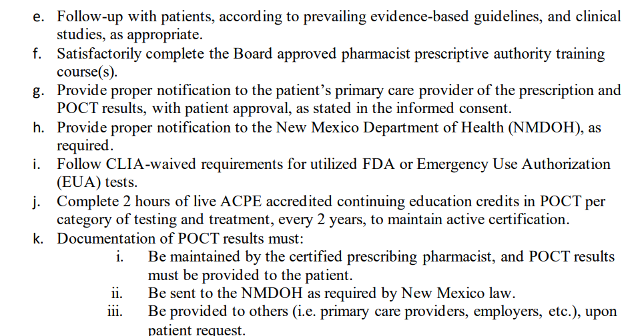
Board of Pharmacy Test-to-Treat Protocol
https://api.realfile.rtsclients.com/PublicFiles/1ee897135beb4b1c82715d36398de4c5/da55c9bc-7461-4393-a6c6-5e7ed2d662e2/Protocol%20for%20Pharmacist%20Prescribing%20for%20COVID-19,%20Strep,%20and%20Influenza.pdf

Slide 8
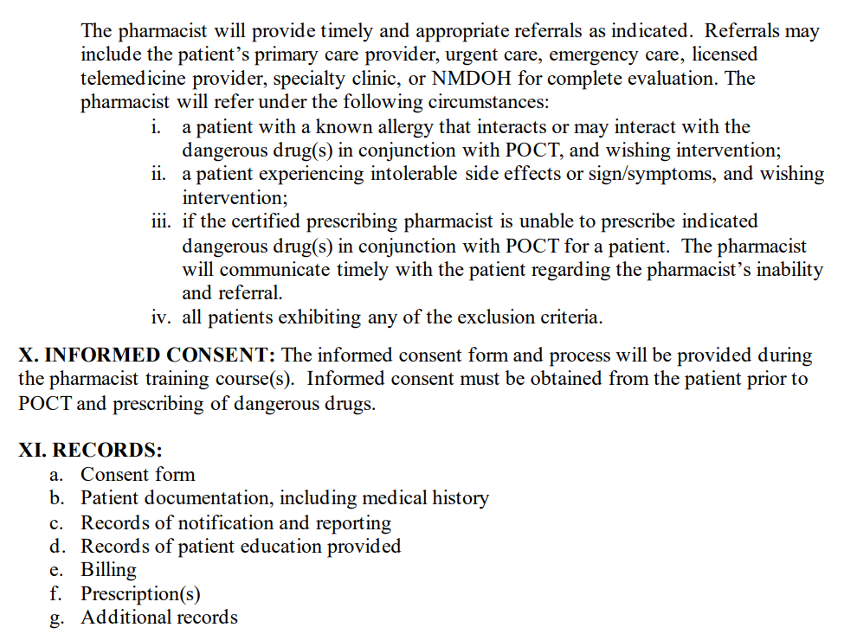
Board of Pharmacy Test-to-Treat Protocol

Slide 9
Senate Bill 92 Pharmacist Expanded Scope of Practice

Slide 10
Pharmacy Technicians and Test-to-Treat New Mexico

Slide 11
Ordering of Lab Values and Test-to-Treat New Mexico

Slide 12
Some Other States, Legislation, 2023
Colorado
Senate Bill 162 expands techs’ scope of practice to perform point of care tests under the supervision of a pharmacist.
Connecticut
Senate Bill 1102 expands pharmacist prescriptive authority to perform point of care tests and prescribe for PEP/Prep, and for techs to administer vaccines.
Montana
Senate Bill 112 expands pharmacist prescriptive authority for conditions that don’t require a new diagnosis, are minor, generally self-limiting, and can be diagnosed with a CLIA waived test or are patient emergencies.

Slide 13
Test-to-Treat Intake Form New Mexico

Slide 14
Test-to-Treat Intake Form New Mexico

Slide 15
Test-to-Treat Intake Form New Mexico

Slide 16
Test-to-Treat Intake Form New Mexico

Slide 17
Test-to-Treat Intake Form New Mexico

Slide 18
Test-to-Treat Intake Form New Mexico

Slide 19
Test-to-Treat Intake Form New Mexico

Slide 20
Question
What are the five sections outlined in the Pharmacist Patient Care Process that help provide pharmacists’ a consistent process to follow in the delivery of patient care?
Collect, Analyze, Plan, Follow-up: Monitor and Evaluate, Refer
Collect, Advise, Document, Plan, Follow-up: Monitor and Evaluate
Collect, Assess, Plan, Implement, Follow-up: Monitor and Evaluate
Collect, Assess, Document, Plan, Follow-up: Monitor and Evaluate

Slide 21
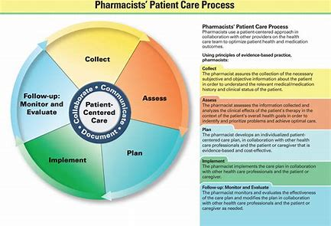
Answer
What are the five sections outlined in the Pharmacist Patient Care Process that help provide pharmacists’ a consistent process to follow in the delivery of patient care?
Collect, Analyze, Plan, Follow-up: Monitor and Evaluate, Refer
Collect, Advise, Document, Plan, Follow-up: Monitor and Evaluate
Collect, Assess, Plan, Implement, Follow-up: Monitor and Evaluate
Collect, Assess, Document, Plan, Follow-up: Monitor and Evaluate
Answer: Recognizing the need for a consistent process in the delivery of patient care across the profession, the Joint Commission of Pharmacy Practitioners (JCPP) released the Pharmacists’ Patient Care Process. The process includes the following elements: Collect, Assess, Plan, Implement, and Follow-up: Monitor and Evaluate.

Slide 22
Case
K.G. is a 66 year old male who presents to the pharmacy with fever, chills, non-productive cough, and fatigue for over 48 hours. He also reports diarrhea and vomiting. He has no other known health conditions or on any medication at this time. He appears short of breath and is breathing rapidly. Upon physical exam, you note K.G.'s heart rate is 109 beats/min and respiratory rate is 29 breaths/min. What is the best course of action for this patient?
Perform the point-of-care test and treat this patient as appropriate
Refer patient to the emergency room or nearest urgent care facility for immediate care due to clinical instability

Slide 23
Answer
K.G. is a 66 year old male who presents to the pharmacy with fever, chills, non-productive cough, and fatigue for over 48 hours. He also reports diarrhea and vomiting. He appears short of breath and is breathing rapidly. Upon physical exam, you note K.G.'s heart rate is 109 beats/min and respiratory rate is 29 breaths/min. What is the best course of action for this patient?
Perform the point-of-care test and treat this patient as appropriate
Refer patient to the emergency room or nearest urgent care facility for immediate care
Patients who are exhibiting symptoms of clinically instability or are clinically unstable such as this patient requires referral
Hypotension
Tachypnea > 25 breaths/min (> 20 breaths/min for patients aged < 18 years)
Tachycardia > 100 beats/min (> 119 beats/min for patients aged < 18 years)
Decreased oxygenation
High fever

Slide 24
Once K.G. is feeling better, what vaccines would you prescribe for him?
66 year old male
Do not give vaccines during moderate to severe illness
No other health conditions at this time
No medications at this time
No vaccine record or NMSIIS record found
Influenza
Covid
Shingrix
Tdap
RSV (shared decision making)

Slide 25
Clinically Unstable, Referral Required
What are the parameters to determine clinical instability?
Systolic hypotension < 100 mmHg
Tachypnea > 25 breaths/min (> 20 breaths/min for patients aged < 18 years)
Tachycardia > 100 beats/min (> 119 beats/min for patients aged < 18 years)
Oxygenation < 90% via pulse oximetry
Temperature > 103°F (>104°F for patients aged < 18 yrs)

Slide 26
Question (Influenza)
Which of the following are “hallmark signs” of influenza?
Headache and nasal congestion
Fever and non-productive cough
Malaise and fatigue
Chest pain

Slide 27
Answer (Influenza)
Which of the following are “hallmark signs” of influenza?
Headache and nasal congestion
Fever and non-productive cough
Malaise and fatigue
Chest pain
Answer: Fever and non-productive cough are “hallmark signs” of influenza and together, these symptoms are associated with a 70-86% sensitivity of diagnosing influenza during high influenza season. In strep throat, a cough is not usually present.

Slide 28
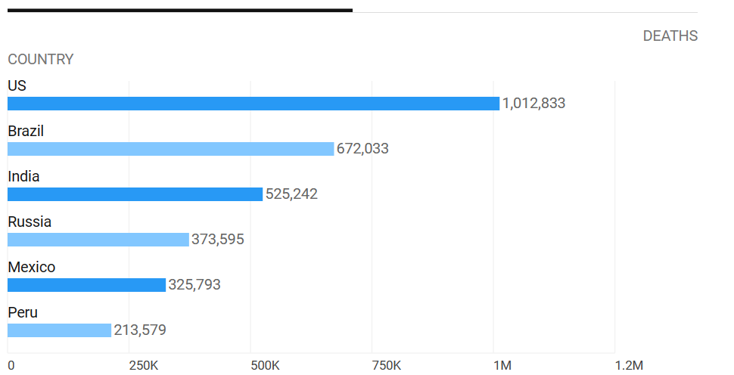
When Performing Test-to-Treat, Consider
Past vaccination history, if relevant
Season or timing of illness
Additional exposures
Illness activity in your given area
Travel to other regions & activity

Slide 29
Case (Influenza)
J.M. is a 38 year old female who presents at the pharmacy with fever, cough, some chills, and muscle aches. She reports that her symptoms began 3 days earlier (72 hours ago). She has no PCP or insurance due to a change in employer recently. She would like to be tested for influenza and get medication to treat the flu as part of your Test-to-Treat protocol. What is the best course of action?
Refer patient to her physician due to symptoms duration of greater than 48 hours
Do not need to test or treat this patient since she is not in a high priority group for complications of influenza
Initiate oseltamivir without testing for influenza since her symptom duration is greater than 48 hours
Complete a rapid influenza point-of-care test and if positive initiate antiviral therapy for influenza

Slide 30
Answer (Influenza)
J.M. is a 38 year old female who presents at the pharmacy with fever, cough, chills, and muscle aches. She reports that her symptoms began 3 days earlier (72 hours ago). She has no PCP or insurance due to a change in employer recently. She would like to be tested for influenza and get medication to treat the flu as part of your Test-to-Treat protocol. What is the best course of action?
Refer patient to her physician due to symptoms duration of greater than 48 hours
Do not need to test or treat this patient since she is not in a high priority group for complications of influenza
Initiate oseltamivir without testing for influenza since her symptom duration is greater than 48 hours
Complete a rapid influenza point-of-care test and if positive initiate antiviral therapy for influenza
Answer: Since influenza treatment is recommended to be initiated within 48 hours of symptom onset or as soon as possible, patients who are exhibiting signs of influenza-like illness for greater than 48 hours may be referred for further discussion of benefits/risks of therapy, however antiviral therapy prescribed by a pharmacist may still provide benefit post 48 hours. She also has no PCP at this time.
Answer choice B and C are not correct because initiation of therapy requires a positive point-of-care test and low risk patients are still treated for influenza if clinically appropriate.

Slide 31
Case
J.M. is a 38 year old female who presents at the pharmacy with fever, cough, sore throat, some chills, muscle aches, and fatigue. She reports that her symptoms began 3 days earlier (72 hours ago). She has no PCP or insurance due to a change in employer recently. She would like to be tested and get medication to treat as part of your Test-to-Treat protocol. What is the best course of action?
Refer patient to her physician due to symptoms duration of greater than 48 hours
Do not need to test or treat this patient since she is not in a high priority group for complications
Initiate treatment without testing since her symptoms are well defined
Complete a rapid point-of-care test and if positive initiate therapy for…

Slide 32
Answer
J.M. is a 38 year old female who presents at the pharmacy with fever, cough, sore throat, some chills, muscle aches, and fatigue. She reports that her symptoms began 3 days earlier (72 hours ago). She has no PCP or insurance due to a change in employer recently. She would like to be tested and get medication to treat as part of your Test-to-Treat protocol. What is the best course of action?
Refer patient to her physician due to symptoms duration of greater than 48 hours
Do not need to test or treat this patient since she is not in a high priority group for complications
Initiate treatment without testing since her symptoms are well defined
Complete a rapid point-of-care test and if positive initiate therapy for…

Slide 33
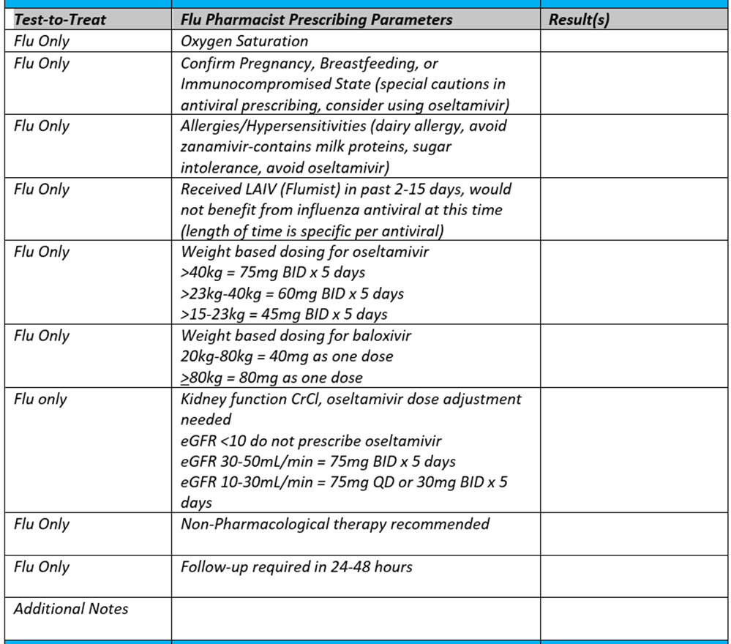
Answer (Influenza)
J.M. is a 38 year old female who presents at the pharmacy with fever, cough, sore throat, some chills, muscle aches, and fatigue. She reports that her symptoms began 3 days earlier (72 hours ago). She has no PCP or insurance due to a change in employer recently. She would like to be tested and get medication to treat as part of your Test-to-Treat protocol. What is the best course of action?
Refer patient to her physician due to symptoms duration of greater than 48 hours
Do not need to test or treat this patient since she is not in a high priority group for complications
Initiate treatment without testing since her symptoms are well defined
Complete a rapid point-of-care test and if positive initiate therapy for…

Slide 34
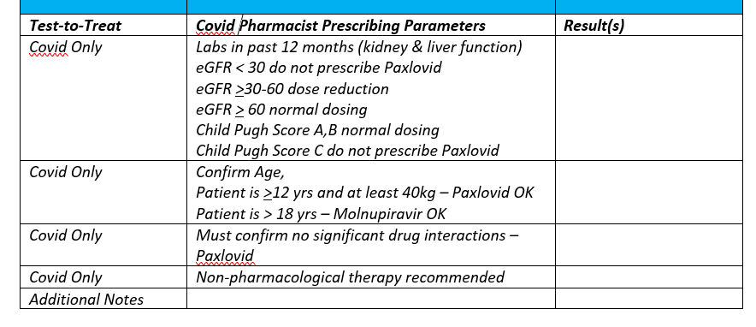
Answer (Covid)
J.M. is a 38 year old female who presents at the pharmacy with fever, cough, sore throat, some chills, muscle aches, and fatigue. She reports that her symptoms began 3 days earlier (72 hours ago). She has no PCP or insurance due to a change in employer recently. She would like to be tested and get medication to treat as part of your Test-to-Treat protocol. What is the best course of action?
Refer patient to her physician due to symptoms duration of greater than 48 hours
Do not need to test or treat this patient since she is not in a high priority group for complications
Initiate treatment without testing since her symptoms are well defined
Complete a rapid point-of-care test and if positive initiate therapy for…

Slide 35
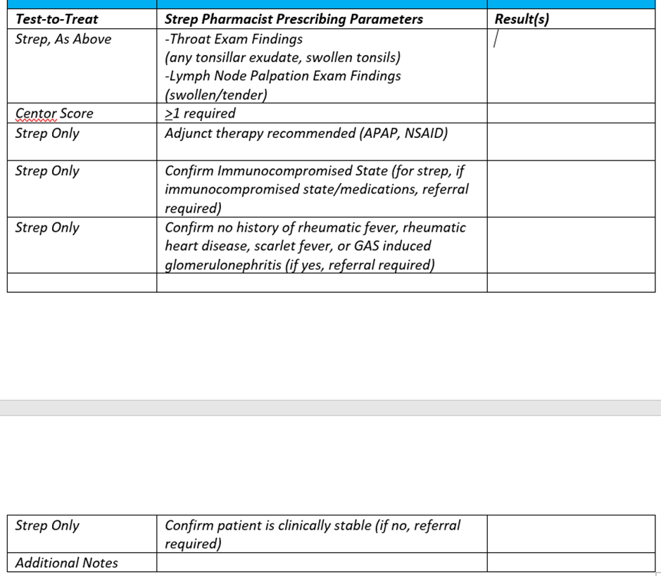
Answer (Strep)
J.M. is a 38 year old female who presents at the pharmacy with fever, sore throat, and swollen tonsils. She reports that her symptoms began 3 days earlier (72 hours ago). She has no PCP or insurance due to a change in employer recently. She would like to be tested and get medication to treat as part of your Test-to-Treat protocol. What is the best course of action?
Refer patient to her physician due to symptoms duration of greater than 48 hours
Do not need to test or treat this patient since she is not in a high priority group for complications
Initiate treatment without testing since her symptoms are well defined
Complete a rapid point-of-care test and if positive initiate therapy for…

Slide 36
Question (Influenza)
Which of the following medications used for the treatment of influenza is contraindicated in patients with underlying respiratory conditions due to the potential adverse effect of bronchospasm?
Baloxavir
Amantadine
Zanamivir
Oseltamivir

Slide 37
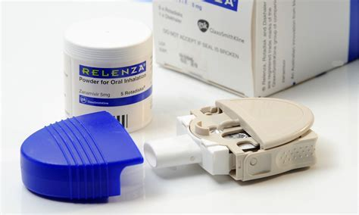
Answer (Influenza)
Which of the following medications used for the treatment of influenza is contraindicated in patients with underlying respiratory conditions due to the potential adverse effect of bronchospasm?
Baloxavir
Amantadine
Zanamivir (Relenza)
Oseltamivir
Answer: Zanamivir is contraindicated in patients with underlying respiratory disease due to the potential for bronchospasm. This is because it is delivered in an inhaled route while oseltamivir and baloxavir are oral medications.
Amantadine is not recommended in the IDSA guidelines for the treatment of influenza due to high rates of resistance.

Slide 38
Case (Influenza)
J.S. is an 8 year old female (Height: 4’9” Weight: 86 lbs.) who has tested positive for influenza with the rapid influenza diagnostic point-of-care test. She reports fever, chills, abdominal pain, and malaise which all began 24 hours ago. She has no other health conditions or past medical history. What is the most appropriate dose of oseltamivir (Tamiflu) for this patient?
60mg by mouth twice daily
45mg by mouth twice daily
30mg by mouth twice daily
75 mg by mouth twice daily

Slide 39
Answer (Influenza)
J.S. is an 8 year old female (Height: 4’9” Weight: 86 lbs.) who has tested positive for influenza with the rapid influenza diagnostic point-of-care test. She reports fever, chills, abdominal pain, and malaise which all began 24 hours ago. She has no other health conditions or past medical history. What is the most appropriate dose of oseltamivir (Tamiflu) for this patient?
60mg by mouth twice daily
45mg by mouth twice daily
30mg by mouth twice daily
75 mg by mouth twice daily
86 lbs. = 39 kg

Slide 40
Question (GAS)
Which of the following symptoms of Strep Throat may point to a viral etiology?
Fever, odynophagia (painful swallowing), lymphadenitis
Conjunctivitis, hoarseness, runny nose
Headache, abdominal pain, red and swollen uvula
Tonsillopharyngeal erythema/exudate, soft palate petechiae (red spots), scarlatiniform rash

Slide 41
Answer (GAS)
Which of the following symptoms of pharyngitis may point to a viral etiology?
Fever, odynophagia, lymphadenitis
Conjunctivitis, hoarseness, runny nose
Headache, abdominal pain, red and swollen uvula
Tonsillopharyngeal erythema/exudate, soft palate petechiae, scarlatiniform rash
Answer: Patient’s with the following symptoms may have a viral infection, which should not be treated with antibiotics: conjunctivitis, cough, hoarseness, or runny nose.

Slide 42
Question (GAS)
Which of the following is a potential benefit of giving an antibiotic for group A streptococcal (GAS) pharyngitis?
Antibiotics can reduce complications of acute otitis media or sinusitis
Antibiotics reduce the need for throat cultures
Antibiotics reduces the need for patient follow-up
Antibiotics can shorten the duration of symptoms by 48 hours

Slide 43
Answer (GAS)
Which of the following is a potential benefit of giving an antibiotic for group A streptococcal pharyngitis?
Antibiotics can reduce complications of acute otitis media or sinusitis
Antibiotics reduce the need for throat cultures
Antibiotics reduces the need for patient follow-up
Antibiotics can shorten the duration of symptoms by 48 hours
Antibiotics can reduce complications of acute otitis media or sinusitis and shorten the duration of symptoms by 16 hours rather than 49 hours as in selection D

Slide 44
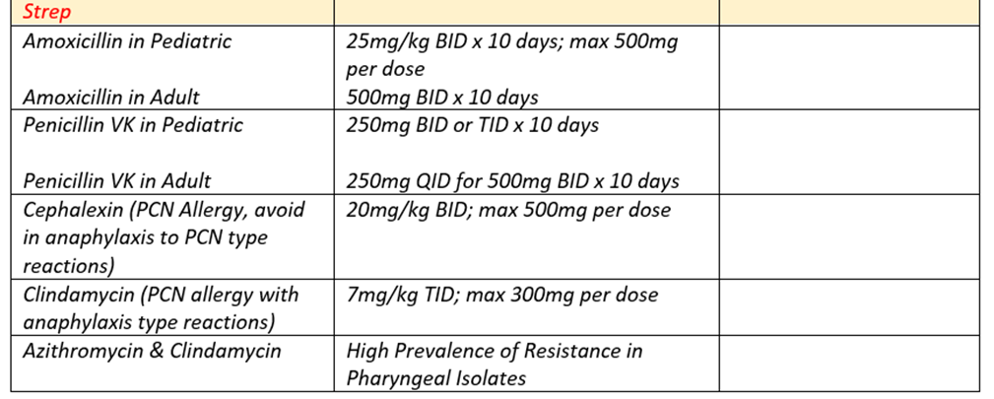
Case (GAS)
A.B. is a 10 year old who has tested positive for group A streptococcal pharyngitis (GAS). She has typical signs/symptoms of GAS pharyngitis with no “red flag” symptoms. She has no known drug allergies. Which is the most appropriate antibiotic for A.B.?
Clindamycin
Amoxicillin
Cephalexin
Azithromycin

Slide 45
Answer (GAS)
A.B. is a 10 year old who has tested positive for group A streptococcal pharyngitis (GAS). She has typical signs/symptoms of GAS pharyngitis with no “red flag” symptoms. She has no known drug allergies. Which is the most appropriate antibiotic for A.B.?
Clindamycin
Amoxicillin
Cephalexin
Azithromycin
Answer: In the New Mexico protocol, weight for Strep prescribing is required for those <18 years of age.
Amoxicillin and penicillin are first line therapies for the treatment of GAS. It is indicated for children 25mg/kg (max 500mg/dose PO every 12 hours for 10 days). Amoxicillin is preferred over penicillin due to less frequent dosing.
Cephalexin would be considered if A.B. had an insensitivity type allergy to amoxicillin/penicillin
Clindamycin is considered when amoxicillin, penicillin, and cephalosporins are not available or not tolerated (anaphylactic type reactions).
Azithromycin should be avoided as much as possible due to resistance.
90 lbs. = 41kg
25mg x 41kg = 1025 mg (max = 500 mg BID)

Slide 46
Case (Influenza)
K.T. is a 37 year old male who presents to your pharmacy to be tested for influenza. He has a fever, headache, and muscle aches which started yesterday morning with no other relevant past medical history to report. He said everyone at his workplace is out with the flu. The rapid influenza diagnostic point-of-care test showed positive results for influenza. What is the best course of action for K.T.?
Start peramivir (Rapivab) for 10 days of therapy
Start oseltamivir (Tamiflu) or zanamivir (Relenza) for 5 days of therapy
Wait for laboratory confirmation before treating him with an antiviral agent
Start baloxavir (Xofluza) for 5 days of therapy

Slide 47
Answer (Influenza)
K.T. is a 37 year old male who presents to your pharmacy to be tested for influenza. He has a fever, headache, and muscle aches which started yesterday morning with no other relevant past medical history to report. He said everyone at his workplace is out with the flu. The rapid influenza diagnostic point-of-care test showed positive results for influenza. What is the best course of action for K.T.?
Start peramivir (Rapivab) for 10 days of therapy
Start oseltamivir (Tamiflu) or zanamivir (Relenza) for 5 days of therapy
Wait for laboratory confirmation before treating him with an antiviral agent
Start baloxavir (Xofluza) for 5 days of therapy
Answer: Antiviral agents should be started as soon as possible for the treatment of influenza. Agents used to treat influenza work by preventing replication which means they are most effective when the virus is replicating the most, which is at the beginning of the life cycle.
Oseltamivir and zanamivir should be used for 5 days for most patients not including immunocompromised or critically ill patients.
Baloxavir is a one time dose and is not used for 5 days.

Slide 48
Case (Influenza)
R.F. is a 43 year old male was diagnosed with the flu a week ago. His fever subsided and he was starting to feel a bit better. Today he reports the following symptoms: fever has returned, cough is worse, shortness of breath, and pressure in his chest. What is the best course of action for R. F.?
Let his Primary Care Provider know about these symptoms during his next scheduled visit
Call Primary Care Provider to report symptoms or go to the emergency room immediately
No specific treatment, these are not concerning symptoms
Wait to see if symptoms improve over the next few days

Slide 49
Answer (Influenza)
R.F. is a 43 year old male was diagnosed with the flu a week ago. His fever subsided and he was starting to feel a bit better. Today he reports the following symptoms: fever is back, cough is worse, shortness of breath, and pressure in his chest. What is the best course of action for R. F.?
Let his Primary Care Provider know about these symptoms during his next scheduled visit
Call Primary Care Provider to report symptoms or go to the emergency room immediately
No specific treatment, these are not concerning symptoms
Wait to see if symptoms improve over the next few days
Answer: Shortness of breath, pressure in the chest/abdomen, and fever or cough that improve but then return or worsen are emergency warning signs in adults that warrant immediate medical attention.

Slide 50
Summary
Review: If primary provider is identified on consent, must notify provider within 15 days of prescribing.
IDSA guidelines approved therapies are all part of the pharmacist prescribing formulary.
Patients will utilize Test-to-Treat as pharmacists begin to offer more services and as provider shortages continue to increase.
Pharmacists can Test-to-Treat in a safe and effective manner that is best for the patient and patient outcomes.

