Slide 1
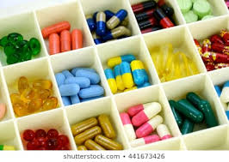
PolyPharmacy

Slide 2
Learning Objectives
The audience will be able to:
Identify pharmacokinetic/pharmacodynamic aspects of pharmacotherapy
Discuss these aspects as they relate to age
Identify patients/medications, polypharmacy, errors, and adverse drug event correlations
Implement strategies to mitigate potential correlations
ALL WHILE WORKING OUT…

Slide 3
Polypharmacy
Definitions:
A range of 2 to 11 or more medications (Masnoon et al.)
Use of a large number of medications, commonly considered to be the use of five or more (Express Scripts)
Five or more medications used daily (CMS)
Taking 5 or more pills a day or currently taking medications for 5 or more conditions (CDC)

Slide 4
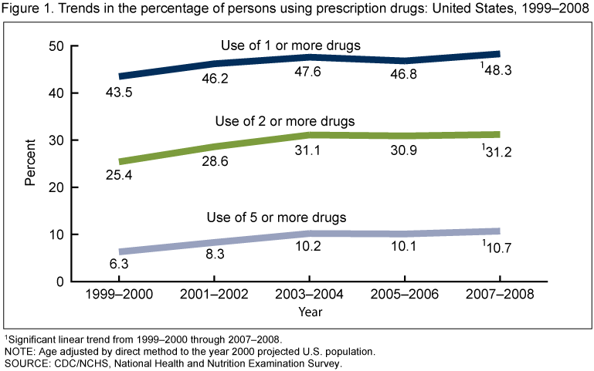
CDC Statistics
>30% of US seniors are taking 5 or more medications
22.4% of US adults aged 40-79 use 5 or more medications in the past 30 days
https://www.cdc.gov/nchs/products/databriefs/db42.htm

Slide 5
CDC Statistics
Over the last 10 years:
The percentage of Americans who took at least one prescription drug in the past month increased from 44% to 48%
The use of two or more drugs increased from 25% to 31%
The use of five or more drugs increased from 6% to 11%
In 2007-2008, 1 out of every 5 children and 9 out of 10 older Americans reported using at least one prescription drug in the past month
Those who were without a regular place for health care, health insurance, or prescription drug benefit had less prescription drug use compared with those who had these benefits
The most commonly used types of drugs involved in these statistics included:
Asthma medications (in children)
Central nervous system stimulants (in adolescents)
Antidepressants (in middle-aged adults)
Cholesterol lowering drugs (in seniors)

Slide 6
Additional Statistics
Those 65 year and older represent 12.6% of the US population, approximately one in eight Americans
The elderly account for nearly 30% of the nation’s health care expenditures and 25% of drug expenditures
A survey of non-institutionalized participants found that 12% of women aged above 65 years took at least 10 medications and 23% took at least five prescription drugs
The average US nursing home resident uses seven different medications each month, and about one-third of residents have monthly drug regimens of nine or more medications
By 2030, it is estimated that one in five Americans (71.5 million) will be over the age of 65 years
Ramaswamy R, et al. J Eval Clin Pract. 2010

Slide 7
New Mexico Statistics
By 2030, it is estimated that New Mexico will have 33% (300,000) seniors taking 5 or more medications (4th on the state rankings)
In case you are wondering why pharmacies are so busy, here’s a possible answer: They are filling a lot of prescriptions each month, for nearly half the population of the US.
PRE COVID START
POST COVID START
UNM COP Dept. of Pharmacy Practice and Admin. Sciences

Slide 8
Pharmacokinetics Review
Absorption
Distribution
Metabolism – varies based on age, sex, individual variation/genetic polymorphism, enterohepatic circulation, intestinal flora, nutrition, age
Excretion
* Changes with age:
Increase in body fat relative to skeletal muscle (diazepam)
Decreased drug metabolism due to natural renal and hepatic decline (fentanyl)
Increased drug concentrations due to prolonged half lives (lithium)

Slide 9
Pharmacokinetics Quiz
The definition of Bioavailability is “the fraction
of the administered dose reaching the systemic
circulation”?
True
False

Slide 10
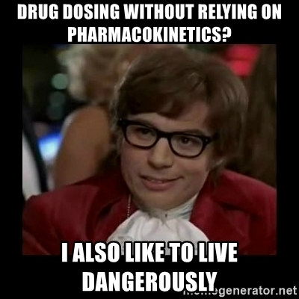
Answer
True!

Slide 11
Pharmacodynamics Review
Receptor affinity
Receptor number
Response
Homeostasis
* Changes with age:
Increase in response to benzodiazepines and opioids (alprazolam, oxycodone)
Decrease in adrenergic 2 receptors results in decreased responsiveness (clonidine)
Impairment of homeostasis such as BP regulation, bladder functionality, electrolyte balance (confusion)

Slide 12
Pharmacodynamics Quiz
A drug’s pharmacodynamics can be affected by
physiologic changes due to?
A disorder or disease
Aging process
Other drugs
All of the above

Slide 13
Answer
All of the above!

Slide 14
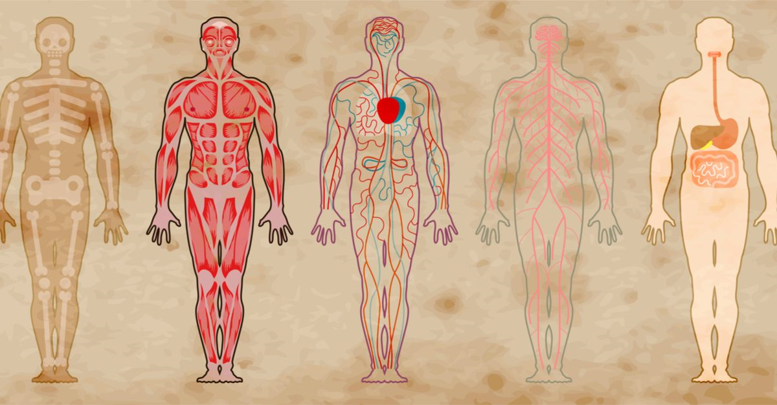
List here…

Slide 15
Disease States that Affect Pharmacokinetics and/or Pharmacodynamics
Renal Failure, Liver Disease, Congestive Heart Failure are some…
Increases distribution
Decreases elimination

Slide 16
Disease States Quiz
Patients diagnosed with Celiac Disease have been shown to generally have an increased rate of stomach emptying and increase permeability in the small intestine.
If a patient with Celiac Disease was prescribed Cephalexin you would expect the absorption to be ________.
Increased
Decreased
Unchanged

Slide 17
Disease States Quiz
Patients diagnosed with Celiac Disease have been shown to generally have an increased rate of stomach emptying and increase permeability in the small intestine.
If a patient with Celiac Disease was prescribed Cephalexin you would expect the absorption to be ________.
Increased
Decreased
Unchanged

Slide 18
Factors Contributing to Polypharmacy
Increasing age
Multiple symptoms and/or medical problems
Over prescribing
Multiple providers or lack of PCP coordination
Multiple pharmacies
Drug regimen changes/Guideline changes
Hoarding of medications by patient
Self-treatment by patient

Slide 19
Factors Contributing to Polypharmacy Quiz
A patient comes to your pharmacy and wants to pick up their medications, you identify they are on 10 different allergy meds from multiple providers. They have not filled at your pharmacy in 8 months.
List 3 factors contributing to polypharmacy in this patient:

Slide 20
Factors Contributing to Polypharmacy Quiz
A patient comes to your pharmacy and wants to pick up their medications, you identify they are on 10 different allergy meds from multiple providers. They have not filled at your pharmacy in 8 months.
Overprescribing (15)
Multiple providers (10)
Multiple pharmacies (5)

Slide 21
Indicators of Polypharmacy
Prescribing medications with no indication
Use of medications in same drug category
Concurrent use of interacting medications
Prescribing drugs contraindicated in elderly
Ordering inappropriate dosages or not maximizing current therapies
Using a drug to treat an adverse drug event

Slide 22
Additional & Potential Indicators of Polypharmacy
Transitions of care mismanaged
Discharge review incomplete
Medication reconciliation incomplete
Lack of electronic health information interface
COVID barriers to care
Worried about appt. cancellations
Inability to tele-visit
Online medication sales

Slide 23
Case (NetCE.com)
82 year old female with a history of CHF, glaucoma, hypertension, and osteoarthritis.
Current medications: furosemide, potassium, lisinopril, metoprolol, aspirin, timolol maleate opth. solution, acetaminophen (prn), multivitamin, and a calcium/vitamin D supplement.

Slide 24
Case (NetCE.com)
She has an appointment with a new orthopedic physician. During the appointment, the patient complains of persistent arthritic pain in her knee and is prescribed, meloxicam (7.5 mg per day) for pain and inflammation.

Slide 25
Medication Choices
Fill meloxicam prescription as written
Change to OTC ibuprofen
Change to any NSAID
Change to topical
Increase Tylenol (max.)
Change to Tramadol

Slide 26
Discussion
Meloxicam is a good choice, as it should help to improve symptoms, however, from a cardiac standpoint, this is a risky approach due to the potential side effect of fluid retention and its effect on the heart for a patient with CHF.
In general, NSAIDs can be dangerous for an 82 years old patient.
NSAIDs (including meloxicam, as well as over-the-counter options like ibuprofen) have been issued warnings by the U.S. Food and Drug Administration for the increased risk of:
Serious and potentially fatal cardiovascular and thrombotic events, including myocardial infarction and stroke
Serious adverse gastrointestinal events such as bleeding, ulcer, and intestinal perforation (higher in seniors)

Slide 27
Choices: Chair Yoga - Repeat 5 times
Meloxicam
Ibuprofen
Any NSAID
Topicals
Tylenol (max.)
Tramadol

Slide 28
Choices: Chair Yoga - Repeat 5 times
Meloxicam
Ibuprofen
Any NSAID
Topicals
Tylenol (max.)
Tramadol

Slide 29
Case Outcome
Pharmacist faxes PCP prior to dispensing, which results in makes the elderly patient come back at a later time.
PCP advises against NSAID and instead, creates a pain management plan that minimizes the potential risks.
Plan:
Patient was taking acetaminophen as needed, averaging up to one dose daily, this is increased to twice daily extended-release acetaminophen (650 mg total daily dose)
For breakthrough pain, tramadol 25 mg every four hours (as needed) is prescribed
Another option considered was the topical anti-inflammatory diclofenac gel, which would have fewer side effects than systemic agents
Patient is scheduled with a physical therapist to create a safe exercise plan, including strengthening and range-of-motion exercises including chair yoga which the patient greatly enjoys

Slide 30
The Prescribing Cascade
INITIAL CONDITION THERAPY NEW SYMPTOM SUBSEQUENT RX
ARTHRITIS
NSAID
↑ Blood Pressure
BP Med
DEPRESSION
Tricyclic Antidepressant
CONSTIPATION
AGITATION
LAXITIVE USE
ANTIPSYCHOTIC
Extra-Pyramidal Syndromes
PARKINSONS
MED
Gurwitz JH. P&T. 1997

Slide 31
Prescribing Cascade Quiz
Which of the following is NOT an example of a Prescribing Cascade?
Patient taking lisinopril develops a cough, so she begins taking Robitussin DM every night without improvement.
Patient brings a new prescription for levodopa-carbidopa for tremor and is here to refill haloperidol, which was started 2 months ago.
Female patient requesting an OTC recommendation for a rash she noticed after restarting lamotrigine after her recent pregnancy.
All of the above are examples of Prescribing Cascades.

Slide 32
Chair Yoga - Repeat 5 times per side

Slide 33
Prescribing Cascade Quiz
Which of the following is NOT an example of a Prescribing Cascade?
Patient taking lisinopril develops a cough so she begins taking Robitussin DM every night without improvement.
Patient brings a new prescription for Levodopa-carbidopa for tremor and is here to refill haloperidol which was started 2 months ago.
Female patient requesting an OTC recommendation for a rash she noticed after restarting lamotrigine after her recent pregnancy.
All of the above are examples of Prescribing Cascades.

Slide 34
BEERS and PIMS
Prescribing that poses more risk than benefit to the individual
Using medications that either have no clear evidence-based indication, carry a substantially higher risk of ADE, or not cost-effective
Ramaswamy R, et al. J Eval Clin Pract. 2010

Slide 35
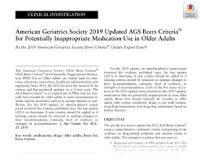
Removal of loratadine from the Beers
More liberal renal threshold (Crcl = <60mL to <30mL)
PPI avoidance long term due to C.diff., bone loss, and fractures
Stricter guidelines to avoid antipsychotics for behavioral problems

Slide 37
Potentially Inappropriate Prescribing
The cost of medication related problems has been estimated to be:
$76.6 billion to ambulatory care
$20 billion to hospitals
$4 billion to nursing home facilities
If medication-related problems were ranked as a disease by cause of death, it would be the fifth leading cause of death in the US,
Ramaswamy R, et al. J Eval Clin Pract. 2010

Slide 38
Case
78 year old man, resides in a nursing facility.
One year ago, he fell and fractured his left hip and underwent surgical repair. He returned to the nursing facility, completed rehabilitation, and regained most of his prior function.
After the surgery, was prescribed warfarin to prevent deep vein thrombosis (DVT) after surgery.
During a routine visit, it was discovered that patient is still being administered warfarin, the warfarin was never discontinued after the appropriate duration after the hip fracture repair.

Slide 39
What went wrong?
Wrong drug, right duration
Right drug, wrong duration
Wrong drug, wrong duration

Slide 40
Answer/ Exercise
10 knee ups
Right Answer! You can choose which work out you would like (either knee ups or jumping jacks)
10 jumping jacks

Slide 41
Discussion
This is an example of using the right drug but not using it for the correct duration.
After surgery, warfarin is usually indicated for approximately two to three months or until activity/ambulation has increased to a point that the risk of DVT is reduced.
There is a substantial burden of treatment with warfarin, including weekly evaluations of prothrombin time/international normalized ratio (PT/INR), adverse reactions, interactions, and increased risk of bleeding and brain hemorrhage, especially for patients with a history of falls.

Slide 42
Outcome
PCP called and warfarin was discontinued.
When medications are DC’d, plans to monitor should be put in place.
There is shared responsibility for this error between the prescriber/healthcare provider and the facility, and the consultant pharmacist.

Slide 43
Mitigation
Tools developed by expert panels:
Drug Burden Index
FORTA (Fit for the Aged) List
STOPP/START Criteria
Medication Appropriateness Index
Others
Adherence strategies/pharmacy automation
Individual drug class/De-Prescribing Criteria

Slide 44
Medication Appropriateness Index
Each question is answered using a three-point Likert scale. The first two questions receive a weighting of (3), the next four a weighting of (2), and the last four a weighting of (1).
Is there an indication for the drug?
Is the medication effective for the condition?
Is the dosage correct?
Are the directions correct?
Are the directions practical?
Are there clinically significant drug–drug interactions?
Are there clinically significant drug–disease/condition interactions?
Is there unnecessary duplication with other drugs?
Is the duration of therapy acceptable?
Is the drug the least expensive alternative compared to others of equal utility?
Fitzgerald LS, et al. Ann Pharmacother. 1997;31:543-8.

Slide 46
Screening Tool of Older Persons' Potentially Inappropriate Prescriptions (STOPP)
STOPP is comprised of 65 clinically significant criteria for potentially inappropriate prescribing in seniors:
includes drug-drug and drug-disease interactions
arranged according to relevant physiological systems
each criterion is accompanied by a concise explanation as to why potentially inappropriate
Levy HB, et al. Ann Pharmacother. 2010 ;44(12):1968-75.

Slide 47
Screening Tool to Alert to the Right Treatment (START)
START consists of 22 evidence-based prescribing indicators to identify prescribing omissions (medication indicated, but not prescribed)
Cardiovascular system
Warfarin in the presence of chronic atrial fibrillation, where there is no contraindication to warfarin
Beta blocker in chronic stable angina, where no contraindication exists
Respiratory system
Inhaled steroid in moderate-to-severe asthma or COPD, where reversibility of airflow obstruction has been shown
Central nervous system
L-dopa in idiopathic Parkinson’s disease with definite functional impairment and resultant disability
Gastrointestinal system
Proton pump inhibitor in the presence of chronic severe gastro-esophageal acid reflux
Locomotor system
Calcium and vitamin D supplement in patients with known osteoporosis
Endocrine system
ACE inhibitor or Angiotensin Receptor Blocker in diabetes with nephropathy
Levy HB, et al. Ann Pharmacother. 2010 ;44(12):1968-75.

Slide 50
Strategies to Optimize Prescribing
Computerized Interventions (soft edits, reports)
Colleague Interventions (collaborations, continuing education)
Educational interventions (learn sessions, journal clubs, patient calls)
Caution, Pushback Examples:
Fax Backs
Videos
Kaur S, et al. Drugs Aging 2009;26(12):1013-28.
Steinman M, Hanlon JT. JAMA 2010;304(14):1592-1601.

Slide 51
Strategies to Increase Adherence
Short-term Treatment
Counseling on importance
Written instructions
Tools for reminder
Long-term Treatment
Counseling on importance/long term benefits
Written instructions
Simplify regimen
Tools for reminder
Cueing to daily events
Reinforce/Reward
Patient self monitoring
Involve family/significant others
Haynes et al. JAMA, 288:2880-83.

Slide 52
Additional Adherence Strategies
90-day supply
Medication synchronization w/ automatic refills and text or calls reminders
Cost issues
Genercis
Assistance programs
Side effects
Communication w/ the prescriber or pharmacist

Slide 53
Medication Characteristics; Making them at High Risk for Potential ADE
For example: Cimetidine, CYP450 enzyme inducer, can
increase both plasma concentration and elimination half-life.
Negative:
Long biological half-life
Extensive oxidative metabolism (P450)
Many active metabolites
Highly protein bound
Lipophilic
For example: Pheytoin, CYP450 inhibitor, slows or stops the chemical action
of a CYPP450 by binding with the enzyme before it can do its job.

Slide 54
CDC Data

Slide 55
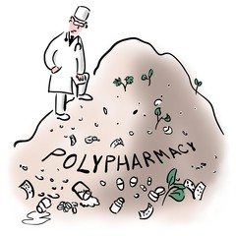
ISMP Recommendations
Recommendations for Patients
Pharmacy Areas of Improvement

Slide 56
Case
A patient is currently taking iron therapy for anemia and azithromycin for a URI and complains about heartburn, you want to treat.
What is the most appropriate treatment plan?
A.Administer omeprazole at the same time as the iron therapy, making sure to separate the iron from the azithromycin.
B.Administer famotidine at the same time as the iron therapy, making sure to separate the iron from the azithromycin.
C.Continue to treat both the anemia and URI. Administer calcium carbonate with food making sure to separate 2 hours before or 4 hours after iron therapy.
D.Discontinue the iron therapy, initiate acid reducing therapy, and separate it from azithromycin.

Slide 57
What is the most appropriate treatment plan?
A. Administer omeprazole at the same time as the iron therapy, making sure to separate the iron from the azithromycin.
B. Administer famotidine at the same time as the iron therapy, making sure to separate the iron from the azithromycin.
C. Continue to treat both the anemia and URI . Administer calcium carbonate with food making sure to separate 2 hours before or 4 hours after iron therapy .
D. Discontinue the iron therapy, initiate acid reducing therapy, and separate it from azithromycin.

Slide 58
Everyone that did NOT pick
the correct answer
C. Continue to treat both the anemia and URI. Administer calcium carbonate with food making sure to separate 2 hours before or 4 hours after iron therapy.
10 HIGH KNEES!

Slide 59
Discussion
•Minerals like calcium, magnesium, and iron therapy, interfere with the absorption of certain antibiotics.
•Iron needs an ACIDIC environment to absorb properly and it is best taken on an EMPTY stomach.
•Histamine blockers, like famotidine, decrease stomach acid, and therefore interfere with iron therapy.

Slide 60
Case
Your patient notes that they cannot take their levothyroxine before breakfast on an empty stomach due to GI sensitivity.

Slide 61
What would your recommendation be to the patient?
Try taking the levothyroxine with milk.
Take the levothyroxine after a meal.
Don’t take the medication if it’s causing GI issues.
Administer consistently in the morning on an empty stomach, at least 30 to 60 minutes before food.

Slide 62
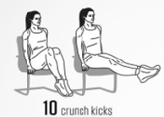
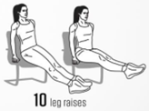
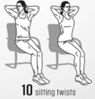
What would your recommendation be to the patient?
Try taking the levothyroxine with milk
Take the levothyroxine after a meal
Don’t take the medication if it’s causing GI issues
Administer consistently in the morning on an empty stomach, at least 30 to 60 minutes before food

Slide 63
Explanation
Absorption of levothyroxine is greatly affected by food and even when drinking coffee within an hour.

Slide 64
Additional Recommendations
Wait 60 minutes after taking levothyroxine to drink your coffee.
Alternatively, may consistently administer at night 3 to 4 hours after the last meal
Enteral tube feedings interfere with the absorption of levothyroxine as well.

Slide 65
Cannabis Instead of Polypharmacy?
https://www.projectcbd.org/

Slide 66
Summary
Identification of potential polypharmacy is key to it’s decrease in the US.
Many tools are available for use in the mitigation of polypharmacy.
A stepwise approach to avoidance of polypharmacy, medication errors, and adverse drug events may be beneficial to your practice.

