Slide 1
Emergency contraception
Courtney Forbis, MD, MS
Assistant Professor
UNM Department of Obstetrics and Gynecology

Slide 2
Learning Objectives
Discuss the ways the use of emergency contraception (EC) is affected by restrictions, myths, and under-use
Discuss indications and medical contraindications for EC
Understand the mechanism of action and effectiveness for available forms of EC
Discuss current data that support the use of hormonal intrauterine devices (IUDs) for EC

Slide 3
Outline
What is EC? Why do we need it?
Legal history and barriers to access
Population impact
Types of EC used in the United States
Mechanism of action and effectiveness
Safety
Screening and provision
Side effects
Effects of obesity and medication interactions
Patient cases

Slide 4
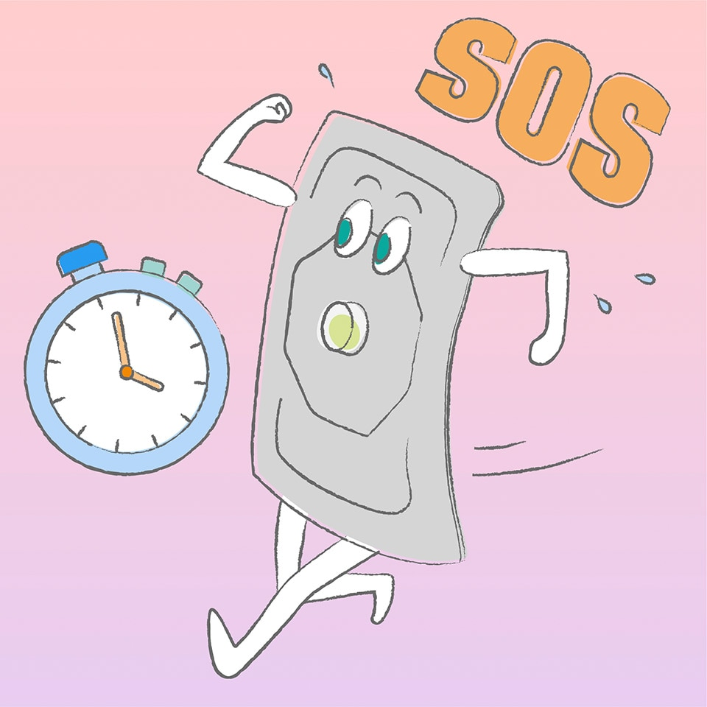
What is emergency contraception?
WHO definition
“Emergency contraception refers to methods of contraception that can be used to prevent pregnancy after sexual intercourse. These are recommended for use within 5 days but are more effective the sooner they are used after the act of intercourse.”
Methods available
Ulipristal acetate (UPA)
Levonorgestrel (LNG)
IUDs
Copper and LNG

Slide 5
Why do we need emergency contraception?
Approximately 50% of pregnancies in the United States are unintended (mistimed or unwanted)
Around 10 million couples have sexual intercourse every night in the United States
Approximately 27,000 condoms break or slip each year in the United States
Even perfect contraceptive use can result in failure and pregnancy
COCs, patch, and ring have a failure rate of ~7% per year (Guttmacher institute)
Injectable contraception has failure rate of ~4% per year
IUDs and implants have a less than 1% failure rate per year
Notes:
Unintended pregnancy is “a pregnancy that is mistimed, unplanned, or unwanted”.
Unintended pregnancy mainly results from the lack of, inconsistent, or incorrect use of effective contraceptive methods.

Slide 6
Indications for EC
No use of contraception at time of coitus
Male condom slippage or breakage
Female condom incorrectly placed, dislodged, or torn
Missing 3+ consecutive combined oral contraceptive pills
3 or more hours late taking progestin-only contraceptive pill
More than 14 days late getting Depo-Provera injection
2 or more days late starting new vaginal ring or patch
Failed attempt at coitus interruptus

Slide 7
Legal history
In 1999 FDA approved the first two dose regimen of 750mcg levonorgestrel (LNG) pills for EC
In 2009 single pill version was introduced and generic made available
In 2006 FDA approved over the counter (OTC) access to women age 18 or older
In 2009 a US judge ordered the FDA to allow women age 17 to acquire LNG EC without prescription
In June 2013, Obama administration reversed age restriction
Notes:
In 2003, FDA advisory committed voted 23 to 4 to approve Plan B as an OTC medication. However, despite this the FDA still rejected the stitch
(Cited concerns about the effects of OTC availability on the sexual behavior of young teenagers)
Data at that point had already demonstrated that ready access to LNG EC by adolescents as young as 15 did not increase irresponsible sexual behavior

Slide 8
Restricting access
Texas excludes EC as one of the services included in the state’s family planning program
Arkansas and North Carolina exclude EC from contraceptive coverage mandate
Seven states (Arizona, Arkansas, Connecticut, Georgia, Idaho, Mississippi, and South Dakota) explicitly allow pharmacists to refuse to dispense contraceptives, including emergency contraception
Three states (Arizona, Louisiana, and Mississippi) allow pharmacies to refuse to dispense emergency contraception
Notes:
When pharmacies fail to stock EC or pharmacists refuse to fill prescriptions has significant negative impact on access and is a direct assault on reproductive justice.

Slide 9
Barriers to access
Sometimes oral EC is not stocked in pharmacies
Studies estimate only an average of 3-10% of pharmacies report the product is in stock
Not having EC displayed as OTC medication and keeping EC in theft-proof boxes that must be unlocked by pharmacy staff result in physical barriers
Patients may not want to ask staff for assistance
Can produce a sense of shame and interfere with confidentiality
High costs
Lack of awareness among patients/providers
Lack of advanced provision of oral EC
Notes:
There are a lot of competing demands on busy clinicians
Only 3% of US women of reproductive age discussed EC with a clinician in the past year
Women who discuss EC with a clinician are much more likely to use EC if it is needed

Slide 10
Myths and false science
Language on label of EC can provide misleading information and thus result in false science used by those opposed
(may also prevent) “attachment of a fertilized egg to the uterus (implantation)” implies that EC causes abortion
Common myths stated among patients include
EC will cause an abortion or harm a pregnancy
EC will prevent future fertility
EC is dangerous
It is unsafe to take multiple doses of EC
Notes:
Statements that imply that oral EC results in abortion include “may prevent implantation”

Slide 12
Who is using EC?
Statistics from National Survey of Family Growth showed that among women age 22-49, 24% had ever used emergency contraception (2017-2019 data)
Of these users, incidence was increased among those with higher level of education
EC (both IUDs and pills) is largely underused in the United States

Slide 13
Emergency department provision
Estimated that as many as 22,000 pregnancies resulting from sexual assault each year could be prevented by EC¹
20 states and the District of Columbia require emergency rooms to provide information about emergency contraception to sexual assault victims. (Guttmacher)
16 states and the District of Columbia require emergency rooms to dispense the drug on request to sexual assault victims. (Guttmacher)
Likely a missed opportunity

Slide 14
Population impact
Systematic review by Raymond et al² showed that increased access to EC enhances use but does not reduce unintended pregnancy rates
RCT by Raymond et al³ involving 1,490 participants showed increased use of method with advanced access (two packs dispensed in advance) with no increased rate of STIs but no reduction in pregnancy rates
No studies have shown evidence of increased sexual risk taking or increased rates of STIs
In a RCT of Egyptian women where LNG EC was used as supplement to lactational amenorrhea, pregnancy rates were lower in the group that received EC provision (0.8% vs 7.3%)

Slide 15
Unintended pregnancies
Advance provision of EC pills
EC use
Does not increase STIs
Does not increase sexual risk taking

Slide 16
Current options for EC
Copper IUD
UPA
LNG
LNG IUD

Slide 17
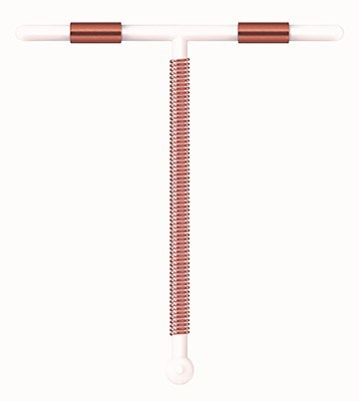
Copper IUD
Highest efficacy of all EC
Not FDA labeled for EC
Pregnancy rate of less than 0.1%⁵
Can be inserted up to 5 days following coitus
No effect on ovulation, primary effect is to prevent fertilization
Inhibits sperm function, fertilized egg transport, and implantation
Common side effects
Bleeding and cramping

Slide 18
Copper IUD
Advantages
Can be left in place for highly effective long acting reversible contraception (12 years)
Highly effective form of EC and general contraception
Disadvantages
Cost (up to $1000 if no insurance)
Timing may be tricky
Must be inserted by trained health care provider
Notes:
Some offices have to order IUDs ahead of time, many providers not aware that Cu IUD can be used as EC

Slide 19
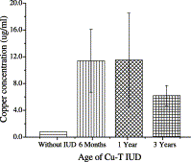
Effect of copper on sperm function
Most studies were performed in the 1970s and 1980s
Copper ions thought to inhibit sperm motility
Reduces oxidative processes and glucose consumption, both reduce mobility
Higher Copper ion concentration results in higher inhibition of sperm
Arancibia V, Peña C, Allen HE, Lagos G. Characterization of copper in uterine fluids of patients who use the copper T-380A intrauterine device. Clin Chim Acta. 2003 Jun;332(1-2):69-78. doi: 10.1016/s0009-8981(03)00124-4. PMID: 12763282.

Slide 20
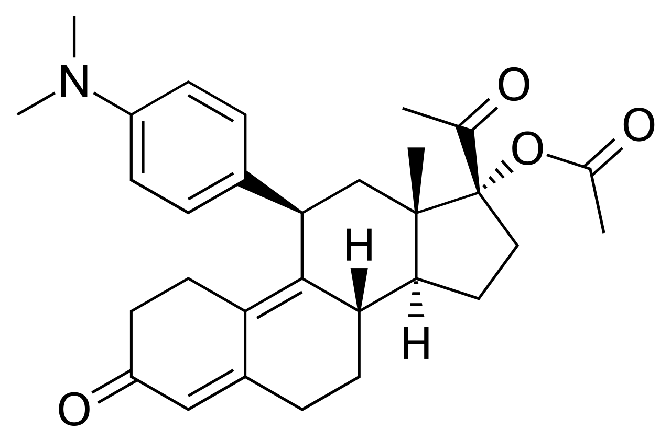
Ulipristal acetate (UPA)
Approved by FDA in 2010
Selective progesterone receptor modulator (SPRM)
Inhibits or delays ovulation even after LH has started to rise
Suppresses follicular growth
May alter endometrium

Slide 21
UPA
Single 30mg dose taken up to 120 hours following coitus
Rapidly absorbed; peak plasma concentration 0.5-3 hours after ingestion
Most effective oral EC
Higher efficacy than levonorgestrel (between 62-85% effective)⁶
Only available by Rx
Online prescription available (www.ella-kwikmed.com)
2016 US selected practice recommendations are to delay resumption of hormonal contraception for up to 5 days after the use of UPA
Notes:
Because it is metabolized by CYP3A4 in the liver, there is the potential for drug interactions

Slide 22
Efficacy of UPA
Efficacy is sustained over time
Moreau C, Trussell J. Results from pooled phase III studies of ulipristal acetate for emergency contraception. Contraception. 2011;84(3):308.

Slide 23
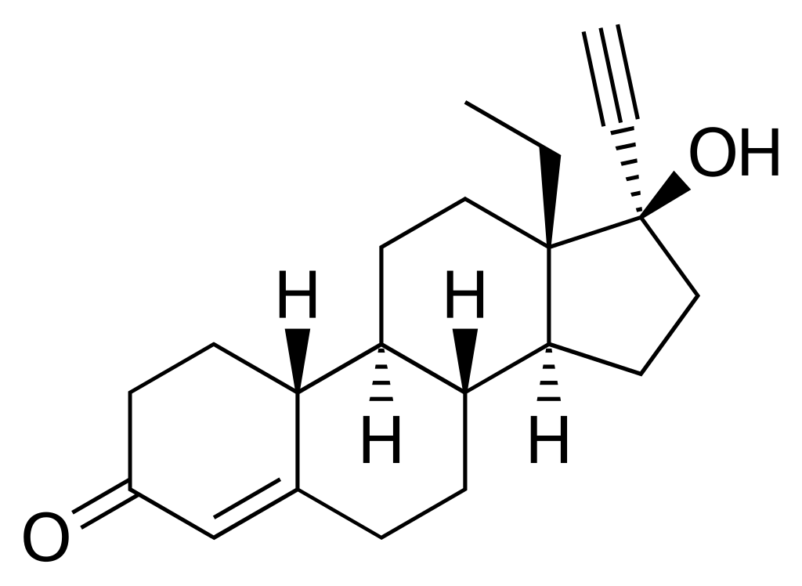
Levonorgestrel
Single dose of 1.5mg dose approved in 2009
Inhibits ovulation but ineffective after LH surge
Not effective at preventing ovulation when follicle reaches 15-17mm⁷
Most effective if taken as soon as possible
Postponing by 12 hours increases pregnancy by 50%
No effect on implantation
OTC cost $40-60 (may be cheaper with Rx)
Many clinics, including Planned Parenthood, have LNG EC available at a sliding scale cost for those without insurance or low income
Notes:
Effectiveness greatly declines the longer you take it after coitus

Slide 24
Efficacy of LNG
Odds ratio
Hours from unprotected intercourse to ECP intake
Piaggio G, Kapp N, von Hertzen H. Effect on pregnancy rates of the delay in the administration of levonorgestrel for emergency contraception: a combined analysis of four WHO trials. Contraception. 2011;84:35-9.

Slide 25
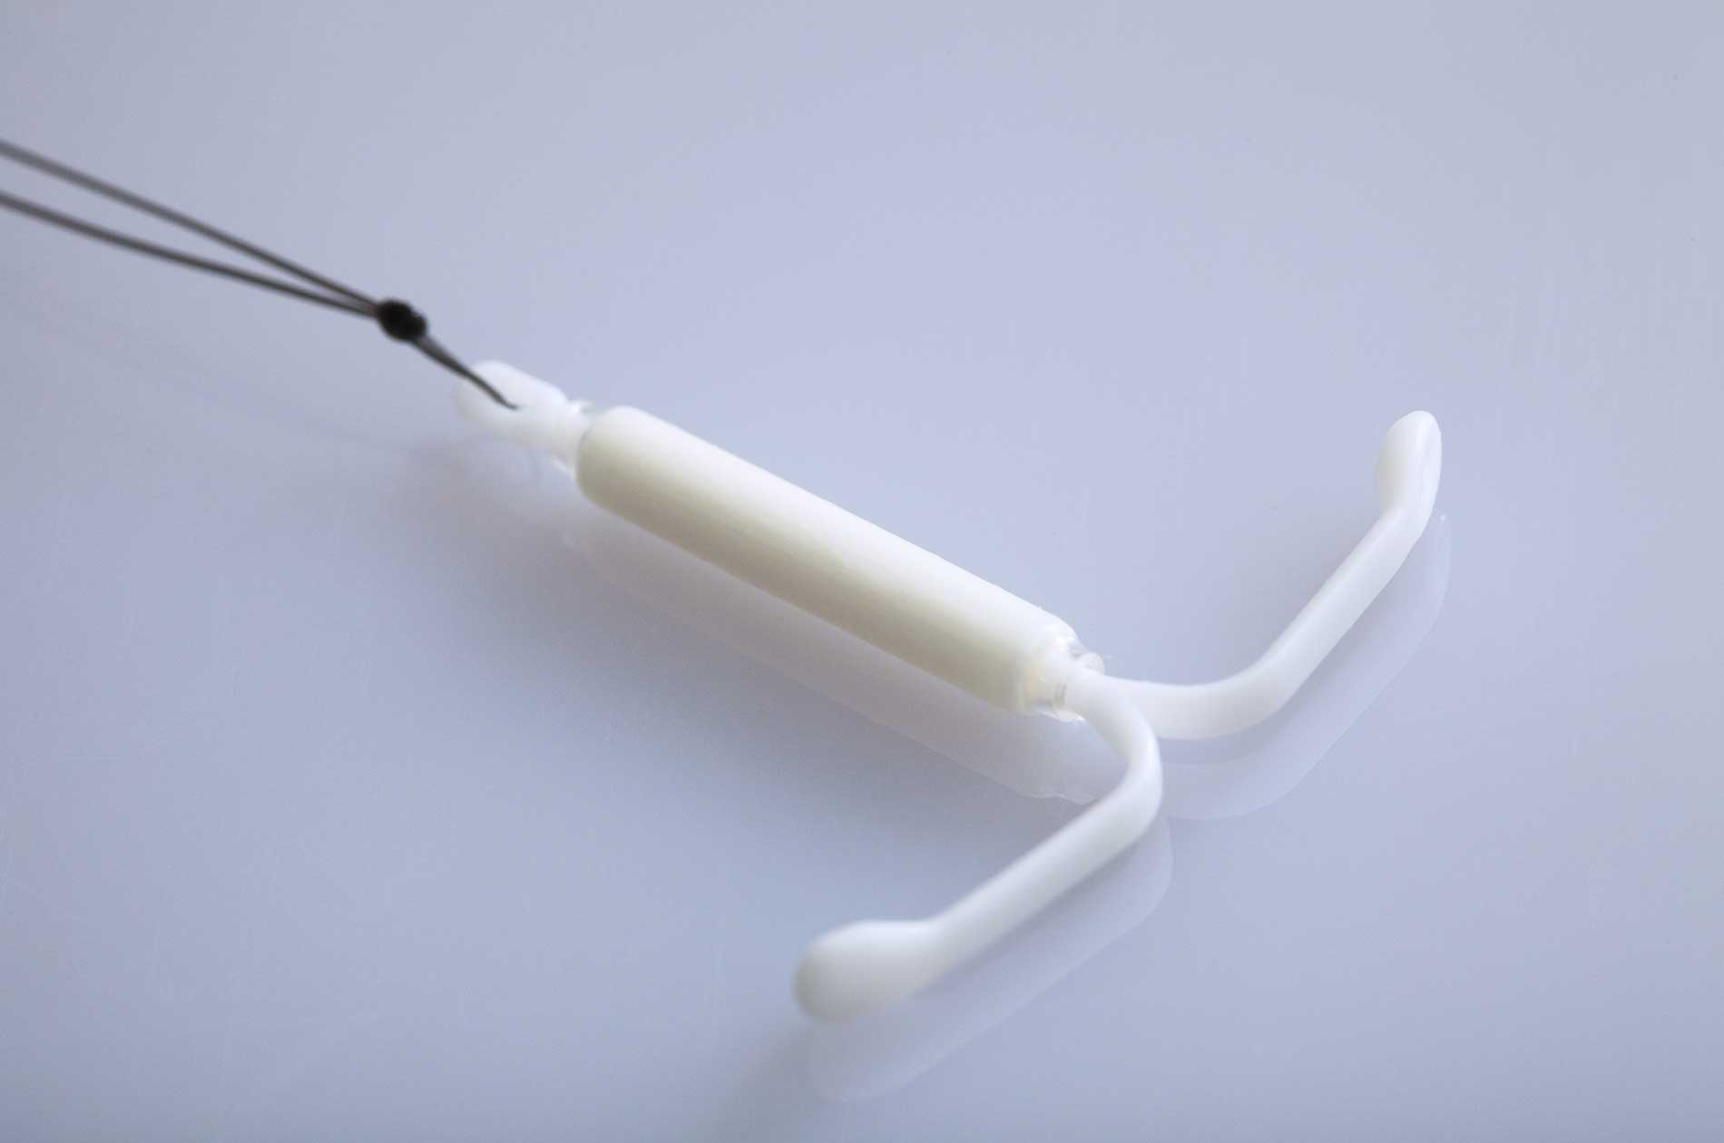
LNG IUD as EC
A randomized, noninferiority trial of 638 patients investigated the efficacy of LNG 52 mg compared to the copper IUD within 5 days of unprotected intercourse¹¹
The trial demonstrated a 0.5% (95% CI 0.01% to 1.7%) failure rate for the LNG 52 mg IUD as compared to a 0% (95% CI 0%–1.1%) failure rate for the copper IUD.
The LNG 52 mg IUD was found to be noninferior to the cop- per IUD for EC
SFP recommends LNG 52mg IUD be used as first line method for EC

Slide 26
LNG IUD as EC
When given the choice, women prefer the LNG IUD to the copper IUD as EC
In a study by Sanders et al in 2017, of 188 women enrolled, 38% chose copper, 63% chose LNG
Higher satisfaction rates with LNG IUD at 12 months

Slide 27
IUDs as EC
Sanders JN, Turok DK, Royer PA, Thompson IS, Gawron LM, Storck KE. One-year continuation of copper or levonorgestrel intrauterine devices initiated at the time of emergency contraception. Contraception. 2017 Aug;96(2):99-105. doi: 10.1016/j.contraception.2017.05.012. Epub 2017 Jun 5. PMID: 28596121; PMCID: PMC6040824.

Slide 28
Combined oral contraceptives as EC
Referred to as the Ypzpe method
Less efficacy, more side effects
Up to 50% experience nausea, 20% experience vomiting
Not currently recommended given more effective options
Four case reports of stroke following Yuzpe method

Slide 29
Old methods for EC
Preven
Approved in 1998, discontinued 2004
Essentially a Yuzpe regimen available as prescription
4 pills containing 0.25mg levonorgestrel and 0.05mg EE
High dose ethinyl estradiol
5-10mg given daily x5 days
High incidence GI side effects
Danazol
Low efficacy
Diethylstilbestrol (DES)
25-50mg

Slide 30
Other potential options for EC
Mifepristone:
Available in China, Vietnam, & Russia
Anti-progesterone effects prevent ovulation and disrupt luteal-phase events
Dose: 10mg within 120 hours of unprotected intercourse
Equal efficacy to 150mg Levonorgestrel ( meta-analysis in China showed lower failure rate for mifepristone)
Meloxicam
COX-2 Inhibitor
Dose: 30mg per day x5 days
Compared effectiveness not studied

Slide 31
Mechanism of action of EC
Method | MoA
Copper IUD | Prevention of fertilization, affects sperm viability and function
Ulipristal acetate | Delayed ovulation, inhibits follicular rupture even after LH has started to rise
LNG (oral) | Impair ovulation and luteal function, delays follicular development if administered before LH rise
LNG (IUD) | May interfere with sperm transport, sperm capacitation, and oviduct transport

Slide 32
Ella
PlanB

Slide 33
Effectiveness by method
Pregnancies expected per 1000 women who had unprotected sex in the last week
12
10
8
6
4
2
0
Levonorgestrel (oral)
UPA
Copper IUD (Paragard)
or LNG IUD (Mirena)
Raymond E, et al. 2004; Task Force on Postovulatory Methods of Fertility Regulation. 1998; Trussell J, Raymond EG 2011; Fine P, et al. 2010; Glasier AF, et al. 2010.

Slide 34
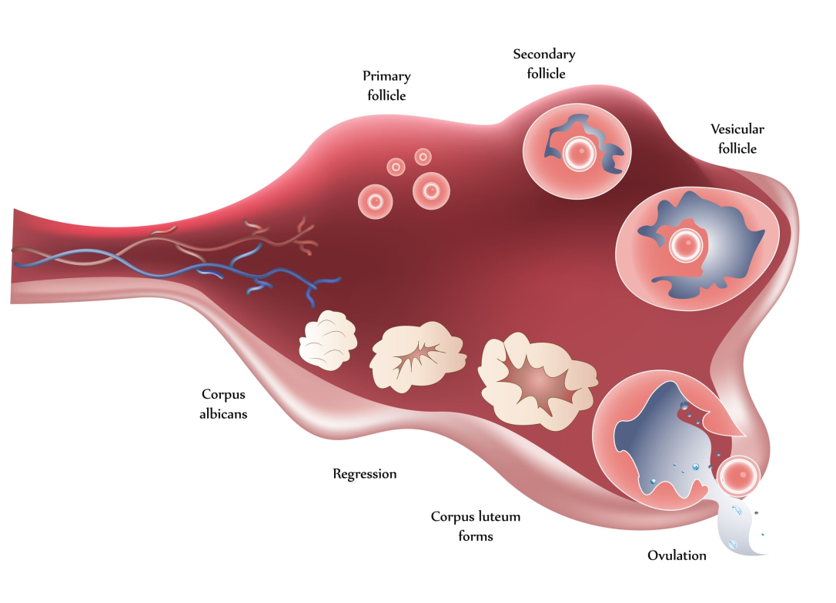
UPA vs. LNG effectiveness
In comparative trials, UPA is more effective than LNG
Odds of pregnancy were 64% lower in UPA users when taken during first 24 hours
Odds of pregnancy were 42% lower in UPA users when taken up to 72 hours⁶

Slide 35
Medical eligibility criteria
Condition | Copper IUD | UPA | LNG | COC
Pregnancy | 4 | N/A | N/A | N/A
Breastfeeding | 1 | 1 | 1 | 1
H/O ectopic | 1 | 1 | 1 | 1
H/O bariatric sx | 1 | 1 | 1 | 1
CV disease | 1 | 2 | 2 | 2
Rheumatoid arthritis | 1 (2 if on immuno-suppression) | 1 | 1 | 1
Migraine | 1 | 1 | 1 | 2
IBD | 1 | 1 | 1 | 1
Liver dx | 1 | 2 | 2 | 2
Solid organ transplant | 3 if complicated, 2 if uncomplicated | 1 | 1 | 1
Repeated EC use | 1 | 1 | 1 | 1
Sexual assault | 2 | 1 | 1 | 1
Obesity (BMI>30) | 1 | 2 | 2 | 2
CYP3A4 inducers | 1 | 2 | 2 | 2

Slide 36
Safety of EC
There are no contraindications to EC except known pregnancy
No known risk of birth defects if given and pregnancy is undetected
No increased risk of ectopic pregnancy

Slide 37
Repeated use
Repeated use likely safe
Multiple studies have showed that LNG administered multiple times per cycle causes no serious adverse events
Repeated use of UPA at 30mg dose not specifically studied, but studies have shown safety at 5mg and 10mg dose for treatment of fibroids
Chance of pregnancy following repeated use of progestin-only EC is 20%⁴

Slide 38
Pregnancy rates with repeated unprotected intercourse
Glasier A, Cameron ST, Blithe D, et al. Can we identify women at risk of pregnancy despite using emergency contraception? Data from randomized trials of ulipristal acetate and levonorgestrel. Contraception. 2011;84:363-7.

Slide 39
Breastfeeding
Not considered a contraindication to oral EC use
Breastfeeding should not be interrupted following LNG EC use
Little information is available for effects of UPA on breast feeding
CDC recommends discarding breast milk for 24 hours after dosing

Slide 40
Screening and provision
No clinical exam or pregnancy test necessary
Pregnancy test if multiple episodes of unprotected intercourse have occurred earlier in month
EC should NOT be withheld in order to test for pregnancy
Discuss possible side effects
If no menses 3 weeks after taking EC, recommend pregnancy test
Discuss need to abstain following UPA or LNG as these delay ovulation
Use as an opportunity to discuss contraceptive plans

Slide 41
Screening and provision
IUDs can be safely placed same day with concurrent testing for gonorrhea and chlamydia
Treat positive test results
IUDs are safe for adolescents and people who have not had a pregnancy

Slide 42
Unprotected Sex
When?
Up to 72 hours
72 to 120 hours
Most effective
BMI?
IUD
≤ 30 kg/m²
> 30 kg/m²
Unable to have an IUD inserted?
Preferred
UPA
LNG
UPA
ella not available?
LNG
LNG

Slide 43
Shared side effects of oral EC
Most common side effects are headache (19%) and nausea (12%)⁶
Fatigue, breast tenderness, lower abdominal pain, dizziness, and diarrhea have also been reported⁸

Slide 44
Effects on mensural bleeding
Irregular bleeding-menstrural cycle typically occurs within one week of expected time after single use
16% of LNG users reported nonmenstrual bleeding in first week after use⁹
Menses can come early (11%) or late (28%) (Contraceptive Technology)

Slide 45
Effects on mensural bleeding
Spotting happens for 10-15% of people and can last up to 5 days
Ellertson C, Webb A, Blanchard K, Bigrigg A, Haskell S, Shochet T, Trussell J. Modifying the Yuzpe regimen of emergency contraception: a multicenter randomized controlled trial. Obstet Gynecol. 2003 Jun;101(6):1160-7. doi: 10.1016/s0029-7844(03)00353-3. PMID: 12798518.

Slide 46
Obesity
Levonorgestrel EC is less effective for those with BMI >25¹⁰
A meta-analysis of oral EC studies demonstrated that the risk of pregnancy is one and one-half times greater in users with an overweight BMI (25–29.9 kg/m 2 ) and more than three times greater in users with an obese BMI ( > 30 kg/m 2 ), compared to nonoverweight users¹²
Patients with overweight BMI have same failure rates as those with normal BMI for UPA use
However, UPA ECP users with obesity are twice as likely to experience pregnancy compared to users with a normal BMI.¹²
Doubling the dose to 3mg not shown to improve effectiveness¹³
Upper weight limit for effectiveness for LNG ~70kg while upper limit for UPA ~85kg

Slide 47
Medication interactions with oral EC
LNG and UPA are substrates of cytochrome P450
Enzyme inducers may lower total dose of EC, therefore reducing effeteness
Clinical significance of these interactions is unclear
When taken with rifampin, UPA exposure is decreased 10-fold¹⁴
UPA does not appear to decrease subsequent oral contraceptive pill efficacy.
However, effectives of UPA is reduced by subsequent administration of oral contraceptive pills
Administration of 75 mg desogestrel the day following UPA is associated with ovulation within five days in 45% of subjects, compared to 3% of subjects who took only UPA¹⁵
SFP recommends delaying oral contraceptive initiation for 5 days following UPA

Slide 48
American College of Obstetricians and Gynecologists recommendations
Inform patients that copper IUD is the most effective option Prescribe UPA over LNG due to increased effectiveness
Write advanced prescriptions to increase awareness
Counsel about all contraceptive methods when seeing a patient for EC
Counsel all women at risk for pregnancy on EC
Provider referrals when appropriate
Collaborate with pharmacies

Slide 49
Patient case 1
Laura is a 24 yo cis-woman who is currently using the Nuvaring for contraception. She is sexually active with a cis-male partner and they do not use condoms.
Her roommate accidentally threw out her Nuvaring (it was in the shared refrigerator). She usually places a new ring on Sunday, but didn’t notice that the ring was missing until Monday night, after the pharmacy was closed. Due to a busy work schedule, she did not make it to the pharmacy until Friday afternoon.
She and her partner had UPIC on Sunday and Wednesday that week.
Laura weighs 55kg and has no significant PMHx.

Slide 50
Patient case 1
Does Laura need EC?
What type of EC would be best for Laura?
At what point in the week did her Nuvaring become ineffective?

Slide 51
Patient case 1

Slide 52
Patient case 2
Ann is a 25 yo who presents to the office for well-woman exam. Her PMHx is significant for hypothyroidism, for which she is on levothyroxine daily, high blood pressure (recently diagnosed, no medications) and an elevated BMI of 47.
Her blood pressure in clinic today is 145/78
During the visit today, she endorses that she has been having frequent unprotected intercourse. Upon further questioning, she expresses that she does not desire to be pregnant at this time and is open to contraception options.
Can Ann be started on a method of birth control today?
Does she qualify for emergency contraception?

Slide 53
Patient case 2
Fig. 1. Cumulative frequency distribution of weight according to pregnancy status post-intake of LNG
Nathalie Kapp, Jean Louis Abitbol, Henri Mathé, Bruno Scherrer, Hélène Guillard, Erin Gainer, André Ulmann, Effect of body weight and BMI on the efficacy of levonorgestrel emergency contraception, Contraception, Volume 91, Issue 2, 2015, Pages 97-104,

Slide 54
Patient case 2
Nathalie Kapp, Jean Louis Abitbol, Henri Mathé, Bruno Scherrer, Hélène Guillard, Erin Gainer, André Ulmann, Effect of body weight and BMI on the efficacy of levonorgestrel emergency contraception, Contraception, Volume 91, Issue 2, 2015, Pages 97-104,

Slide 55
References
Stewart FH, Trussell J. Prevention of pregnancy resulting from rape: a neglected preventive health measure. Am J Prev Med. 2000 Nov;19(4):228-9. doi: 10.1016/s0749-3797(00)00243-9. PMID: 11064225.
Raymond, E. G. , Trussell, J. & Polis, C. B. (2007). Population Effect of Increased Access to Emergency Contraceptive Pills. Obstetrics & Gynecology, 109 (1), 181-188. doi: 10.1097/01.AOG.0000250904.06923.4a.
Raymond, E. G. , Stewart, F. , Weaver, M. , Monteith, C. & Van Der Pol, B. (2006). Impact of Increased Access to Emergency Contraceptive Pills. Obstetrics & Gynecology, 108 (5), 1098-1106. doi: 10.1097/01.AOG.0000235708.91572.db.
Trussell J, Ellertson C, Stewart F, Raymond EG, Shochet T. The role of emergency contraception. Am J Obstet Gynecol. 2004 Apr;190(4 Suppl):S30-8. doi: 10.1016/j.ajog.2004.01.063. PMID: 15105796.
Cleland K, Zhu H, Goldstuck N, Cheng L, Trussell J. The efficacy of intrauterine devices for emergency contraception: a systematic review of 35 years of experience. Hum Reprod. 2012 Jul;27(7):1994-2000. doi: 10.1093/humrep/des140. Epub 2012 May 8. PMID: 22570193; PMCID: PMC3619968.
Glasier AF, Cameron ST, Fine PM, Logan SJ, Casale W, Van Horn J, Sogor L, Blithe DL, Scherrer B, Mathe H, Jaspart A, Ulmann A, Gainer E. Ulipristal acetate versus levonorgestrel for emergency contraception: a randomised non-inferiority trial and meta-analysis. Lancet. 2010 Feb 13;375(9714):555-62. doi: 10.1016/S0140-6736(10)60101-8. Epub 2010 Jan 29. Erratum in: Lancet. 2014 Oct 25;384(9953):1504. PMID: 20116841.
Croxatto HB, Brache V, Pavez M, Cochon L, Forcelledo ML, Alvarez F, Massai R, Faundes A, Salvatierra AM. Pituitary-ovarian function following the standard levonorgestrel emergency contraceptive dose or a single 0.75-mg dose given on the days preceding ovulation. Contraception. 2004 Dec;70(6):442-50. doi: 10.1016/j.contraception.2004.05.007. PMID: 15541405.
Croxatto HB, Brache V, Pavez M, Cochon L, Forcelledo ML, Alvarez F, Massai R, Faundes A, Salvatierra AM. Pituitary-ovarian function following the standard levonorgestrel emergency contraceptive dose or a single 0.75-mg dose given on the days preceding ovulation. Contraception. 2004 Dec;70(6):442-50. doi: 10.1016/j.contraception.2004.05.007. PMID: 15541405.
Croxatto HB, Brache V, Pavez M, Cochon L, Forcelledo ML, Alvarez F, Massai R, Faundes A, Salvatierra AM. Pituitary-ovarian function following the standard levonorgestrel emergency contraceptive dose or a single 0.75-mg dose given on the days preceding ovulation. Contraception. 2004 Dec;70(6):442-50. doi: 10.1016/j.contraception.2004.05.007. PMID: 15541405.
Croxatto HB, Brache V, Pavez M, Cochon L, Forcelledo ML, Alvarez F, Massai R, Faundes A, Salvatierra AM. Pituitary-ovarian function following the standard levonorgestrel emergency contraceptive dose or a single 0.75-mg dose given on the days preceding ovulation. Contraception. 2004 Dec;70(6):442-50. doi: 10.1016/j.contraception.2004.05.007. PMID: 15541405.
Turok DK, Gero A, Simmons RG, Kaiser JE, Stoddard GJ, Sexsmith CD, et al. Levonorgestrel vs. Copper Intrauterine Devices for Emergency Contraception. N Engl J Med 2021;384(4):335–44 .
Glasier A, Cameron ST, Blithe D, Scherrer B, Mathe H, Levy D, et al. Can we identify women at risk of pregnancy despite using emergency contraception? Data from randomized trials of ulipristal acetate and levonorgestrel. Contra-ception 2011;84(4):363–7 .
Edelman AB, Hennebold JD, Bond K, Lim JY, Cherala G, Archer DF, Jensen JT. Double Dosing Levonorgestrel-Based Emergency Contraception for Individuals With Obesity: A Randomized Controlled Trial. Obstet Gynecol. 2022 Jul 1;140(1):48-54.
Pohl O, Zobrist RH, Gotteland JP. The clinical pharmacology and pharmacoki-netics of ulipristal acetate for the treatment of uterine fibroids. ReprodSci 2015;22(4):476–83 .
Brache V, Cochon L, Duijkers IJM, Levy DP, Kapp N, Monteil C, et al. A prospective, randomized, pharmacodynamic study of quick-starting a deso-gestrel progestin-only pill following ulipristal acetate for emergency contra-ception. Hum Reprod 2015;30(12):2785–93 .

