Slide 1

pharmacologic Treatments of Parkinsons disease
NM Pharmacists Association
Melanie Stewart, AGNP
The Nene and Jamie Koch comprehensive movement disorder center
Notes:
Introduction PD
Treatment
Most common
SE
Benefit
Algorithm
Meds to avoid

Slide 2
Disclosures
I have no relationships to disclose.

Slide 3
Objectives
Describe pathophysiology of Parkinson
Review dosing complexity of medications
Describe pharmacologic strategies utilized in the treatment of Parkinson
Recognize common preparations
Recognize medications to avoid in Parkinsons

Slide 4
What word comes to mind when you think of parkinsons?
Notes:
Parkinson’s Foundation definition: A neurodegenerative disorder that affects predominately the dopamine producing (“dopaminergic”) neurons in a specific area of the brain called the substantia nigra.
In 2022 a Parkinsons Foundation study revealed nearly 90,000 people are diagnosed with PD each year. Predict 1.2 million people in the US will be living with PD by 2030
Average age of onset 60, 10% under 50

Slide 5
History
In 1817 James Parkinsons, characterized the tremor
in his essay as the shaking palsy as “involuntary tremulous
motion in parts not in action”

Slide 6
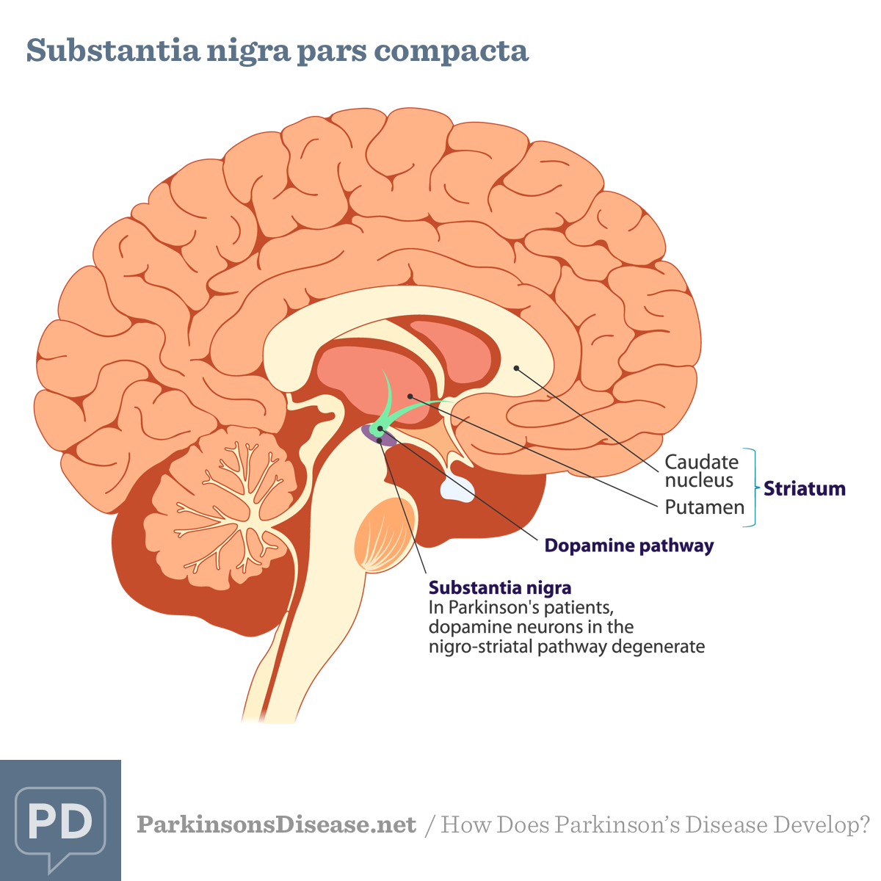
Notes:
Location: mid brain
There are two right and left
SN produces dopamine
Dopamine controls movements and muscle tone- plays a part in eye movement-motor planning-reward seeking-learning-addiction

Slide 7
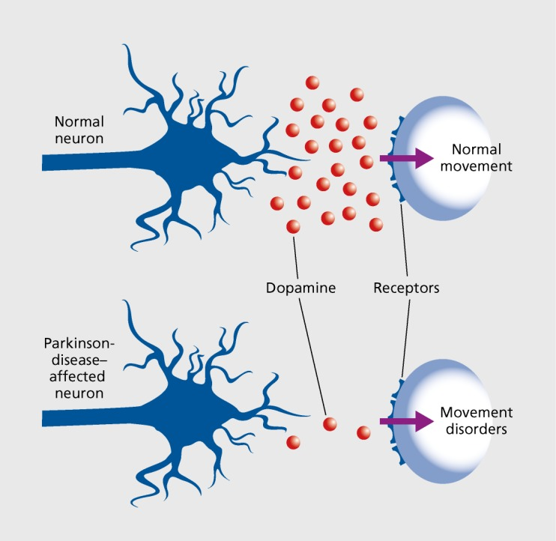
Notes:
Death of dopaminergic neurons
Studies have shown that symptoms of Parkinsons develop in patients with an 80 percent or greater loss of dopamine producing cells in the substantia nigra

Slide 8
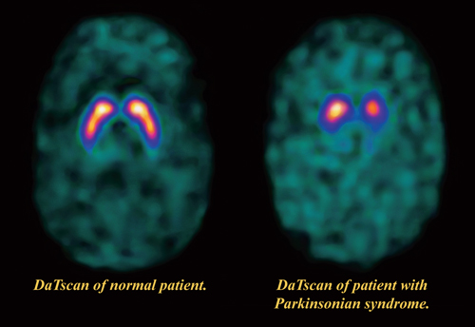
Notes:
DaTscan (dopamine transporter scan) visualize dopamine uptake
Need to be OFF of any dopamine blockers

Slide 9
Diagnosis
Asymmetric rest tremor: resting, pill rolling, disappears with action
Asymmetric rigidity (stiffness of limbs, trunk): cogwheel type in upper limbs plastic hypertonicity in legs
Asymmetric bradykinesia (slowness of movement): facial hypomimia, delayed motor initiation, slow, shuffling gait, decreased arm swing, en bloc turns, micrographia, hypophonia speech
[Postural instability: impaired balance and coordination]
Classic Triad in Parkinsons Disease or Four Cardinal signs
You must see bradykinesia and at least one of the following: rigidity, rest tremor, postural instability
Notes:
What does it take to make a diagnosis?
Presentations are variable
Motor symptoms described here, but there are non motor symptoms that present as well
Impo
Clinicians aware of ET vs PD vs med induced parkinsons
1 to 35% of patients with essential tremor can develop cardinal features of parkinsonism such as bradykinesia or rigidity
Some patients can have both-mixed tremor
rtant to know the first symptom noted and when it started- atypical VS typical

Slide 10
diagnosis
Clinical history
Tremor onset
Duration
Severity
Affected area
Activating factors
Relieving factors
ETOH effects
Family history
Associated symptoms
Clinical examination
Tremor: rate and frequency
examined at rest-various positions-when moving
Gait
Muscle tone
Facial expressions
Dexterity
Differentiating ET from PD
Notes:
Acute tremor not likely PD
PD often unilateral occurring at rest
Hand-limbs-jaw-mouth
stress tired tremor worse- “can stop it”-
not necessary to have family history-5% are due to gene abnormality, most are idiopathic
Associated symptoms: gait, swallowing, smell, falls
Clinical Exam extremely important- OVERFLOW can occur
Tremor will always look the same in PD
Gait closed in look down-Cogwheeling-not able to due buttons or whisk or write

Slide 11
Treatment options
No preventive therapy
Pharmacologic
  Monotherapy
  Combination therapy
  Do the risks outweigh the benefit
Procedures
  Botox injections
  DBS
  Gamma knife
  Focused ultrasound
  Duopa pump
Alternative therapies
Notes:
I wont go into detail about procedures or alternative therapies
Risks- psychosis, atypical PD

Slide 12
Rytary
ER capsule that combines IR and ER beads
Carbidopa/levodopa extended release
Carbidopa/levodopa immediate release
Pramipexole/Mirapex
IR and ER
Ropinirole/Requip
IR and ER
Rotigotine/Neupro
Apomorphine/Apokyn
Rasagiline/Azilect
Selegiline/Eldepryl
Safinamide/Xadago
Entacapone/comtan
Carb levo entac/Stalevo
Carb levo enteral/duopa
Levodopa inhalation powder/Inbrija
Apomorphine SL/ Kynmobi
Amantadine IR/ ER Gocovri or Osmolex
Istradefylline/Nourianz
Opicapone/Ongentys
Notes:
Dopamine: carb/levo IR or CR, rytary, duopa, inbrija
MAO-B inhibitors: rasagiline, selegiline, safinamide
COMT: entacapone, stalevo, ongentys
Antagonist NMDA-type glutamate receptor-amantadine
Adenosine A2A antagonist- nourianz
Dopamine agonists: pramipexole, ropinirole, rotigotine, apomorphine, kynmobi (sleepiness)
Ropinirole ER and IR: 0.25, .5, 1, 2, 3,4,5,6,8,12
Pramipexole ER and IR: 0.125, 0.25, 0.5, .375, 1, 1.5, 2, 2.25
Apokyn: .1 to .2 ml up to 5 times per day
Inbrija: 5min- early morning OFF

Slide 13
Carbidopa/levodopa (Sinemet)
GOLD Standard
“Motor pill”
Dopamine precursor
This should be first medication started
Start on immediate release
Compare other therapies against carb/levo
Notes:
L-dopa = levodopa
Sinemet = carb/levo = c/l
Compare surgical candidacy
Research candidacy

Slide 14
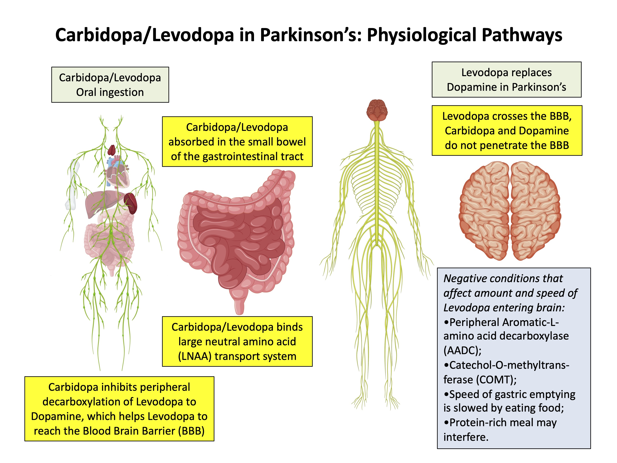
Notes:
Very important to understand how this medication works: carbidopa is a decarboxylase inhibitor ( inhibits peripheral metabolism of levodopa)- it prevents levodopa from being broken down before it reaches the brain= more ldopa available to CNS. Then levodopa crosses the blood brain barrier and is converted into dopamine
CANNOT give carbidopa alone- will not help with PD symptoms & levodopa alone would cause severe GI side effects

Slide 15
Slow low Titration recommended
Notes:
Start within 30min of waking up
Schedule varies between 3-6 hrs apart
Avoid medication at bedtime
Buy in for TID dosing-goal is during meals
Protein and c/l
Use UPDRS (unified pd rating scale) to score
Re-evaluate after med start 6-8 weeks

Slide 16
Common side effects
Nausea & vomiting
constipation
hypotension
Make sure taking with food not on empty stomach
If they continue to have nausea then they need lodosyn/carbidopa
This is in addition to current carb/levo dose and 1 tab per carb/levo dose
Slower motility due to age
Slower motility due to Parkinsons
Anticholingergic effects of ldopa
Carb/levo unable to be absorbed in small intestine
Please check sitting and standing BPs on PD patients
Directly related to PD
Directly related to Sinemet
Fludrocortisone OR midodrine
Notes:
Straining or hard stools
Ldopa delays gastric emptying
Ldopa absorbed in small intestine

Slide 17
Less common side effects
Hallucination
Dyskinesias- involuntary
Notes:
Dose dependent
Hallucinations that are scary-intrusive should be addressed
There are subtle hallucinations that can occur
Dyskinesias occur with peak dose, abnormal movements
https://www.youtube.com/watch?v=Q432Ao4kPh0
Patients are often afraid of side effects of medication and classification

Slide 18
Poll Questions
How do we treat dyskinesias?
How do we treat hallucinations?

Slide 19
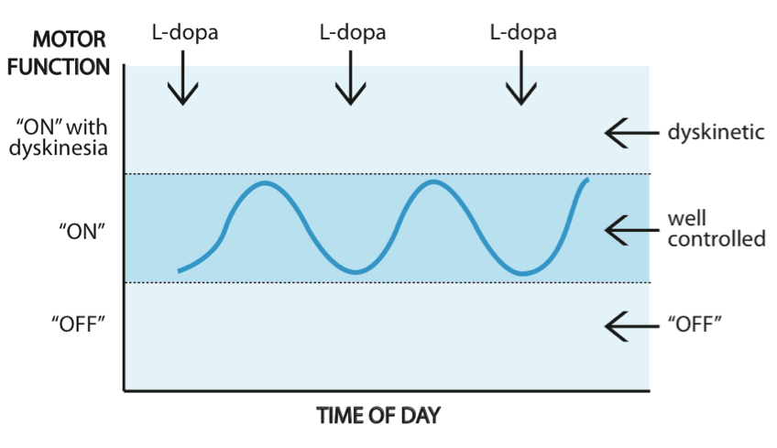
ON OFF periods
Notes:
Some patients do not have these fluctuations
As the disease progresses the “on off” swings become less closely related to the timing of a dose of ldopa
May feel worse early morning and evening
Aggravations of medication not working well physical and emotional triggers

Slide 20
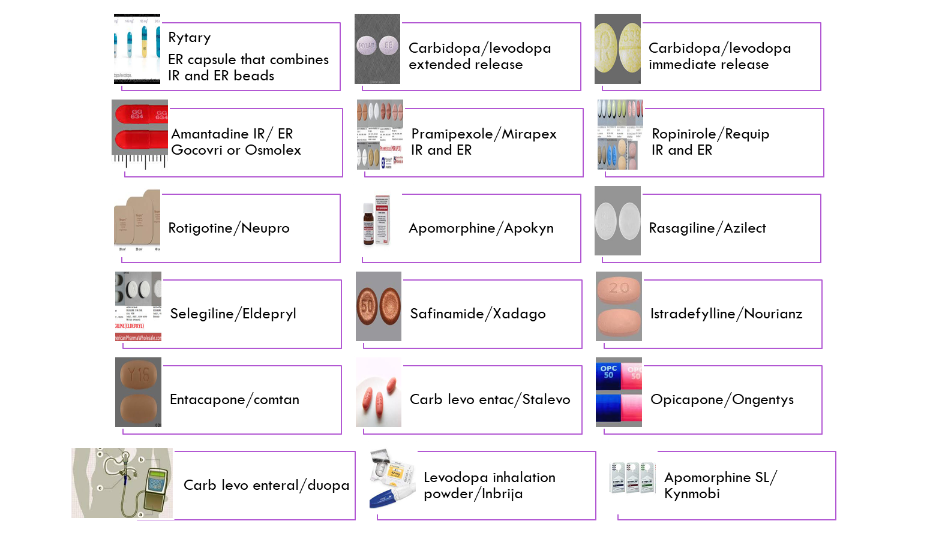
Notes:
OFF times
Quick ON-patients can chew IR use carbonation
Liquids IR meds
Disintegrating-shortage
IR vs ER
Apokyn-20min ON

Slide 21
Medications that may be contraindicated in Parkinson disease
D2 Receptor Blockers
  Antipsychotics
  Nausea/GI
Medications that may cause confusion
  Anticholinergics
  Benzodiazepines
  Muscle relaxer
  Sleep meds
  Pain meds
Antidepressants
https://www.apdaparkinson.org/wp-content/uploads/2018/05/APDA-Meds_to_Avoid.pdf
Notes:
D2 blockers (dopamine) receptors which can worsen PD
Pain meds- psychosis and constipation
Anesthesia- in case patients on are on a MAO B inhibitor (Selegiline)
Antidepressants- depending on other PD meds can be problematic

Slide 22
When to refer
Complicated history and exam
Reasonable trial of basic medications
PD vs ET OR PD and ET
Patient not tolerating meds
Surgical candidacy
Notes:
Non motor: cognitive changes, constipation, mood, drooling, orthostatic hypotension, psychosis, sleep disturbance, vision issues, fatigue

Slide 23
Comprehensive Movement disorder center
Phone: 505-272-0664
Fax: 505-272-0439
Tiger connect Melanie Stewart
mcostales@salud.unm.edu

Slide 24
References
https://www.parkinson.org/understanding-parkinsons/what-is-parkinsons
https://parkinsonsdisease.net/basics/pathophysiology-what-is-it
https://pubmed.ncbi.nlm.nih.gov/17447410/
https://www.aans.org/en/Patients/Neurosurgical-Conditions-and-Treatments/Parkinsons-Disease#:~:text=Studies%20have%20shown%20that%20symptoms,muscle%20cells%20involved%20in%20movement.
https://www.parkinson.org/understanding-parkinsons/statistics#:~:text=A%202022%20Parkinson's%20Foundation%2Dbacked,rate%20of%2060%2C000%20diagnoses%20annually
Cleveland Clinic Center for Continuing education Tremor https://www.clevelandclinicmeded.com/medicalpubs/diseasemanagement/neurology/tremors/

