Slide 1
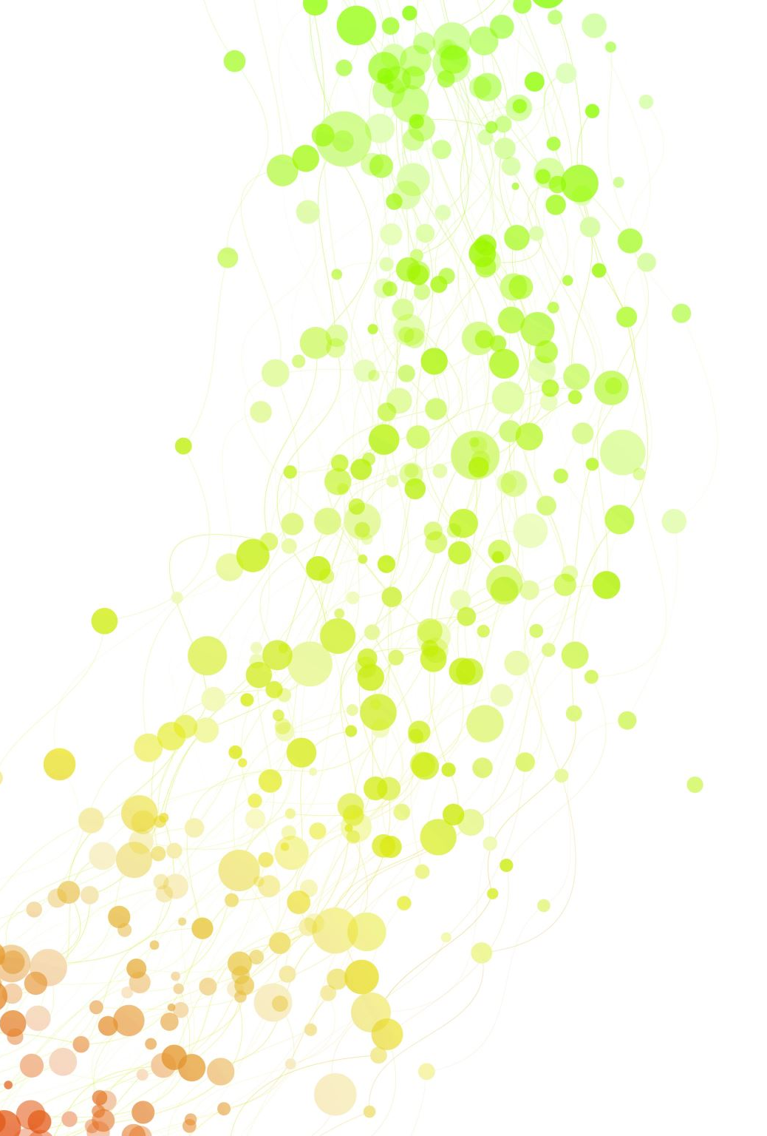
Error Prevention and Pharmacist Interventions: A Retrospective Analysis in a Long-term Care Setting.
Turning Errors Into Opportunities
NMPhA Mid Winter Meeting
January 24, 2021
Presented By:
Rebecca DeMoss PharmD, BS
rvanvleck06@gmail.com
Allen de Somer PharmD Candidate 2021

Slide 2
Pharmacist Learning Objectives:
Outline a process that could aid in preventing medication errors.
Describe common techniques to prevent medication errors in a pharmacy.
Describe the most common prescribing errors in a long-term care setting.
Identify the most common clinician interventions made in a long-term care setting.
Identify processes improvement techniques for detecting and managing medication errors.
Discuss how essential pharmacists and pharmacy technicians are in preventing errors, correcting prescriptions, and making appropriate life-saving interventions.

Slide 3
Pharmacy Technician Learning Objectives:
Outline a process that could aid in preventing medication errors.
Describe common techniques to prevent medication errors in a pharmacy.
Describe the most common prescribing errors in a long-term care setting.
Discuss how essential pharmacists and pharmacy technicians are in preventing errors, correcting prescriptions, and making appropriate life-saving interventions.

Slide 4

Pilot Project
Error Prevention and Pharmacist Interventions, a retrospective analysis in a long-term care setting.

Slide 5
Background
Preventable medication errors are a considerable financial burden on the healthcare system, affect patient quality of life, and ultimately may increase both morbidity and mortality.
A systematic search was conducted of the relevant peer-reviewed research published between January 1, 2000, and October 1, 2015, in English, French, German, or Spanish examining serious outcomes of medication errors (MEs) in NHs residents.
  MEs were common, involving 16-27% of residents in studies examining all types of MEs
  13-31% of residents in studies examining transfer-related MEs
  75% of residents were prescribed at least one potentially inappropriate medication.
Many of these residents have multiple comorbidities and polypharmacy, leading to a need for dose adjustments and extensive review for drug-drug interactions.
Lisa L. Dwyer, Beth Han, David A. Woodwell, Elizabeth A. Rechtsteiner,. Polypharmacy in nursing home residents in the United States: Results of the 2004 National Nursing Home Survey,The American Journal of Geriatric Pharmacotherapy, Volume 8, Issue 1, 2010, Pages 63-72
Ferrah N, Lovell J. et al. Systematic Review of the Prevalence of Medication Errors Resulting in Hospitalization and Death of Nursing home Residents. J AM Geriatr Soc. 2017 Feb; 65(2):433-442.
Notes:
Residents in a long-term care setting are at a greater risk for becoming a victim of inappropriately prescribed medications and potential medication interactions.

Slide 6
Methods
A retrospective cohort design over a one-year period
Medication orders for patients at multiple long-term care facilities in New Mexico were reviewed and evaluated by pharmacists at a central dispensing pharmacy.
All prescriptions that were processed through the point-of-sale system were considered eligible for review. These prescriptions were canceled by a pharmacy team member due to the error caught and were never dispensed.
Medication errors and subsequent pharmacist interventions were identified by reviewing the point-of-sale system for cancelled prescriptions and grouped into categories.
The groups were based on the clinical impact and were divided into various subcategories for further analysis.
Once the medication errors were identified, the results were then described and grouped into categories of various types of pharmacist interventions.
If a prescription contained multiple errors and subsequent interventions these were categorized in their own grouping.

Slide 7
Results
Total of 215,914 prescriptions being processed by the central dispensing pharmacy.
22,514 patients with an average of 6 to 9 prescriptions per patient
A total of 205 medication errors were identified through the point-of-sale system.

Slide 8
Results continued
Table 1
Categories | Interventions
IR vs. ER | 39
Missing Info/Clarification | 25
Unavailability | 22
Dosing/Frequency | 21
Cost | 16
End of Therapy | 14
Wrong formulation | 13
Ease of administration | 12
Max dosing | 8
Therapeutic Indication | 7
Duplicate Therapy | 6
Allergy | 6
Law | 5
Wrong drug/indication | 5
Drug-drug interaction | 4
G-tube clarification | 2
Total | 205
16 categories of medication errors identified
The most common individual medication error was an incorrect immediate-release or extended-release formulation chosen.
The second most common medication error was missing information or the need to clarify an item on the prescription.
12 order sets were identified that included multiple interventions (duplicate or triplicate errors)

Slide 9
Results continued
Table 2
Categories | Interventions
Clinical Interventions | 54
Quality of Life | 52
Clerical | 30
Dosing/Frequency Errors | 21
Wrong Drug Indication/Formulation | 18
Unintended Patient Harm | 16
End of Therapy | 14
Total | 205
The types of medication errors were then reclassified and organized by intervention type.
The analysis concluded with 7 identified types of interventions.
Clinical interventions made up most of the errors accounting for 26% of the overall data.

Slide 11
Limitations
The utilization of the point-of-sale service and triaging for cancelled prescriptions
  Numerous pharmacist interventions can occur before the prescription is processed.
If the medication error was identified before the prescription was processed, the medication error and subsequent intervention would not be captured and included in our study.

Slide 12
Discussion
Interventions can often lead to a point of confrontation among healthcare professionals. This is where an area of confrontation can turn into a moment of education and opportunity.
The findings from this study suggest that pharmacists play a key role and are a vital and necessary addition to any healthcare team

Slide 13

Turning Errors into Opportunities
Notes:
We need to stop and think
We have so many error reporting systems, or statistics about how many errors we make, but there really is not a lot of discussion on HOW to prevent the error. Hopefully by the end of this presentation we all can be more prepared on how to catch these errors, how to prevent further errors from occurring, and how to approach the health care provider when we have detected an error to hopefully get an accepted clinical intervention . This is why this lecture is titled “turning errors into opportunities” because really they are. Each moment we get to make a clinical recommendation we have the opportunity to education and further guide to enable our abilities as a team to not make the same mistake again.
How do we catch a medication error- Stop and think about your process. (Does it come naturally, do you stop and review each order for completeness. Do you have a step wise approach)
For the rest of the lecture, we will be going over the more severe errors that were identified during the analysis and together we will go through our pharmacy approach. How we identified the error, how we approached the providers in hopes of education all of you here, so the errors do not occur I your pharmacy and in hopes of educating everyone here to be better communicators and ensure that all your clinical interventions are accepted.

Slide 14
Poll Question
Have you made a medical or dispensing error?
Yes
No

Slide 15
Statistics of Medication Errors
Estimated dispensing accuracy in community pharmacy is 98.35%
  It is estimated a pharmacist will fill 1.5 million prescriptions in their career= 25,500 errors during the CAREER
440,000 deaths in America occur each year due to PREVENTABLE medical errors
  1,000 people every day=capacity of 2 JUMBO JETS!!
Root Cause Analysis Workbook for Community/ Ambulatory Pharmacy [Brochure]. (n.d.) Horsham, PA: Institution for Safe Medication Practices
James, John T., The Journal of Patient Safety (Sept. 2013, V3, I3, pp.322-328.
Notes:
These numbers show us our ability to make errors, but what about the near misses. How do we turn an error into a near miss?

Slide 16
Our minds are against us!
Proofreading-our minds fill in the blanks or what we EXPECT to be there
“I cdnuolt blveiee that I cluod aulaclty uesdnatnrd what I was rdanieg.
The phaonmneal pweor of the hmuan mnid, aoccdrnig to a rscheearch
at Cmabrigde Uinervtisy, it dseno’t mtaetr in what oerdr the ltteres in a
word are, the olny iproamtnt tihng is that the frsit and last ltteer be in
the rghit pclae. The rset can be a taotl mses and you can still raed it
whotuit a pboerlm. This is bcuseae the huamn mnid deos not raed
ervey lteter by istlef, but the word as a wlohe. Azanmig huh? Yaeh and I
awlyas tghuhot slpeling was ipmorantt!”
Notes:
Why is it so dang hard to catch our own errors?
Who can read this- feel free to chat yes or no
Most of us do not get the luxury of a two person check.. Our minds really are against us.

Slide 17
Detecting Errors
“How could you have missed that?” OR “Who caused this error?”
Movie depicted basketball game, and the researchers asked the participants to count how many passes occurred between the two groups of players.
During the experiment, a gorilla is seen in the video
40% of people failed to see the gorilla
HOW we focus our attention is key, and it determines if we can “see” something that is unexpected
Notes:
Recently attended a FreeCE lecture by Kevin Hope- if further interested in preventing/detecting medication errors, great CE to gain further tools and knowledge.
The Invisible Gorilla is a book published in 2010, co-authored by Christopher Chabris and Daniel Simons. This title of this book refers to an earlier research project by Chabris and Simons revealing that people who are focused on one thing can easily overlook something else.
*take out your phone example

Slide 18
Selective Attentive Tests
https://www.youtube.com/watch?v=_bnnmWYI0lM
OR
https://www.youtube.com/watch?v=EzC_sHTW43c
OR
TEDTalk; Apollo Robbins-The art of misdirection
https://www.youtube.com/watch?v=GZGY0wPAnus
When we are too focused on ONE thing, we FAIL to see more
Notes:
Another great test is the SAT. This test really shows that HOW we focus our attention allows for our ability to catch discrepancies.
Interesting that as you are watching these, I knew what kind of test. So I knew to look for something else. But in tern, decreased my ability to actually correctly guess what was asked of in the video.
Attention is what controls our perception

Slide 19

“Attention is a powerful thing, and it shapes our reality”

Slide 20
How to identify medication errors?
Stepwise prescription verification process
5 (or 8) Rights of Medication Administration
Always utilizing drug references (Lexicomp, Micromedex, GlobalRph, etc)
Dual pharmacist/technician check
Patient counseling
  3 prime questions
Continuous quality improving (CQI) and Root Cause Analysis
Failure mode and effects analysis (FEMA)
Subscribing/Alerts from companies that report the most common errors can contributing factors (ISMP, ECRI)
Phone/Text a friend
Others?
https://www.pharmacist.com/article/prevent-medication-errors-fmea
Notes:
Others CQI and RCA after error occurred, but can also use them for near misses
FEMA systematically identify areas of potential failure within a process and gauge what the effects would be—before an error takes place
ECRI- Emergency Care Research Institute- combined forces with ISMP in august of 2020
*I encourage everyone to utilize the chat box to included helpful ways you identify med errors in your practice setting

Slide 21
Stepwise Verification Process
Step 1
  Take a breath
Step 2
  Think BIG picture –WHO is getting WHAT
  Does it make sense?
J. Poquette. Prescription Verification Tips for the NEW Pharmacist or Student. http://www.thehonestapothecary.com/2015/01/22/prescription-verification-tips-for-the-new-pharmacist-or-student/. Accessed December 16, 2020.
Notes:
From the honest apothecary
-Take a breath means to reset, if you were interrupted, or a difficult patient, take time to be in the moment, ensure you are 100% focused on the verification process
-Don’t worry about the details just yet, does the order make sense, does it make sense considering their age, diagnosis, or gender

Slide 22
Stepwise Verification Process
Step 3
  Check the DETAILS
  Check hard copy prescription against what is on the bottle/what is typed
  BIG 3
    Patient name and date of birth
    Drug name, strength and quantity
    Directions* (NOT merely that they MATCH, but do they make SENSE and are REASONABLE)
  More important items
    Prescriber
    Number of refills
    Prescription date/legal concerns
    Patient allergies
    Day’s supply
    Billing & copay, insurance and reimbursement
J. Poquette. Prescription Verification Tips for the NEW Pharmacist or Student. http://www.thehonestapothecary.com/2015/01/22/prescription-verification-tips-for-the-new-pharmacist-or-student/. Accessed December 16, 2020.

Slide 23
Stepwise Verification Process
Step 4
Check the PROFILE
  Potential drug-drug interactions
  Potential drug-disease interactions
  Patient history (example: history of ER, and new prescriptions for IR)
Utilizing Prescription Drug Monitoring Program (PDMP)
J. Poquette. Prescription Verification Tips for the NEW Pharmacist or Student. http://www.thehonestapothecary.com/2015/01/22/prescription-verification-tips-for-the-new-pharmacist-or-student/. Accessed December 16, 2020.

Slide 24
5 (or 8) Rights of Medication Administration
Right Patient
Right Drug
Right Dose
Right Route
Right Time
Right Reason
Right Drug Formulation
Right Line
Institute for Healthcare Improvement. Improvement Stories. http://www.ihi.org/resources/Pages/ImprovementStories/FiveRightsofMedicationAdministration.aspx. Accessed December 16, 2020.

Slide 25
Patient Counseling
3 Prime questions
      What did the prescriber tell you this medication is for
      How did the prescriber tell you to take the medication
      What did the prescriber tell you to expect from taking this medication?
Teach back method
Active listening
Empathetic approach
Hanh thi Nguyen. The prime questions in authentic patient’s consultations: A call for additional research on current and new paradigms. Sapharm.2012.04.007.
Notes:
Creating empathy and actively listening enhances the ability for the pharmacist to make a connection and potentially catch errors

Slide 26

Last but not least…
Pharma Sense
Notes:
Tom Holland playing Spiderman in the most recent Marvel Movies

Slide 27
Common Errors in LTC
Table 1
Categories | Interventions
IR vs. ER | 39
Missing Info/Clarification | 25
Unavailability | 22
Dosing/Frequency | 21
Cost | 16
End of Therapy | 14
Wrong formulation | 13
Ease of administration | 12
Max dosing | 8
Therapeutic Indication | 7
Duplicate Therapy | 6
Allergy | 6
Law | 5
Wrong drug/indication | 5
Drug-drug interaction | 4
G-tube clarification | 2
Total | 205
Table 2
Categories | Interventions
Clinical Interventions | 54
Quality of Life | 52
Clerical | 30
Dosing/Frequency Errors | 21
Wrong Drug Indication/Formulation | 18
Unintended Patient Harm | 16
End of Therapy | 14
Total | 205
Notes:
The information and discussion of the errors in terms of pharmacology and pharmacokinetic information is an overview,

Slide 28
IR vs ER
Previous order was:
Phenytoin ER Capsules
  3 capsules at bedtime
What should be clarified on this order?

Slide 29
Phenytoin (Dilantin™️)
Immediate Release | Extended Release
Tablets (Dilantin Infatabs™️) → 50mg (Chewable) Suspension→ 125mg/5ml Injection→ 50mg/ml (2ml/5ml) | Capsules→ 100mg, 200mg, 300mg Dilantin™️→ 30mg, 100mg Phenytek™️→ 200mg, 300mg
Divided in 2 to 3 doses per day | Divided in 1 to 2 doses
Time to peak→1.5-3 hours | Time to peak→ 4 to 12 hours
https://online.lexi.com/lco/action/doc/retrieve/docid/patch_f/7489?cesid=2LWm6CHT7lB&searchUrl=%2Flco%2Faction%2Fsearch%3Fq%3Dphenytonin%26t%3Dname%26va%3Dphenytonin#rftlist
Notes:
5 half-lives to clear a drug
Half-life- cannot really use as a deciding factor, due to Dilantin's elimination is not first-order kinetics- it follows the Michalis-Menton, half-life increases with increasing phenytoin concentrations; best described using parameters such as V_{max} and K_{m} (Patsalos 2008).

Slide 30
Key Points from Error
Phenytoin (Dilantin™️)
Converting from ER capsules to oral solution needs to be converted to multiple administrations instead of daily.

Slide 31
IR vs ER
What should be clarified on this order?

Slide 32
Metoprolol Tartrate (Lopressor ™️) vs Metoprolol Succinate (Toprolol XL™️)
Immediate Release Strengths: Available: Tablet→25mg, 37.5mg, 50mg, 75mg 100mg Injectable→5mg/5ml Oral Solution→ 10mg/ml | Extended Release Strengths: Available Tablet→ 25mg, 50mg, 100mg, 200mg Capsule (Kapspargo Sprinkle™️)→ 25mg, 50mg, 100mg, 200mg
Duration of Action→ (dose related) 3.3-6.4 hours | Duration of Action→ ~24 hours
Typically given twice daily (at lower strengths <25mg given once daily) | Given once to twice daily* (Twice daily dependent on heart rate control)
CAN be crushed | Tablets CANNOT be crushed
CAN by cut in half | Tablets CAN by cut in half
Available as liquid for G-Tube/PEG-Tube | Sprinkle Capsules: CAN by opened over food NG-Tube- CAN by opened and put in all plastic oral tip syringe with 15ml of water. Shake for ~10 sec and deliver medication
https://online.lexi.com/lco/action/doc/retrieve/docid/patch_f/7287?cesid=5qUQvg0oXzz&searchUrl=%2Flco%2Faction%2Fsearch%3Fq%3Dmetroprolol%26t%3Dname%26va%3Dmetroprolol
Notes:
Maximum 400mg daily

Slide 33
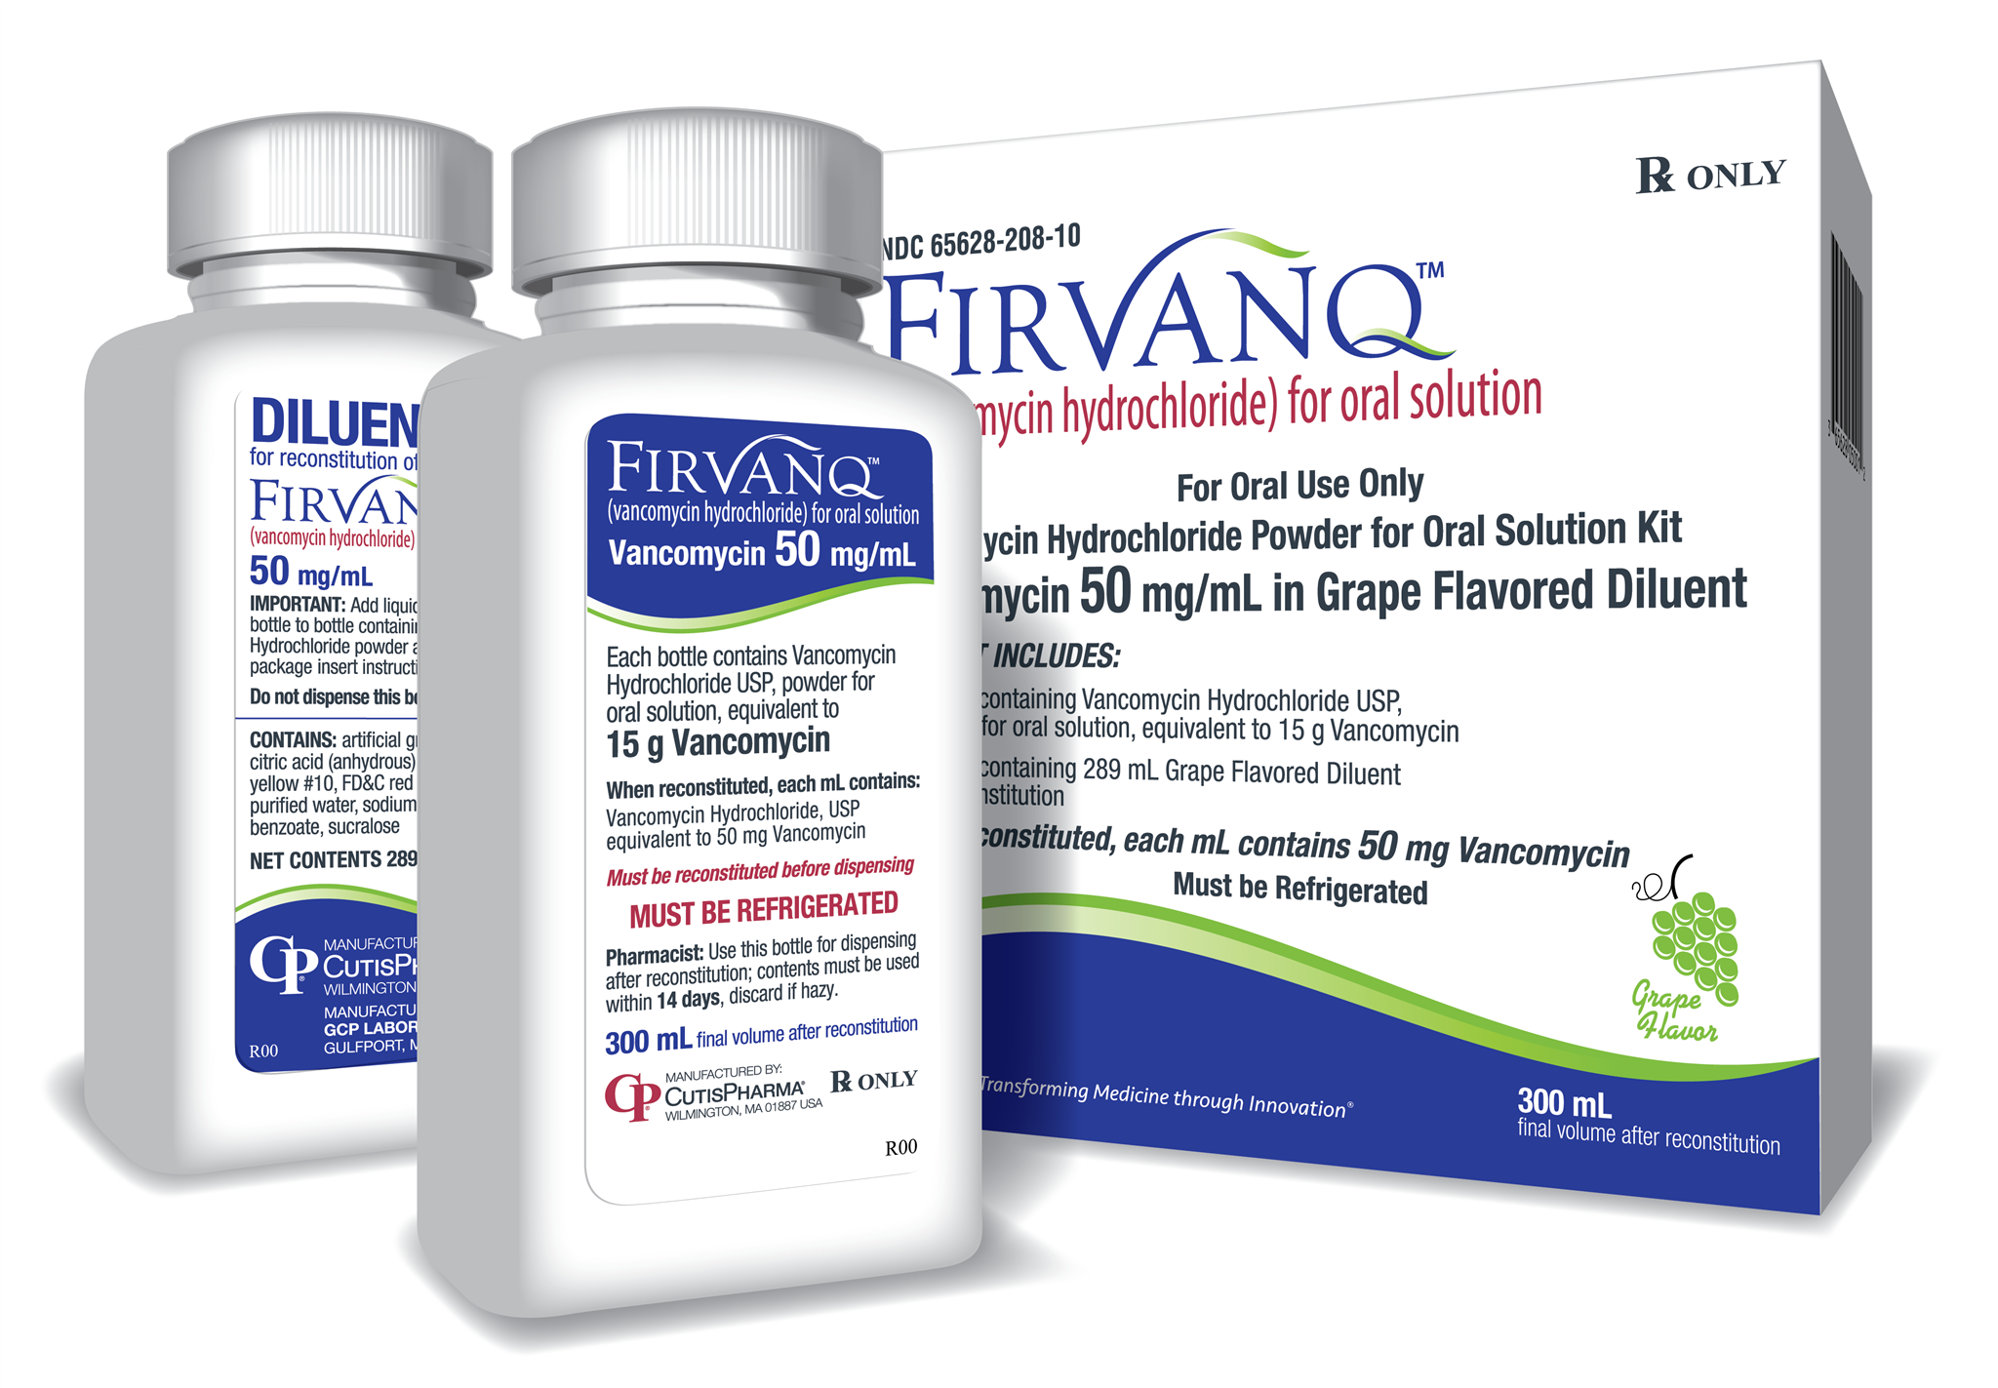
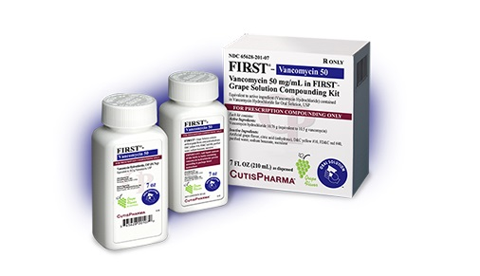
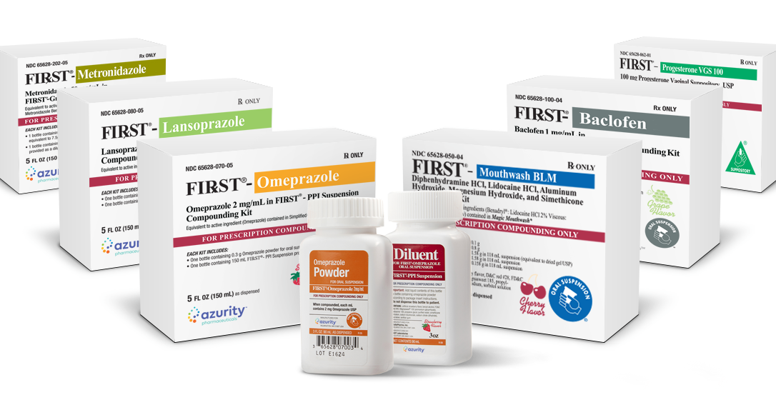
Compounding Kits
https://azurity.com/compounding-kits/, https://www.empr.com/drug/firvanq/
Notes:
Remind regarding extemporaneously compounding, section 503A of Food, Drug, and Cosmetic Act- if currently doing this at hospital or practice, may violate this act.

Slide 34
Key Points from Error
Metoprolol Succinate (Toprolol XL™️) vs Metoprolol Tartrate (Lopressor ™️)
Tartrate formulation
  Dosed twice daily (unless low dose for indication)
  Can be crush or cut in half
Succinate formulation
  once to twice daily
  Can be cut in half
  DO NOT CRUSH→ use IR formulation or Suspension

Slide 35
IR vs ER
What should be clarified on this order?

Slide 36
Diltiazem (Cardizem ™️, Cartia XT ™️, Taztia XT ™️, Dilt-XR ™️, Etc…)
Immediate Release | Extended Release | Controlled Delivery (CD)
Tablets→ 30mg, 60mg, 90mg, 120mg Injectable→ 100mg powder, 5mg/5ml, 25mg/5ml, 125mg/25ml, 50mg/10ml | Capsules→ 60mg, 90mg, 120mg | Capsules→ Cadizem CD™️ comes in 120mg, 180mg, 240mg, 300mg and 360mg strengths Tiazac™️ comes in 120mg, 180mg, 240mg, 300mg, 360mg, 420mg strengths Cartia XT™️ comes in 120mg, 180mg, 240mg and 300mg strengths Diltia XT™️ comes in 120mg, 180mg and 240mg strengths Taztia™️ comes in 120mg, 180mg, 240mg, 300mg and 360mg strengths Dilacor XR™️ comes in 120mg, 180mg and 240mg strengths Tablets--> Cardizem LA™️ comes in 120mg, 180mg, 240mg, 300mg, 360mg and 420mg
Doses in 3-4 divided doses | 2 divided doses | Daily
Maximum→ 240mg-360mg/day | Maximum→ 240mg-360mg/day | Maximum→ 240mg-360mg/day
http://www.thehonestapothecary.com/2016/09/03/diltiazem-dilemmas-why-so-many-diltiazems/
https://online.lexi.com/lco/action/doc/retrieve/docid/patch_f/6753?cesid=6zTdlBN6wP2&searchUrl=%2Flco%2Faction%2Fsearch%3Fq%3DdilTIAZem%26t%3Dname%26va%3DdilTIAZem
Notes:
Honestly I can make a whole lecture on understanding and differences between the formulations of diltiazem.
Diltiazem comes is so many different formulations and strengths
In US-10 different brand names
In Canada-22 different brand names

Slide 37
Diltiazem (Cardizem ™️, Cartia XT ™️, Taztia XT ™️, Dilt-XR ™️, Etc..)
Immediate Release | Extended Release | Controlled Delivery (CD)
Half-Life→3 to 4.5 hours | Half-Life→ 6 to 9 hours | Half-Life→ 4 to 9.5 hours
Time to peak→ 2 to 4 hours | Time to peak→ 11 to 18 hours | Time to peak→ 10-14 hours
http://www.thehonestapothecary.com/2016/09/03/diltiazem-dilemmas-why-so-many-diltiazems/
https://online.lexi.com/lco/action/doc/retrieve/docid/patch_f/6753?cesid=6zTdlBN6wP2&searchUrl=%2Flco%2Faction%2Fsearch%3Fq%3DdilTIAZem%26t%3Dname%26va%3DdilTIAZem

Slide 38
Key Points from Error
Diltiazem (Cardizem ™️, Cartia XT ™️, Taztia XT ™️, Dilt-XR™️, Etc..)
Understand formulation
  IR only comes as tablets
  ER (12 hour) only comes as capsules→ may indicate 12 hour on bottle
  CD (24 hour) comes as tablets and capsules BUT→ starts at higher dosing strengths of 120mg
Organize the medication bottles by how many times per day that formulation is usually dosed and mark shelves clearly
http://www.thehonestapothecary.com/2016/09/03/diltiazem-dilemmas-why-so-many-diltiazems/
https://online.lexi.com/lco/action/doc/retrieve/docid/patch_f/6753?cesid=6zTdlBN6wP2&searchUrl=%2Flco%2Faction%2Fsearch%3Fq%3DdilTIAZem%26t%3Dname%26va%3DdilTIAZem

Slide 39
Key Points from IR VS ER Error
Important to verify strength and identify if directions should be modified to daily or in divided doses
Additional medications to clarify regarding potential IR vs ER errors
  Divalproex (Depakote ™️)
    IR formulation given in divided doses
    ER given once daily
  Levetiracetam (Keppra ™️)
    IR formulation given twice daily
  Venlafaxine (Effexor ™️)
    IR formulation given in divided doses
    ER given once daily

Slide 40
Dosing/Frequency Clarification
What should be clarified on this order?
What other medication could this order be for?

Slide 41
Lantus™️ (Insulin Glargine)
Long-Acting Insulin
100 units/ml Basaglar™️ KwikPen Lantus™️ Lantus Solostar™️ Pen Semglee™️ Pen 300 units/ml Toujeo™️ Pen
TDD in 1 or 2 divided doses
Onset of action→ 3-4 hours (Toujeo™️-6 hours)
Duration→ 10.8-24 hours (up to 30 hours)
Time to peak→~ 12 hours (Toujeo™️ 12-16 hours)
https://online.lexi.com/lco/action/doc/retrieve/docid/patch_f/7162?cesid=32rXCp55Psg&searchUrl=%2Flco%2Faction%2Fsearch%3Fq%3Dkeppra%26t%3Dname%26va%3Dkeppra

Slide 42
Key Points from Error
Typical dosing is 1 or 2 divided doses depending on blood sugar patterns, any more frequent dosing could have long-acting repercussions on blood sugar and be dangerous.

Slide 43
Wrong Formulation
What should be clarified on this order?
What other medication could this order be for?

Slide 44
Key Points from Error
Provider is wanting to change from nebulizers to an oral formulation of budesonide due to CDC recommendations for decreasing COVID transmission.
Oral budesonide available in two forms Pulmicort™️ HFA and Entocort™️ EC
Pulmicort™️ HFA indicated COPD
Entocort™️ EC FDA indicated for Crohn disease or Ulcerative colitis
Knowing the differences in indications for the different formulations is key to preventing this type of error.
https://online.lexi.com/lco/action/doc/retrieve/docid/patch_f/5725313?cesid=2yvr7B9KnPS&searchUrl=%2Flco%2Faction%2Fsearch%3Fq%3Dbudesonide%252520oral%26t%3Dname%26va%3Dbudesonide%252520oral

Slide 45
Wrong Formulation
What should be clarified on these orders?

Slide 46
Nitrofurantoin (Macrodantin™️ /Macrobid™️)
MacroDANTIN™️→ Nitrofurantoin macrocrystals | MacroBID™️→ Nitrofurantoin macrocrystals/monohydrate
Capsules→ 25mg, 50mg and 100mg Suspension→ 25mg/5ml | Capsule→ 100mg
50 to 100mg in 4 divided doses 50 to 100mg daily for prophylaxis | 100mg twice daily for active infection 100mg daily for prophylaxis
 | Monohydrate formulation more slowly absorbed by forming a gel-like matrix
Renal dose adjustment <60ml/min not recommended
https://online.lexi.com/lco/action/doc/retrieve/docid/patch_f/7344?cesid=0cXt2tzUASR&searchUrl=%2Flco%2Faction%2Fsearch%3Fq%3Dnaproxen%26t%3Dname%26va%3Dnaproxen

Slide 47
Key Points from Error
Understanding difference between the macrocrystals and monohydrate guide the dosing strategies.
Recommend providers using Brand names instead of choosing the generic. Choosing the generic formulation often ends in the incorrect formulation chosen.

Slide 48
Max Dosing
What should be clarified on this order?

Slide 49
Bimatoprost (Lumigan™️/Latisse™️)
Lumigan™️: 0.01% 0.03% Latisse™️: 0.03%
Lumigan™️ → Glaucoma- treatment for elevated intraocular pressure Latisse™️ → Eyelash growth (hypotrichosis)
Lumigan™️- 1 drop to affected eye daily More frequent dosing may decrease IOP lowering effects Latisse™️- Apply to base of eyelashes once daily More frequent dosing may increase side effect profile
https://online.lexi.com/lco/action/doc/retrieve/docid/patch_f/7162?cesid=32rXCp55Psg&searchUrl=%2Flco%2Faction%2Fsearch%3Fq%3Dkeppra%26t%3Dname%26va%3Dkeppra

Slide 50
Key Points from Error
Both formulations of bimatoprost are dosed daily, any different dosing strategies is not recommended.

Slide 51
Max Dosing
What should be clarified on this order?

Slide 52
Ipratropium and Albuterol (Combivent Respimat™️ )
Combivent™️ | Combivent Respimat™️
CFC-propelled Inhaler- Discontinued in 2013 | Non-CFC propelled Inhaler
2 puffs by mouth 4 times daily | 1 puff 4 to 6 times daily
Maximum 12 puffs daily | Maximum of 6 puffs daily
https://online.lexi.com/lco/action/doc/retrieve/docid/patch_f/7114?cesid=3TJKURg3QLc&searchUrl=%2Flco%2Faction%2Fsearch%3Fq%3Dcombivent%26t%3Dname%26va%3Dcombivent#monograph-tab-content
Notes:
Chloroflurocarbons- which are no longer used in any inhaler

Slide 53
Key Points from Error
Combivent is still a choice in many OE systems, we all need to know the change in dosing and max dosing recommendations.

Slide 54
Max Dosing
What should be clarified on this order?

Slide 55
Apixaban (Eliquis™️)
Factor Xa Inhibitor
Treatment dosing always has loading dose followed by prophylaxis dosing
DVT/PE treatment: 10mg twice daily for 7 days → 5mg twice daily Heparin Induced Thrombocytopenia (HIT) 10mg twice daily for 7 days → 5mg twice daily
https://online.lexi.com/lco/action/doc/retrieve/docid/patch_f/3804162?cesid=ac7WpsIHSPA&searchUrl=%2Flco%2Faction%2Fsearch%3Fq%3Deliquis%26t%3Dname%26va%3Deliquis

Slide 56
Key Points from Error
Key differences between treatment/loading dosing and prophylactic dosing
Need to identify if patient needs the treatment/loading dose or is on the maintenance/prophylactic dosing
Understanding ALL treatment/loading dose is for 7 days only, extending the time frame could lead to unintended patient harm.
Can occur with many other medications
  Amiodarone
  Xarleto ™️
  Others?
Notes:
Can you think of others? Feel free to chat them

Slide 57
Wrong Drug/Indication
What should be clarified on this order?

Slide 58
HydrALAZINE | HydrOXYZINE HCL Tablet HydrOXYZINE Pamoate Capsule
FDA indication for hypertension | FDA indication for anxiety/dermatitis
Tablets→ 10mg, 25mg, 50mg, 100mg Injection→ 20mg/ml | Tablets→ 10mg, 25mg, 50mg Capsules→ 25mg, 50mg, 100mg Solution→ 10mg/5ml
https://online.lexi.com/lco/action/doc/retrieve/docid/patch_f/7034?cesid=451efC5foYM&searchUrl=%2Flco%2Faction%2Fsearch%3Fq%3DhydrALAZINE%26t%3Dname%26va%3DhydrALAZINE
https://online.lexi.com/lco/action/doc/retrieve/docid/patch_f/7034?cesid=451efC5foYM&searchUrl=%2Flco%2Faction%2Fsearch%3Fq%3DhydrALAZINE%26t%3Dname%26va%3DhydrALAZINE

Slide 59
Most Confused Drug Names (Sound Alike)
https://www.ismp.org/recommendations/confused-drug-names-list
https://www.ismp.org/recommendations/tall-man-letters-list
Some Examples:
Adderall™️/ Inderal™️ | Lodine™️/ codeine
Allegra™️/ Viagra™️ | metolazone/ methadone
Benadaryl™️/ benazepril | Mirapex™️/ Miralax™️
bupropion/ buspirone | naloxone / Lanoxin™️
clonidine/ Klonopin™️ | Prilosec ™️/ Prozac™️
Notes:
Think about when you or a nurse or you yourself as the pharmacist is taking a prescription over the phone→ very easy to confuse these medication

Slide 60
Key Points from Error
Identifying diagnosis will aid in dispensing correct medication for disease state.
Always repeat order or use teach back method to ensure correct medication was transcribed.

Slide 61
Poll Question
Do you feel comfortable making clinical recommendations?
Yes
No
Notes:
Thought provoking. Do you honestly feel comfortable making clinical recommendations in your day to day practice.

Slide 62
How to Effectively Make Clinical Interventions?
Build a rapport
Approach conversation with mutual respect for fundamental knowledge and time
Clarify order from their perspective BEFORE providing your point of view
Be prepared with references to build your case
  Gather useful information
    Medical references
    Family members
    Nursing staff
Keep the focus of the conversation on the patient
If error could cause patient harm
  Use Conscientious Objection law
  If used, be prepared to transfer prescription to a different pharmacy AFTER adequate counseling to patient and next pharmacy if possible.

Slide 63
7 Ways to Build a Rapport
Maintain Eye Contact
Show Empathy
Open Communication
Make it Personal
  Practice small talk
Active Listening
  Repeat to identify mutual understanding
Practice Mirroring
  Matching the patient’s demeanor or disposition
Keep Your Word
https://www.nursechoice.com/traveler-resources/how-to-build-rapport-with-patients-7-effective-tips-for-rns/
Notes:
This is from a nursing website about 7 ways to build a rapport with patients, however I believe these skills can be used in every relationship we need to build a rapport in

Slide 64
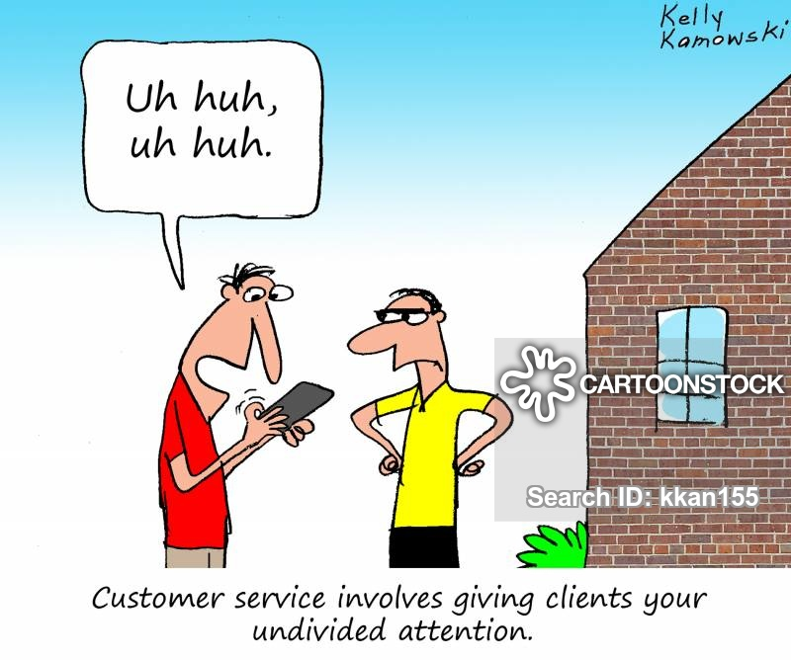
Thank You and
Questions ?? rvanvleck06@gmail.com
https://www.cartoonstock.com

Slide 65
References
Ferrah N, Lovell J. et al. Systematic Review of the Prevalence of Medication Errors Resulting in Hospitalization and Death of Nursing home Residents. J AM Geriatr Soc. 2017 Feb; 65(2):433-442.
Institute for Healthcare Improvement. Improvement Stories. http://www.ihi.org/resources/Pages/ImprovementStories/FiveRightsofMedicationAdministration.aspx. Accessed December 16, 2020.
J. Poquette. Prescription Verification Tips for the NEW Pharmacist or Student. http://www.thehonestapothecary.com/2015/01/22/prescription-verification-tips-for-the-new-pharmacist-or-student/. Accessed December 16, 2020.
Hanh thi Nguyen. The prime questions in authentic patient’s consultations: A call for additional research on current and new paradigms. Sapharm.2012.04.007.
Root Cause Analysis Workbook for Community/ Ambulatory Pharmacy [Brochure]. (n.d.) Horsham, PA: Institution for Safe Medication Practices
Prevent medication errors with FMEA. https://www.pharmacist.com/article/prevent-medication-errors-fmea. (Accessed December 27, 2020. )
Lexicomp https://online.lexi.com/lco/action/home
Honesty Apothecary. Diltiazem Dilemmas- Why So Many Diltiazems? http://www.thehonestapothecary.com/2016/09/03/diltiazem-dilemmas-why-so-many-diltiazems/ (Accessed January 2, 2021)
ISMP. https://www.ismp.org/resources/u-500-insulin-safety-concerns-mount-its-time-rethink-safe-use-strengths-above-u-100 (Accessed January 2, 2021)

Slide 66
References
Comparing Macrobid and Macrodantin. By Dr. Brian Staiger Pharm.D https://walrus.com/articles/comparing-macrobid-and-macrodantin#:~:text=Macrodantin%20contains%20nitrofurantoin%20in%20the%20macrocrystalline%20form.%20Macrobid,for%20Macrodantin%29%20and%20causes%20less%20gastrointestinal%20side%20effects.
http://thoracicandsleep.com.au/respiratory-inhalers/

