Slide 1
Pharmacist Technician Immunization Training Course
Live Course

Slide 2
Who’s still Excited?
After you get your certification, you will be able to administer Immunizations (IZ)…
Please Ensure you submit all of the following…
CPR certification
Live Course post-quiz
Live course NMPHA evaluation form
Vaccine skills checklist

Slide 3
Introduction
NMPhA presents the “NEW MEXICO PHARMACY TECHNICIAN IMMUNIZATION LIVE TRAINING COURSE.”
This course was created in collaboration with the University of New Mexico College of Pharmacy, the Department of Health New Mexico Immunization Coalition, the New Mexico Board of Pharmacy, and the New Mexico Pharmacists Association.
This course is accredited by the Accreditation Council for Pharmacy Education (ACPE).
ACPE #0104-0000-21-018-L06-T 2 contact hrs. / 0.2 CEUs / Initial Release Date: 12/19/20 / Expiration Date: 12/19/2023
Presenters:
Amy Bachyrycz, PharmD, Walgreen’s Patient Care Center Clinical Pharmacy Specialist; Clinical Assistant Professor, UNM College of Pharmacy, Albuquerque, NM
Alexandra Herman, PharmD, Assistant Professor - Clinical Educator, University of New Mexico College of Pharmacy Department of Pharmacy Practice & Administrative Sciences, Albuquerque, NM

Slide 4
Disclosures
Amy Bachyrycz, PharmD, has nothing to disclose and is not a paid speaker for any vaccine manufacturer or drug company. She is an NMPhA Immunization Trainer for Pharmacists, an NMPhA Trainer for pharmacy students at the University of New Mexico College of Pharmacy, and an APhA Trainer for Pharmacists & Technicians.
Alexandra Herman, PharmD, has nothing to disclose and is not a paid speaker for any vaccine manufacturer or drug company. She is an NMPhA Immunization Trainer for pharmacy students at the University of New Mexico College of Pharmacy.
Other Possible Presenter Disclosures.

Slide 5
Home Study Assessment exam review
1) As a New Mexico qualified pharmacy technician, now certified in immunizations, you are able to:
A) Order vaccines and maintain vaccine inventory.
B) Educate patients on the efficacy of vaccines.
C) Complete billing and documentation of vaccines given.
D) A and C

Slide 6
Home Study Assessment exam review
2) As In accordance with the New Mexico Board of Pharmacy Qualified Pharmacy Technician Childhood and COVID-19 Vaccine Administration and COVID-19 Testing Document (link included in the home study slides), the Mexico qualified pharmacy technicians can now vaccinate:
A) All ACIP approved vaccines, ages 3 to 64 and licensed/approved COVID-19 vaccines, ages 3 to 18.
B) All ACIP approved vaccines, ages 3 to 18 and licensed/approved COVID-19 vaccines, ages 3 to 64.
C) All ACIP approved vaccines, ages 3 to 18 and licensed/approved COVID-19 and influenza vaccines, ages 3 and above.
D) All ACIP approved vaccines, ages 3 to 18 and licensed/approved COVID-19 and influenza vaccines, ages 3 to 64.

Slide 7
Home Study Assessment exam review
3) In accordance with the New Mexico Board of Pharmacy Qualified Pharmacy Technician Childhood and COVID-19 Vaccine Administration and COVID-19 Testing Document (link included in the home study slides), the qualified pharmacist must:
A) Be certified to prescribe and administer immunizations.
B) Be readily and immediately available to directly supervise qualified pharmacy technicians.
C) Be in compliance with recordkeeping and reporting requirements.
D) Be performing all of the above.

Slide 8
Home Study Assessment exam review
4) An 18 year old patient comes to the pharmacy to receive an MMR vaccine, as her NMSIIS profile recommends, and in accordance with the ACIP catch up schedule for childhood vaccines. Which of the following situations would require the qualified pharmacy technician to request help from the Supervising Pharmacist?
A) Preparing the vaccine, including reconstitution.
B) Ordering a replenishment of MMR vaccine inventory.
C) Answering a question about a previous reaction to a vaccine.
D) Documentation of the MMR vaccine after administration.

Slide 9
Home Study Assessment exam review
5) In accordance with the New Mexico Board of Pharmacy Qualified Pharmacy Technician Childhood and COVID-19 Vaccine Administration and COVID-19 Testing Document (link included in the home study slides), the New Mexico qualified pharmacy technician must:
A) Complete and maintain CPR training and certification.
B) Complete 2 hours of immunization related ACPE-approved continuing education (CE) during the relevant state licensing period.
C) Inform the patient/parent, if 18 years or younger, about the importance of a well-child visit with a provider.
D) Complete all of the above.

Slide 10
Home Study Assessment exam review
6) In accordance with the New Mexico Board of Pharmacy Qualified Pharmacy Technician Childhood and COVID-19 Vaccine Administration and COVID-19 Testing Document (link included in the home study slides), the qualified pharmacist must:
A) Perform final verification of the vaccine after vaccine preparation.
B) Avoid counseling patients about vaccines and vaccine questions.
C) Not supervise more than two vaccinating technicians in a pharmacy setting at one time.
D) A and C

Slide 11
Home Study Assessment exam review
7) To maintain certification and continue immunizing patients in New Mexico, qualified technicians must:
A) Maintain CPR certification, complete 2 hrs immunization CE per licensing period, and receive 70% or better on both home study assessment exam and live course assessment post quiz.
B) Maintain CPR certification, purchase liability insurance, complete 2 hrs immunization CE per licensing period, and receive 70% or better on home study assessment exam and live course assessment post quiz.
C) Maintain CPR certification, purchase liability insurance, and OSHA training and certification.
D) All of the above.

Slide 12
Home Study Assessment exam review
8) Which of the following accurately defines the mechanism(s) of how vaccines work?
A) Vaccine or Antigen > T-Lymphocytes > Antibodies produced > Immediate and Full Protection Against Disease
B) Vaccine or Antigen > T-Lymphocytes > Antibodies Produced > Protection Against Disease Begins to Build
C) Antibodies > Macrophages > T-Lymphocytes > Immediate and Full Protection Against Disease
D) Antibodies > Immunoglobulin > Macrophages > Protection Against Disease Begins to Build

Slide 13
Vaccine mechanism of action
https://www.gavi.org/vaccineswork/what-are-viral-vector-based-vaccines-and-how-could-they-be-used-against-covid-19

Slide 14
Home Study Assessment exam review
9) After a patient receives the COVID-19 vaccine, one can expect immediate and full protection against the virus.
A) True
B) False

Slide 15
Home Study Assessment exam review
10) A patient reports being directly exposed to the confirmed Hepatitis B virus, which of the following are the best next steps for the qualified pharmacy technician to take:
A) Get the Supervising Pharmacist for referral and the Emergency Kit for possible treatment.
B) Get the Supervising Pharmacist for referral and give a Hepatitis B vaccination.
C) Get the Supervising Pharmacist for referral, as Hepatitis B Immune-Globulin is needed.
D) Ignore the concern and process the Hepatitis B vaccination for vaccine preparation & administration.

Slide 16
Home Study Assessment exam review
11) A patient requests an influenza vaccine, after the vaccine is prepared and before vaccine administration, the patient asks “so what is the efficacy of this vaccine and is it safe?” Which of the following are the best next steps for the qualified pharmacy technician to take:
A) Give the vaccine then get the Supervising Pharmacy to answer the patient’s questions and concerns.
B) Give the vaccine then answer the patient’s questions and concerns accordingly.
C) Answer the patient’s questions and concerns then give the vaccine.
D) Get the Supervising pharmacy to answer the patient’s questions and concerns then give the vaccine.

Slide 17
Home Study Assessment exam review
12) A patient comes to the pharmacy requesting the varicella or chickenpox vaccine. From the home study materials and review of the ACIP schedule, you note this a live-attenuated vaccine. The patient’s screening response identifies that YES - she is currently pregnant, what are the best next steps for the qualified pharmacy technician to take:
A) Prepare the vaccine then get the Supervising Pharmacist to discuss this with the patient.
B) Prepare the vaccine & administer then get the Supervising Pharmacist to discuss this with the patient.
C) Do not prepare the vaccine and get the Supervising Pharmacist to first discuss this with the patient.
D) Do not prepare the vaccine and explain the contraindication to the patient.

Slide 18
Home Study Assessment exam review
13) A patient has a weakened immune system, which type of vaccine is not a safe vaccine for this patient?
A) Inactivated vaccine
B) Live, attenuated vaccine
C) Toxoid vaccine
D) Polysaccharide vaccine

Slide 19
Home Study Assessment exam review
14) A patient explains “I got my flu shot in January of last season, do I need another vaccine this year?” What is your response:
A) Yes, an influenza shot is needed every flu season.
B) Yes, but only if you have chronic conditions.
C) No, you are already protected.
D) No you are not a candidate.

Slide 20
Home Study Assessment exam review
15) A patient explains “I am 65 years old and already had a pneumococcal vaccine.” What is your response:
A) You are all set, have a great day.
B) Let me get the Supervising Pharmacist, but I think you are done with your pneumococcal vaccines.
C) Let me get the Supervising Pharmacist because there are two pneumococcal vaccines, so you may need another one.
D) Let me get the Supervising Pharmacist because there are three pneumococcal vaccines, so you may need another one.

Slide 21
Home Study Assessment exam review
16) A patient says “I had a tetanus, diphtheria, pertussis (Tdap) vaccine three years ago, but now I am pregnant, do I need another vaccine?”
A) You are all set, have a great day.
B) Let me get the Supervising Pharmacist, but I think you are done with your tdap vaccine.
C) Let me get the Supervising Pharmacist because there are two tdap vaccines, so you may need another one.
D) Let me get the Supervising Pharmacist because you may need another one.

Slide 22
Home Study Assessment exam review
17) A patient asks “I know there are many types of COVID-19 vaccines, what do you think about the mRNA vaccine over the protein vaccine? Which one is better or safer?”
A) No difference, just get one in my opinion.
B) Let me get the Supervising Pharmacist, they can further explain vaccine differences.
C) If I were you, I would get all available COVID-19 vaccines?
D) Let me give you the vaccine first, then get the Supervising Pharmacist to discuss further.

Slide 23
Home Study Assessment exam review
18) All qualified pharmacy technicians giving vaccines should wear protective eye covering when vaccinating patient’s?
A) True
B) False

Slide 24
Home Study Assessment exam review
19) What type of immunity does vaccines produce in one’s body?
A) Active Immunity
B) Passive Immunity
C) Vector Immunity
D) Active + Passive Immunity
20) What type of immunity does antibodies from the mother’s placenta to newborn produce in one’s body?
A) Active Immunity
B) Passive Immunity
C) Vector Immunity
D) Active + Passive Immunity

Slide 25
Home Study Assessment exam review
21) What type of immunity does contracting the actual infection produce in one’s body?
A) Active Immunity
B) Passive Immunity
C) Vector Immunity
D) Active + Passive Immunity
22) What type of immunity does Immune-Globulin produce in one’s body?
A) Active Immunity
B) Passive Immunity
C) Vector Immunity
D) Active + Passive Immunity

Slide 26
Home Study Assessment exam review
23) New Mexico has never had any outbreak so therefore, vaccinating is not as significant for our state?
A) True
B) False

Slide 27
Home Study Assessment exam review
24) The way you handle, prepare, and store vaccine to prevent contamination is called:
A) Adjuvant technique
B) Aseptic technique
C) Aromatic technique
D) Attenuated technique

Slide 28
Home Study Assessment exam review
25) What is the first step one must do when preparing vaccines for administration?
A) Billing vaccines to insurance
B) Documenting which vaccine was given & site of injection
C) Handwashing
D) Cashiering

Slide 29
Home Study Assessment exam review
26) If a patient is getting the influenza vaccine and COVID-19 vaccines at the same visit to the pharmacy, it is NOT OK to mix them in the same syringe?
A) True
B) False

Slide 30
Home Study Assessment exam review
27) An expired vaccine was given to the patient in error. What are the best next steps for the qualified pharmacy technician to do:
A) Call the patient and tell them to report back to the pharmacy immediately.
B) Get the Supervising Pharmacist, and discuss the situation.
C) Get the Supervising Pharmacist, and begin crying uncontrollably.
D) Give the patient an unexpired one in the other arm.

Slide 31
Home Study Assessment exam review
28) If someone else prepared the vaccine you will be administering into the patient, it is essential to make sure the prepared vaccine is:
A) Marked with the initials of the person whom prepared the vaccine.
B) Marked with the name of the vaccine that is inside the syringe.
C) Labeled with the expiration date of the vaccine that is prepared.
D) All of the above.

Slide 32
Home Study Assessment exam review
29) You note that a pharmacist prepared an influenza vaccine for you to administer, however, there is only 0.25mL of vaccine inside the syringe. What is the best next step for the qualified pharmacy technician to do?
A) Ask the Supervising Pharmacist about the vaccine and half-filled syringe.
B) Give the vaccine and ask the Supervising Pharmacist only after the patient has left.
C) Discard and prepare yourself without further question or discussion.
D) Give the vaccine and give the patient an additional vaccine in the other arm.

Slide 33
Home Study Assessment exam review
30) Which of the following, would be a thinner and shorter needle?
A) 22G & one inch needle
B) 23G & one inch needle
C) 25G & one and a half inch needle
D) 25G & one inch needle

Slide 34
Home Study Assessment exam review
31) An obese patient (female about 300 lbs), is getting an influenza vaccine, what needle size is recommend for this patient?
A) Five-eights inch needle
B) One inch needle
C) One and a half inch needle
D) None of the above

Slide 35
Home Study Assessment exam review
32) An obese patient (male about 350 lbs), is getting and MMR vaccine, what needle size is recommended for this patient?
A) Five-eights inch needle
B) One inch needle
C) One and a half inch needle
D) None of the above

Slide 36
Home Study Assessment exam review
33) The varicella (chickenpox) vaccine is a SQ injection, what degree angle should the needle be injected at?
A) 15 degrees
B) 45 degrees
C) 90 degrees
D) None of the above

Slide 37
Home Study Assessment exam review
34) At an offsite Long Term Care Facility COVID-19 vaccine clinic, you have your appropriate supplies which include Band-Aids, Gloves, Cotton, Alcohol Swabs. Which of the following supplies are missing from your equipment
A) Counting trays
B) Prescription labels
C) Vials
D) Emergency Kit

Slide 38
Home Study Assessment exam review
35) A patient wants two intramuscular (IM) vaccines, in the same arm. How far apart should the two vaccines be placed in the deltoid area of the arm?
A) One-half inch
B) Five-eights inch
C) One inch
D) Two inches

Slide 39
2 vaccines given in the same site
CDC Multiple Vaccinations At Once Resource:

Slide 40
Home Study Assessment exam review
36) A Vaccine Information Statement (VIS) should be given after the patient gets the vaccine, but before you leave the vaccine clinic?
A) True
B) False

Slide 41
Home Study Assessment exam review
37) As of 2013, New Mexico state law requires all vaccine administration reporting be sent into:
A) NMIC
B) NMPHA
C) NMSIIS
D) NMMA

Slide 42
Home Study Assessment exam review
38) It is a busy Monday in the pharmacy. You just gave an influenza vaccine to a patient and hurry to deploy the safety device, but miss and needle stick yourself instead. What is the first thing you should do after a needle stick?
A) Call the Lab the schedule an appointment.
B) Call the Supervising Pharmacist to explain the situation.
C) Tell the patient it is OK for them to leave the pharmacy.
D) Wash the area with soap and water.

Slide 43
Home Study Assessment exam review
39) An eleven year old patient has just received her HPV vaccine, and she turns very pale and faints forward into your arms, what are the best next steps for the qualifying pharmacy technician to do:
A) Get help and lie the patient down, stabilizing her and preventing falls.
B) Get help and leave the emergency situation.
C) Keep the patent sitting upright in the chair.
D) Avoid the situation due to increased anxiety you are having.

Slide 44
Home Study Assessment exam review
40) Upon vaccine documentation, a medication error is noticed, the patient was given the Hepatitis A vaccine rather than the Hepatitis B vaccine, as requested by the patient due to her medical provider status and possibility of being exposed to bodily fluids of her patients. What are the best next steps for you to do as a qualified pharmacy technician?
A) Faint, get help, call EMS.
B) Get the Supervising Pharmacist to discuss further.
C) Call the patient to inform her of the error immediately.
D) Pretend that the error did not occur and say nothing.

Slide 45
Home Study Assessment exam review
41) A patient comes back to your pharmacy the next day, stating that “the influenza vaccine you gave her made her arm swell and pus.” What are the best next steps for you to do as a qualified pharmacy technician?
A) Get the Supervising Pharmacist and report the adverse event to NMSIIS.
B) Get the Supervising Pharmacist and report the adverse event to NMPHA.
C) Get the Supervising Pharmacist and report the adverse event to VAPHA.
D) Get the Supervising Pharmacist and report the adverse event to VAERS.

Slide 46
Home Study Assessment exam review
42) A patient, after having just received the influenza vaccine, asks “What other vaccines do I need?” What are the next best steps for you to do as the qualified pharmacy technician?
A) Get the ACIP vaccine schedule and recommend all necessary vaccines.
B) Get the ACIP vaccine schedule and give it to the patient to determine.
C) Get the Supervising Pharmacist to further discuss.
D) Get the Primary Medical Provider to further discuss.

Slide 47
Objectives
Pharmacy Technicians, at the completion of this course, will be able to:
Further identify clinic or pharmacy policies & procedures (includes CPR/OSHA/Hep B).
Further identify the pharmacy technician’s role.
Further understand screening questions, patient responses, & vaccine consent.
Further describe sterile technique, safety needle devices, other injection techniques, and common vaccines.
Further describe proper use of sharps, needle stick management, and post vaccine care.
Further recognize treatment and management of emergency reactions to vaccines.
Further review Immunization Regulations and Emergency Order for New Mexico.
Further discuss FAQs about immunization and patient cases that the pharmacy technician may encounter.

Slide 48
Policies & procedures
Remember who you can vaccinate and who you cannot vaccinate:
CAN: Age 3-18 routine ACIP recommended vaccine(s) or non-flu/non-COVID-19 vaccines.
CAN: Age 3 and above FDA approved influenza vaccine(s).
CAN: Age 3 and above FDA approved COVID-19 vaccine(s).
CANNOT: Age 19 and above non-flu/non-COVID-19 vaccines & age 0 to 3 years all vaccines.
A patient presents that is 21 years old needing a routine HPV vaccine (ACIP recommended ages 9-26 then shared clinical decision making with the Supervising Pharmacist age 26-45), what do you confirm?
Confirm patient age.
Confirm routine ACIP recommended vaccine(s).
Confirm allergies/contraindications & screening questions.
Ability to bill or pay.
Confirm Supervising Pharmacist verification & pharmacist administration of vaccine.
New Mexico Protocol for Pharmacists Prescribing of Vaccines: https://www.nmpharmacy.org/resources/Documents/IZprot2015%20-%20June%20BOP-Aug%20MB-Aug%20BON%201.pdf

Slide 49
CPR/OSHA/Hep B
CPR: things to note
Live CPR training is not required.
May be BLS which is basic life support for non-healthcare professionals.
Must be current CPR certification.
If CPR certification is expired, you may not vaccinate (you are responsible for maintaining this is active).
Supervising pharmacist must also be CPR certified.
OSHA: things to note
Completed annually, only if required by your clinic or pharmacy.
Not required by the NM Board of Pharmacy (for pharmacy technician or Supervising Pharmacist).
Explains Blood Bourn Pathogens, Sharps, Needle Stick, etc.
Hep B: things to note
Three shot series for adults (one time booster series) even if childhood series was complete (day 0,1 month, 6-12 months) and you can be late never early.
Not required by the NM Board of pharmacy (NMPhA strongly encourages a booster series).
Remember you could be exposed to patient’s bodily fluids and you MUST protect yourself (get at least one NOW).
New Mexico Protocol for Pharmacists Prescribing of Vaccines: https://www.nmpharmacy.org/resources/Documents/IZprot2015%20-%20June%20BOP-Aug%20MB-Aug%20BON%201.pdf

Slide 50
Policies & procedures
Frequent FAQs
What if the New Mexico Board of Pharmacy (NM BOP) audits and requests your immunization materials?
You should offer: pharmacy tech. license, IZ Certification, IZ P & P, NM BOP Emergency Order, Needle Stick Policy.
What if the place I am working does not provide adequate PPE (i.e. eye covering, masks, disinfectant)?
You are responsible for your own health, if you feel anyone/anything is unsafe, please do not proceed unless questions or concerns are addressed.
What if you cannot find an E-kit and the Supervising Pharmacist says “go ahead anyway, nothing will happen?”
An E-kit is required per the NM BOP and despite most liability falling on the Supervising Pharmacist, additional liabilities could fall on the pharmacy technician as the administrator of vaccine(s), so protect yourself!
No E-Kit = No Vaccine

Slide 51
The pharmacy technician’s role what’s required
As a New Mexico pharmacy technician, certified in immunizations, you MUST:
Only give pharmacist prescribed/ordered, FDA-authorized/licensed vaccine(s), this includes vaccine approved for Emergency Use Authorization (EUA).
Only give childhood vaccine(s) that are routine ACIP recommended/scheduled vaccine(s).
Maintain 2 hour CE in immunizations every NM BOP licensing period and CPR certification as required.
During vaccinations given to patients 18 years or younger, inform patients/parents the significance of well-child visits.
Documentation of identify any/all vaccine(s) given.
NM Board of Pharmacy Qualified Pharmacy Technician Childhood and COVID-19 Vaccine Administration and COVID-19 Testing Document: http://www.rld.state.nm.us/uploads/FileLinks/ad6770c244f74bdaaeaa53842023b4c7/technician_vaccine_administration_and_covid_testing_ii.pdf

Slide 52
The Pharmacy Technician’s Role what’s required
Frequent FAQs
What if a patient brings in a hardcopy prescription for the tdap vaccine for their 11 year old son, required for school registration, and the script is processed with the hardcopy prescriber (not prescribed from Supervising Pharmacist)?
Confirm appropriateness with Supervising Pharmacist & change hardcopy to Supervising Pharmacist prescription with Supervising Pharmacist as provider.
ACIP childhood schedule: https://www.cdc.gov/vaccines/schedules/downloads/child/0-18yrs-child-combined-schedule.pdf
What if my Supervising Pharmacist prescribes an off label, rotavirus for a 3 year old patient as catch-up, outside of routine ACIP age recommendations?
Confirm and discuss with Supervising Pharmacist (the catch-up schedule finds this not required for a 3 year old patient).
ACIP catch-up schedule: https://www.cdc.gov/vaccines/schedules/hcp/imz/catchup.html#table-catchup
What if it is the last month before my NM pharmacy tech. license expires and I forgot to do my CE’s?
Reach out to colleagues, search online, GET IT DONE!
If expired, do not continue to vaccinate, and retake this NMPhA class (and re-pay).

Slide 53
The Pharmacy technician’s role
Frequent FAQs
What if my CPR expired three months ago and I have been vaccinating patients with an expired CPR?
Work with your pharmacy leadership for appropriate next steps. Do not hide it!
Get CPR renewed ASAP. There is lots of online CPR and some CPR is better than expired/no CPR, even if it is outside the company requested CPR course.
What if a 4 year old patient comes to the pharmacy for a routine influenza vaccine and mom states “my daughter is pretty healthy, she rarely goes to the doctor at least.”
You are required by the NM BOP for those (18 years or younger) to inform their parent/legal guardian about the significance of a well-child visit with their/a primary provider. These well-child checks confirm childhood development, motor skills, and social history.
What if a co-worker, also immunizing, never documents completely or signs their name or site of injection?
RD (right deltoid) or other site of injection, is essential to tracking adverse reactions. You should not take on this liability if incomplete from co-worker(s). Work with the Supervising Pharmacist to determine next steps.
Documentation of the vaccinator is required by NM BOP and is essential for NMSIIS reporting (which is a state law).

Slide 54
NMSIIS
By logging into the NMSIIS domain, you agree to abide by the terms of the New Mexico Department of Health (NMDOH)...
Only authorized users of this site should be accessing this system (do not share passwords).
Any unauthorized and improper use of this system may result in disciplinary action or criminal and civil penalties.
NMSIIS Technical assistance, please contact the NMSIIS Help Desk at (833) 882-645
NMSIIS Sign Up: https://www.nmhealth.org/about/phd/idb/imp/siis/train/

Slide 55
NMSIIS
Frequest FAQs
Am I a provider of vaccines, how do I get an NMIIS log in to see what patients have had or need?
Anyone who provides vaccines, even if not the prescriber, can get a log on via NM DOH.
The NMSIIS Access Exam must be passed (80% or better) to obtain log in credentials.
What if a patient says to you “I had my first COVID-19 vaccine at the hospital clinic, but not sure when or which brand. I’m here for my second shot please!”
Either the patient can access Viewvax.org or you can access NMSIIS to determine if the second shot is due and which shot is required (brand names of COVID-19 vaccines are not interchangeable in the series.)
What if a patient says, I got my COVID-19 vaccines at the hospital clinic (Pfizer), but now I want the other brand (Moderna).
At this time, because the CDC ACIP recommendation is only one COVID-19 vaccine per patient, we are not able to give multiple vaccines for COVID-19.
Viewvax: https://nmsiis.health.state.nm.us/webiznet_nm_public/Application/PublicPortal

Slide 56
Screening questions
For patients: The following questions will help us determine which vaccines you may be given today. If you answer “yes” to any question, it does not necessarily mean you should not be vaccinated. It just means additional questions must be asked. If a question is not clear, please ask your healthcare provider to explain it.
1. Are you sick today?
2. Do you have allergies to medications, food, a vaccine component, or latex?
3. Have you ever had a serious reaction after receiving a vaccination?
4. Do you have a long-term health problem with heart, lung, kidney, or metabolic disease (e.g., diabetes), asthma, a blood disorder, no spleen, complement component deficiency, a cochlear implant, or a spinal fluid leak? Are you on long-term aspirin therapy?
5. Do you have cancer, leukemia, HIV/AIDS, or any other immune system problem?
6. Do you have a parent, brother, or sister with an immune system problem?
7. In the past 3 months, have you taken medications that affect your immune system, such as prednisone, other steroids, or anticancer drugs; drugs for the treatment of rheumatoid arthritis, Crohn’s disease, or psoriasis; or have you had radiation treatments?
8. Have you had a seizure or a brain or other nervous system problem?
9. During the past year, have you received a transfusion of blood or blood products, or been given immune (gamma) globulin or an antiviral drug?
10. For women: Are you pregnant or is there a chance you could become pregnant during the next month?
11. Have you received any vaccinations in the past 4 weeks?

Slide 57
Vaccine timing principles
2 Inactivated vaccines = no spacing required
2 Live attenuated vaccines = same clinic day or 4 weeks apart
1 inactivated vaccine and 1 live attenuated vaccine = no spacing required
2 Covid vaccines = 14 days from other vaccines

Slide 58
Screening questions
Frequent FAQs
What if a patient wants a shingles vaccine, but is on chemotherapy treatment for cancer?
What if child (4 years) comes in for a routine MMR vaccine (a live, attenuated vaccine), but is asplenic (has no spleen)?
What if a child (4 years) comes in for a routine varicella (a live, attenuated vaccine), and lives with an immunocompromised relative?
Answer to all of the above: Refer to the Supervising Pharmacist, and for your own vaccine knowledge, reference the ACIP medical indication vaccination schedule.
What if a patient says yes to a serious reaction after receiving a vaccine?
What if a patient says yes to allergies, but does not specify further details?
Answer to al of the above: Refer to the Supervising Pharmacist to discuss and counsel the patient. Note the reaction or allergy and document the necessary info.

Slide 60
ACIP vaccine schedules (Updates in Jan.)

Slide 61
ACIP vaccine schedules (updates in Jan.)

Slide 62
Patient responses
Why are patient responses to the screening questions so significant?
Better screening = less emergency situations/reactions.
Contraindications are conditions in a patient that increases the risk for a serious adverse reaction to a vaccination & are conditions under which vaccines should NOT be administered.
Because the majority of contraindications are temporary, vaccinations often can be administered later when the condition leading to a contraindication no longer exists.
A vaccine should not be administered when a contraindication is present; for example, MMR vaccine should not be administered to severely immunocompromised patients, but there are a lot of myths as well.
Severely immunocompromised patients should not receive any live, attenuated vaccines.
Because of the theoretical risk to the fetus, women known to be pregnant should not receive any live, attenuated vaccines.
Persons who experienced encephalopathy within 7 days after administration of a previous dose of pertussis-containing vaccine not attributable to another identifiable cause, should not receive additional doses of a vaccine that contains pertussis.
Persons with PEG allergic reaction(s) should not receive any COVID-19 vaccine (Moderna or Pfizer) to date.
CDC Contraindications & Precautions to Commonly Used Vaccines: https://www.cdc.gov/vaccines/hcp/acip-recs/general-recs/contraindications.html

Slide 63
Patient responses
Precautions are conditions in a patient that might increase the risk for a serious adverse reaction or might compromise the ability of the vaccine to produce immunity, and therefore be deferred to a later time when the precaution no longer exists or is no longer a concern.
For example, if you administer the measles vaccine to a person with passive immunity to measles from a blood transfusion administered up to 7 months ago, a person might experience a more severe reaction than otherwise expected.
When is it OK to give the vaccine regardless of a possible precaution?
When the benefits of vaccine outweighs the risk to the patient.
Precaution of ALL vaccines: Moderate or severe acute illness with or without a fever. Response: Discuss with Supervising Pharmacist and delay vaccine until illness resolves.
Precaution of ALL vaccines: Allergic reaction to component of the vaccine. Response: Discuss with Supervising Pharmacist and defer vaccine to primary care provider.
Precaution for ALL vaccines: Previous reaction of febrile seizures in children who received that specific vaccine during childhood. Response: Discuss with Supervising Pharmacist and APAP for potential fever post-vaccine care.
Precaution for MOST vaccines: Egg allergy documented with hives/breathing discomfort. Response: Discuss with Supervising Pharmacist and confirm with package insert that eggs were not involved in manufacturing of vaccine (i.e. Flucelvax or FluBlock, COVID-19 vaccine (Pfizer)).

Slide 64
Patient responses
Anyone (patients or health-care providers) can misperceive certain conditions or circumstances as valid contraindications or precautions, which results in missed opportunities to administer recommended vaccines.
Examples:
Varicella & unknown history of having chickenpox.
MMR & positive TB test result.
HPV & breastfeeding.
Warfarin and any vaccine.
CDC Incorrectly Perceived Contraindications or Precautions: https://www.cdc.gov/vaccines/hcp/acip-recs/general-recs/contraindications.html#t-02

Slide 65
Common Myths of vaccinations
Myth: Vaccines aren't worth the risk.
Despite parent concerns, children have been successfully vaccinated for decades. In fact, there has never been a single credible study linking vaccines to long term health conditions.
Myth: Better hygiene and sanitation are actually responsible for decreased infections, not vaccines.
Although vaccines don't deserve all the credit for reducing or eliminating rates of infectious disease. Better sanitation, nutrition, and the development of antibiotics helped a lot too. But when these factors are isolated and rates of infectious disease are scrutinized, the role of vaccines cannot be denied.
Vaccine Myths Debunked PublicHealth.Org Resource: https://www.publichealth.org/public-awareness/understanding-vaccines/vaccine-myths-debunked/

Slide 66
Motivational interviewing
Do
Do not
“We have some shots to do today?” (emphasize)
“I understand your concern, let me get the Supervising Pharmacist to go over the information with you.” (reflective)
“So you have heard the flu shot can give you the flu?” (repeat back)
“Have you thought about what shots you would like today?”
“Well that is just a silly concern.”
“The flu shot does not give you the flu, let’s just do it.”
“Next victim please.”

Slide 67
Communication tips
Ask
Listen
Body language
Check back
Summarize
Affirm
NM by County, % fully immunized (children age 2 years): https://ibis.health.state.nm.us/indicator/view/Immun431331.Cnty.html
Catron County 33%
Sierra County 60%
Curry County 62.7%
Bernalillo Country 85.9%
Sandoval County 86.8%

Slide 68
Let’s Practice with Some Vaccine hesitancy
Patient: “Aluminum is used in vaccines and seems dangerous to give to my kid.”
Pharm Tech.: “Let me get the Pharmacist and we can get the information to help make the best decision for your child.”
Supervising Pharmacist: “Although aluminum is used as an adjuvant to improve immune response it is in trace amounts and is not harmful to your child.”
Patient: “Thimerisol is a preservative used in vaccines and I heard it causes autism in kids.”
Pharm Tech.: “Let me get the Pharmacist and we can get the information to help make the best decision for your child.”
Supervising Pharmacist: “Although Thimerisol, a form of ethylmercury, can be used as a preservative in some flu vaccines, it was removed from all childhood vaccines in 2001. We also do not carry the flu vaccine that contains this anymore.”

Slide 69
Vaccine consent
Titer Discussion – blood test to determine if antibodies are present and if vaccine is needed. (Consider: time, cost, availability).
Parent or legal guardian if patient is under age, however, parent need not be present for vaccine administration. (Consider: school clinics, consent sent in by parent/guardian).
The signature line consents that they will be asked to stay for 15 minutes post vaccine for observation, this is a must for COVID-19 vaccine(s).
Vaccine for Children (VFC) Program in New Mexico, what is it, how does it work, and how can it benefit patients? (Consider: time, cost, availability).

Slide 70
Example of a positive tech-patient interaction continued…
Pharm Tech.: Thanks Ms. Smith, your right arm, let me get that done right away for you. A quick pinch and you are done.
Patient: That’s it, I’m done? I did not even feel a thing!
Pharm Tech.: That’s great. Thank you and don’t forget your VIS has additional information about the vaccine. Call the pharmacy if you have any further questions or if anything comes up.
Patient: OK, will do. Can I take Tylenol if my arm gets sore?
Pharm Tech.: Let me get the Pharmacist to go over that with you. Also, we can have him/her discuss what other vaccines you may need today or in the future if you did not get a chance to do that already.
Patient: OK. That would be great. Thanks again.

Slide 71
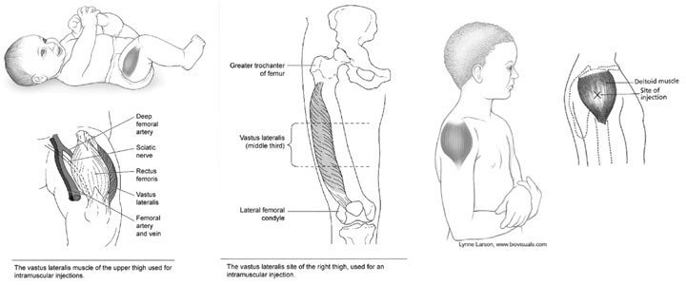
Vaccine Placement reminders

Slide 72
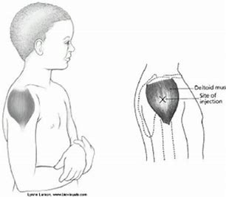
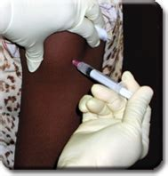
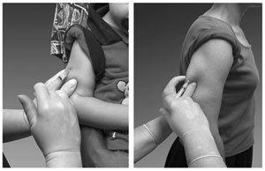

Slide 73
Live Demonstration
Aseptic Technique
Safety Device
Injection location

Slide 74
Other injection technique(s) Technique video discussion/review
California DOPH, 2014: https://www.youtube.com/watch?v=WsZ6NEijlfI
APHA, 2018: https://www.youtube.com/watch?v=1H7LnK0CpOY
APhA, 2014: https://www.youtube.com/watch?v=-STH2nfCIk8

Slide 75
Vaccine skills checklist
Competency | Procedures, Preparation, Administration, & Reporting
Patient Interaction | Welcomes/verify patient, states what/where vaccine will be given, confirm no questions/concerns.
Patient Interaction | Verifies Vaccine Information Statement (VIS) given before vaccine administration.
Patient Interaction | Confirm Vaccine Administration Record (VAR) has no potential questions (discuss with RPH if needed).
Procedures | Confirm location of the Emergency Kit (required).
Procedures | CPR certification is current and/or kept up-to-date.
Procedures | Confirm temperature log and storage is appropriate.
Procedures | Aware of Needle Stick Policies and where to locate.
Preparation | Completes proper hand hygiene before preparing vaccine (hand-washing, gloves).
Preparation | Check vaccine expiration date and contents before preparing vaccine.
Preparation | Selects correct needle size, length based on age, size/weight, and area of injection.
Preparation | Confirm proper aseptic technique (i.e. clean stopper, reconstitute, agitate vial, draw up proper dose).
Preparation | Confirm vaccine before administration begins.
Administration | Gather and correctly set-up ALL needed supplies for administration, including sharps container.
Administration | Rechecks the prescription against the vial and the prepared syringe contents.
Administration | Confirms proper hand hygiene (gloves).
Administration | Identifies correct injection site & positions patient accordingly (restrict limb movement). (IM and SQ MUST BE PERFORMED).
Administration | Alcohol wipe area (circle motion from center outward) and allows alcohol to dry.
Administration | Hold area with non-dominant hand, inject vaccine at appropriate needle angle, and withdraw needle. (IM and SQ MUST BE PERFORMED).
Administration | Deploy needle safety device and IMMEDIATELY place used need in sharps container.
Reporting | Properly document required information on VAR.
Reporting | Conclude visit, discuss next appointment date, and thank your vaccinated patient.

Slide 76
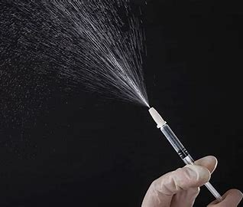
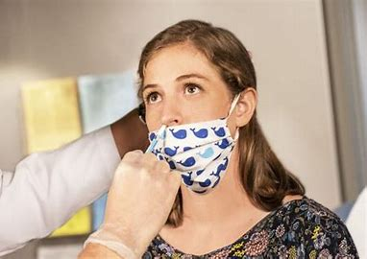
Common vaccines
Influenza Vaccine (0.5 mL IM)
The influenza vaccine has a few strains in it and updates every season.
The CDC ACIP, currently, does not recommend one vaccine type or brand over another.
When preparing these vaccines, try and only prepare what you need.
Multiple brand names of vaccines with different routes of administration exist (double check always).
Picture adopted from Quadrivalentfluvaccine.com and CDC photo gallery

Slide 77
Common vaccines
Pneumococcal vaccine (0.5 mL IM)
Patients must wait a year between the two different vaccines, unless they are immunocompromised.
The conjugate vaccine is a shared clinical decision making vaccine and must be discussed with patient and the Supervising Pharmacist.
Some vaccines, like the Pneumovax 23, can be given IM or SQ, but IM minimizes adverse reactions.

Slide 78
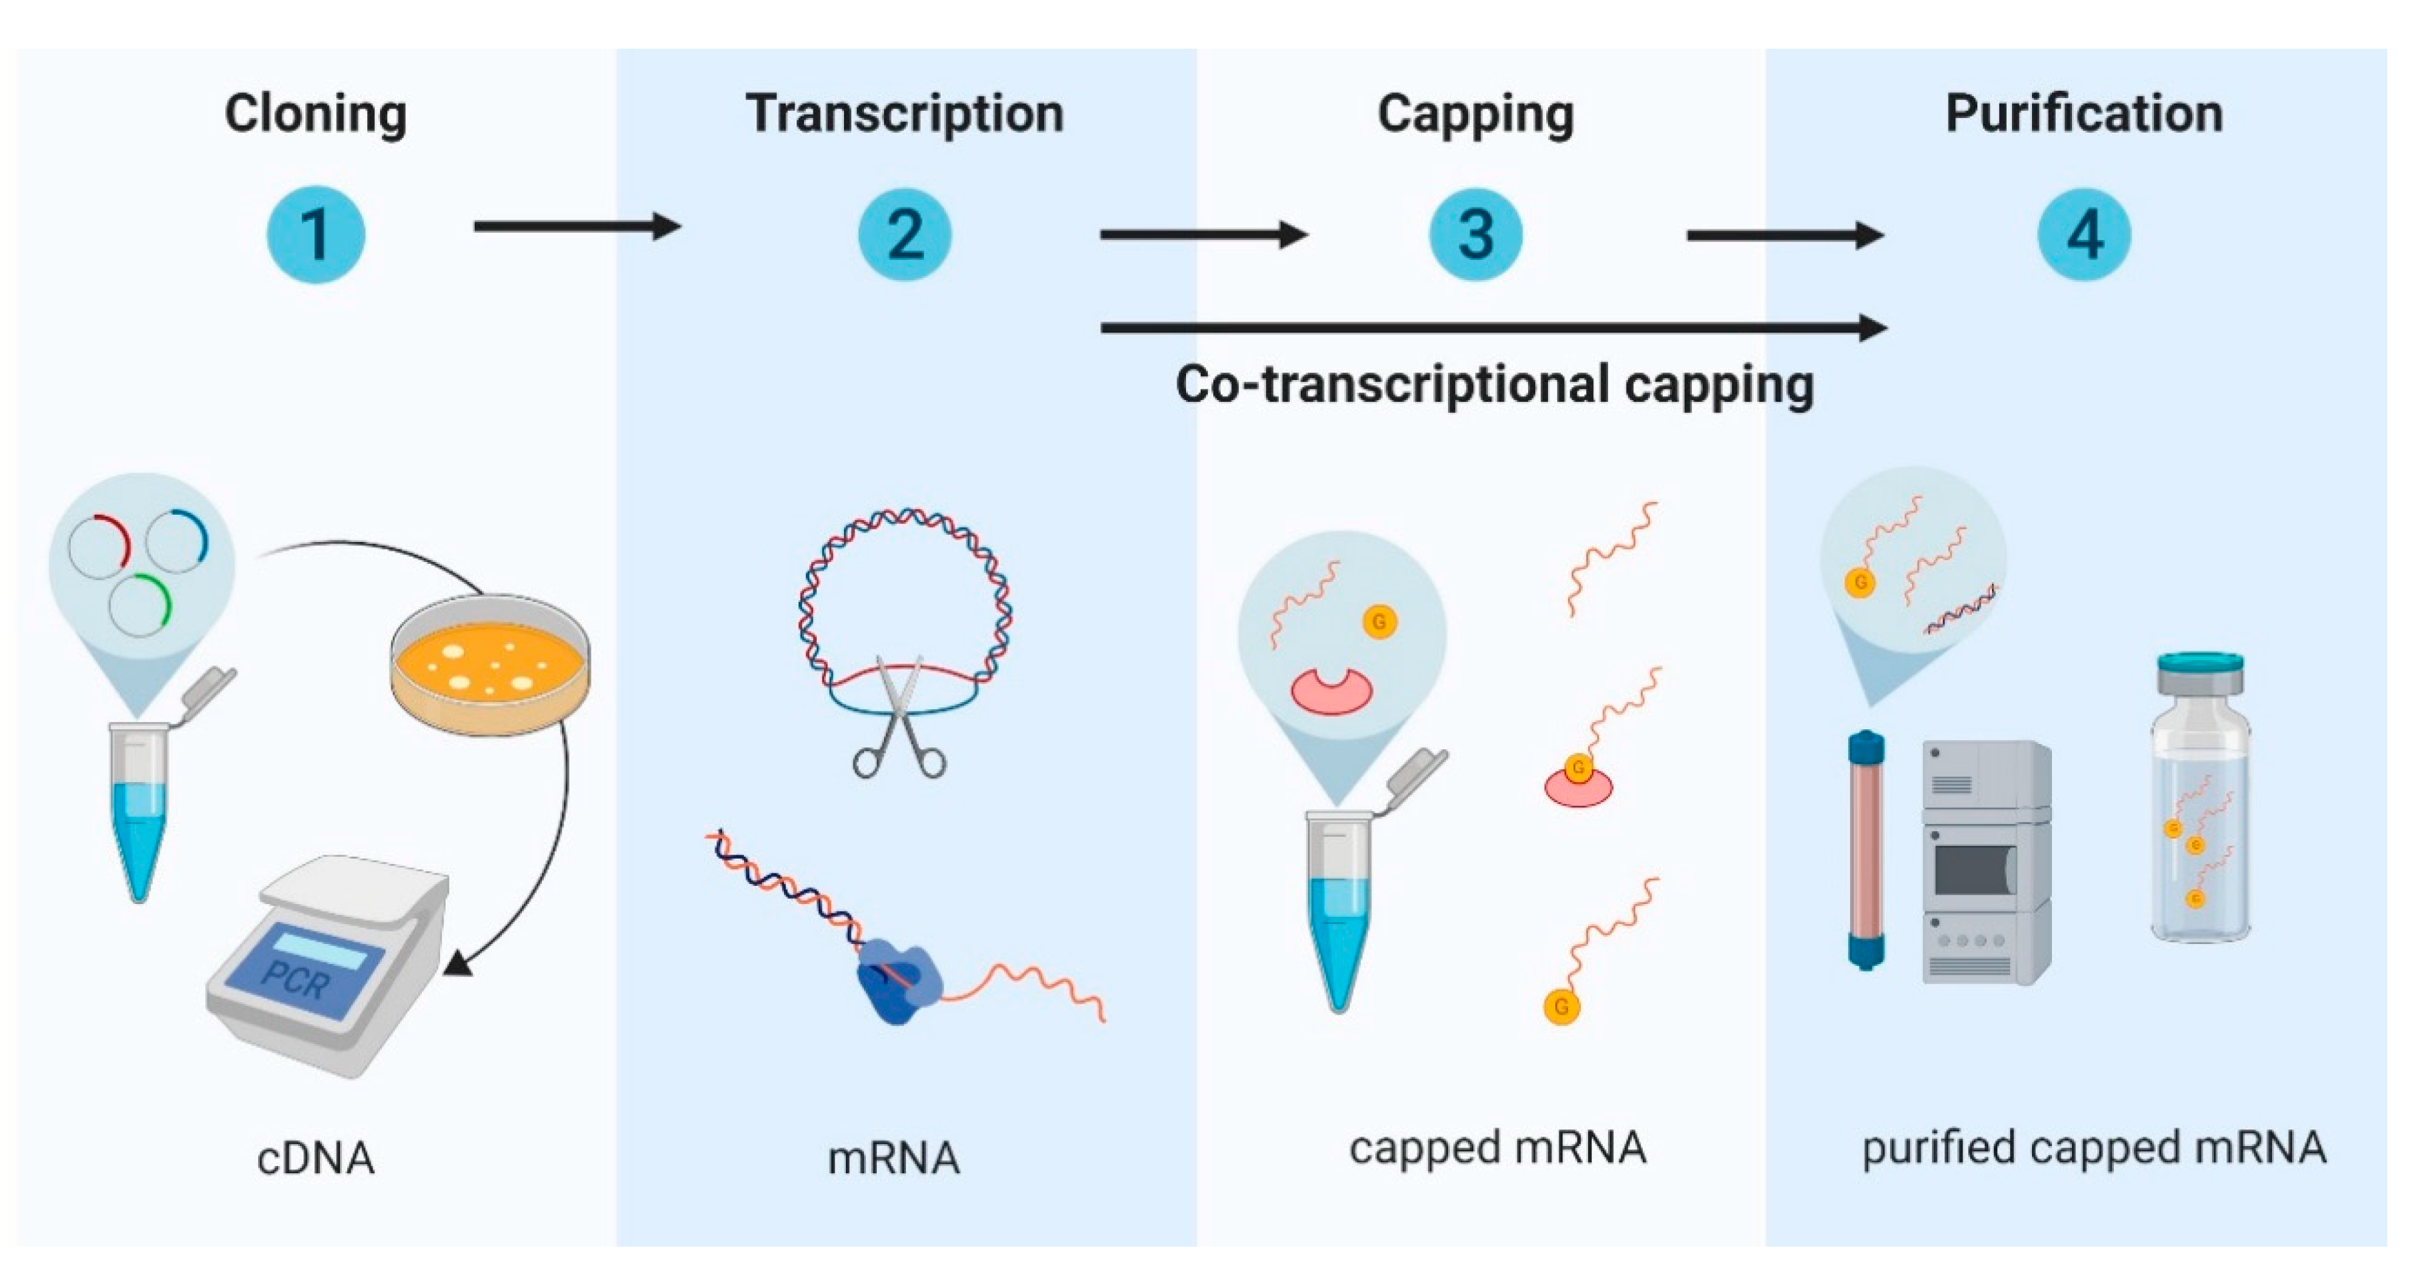
Types of covid-19 vaccines
mRNA vaccines contain material from the virus that causes COVID-19 that gives our cells instructions for how to make a harmless protein that looks like COVID-19 causing our cells to then make copies of the protein.
Our bodies recognize that the protein should not be there and build T-lymphocytes and B-lymphocytes that will remember how to fight the virus that causes COVID-19 if we are infected in the future.
Viral Vector vaccines insert the virus genetic code into a harmless virus (called the vector) which then delivers the code into the human cells, which then make large amounts of antigen invoking an immune response.
MDPI Vaccine Resource:
https://www.mdpi.com/2076-393X/7/4/122

Slide 79
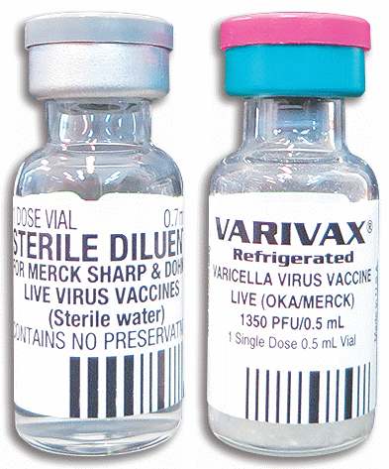
Vaccine/diluent storage

Slide 80
Covid-19 vaccine innovative strategies
Local Hospital:
We are expecting moderate numbers of mild side effects, so it seems prudent to stagger groups/departments, so we don’t have an entire clinic calling out ill the next day.
We could accomplish this by asking individuals to regulate themselves and only get the vaccine when they have the following day off although this requires lots of vaccine availability.
We need to have two E-kits on hand because of the increased risk for prophylaxis so we do not need to halt and replenish once the Epipen is used.

Slide 81
Post-vaccine care
Documentation Needed:
The name of the vaccine and the manufacturer.
The lot number and expiration date of the vaccine.
The date of administration that you gave the vaccine.
The name, address, title and signature (electronic is acceptable) of the person administering the vaccine.
The publication date of the Vaccine Information Statement (VIS) and date the patient or parent receives the VIS.

Slide 82
Sharps; proper use
Deploy safety devices on used needles immediately.
Dispose of used needles in sharps immediately.
Ensure sharps is puncture resistance.
Keep lid closed on sharps during non-use.
Keep sharps upright.
Do not overfill sharps.
Keep sharps within arm’s reach of immunizer.
Do not cross over other immunizers to reach sharps.
If patient bleeds, deploy safety device, and dispose of sharps BEFORE tending to injection site.
Bloodborne Pathogen and Needle stick Prevention: https://www.osha.gov/bloodborne-pathogens
Sharps Disposal Resource: https://www.pharmacytimes.com/publications/supplementals/2017/immunizationsupplementaugust2017/sharps-disposal-assuring-regulatory-compliance-during-offsite-vaccination-clinics

Slide 83
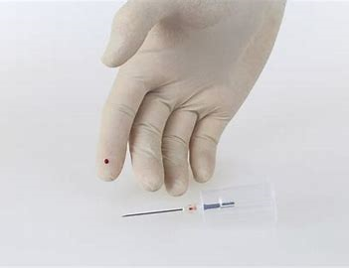
Needle stick management
Clean it
Report it
Call for help/get treatment
Id source the patient
Follow-up

Slide 84
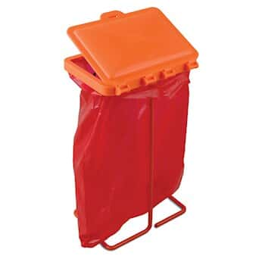
Regulated Waste
Sharps:
* Needles
* Empty vaccine vials
Biohazard Waste Bag:
* Blood saturated items
* Non-sharps infectious material

Slide 85
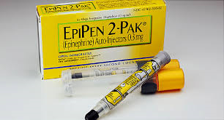
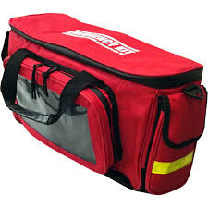
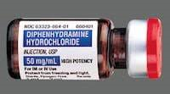
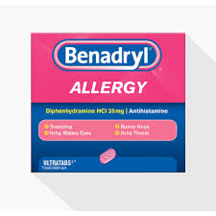
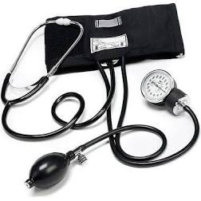
Emergency reactions
Medical Management of Vaccine Reactions (Children/Adults):
https://immunize.org/catg.d/p3082a.pdf https://immunize.org/catg.d/p3082.pdf
Optional but strongly encouraged

Slide 86
Syncope or Fainting
Occurs most commonly in adolescent and teens.
It is best to give injections with the patient in a seated position or lying down position.
If a patient reports feeling light headed or dizzy after you have given the injection:
Get help and/or your Supervising Pharmacist.
Have the patient lie down.
Most patients will recover with in a few minutes.
Prevent falls and stabelize the patient.
Work with your Supervising Pharmacist to assess that there is not a more serious problem.
Note: All patients should be asked to be observed for at least 15 minutes post-vaccine, even at a Drive-Thru Event.
Notes:
Some people are very afraid of needles and they may faint.
Always give injection to patients in a seated position
If they seem light headed after the injection, let them sit for a few minutes or if you can, let them lay down.
You will work in groups of two students, so one student can get help while the other students stays with the patient.

Slide 87
Allergic reaction
Anaphylaxis following vaccines is rare, occurring at a rate of approximately one per million doses for many vaccines.
If a patient reports itchy skin, hives, anaphylaxis, or throat tightness after you have given the injection:
Get help and your Supervising Pharmacist.
Get the Emergency Kit (your Supervising Pharmacist will initiate therapy if required).
For respiratory symptoms, cardiovascular symptoms, or other signs/symptoms of anaphylaxis, immediate IM epinephrine is the treatment of choice.
Most patients will recover after IM epinephrine is administered.
EMS assessment is still required.
CDC Resource: https://www.cdc.gov/vaccines/hcp/acip-recs/general-recs/adverse-reactions.html

Slide 88
Error reporting = vaers
Vaccine Adverse Event Reporting System (VAERS)
Established in 1990, VAERS is a national early warning system to detect possible safety problems in U.S. licensed vaccines.
VAERS accepts and analyzes reports of adverse events or side effects after a person has received a vaccination.
Anyone can report to VAERS, even if you did not administer the vaccination.
NMPhA strongly encourages you to work with your Supervising Pharmacist in reporting VAERS when possible.
New Mexico Pharmacists are required to report adverse events to VAERS as per the New Mexico Board of Pharmacy Prescriptive Authority Protocol for Immunizing Pharmacists.
VAERS Resource: https://vaers.hhs.gov/

Slide 89
Vaers table of reportable events examples
Anaphylaxis
Shoulder Injury Related to Vaccine Administration (7 days)
Vasovagal syncope (7 days)
Any acute complication or sequelae (including death) of above events
(interval - not applicable)
Events described in manufacturer’s package insert as contraindications to additional doses of vaccine (interval - see package inserts)
VAERS Table of Reportable Events: https://vaers.hhs.gov/docs/VAERS_Table_of_Reportable_Events_Following_Vaccination.pdf

Slide 90
Immunization regulations
NM bop Emergency order
Pharmacist protocol
Expires when Emergency Order is over.
Includes age restrictions.
Follows ACIP recommendations & FDA approved vaccines.
Requires 2 hrs of IZ CE.
Requires CPR and E-Kit.
Already has become part of NM BOP Law.
Has no age restrictions.
Follows ACIP recommendations & FDA approved vaccines.
Requires 2 hrs of Live IZ CE.
Requires Live CPR and E-Kit.

Slide 91
Immunization regulations
Pharmacy technician
Supervising pharmacist
Cannot give unless Supervising Pharmacist prescribed.
CPR certified (no live component required).
Reporting = Vaccine Documentation.
Inform patient of Well-Child visit.
Must be available and directly supervise tech.., can administer with hardcopy from other prescriber.
CPR certified (must have live component).
Reporting = Vaccine Documentation, NMSIIS, & VAERS.
Perform vaccine education/assessment, final vaccine verification, and patient counseling.
Note: Immunizing Pharmacy Technician to Supervising Pharmacist Ratio RX-2:1 and IZ Clinics-6:1

Slide 92
Additional Patient cases
Please chat in situations you have witnessed to date to help everyone learn:
Example: A patient called stating that she was vaccinated, but had no soreness and therefore felt she was never given a shot and wanted a repeat shot at no charge.

Slide 93
faqs
The COVID-19 vaccine development was quick—are you sure vaccines are safe?
Please refer to Supervising Pharmacist to discuss and counsel the patient(s).
The vaccines being sent and given to New Mexicans have undergone extensive testing as mandated by the FDA prior to approval of all vaccine.
The FDA, and the CDC, have looked carefully at the results of the studies done regarding effectiveness and safety before approving the use of vaccines.
It is possible unexpected rare adverse effects may be discovered once vaccines, like the COVID-19 vaccine, are in widespread use. Based on the science available, the risks of the vaccines are less than the risks of the disease itself.

Slide 94
FAQs
Is that vaccine mandatory?
Please refer to the Supervising Pharmacy to discuss and counsel the patient(s).
There are certain vaccines that are mandatory for school registration (5th grade – tdap and meningococcal).
There are certain employers that may have influenza vaccines that are mandatory (local hospital – influenza).
There may be other mandatory vaccines for occupations, travel, citizenship, etc.
Currently, the COVID-19 vaccine is not mandatory, but we do recommend it to prevent illness and the spread of COVID-19.
Vaccination is one of the most important public health tools we have to help us all move beyond this pandemic and ensure disease is/stays eradicated in the U.S.

Slide 95
FAQs
Is there more than one shot needed, how far apart are the shots? Can I be late? Do I have to get both?
Please refer to the Supervising Pharmacist to discuss and counsel the patient(s).
There are many vaccines, mostly inactivated vaccines, that require more than one dose to get maximum immunity and complete the series. For maximum immunity, you do need to get all recommended vaccines in the series and it is highly recommended.
For most vaccines, you can be late without restarting the series, but refer to your Supervising Pharmacist for discussion.
Examples:
Shingrix (2 shot series: day 0 and 2-6 months).
Gardasil (2 shot series if first shot before age 15: day 0 and 6-12 months).
Hepatitis B (3 shot series: day 0, 1 month, and 6-12 months).
COVID-19 (Pfizer): (2 shot series: day 0 and day 21).
Childhood Vaccine Grace Period: 4 day early in series if ABSOLUTELY NECESSARY.

Slide 96
fAQs
What are the side effects? How common are they?
Please refer to the Supervising Pharmacist to discuss and counsel the patient(s).
Side effects can occur with most vaccines, including local (at injection site) or systemic (inside the body) reactions.
Local reactions: red or sore arm, warm arm, pain at the injection site.
Systemic reactions: fatigue, headache, muscle aches, chills, joint pain and fever.
These symptoms do not last more than a few days and are mild or moderate, sometimes requiring treatment with acetaminophen or ibuprofen.
COVID-19 (Pfizer), studies thus far have show around 2% of people vaccinated have headaches, 2% have a fever, and 3.8 % have fatigue.
V-Safe: Use your smartphone to tell CDC about any side effects after getting the COVID-19 vaccine. You’ll also get reminders if you need a second vaccine dose: www.cdc.gov/vsafe

Slide 97
Faqs
What do I do if I experience side effects after receiving a vaccine?
Pleaser refer to the Supervising Pharmacist to discuss and counsel the patient(s).
Post-vaccine care can include many self-care options such as: acetaminophen, ibuprofen, ice packs, diphenhydramine, hydrocortisone topical, calamine lotions, etc.
Please report any serous side effects or adverse reactions to the pharmacy for further instruction and proper quality control reporting.
Reporting requires: VAERS and Company Reporting.

Slide 98
FAQs
If we had the illness, like COVID-19, do we still need the vaccine?
Please refer to the Supervising Pharmacist to discuss and counsel the patient(s).
As discussed in the-home study, contracting the illness provides natural immunity, however, for many illnesses, it is unknown how long this natural immunity may last after recovery.
For this reason, the CDC will recommend people who have recovered from the disease should still get the vaccine. This is also expected with COVID-19 as well, but has not been officially stated.

Slide 99
faqs
How quickly do the vaccines work and last?
Please refer to your Supervising Pharmacist to discuss and counsel the patient(s).
As discussed in the home-study, your immune system needs to generate a response, so generally the protection from the virus starts after about seven days and continues to build (incubation period).
COVID-19 vaccine (Pfizer), which needs to be given in two doses, patients are considered to have full immunity a week after the second dose (day 1 and day 21 (full immunity at day 28)).
Often times, we do not know how long protection will fully last from a vaccine. For example, with the COVID-19 vaccine (Pfizer), it is likely to be at least several months, but the series may be that repeat vaccinations are needed.
There are many vaccines, were studies have been able to determine how long protection will fully last from a vaccine. For example, with the Hepatitis B vaccine, it is likely that to last at least 20 years, so the series should be repeated at that time.
Researchers are studying this closely.

Slide 100
faqs
How will the cost of my vaccine be covered? Is there a co-pay?
Insurances (prescription or medical benefits) may be billed for vaccines. (Influenza and Pneumococcal vaccines may be billed to Medicare Part B preventative care services.) Administration fees should be included in the insurance billing.
COVID-19 vaccine is free to everyone with no co-pay. Insurances may be billed, but those without insurance can still get the vaccine at no cost to them.
Vaccine for Children (VFC) Providers can always provide state provided vaccine at no charge to the patient (child must be under the age of 19 for eligibility).
NM VFC Finder: https://www.nmhealth.org/about/phd/idb/imp/vfc/

Slide 101
Additional resources
NM Board of Pharmacy Qualified Pharmacy Technician Childhood and COVID-19 Vaccine Administration and COVID-19 Testing Document: http://www.rld.state.nm.us/uploads/FileLinks/ad6770c244f74bdaaeaa53842023b4c7/technician_vaccine_administration_and_covid_testing_ii.pdf
HHS PREP Act: https://www.hhs.gov/sites/default/files/prep-act-guidance.pdf
New Mexico Protocol for Pharmacists Prescribing of Vaccines: https://www.nmpharmacy.org/resources/Documents/IZprot2015%20-%20June%20BOP-Aug%20MB-Aug%20BON%201.pdf
NMSIIS Sign Up: https://www.nmhealth.org/about/phd/idb/imp/siis/train/
Child & Teen Vaccine Screening questions (sample), immunize.org: https://www.immunize.org/shop/views/pad_sqchild.pdf
Adult Vaccine screening questions (sample), Immunize.org: https://www.immunize.org/catg.d/p4065.pdf
ACIP Vaccine Schedule(s): https://www.cdc.gov/vaccines/schedules/hcp/index.html
Immunization Action Coalition: http://www.immunize.org/
COVID-19 Vaccine EUA Pfizer:

Slide 102
summary
Pharmacy Technicians, with training and certification, are qualified to give immunizations to New Mexicans.
Pharmacy Technicians have the necessary skillset to vaccinate safely and effectively.
Pharmacy Technicians can make a positive impact as well as save lives in their respective communities.
Pharmacy Technicians can perform at a high level within the pharmacy setting and be a significant part of the healthcare team.

Slide 103
Next steps
Please complete the vaccine skills checklist including IM and SQ practice injections signed off by a pharmacist (you must return to NMPhA).
Please complete the live course (open-book) post-quiz (70% or better is required and two attempts are allowed).
If you do not pass after both attempts, the NMPhA will work with your Supervising Pharmacist to determine next steps for you.

