Slide 1
What Outpatient Pharmacy Services do our Patients Want?
Results from a Community Survey and Panel Discussion
Presented by: Luis Gonzalez, PharmD, PhC
PGY2 Ambulatory Care Resident
University of New Mexico College of Pharmacy
Albuquerque, NM
1
IRB Approved

Slide 2
Disclosure Statement Luis Gonzalez, PharmD, PhC
Potential conflicts of interest: none
Sponsorship: none
Proprietary information: research may be subject to different interpretations
Presentation of this slide indicates my agreement to abide by the non-commercialism guidelines provided on the CE Requirements page
2

Slide 3
Pharmacist Learning Objectives
At the end of this presentation, the attendee will be able to…
Describe knowledge gaps and differences between community pharmacy vs. health fair respondents awareness of community pharmacy services
Describe community pharmacy and health fair respondents attitudes towards receiving and paying for community pharmacy services
Describe patients’ perceptions of community pharmacist
Discuss barriers and strategies to help implement community pharmacy services
3

Slide 4
Pharmacist Technician Learning Objectives
At the end of this presentation, the attendee will be able to…
Recall knowledge gaps and differences between community pharmacy vs. health fair respondents awareness of community pharmacy services
Recall community pharmacy and health fair respondents attitudes towards receiving and paying for community pharmacy services
Recall patients’ perceptions of community pharmacist
Discuss barriers and strategies to help implement community pharmacy services
4

Slide 5
Background
Since 2004, the University of New Mexico College of Pharmacy (UNM COP) APhA-ASP chapter has used participant surveys at health-fairs in order to raise awareness of pharmacist-provided services
A previous study at the UNM COP compared the 2004 to 2013-14 community health screening survey responses¹
In 2017 a new pilot project was initiated within select community pharmacies that serve as APPE sites for 4th year student pharmacists
1. Gonzalez L, et. al. J Am Pharm Assoc 2015.

Slide 6
Importance/Relevance
Identify knowledge gaps and/or differences between individuals at community health fairs vs. that of individuals presenting at a pharmacy
Improve education and advertising of pharmacist provided outpatient clinical services
Implement pharmacy services to address needs or wants of the community and customers

Slide 7
Research Objectives
Primary:
Compare community pharmacy patients’ versus health fair participants’ awareness, willingness to utilize, willingness to pay, and interest in insurance coverage for clinical outpatient pharmacy services offered by New Mexico pharmacists (immunizations, glucose, blood pressure and cholesterol monitoring)
Secondary Objectives:
Compare health fair participants’ responses to survey questions from 2004, 2013-14 and 2017-18

Slide 8
Research Objectives
Hypothesis:
Community pharmacy participants surveyed in 2017-18 will be more aware of and more willing to pay for services provided by pharmacists than those surveyed in 2017-18 at health fairs

Slide 9
Research Methodology
Study setting: UNM COP APPE Community pharmacy sites and APhA-ASP sponsored health fairs
Study design: multi-site observational survey
Study groups:
Community pharmacy participants
Health fair participants
Survey Administration: Anonymous surveys offered at health fairs and as part of pilot quality improvement initiative at APPE sites

Slide 10
Research Methodology
Inclusion criteria:
All health fair participants
All patients presenting to participating pharmacies to pick up a prescription
English or Spanish speaking
Exclusion criteria:
Respondents < 18 years of age

Slide 11
Research Methodology
Data collection (2017-18)
Seven question anonymous survey
Surveys were collected by UNM COP students as a continuous part of health screenings and as part of the pilot quality improvement initiative in participating pharmacies
Demographics: Age, gender, and designation of PCP or active insurance
Survey collection period for research analysis:
4 months (October 2017 – February 2018)

Slide 12
Research Methodology
Awareness/Willingness to Utilize:
Did you know that pharmacists could perform the following procedures? (Yes or No)
Would you see your pharmacist on a regular basis to… (Yes or No)
Check/monitor blood sugar (for diabetes)
Check/monitor cholesterol
Measure/ monitor blood pressure
Administer/receive immunizations
Payment for Clinical Services:
Would you be willing to pay to have your pharmacist provide the following services? (Yes or No)
Do you feel that Medicare and other insurance companies should pay pharmacists to… (Yes or No)

Slide 13
Research Methodology
Perceptions:
Do you already talk to your pharmacist for advice on medicines? (Yes or No)
Do you trust your pharmacist’s advice about your medicine? (Yes or No)
Would you trust your pharmacist’s advice on other health issues besides medications? (Yes or No)

Slide 14
Research Methodology
Data analysis
Baseline Characteristics: Descriptive statistics
Primary and Secondary Objectives: Pearson Chi-Square to analyze categorical variables
Sub-Group Analysis: Logistic regression analysis (Wald Chi-Square test)
IBM® SPSS® Statistics Version 25

Slide 15
RESULTS: 2004 VS. 2013-14 VS. 2017-18 RESPONDENTS

Slide 16
Awareness of Community Pharmacists’ Services

Slide 17
Attitudes toward Community Pharmacists’ Services

Slide 18
Interest in Insurance Coverage of Pharmacists’ Services

Slide 19
Willingness To Pay For Pharmacists’ Services

Slide 20
Perceptions of Community Pharmacists

Slide 21
Awareness of Community Pharmacists’ Services – 2017-18

Slide 22
RESULTS: 2017-2018 COMMUNITY VS. HEALTH FAIR RESPONDENTS

Slide 23
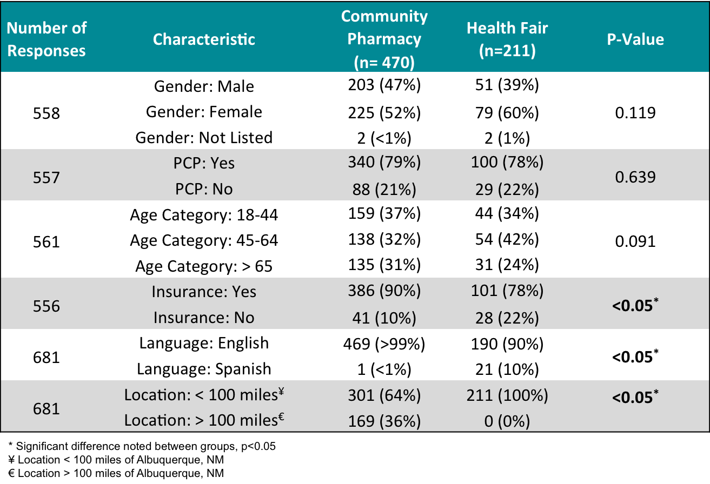
Baseline Demographics

Slide 24
Awareness of Community Pharmacists’ Services

Slide 25
Awareness of Community Pharmacists’ Services

Slide 26
Attitudes toward Community Pharmacists’ Services

Slide 27
Attitudes toward Community Pharmacists’ Services
Notes:
.

Slide 28
Interest in Insurance Coverage of Pharmacists’ Services

Slide 29
Interest in Insurance Coverage of Pharmacists’ Services

Slide 30
Willingness To Pay For Pharmacists’ Services

Slide 31
Willingness To Pay For Pharmacists’ Services

Slide 32
Discussion
Limitations:
Convenience sample
Observational design
Survey response bias - leading questions
Sampling error - total responses collected
Exposure bias – survey locations
Strengths:
Comparison of community vs. health fair respondents
Comparison of multiple time frames
Findings add to limited data available in the literature

Slide 33
Conclusion
Similar response between community vs. health fair respondents, with some exceptions…
Community Pharmacy > Health Fair
Awareness of immunization services
Health Fair > Community Pharmacy
Awareness of prescriptive authority for birth control
Willingness to pay for naloxone rescue therapy
Awareness is low for pharmacist provided services, except immunizations ➔ Increase marketing

Slide 34
Conclusion
Patients are highly interested in insurance coverage for pharmacist provided services ➔ Provider Status
Most patients are willing to pay (co-pay or out-of-pocket) for pharmacy services ➔ Promote services
Patients’ trust in pharmacist advice about medications remain high, while trust in advice about other health care issues has increased

Slide 35
Study Investigators
Pharmacy Practice & Administrative Sciences | University of New Mexico Hospitals
Gretchen Ray, PharmD | Preeyaporn Sarangarm, PharmD
Patricia Marshik, PharmD | John Togami, PharmD
Luis Gonzalez, PharmD | Nathan Duran, PharmD
University of New College of Pharmacy | Experiential Education
Ashley Sanchez, PharmD student | Joe Anderson, PharmD
 | Tracy Hunter, PhD
35

Slide 36
Questions?

