Slide 1
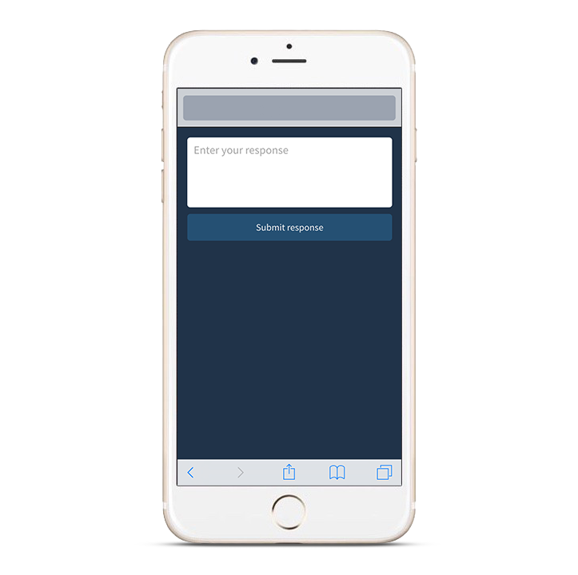
Participating with Poll Everywhere
Pollev.com/nmpha
22333
nmpha
<your response>
Web voting
Text voting
You can download the app by searching “Poll Everywhere” in the App Store
or you can use Text Voting by texting ”nmpha” to 22333
Notes:
General use graphics to be customized according to your poll’s instructions

Slide 2
PHARMACY-BASED NALOXONE DISTRIBUTION: SUCCESSES, CHALLENGES, AND OPPORTUNITIES
Carly Cloud Floyd, PharmD, PhC, AAHIVP
Clinical Staff Pharmacist
Southwest CARE Center
Notes:
2

Slide 3
ACKNOWLEDGEMENTS
This presentation was supported, in part, by the Grant or Cooperative Agreement Number, U17 CE002727, funded by the Centers for Disease Control and Prevention. Its contents are solely the responsibility of the authors and do not necessarily represent the official views of the Centers for Disease Control and Prevention or the Department of Health and Human Services.

Slide 4
OBJECTIVES
Describe the need to address opioid-related overdoses in the state of New Mexico
Describe “A Dose of R_{x}eality” training program strategies for improving access to naloxone
Address common stigmas around opioid use and naloxone distribution that may pose a barrier to care
Outline the progress New Mexico has made in reducing overdose death rates and opportunities for future improvements
Review “A Dose of R_{x}eality” program results over the past year
Describe lessons learned from “A Dose of R_{x}eality” participants
Outline process to request naloxone training and benefits of training for all staff, including pharmacists, pharmacy technicians, & pharmacy clerks
A Dose of R_{x}eality
A Dose of R_{x}eality
A Dose of R_{x}eality

Slide 9
NEW MEXICO OVERDOSE DATA

Slide 11
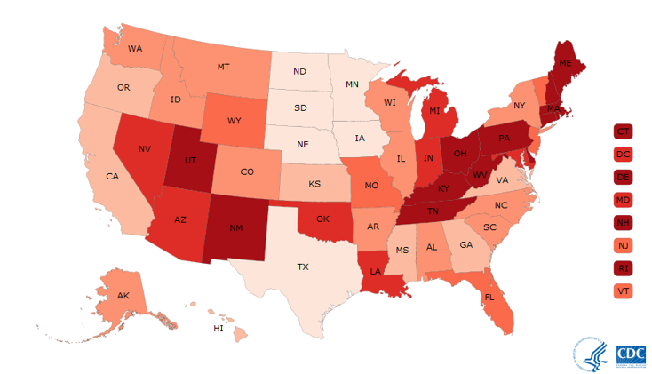
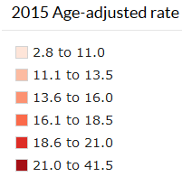
NUMBER AND AGE-ADJUSTED RATES OF DRUG OVERDOSE DEATHS BY STATE, US 2015
Source: CDC (http://www.cdc.gov/drugoverdose/data/statedeaths.html)

Slide 12
NEW MEXICO OVERDOSE DEATHS 2003-2014

Slide 13
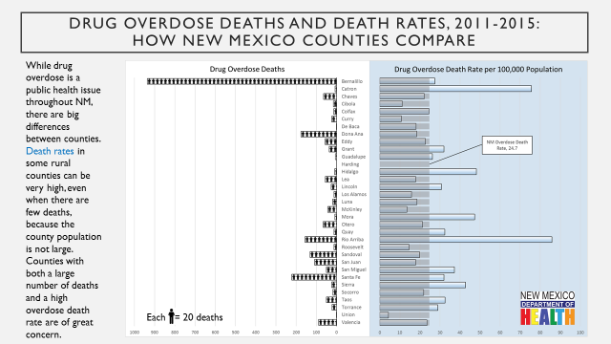
NEW MEXICO DATA BY COUNTY

Slide 14
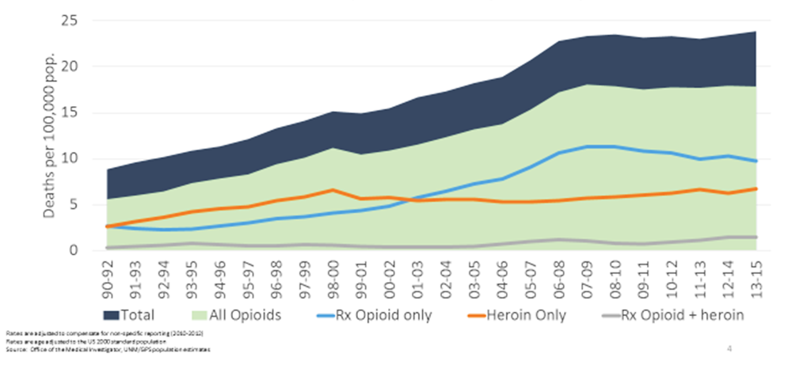
DRUG OVERDOSE DEATH RATES FOR OPIOIDS, NM 1990-2015

Slide 15
ROLE OF PHARMACISTS IN OPIOID
OVERDOSE PREVENTION
At least ½ of all opioid overdose deaths
involve a Rx

Slide 16
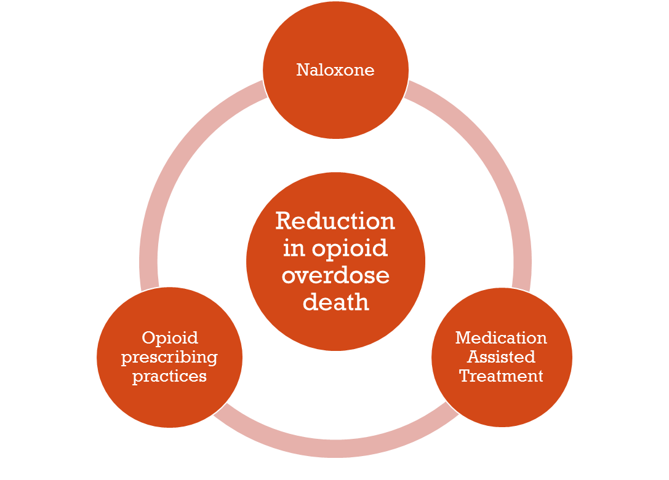
YOU CAN BE PART OF THE SOLUTION!

Slide 17
NALOXONE

Slide 18
NALOXONE MECHANISM OF ACTION
Source: http://www.copeaustralia.com.au/naloxone/

Slide 19
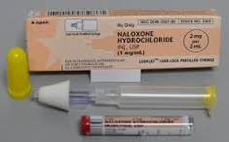
PRODUCTS AVAILABLE TO DISPENSE

Slide 21
OVERDOSE PREVENTION
Harm reduction: reduce risk and death
Counsel patients on the appropriate use of opioids
Avoid mixing opioids with alcohol or other CNS depressants
Give naloxone to patients to prevent death from overdose
Offer a supportive environment to patients
Do not judge people who use opioids
Refer patients to treatment if/when they are ready
Try to meet patients where they are, do not push your beliefs on them

Slide 22
NALOXONE DISTRIBUTION

Slide 23
HISTORY OF NALOXONE DISTRIBUTION IN NM
2001 Naloxone distribution to end user limited to DOH harm reduction programs (with physician standing order)
2014 pharmacist prescriptive authority in New Mexico (first state in the us!)
2016 Senate Bill 262 & House Bill 277 passed
Statute NMSA §24-23-1 Authority to Possess, Store, Distribute, Dispense, Prescribe and Administer Opioid Antagonists; Release from Liability; Rulemaking.

Slide 24
STATEWIDE STANDING ORDER
NMSA §24-23-1
March 18, 2016 – State Epidemiologist, Dr. Michael Landen
A licensed provider may directly or by standing order prescribe, dispense, or distribute an opioid antagonist to:
A person at risk of experiencing an opioid-related overdose
Family member, friend, or other person in a position to assist a person at risk of experiencing an opioid-related overdose
An employee, volunteer, or representative of a community-based entity providing overdose education and prevention services that is registered with the department
A first responder
Source: New Mexico Department of Health

Slide 25
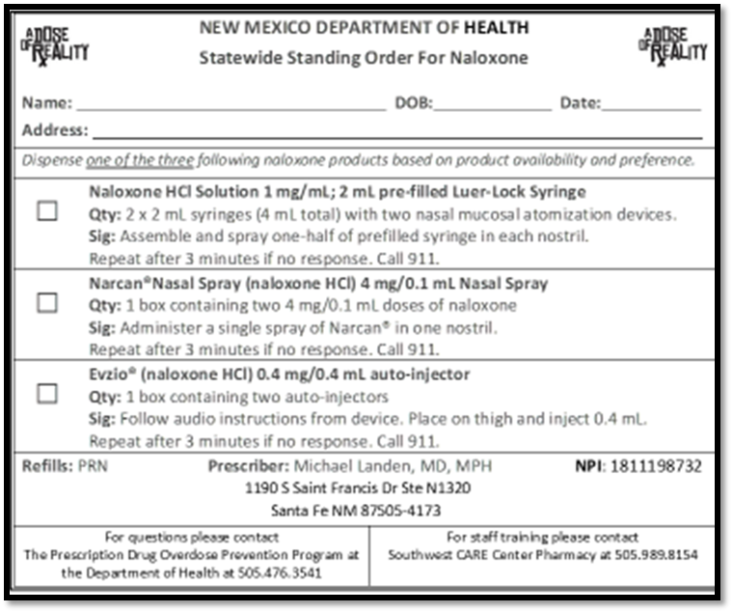
WRITING FOR NALOXONE UNDER THE STANDING ORDER

Slide 26
WHO IS AT RISK OF OVERDOSE?
Anyone who:
Takes opioids (including Suboxone®)
Higher risk with polysubstance use
Has kids/grandkids/teens at home
Older adults higher risk
Uses heroin
Has overdosed before
Has been recently released from prison/jail
Knows someone who takes opioids
Lives far from medical services
Anyone who wants to have naloxone!

Slide 27
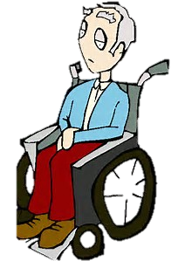
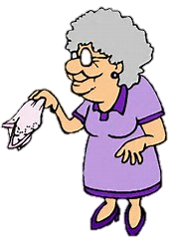

Slide 28
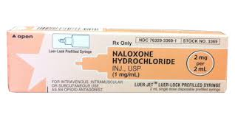
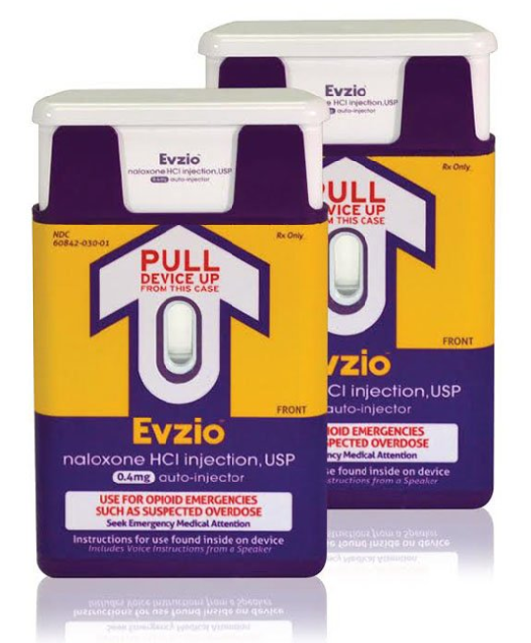
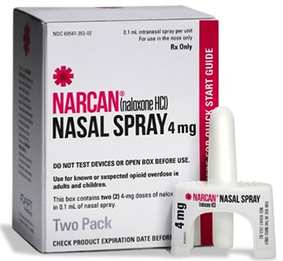
SAFETY FIRST!
=

Slide 30
STRATEGIES FOR NALOXONE DISTRIBUTION

Slide 31
Notes:
31

Slide 32
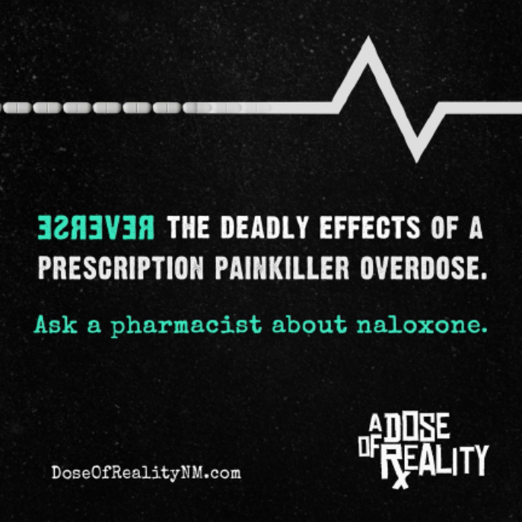
A DOSE OF RXEALITY

Slide 33
EDUCATION TO THE PUBLIC

Slide 34
EDUCATION TO THE PUBLIC

Slide 35
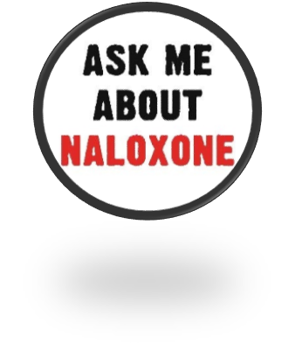
Pharmacy Naloxone Training
Free onsite naloxone training for ALL staff (pharmacists, interns, techs, clerks)
Free live CE for licensed pharmacist and technicians (2 hours)
Access to expert community pharmacists for troubleshooting
Everything you need to start dispensing naloxone under the standing order TODAY!
Free naloxone demonstration kit
Free naloxone kits – (as grant funding allows)
Free pre-printed prescription pad
Ordering guide
Insurance billing guide
Free educational brochures for patients (English and Spanish)
Free advertising material for your pharmacy

Slide 36
PROGRAM RESULTS

Slide 37
A DOSE OF R_{X}EALITY SO FAR…
Total number of people trained: 242
Pharmacists: 105
Technicians: 101
Pharmacy interns: 12
Graduating pharmacists: 83
Pharmacy technician students: 9
Total number of pharmacies represented: 65
Total number of counties represented: 17 (10 designated as ‘rural’)
Total number of ADoR naloxone kits dispensed 120
Data current as of December 31, 2016

Slide 38
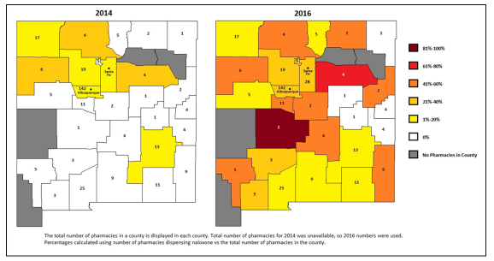
PHARMACIES DISPENSING NALOXONE (% per county)

Slide 39
LESSONS LEARNED

Slide 43
REQUESTING TRAINING

Slide 44
CONTACT US!
Come see our booth in the exhibit hall for more information
Email kmorton@southwestcare.org
Call 505-989-8154

Slide 45
YOU CAN BE PART OF THE SOLUTION!

Slide 46
ADDITIONAL RESOURCES
Harm reduction resources
www.nmhivguide.org
New Mexico Pharmacists Association
http://www.nmpharmacy.org/naloxone-resources
Narcan® nasal spray training video
http://www.narcannasalspray.com/nns-4-mg-dose/how-to-use-nns/#video
Safer use of pain medication
http://nmhealth.org/about/erd/ibeb/pos/
Addiction treatment
New Mexico recovery help
www.recoverynewmexico.com
Suboxone®/buprenorphine providers
http://www.samhsa.gov/medication-assisted-treatment/physician-program-data/treatment-physician-locator
Treatment services in the US
www.findtreatment.somhsa.gov

Slide 47
REFERENCES
Drug overdose deaths. Retrieved on 4/25/2016 from New Mexico department of health, indicator-based information system for public health website: https://ibis.Health.State.Nm.Us/community/highlight/profile/drugoverdosedth.Cnty/geocnty/35.Html.
New Mexico department of health. New Mexico state-wide standing order for naloxone. Https://nmhealth.Org/publication/view/regulation/2126/. accessed April 25, 2016
New Mexico department of health. New Mexico prescription monitoring program data report, 2006-2013. Http://nmhealth.Org/publication/view/data/471/. accessed April 25, 2016.
Prescription painkiller overdoses in the us. Centers for disease control and prevention website. Http://www.Cdc.Gov/vitalsigns/painkilleroverdoses/index.Html. Accessed April 25, 2016.
Guide to developing and managing overdose prevention and take-home naloxone projects, harm reduction coalition, fall 2012. Http://harmreduction.Org/issues/overdose-prevention/overview/overdose-basics/responding-to-opioid-overdose/administer-naloxone/
Gammon DL, Shujun S, Jordan J, Patterson R, Finley PJ, Lowe C, Huckfeldt R. Alteration in prehospital drug concentration after thermal exposure. American journal of emergency medicine. 2008; 26: 566-573.

