Slide 1
You are the Key to HPV Cancer Prevention Understanding the Burden of HPV Disease, the Importance of the HPV Vaccine Recommendation, and Communicating about HPV Vaccination
Lance Chilton, MD
Pediatrician and Emeritus Professor of Pediatrics
University of New Mexico
New Mexico Pharmacists’ Association
24 June 2017

Slide 2
Funding
Funding for this workshop was made possible (in part) by the Centers for Disease Control and Prevention. The views expressed in written workshop materials or publications and by speakers and moderators do not necessarily reflect the official policies of the US Department of Health and Human Services or the NM Department of Health, nor does the mention of trade names, commercial practices or organizations imply endorsement by the US Government.

Slide 3
Faculty Disclosure
Has in the past spoken on behalf of Merck Vaccines (more than two years ago); has no other conflicts
Lance Chilton, MD
Notes:
Note: If speaker does not have any disclosures or conflicts of interest to report, please insert name/credentials and use this faculty disclosure slide. Delete or hide the next slide.
If speaker does have conflicts of interest(s) to report, please delete or hide this slide and update/use the following slide.

Slide 4
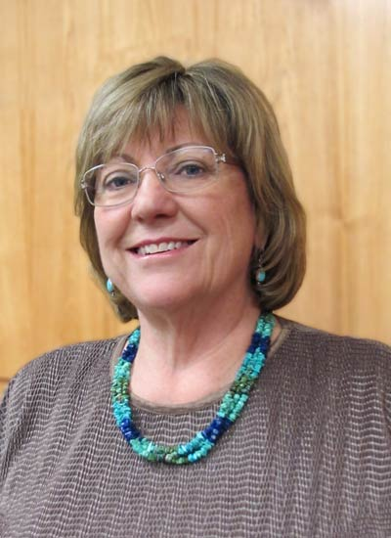
Some of my pharmacist heroes
Dean Michel Disco
Amy Bachyrycz
David Kuhl
John Maito

Slide 5
Objectives
Describe why HPV vaccination is important for cancer prevention.
Identify the appropriate HPV vaccination schedule based on patient age.
Describe effective HPV vaccine recommendations for patients age 11 or 12 years, as well as for age 13 years and older.
Develop self-efficacy in delivering effective HPV vaccination recommendations
Provide useful tips via role playing and identify reassuring, confident, and concise responses to parental questions about HPV vaccination.
Notes:
When this presentation is complete, you should be able to: one, describe why HPV vaccination is important for cancer prevention; two, identify the appropriate HPV vaccination schedule based on patient age; three, describe effective HPV vaccine recommendations for patients age 11 or 12 years, as well as for age 13 years and older; four, develop self-efficacy in delivering effective HPV vaccination recommendations; five, identify reassuring, confident, and concise responses to parental questions about HPV vaccination; and six, implement disease detection and prevention health care services (e.g., smoking cessation, weight reduction, diabetes screening, blood pressure screening, immunization services) to prevent health problems and maintain health.

Slide 6
A little play
Ms. Aurelia Sánchez
38 y.o. mother of
Sara, age 7
Saúl, age 9
Linda, age 11
Generally healthy
Highly intelligent, well-educated
Bala Desai, Pharm. D.
47 y.o. pharmacist, pharmacy owner
Married, mother of
Bijay, age 15
Neema, age 18
Highly intelligent, well-educated
Committed to prevention of disease

Slide 7
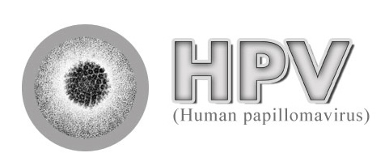
HPV Infection & Disease
Understanding the Burden
Notes:
The first section will focus on HPV infection and disease prevalence.

Slide 8
So, let’s talk about HPV vaccine and its promotion

Slide 9
HPV Types Differ in their Disease Associations
~40 Types
Mucosal
sites of infection
Cutaneous
sites of infection
~ 80 Types
High risk (oncogenic) HPV 16, 18 most common
Low risk (non-oncogenic) HPV 6, 11 most common
Cervical Cancer Anogenital Cancers Oropharyngeal Cancer Cancer Precursors
Low Grade Cervical Disease
Genital Warts
Laryngeal Papillomas
Low Grade Cervical Disease
“Common” Hand and Foot
Warts
Notes:
HPV types differ in their tendency to infect cutaneous and mucosal or genital epithelium. More than 150 HPV types have been identified, including approximately 40 that infect the genital area. Genital HPV types are categorized according to their epidemiologic association with cervical cancer. High-risk types (e.g., types 16 and 18) can cause low-grade cervical cell abnormalities, high-grade cervical cell abnormalities that are precursors to cancer, and cancers. In addition to cervical cancer, HPV infection also is the cause of some cancers of the vulva, vagina, penis, and anus, as well as cancer of the oropharynx.
Low-risk types like 6 and 11 can cause benign or low-grade cervical cell changes, genital warts, and recurrent respiratory papillomatosis.

Slide 10
HPV Infection
Most females and males will be infected with at least one type of mucosal HPV at some point in their lives
Estimated 79 million Americans currently infected
14 million new infections/year in the US
HPV infection is most common in people in their teens and early 20s
Most people will never know that they have been infected
Satterwhite et al. Sex Transm Dis. 2013
Notes:
Most HPV infections happen during the teen and college-aged years because HPV infection usually occurs soon after sexual debut.
Most people never know that they have been infected. Women may find out they are infected because of an abnormal pap test with a positive HPV test or a diagnosis of genital warts. Men may find out because of a genital warts diagnosis as well.

Slide 11
Cancers Caused by HPV per Year, U.S., 2009-2013
Cancer site | Percentage probably caused by any HPV type | Number probably caused by any HPV type
 |  | Female | Male | Both Sexes
Cervix | 91% | 10,600 | 0 | 10,600
Vagina | 75% | 600 | 0 | 600
Vulva | 69% | 2,500 | 0 | 2,500
Penis | 63% | 0 | 700 | 700
Anus | 91% | 3,200 | 1,600 | 4,800
Rectum | 91% | 500 | 200 | 700
Oropharynx | 70% | 2,000 | 9,600 | 11,600
TOTAL |  | 19,400 | 12,100 | 31,500
Based on Viens et al. MMWR 2016. https://www.cdc.gov/cancer/hpv/statistics
Notes:
This slide shows the numbers that were displayed in the figure in the previous slide and focuses in on the number of cancers attributable to HPV per year in the United States from 2009 to 2013. An HPV-attributable cancer is a cancer probably caused by HPV. The column with “percentage probably caused by any HPV type” comes from the CDC genotyping study. HPV causes nearly all cervical cancers and many cancers of the vagina, vulva, penis, anus, and oropharynx. Since rectal cancer was not included in the CDC genotyping study, the HPV-attributable fraction for anal cancer was used because recent studies show that the HPV-associated types of anal and rectal cancer are similar.
CDC estimated that during 2009 to 2013, HPV caused about 31,500 cancers in the United States each year, with 19,400 cancers in women and 12,100 cancers in men. Most HPV-associated cancers in women were cervical cancers while, in men, most were oropharyngeal cancers.

Slide 12
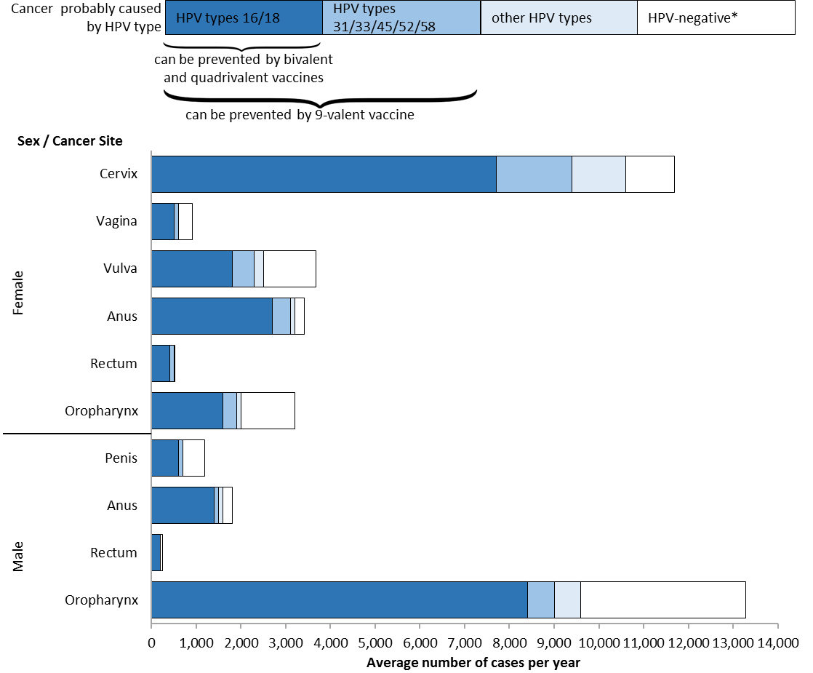
HPV-Associated Cancers per Year, United States, 2009–2013
Based on Viens et al. MMWR 2016. https://www.cdc.gov/cancer/hpv/statistics
Notes:
This slide shows the number of HPV-Associated Cancer cases that were diagnosed and reported each year in United States from 2009 to 2013 (the most recent 5-year period with available data).
Cancer registries do not routinely collect data on whether HPV is in the cancer tissue. So, to estimate the number of HPV-associated cancers, researchers look at cancer in parts of the body and cancer cell types that are likely to be caused by HPV. These parts of the body include the cervix, vagina, and vulva among women; the penis among men; and the anus, rectum, and oropharynx, which is the back of the throat, including the base of the tongue and the tonsils. The cellular types include carcinomas of the cervix and squamous cell carcinomas of the vagina, vulva, penis, anus, rectum, and oropharynx. Additionally, in this analysis, all cancers were microscopically confirmed.
A CDC study published in 2016 used population-based data to genotype HPV types from cancer tissue. These data are used to estimate the percentage of these cancers that are probably caused by HPV, what we call HPV-attributable cancers.
This graph shows the total number of HPV-associated cancers and uses the attributable fractions from the genotyping study to estimate the number probably caused by HPV types. HPV types were grouped as 16/18 (the dark blue bar), other high risk types 31/33/45/52/58 (the medium blue bar), and other HPV types (light blue bar). The white bar means that HPV DNA was not detected.

Slide 13
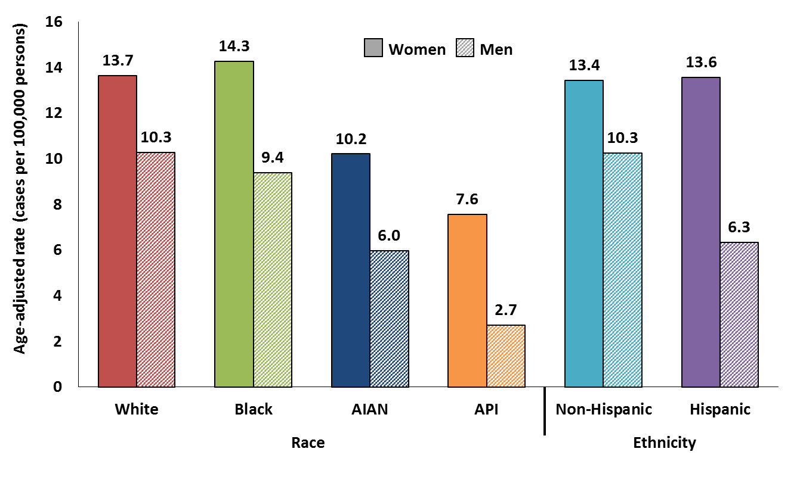
HPV-Associated Cancer Rates by Sex, Race and Ethnicity, United States, 2009–2013
Based on Viens et al. MMWR 2016. https://www.cdc.gov/cancer/hpv/statistics
Notes:
This graph shows the incidence of all HPV-associated cancers (all carcinomas of the cervix and squamous cell carcinomas of the vagina, vulva, penis, anus, rectum, and oropharynx) by sex, race and ethnicity. “Incidence rate” means how many people out of a given number get the disease each year. Incidence rates of HPV-associated cancers varied by sex and race or ethnic group. The rate for women is shown in the solid bar and the rate for men is shown in the hatched bar.
In each race/ethnic group, women had higher rates than men (because of cervical cancer).
Among women, blacks had the highest rates and Asian/Pacific Islanders had the lowest rates compared with other racial groups and Hispanics had higher rates than non-Hispanics.
Among men, whites had the highest rates and Asian/Pacific Islanders had the lowest rates compared with other racial groups and non-Hispanics had higher rates than Hispanics.
However, there were differences by cancer site. For example, men had higher rates of HPV-associated cancers of the oropharynx than women. More data by race and ethnicity can be found at cdc.gov/cancer/hpv

Slide 14
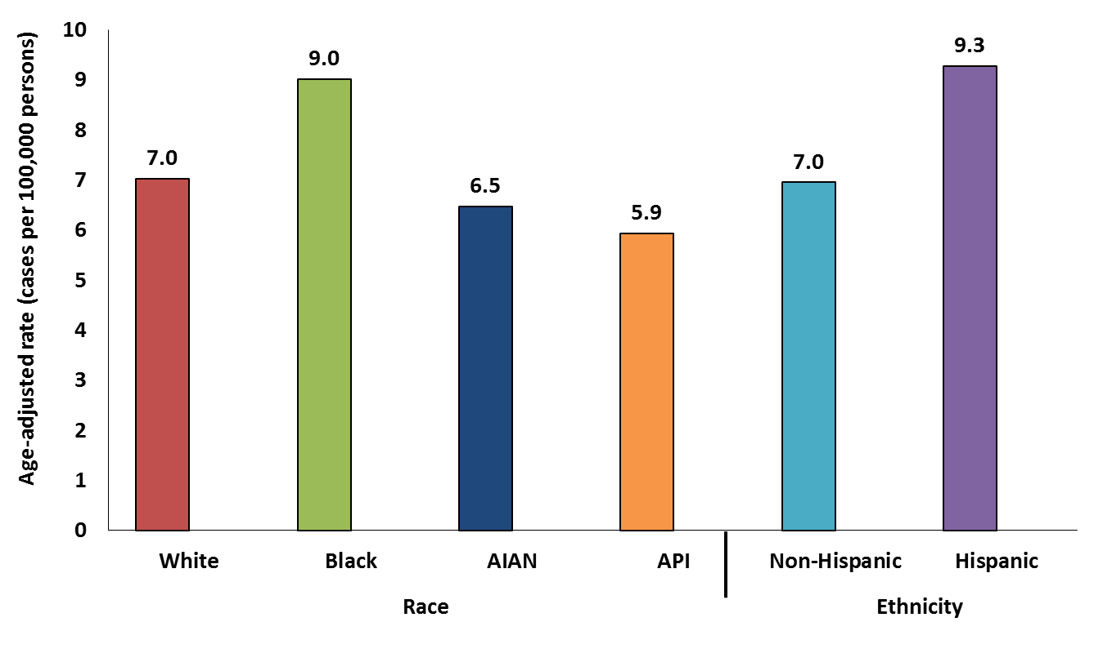
HPV-Associated Cervical Cancer Rates by Race and Ethnicity, United States, 2009–2013
Based on Viens et al. MMWR 2016. https://www.cdc.gov/cancer/hpv/statistics
Notes:
It is estimated that about 12,000 new cases of HPV-associated cervical cancer were diagnosed in the United States each year during 2009-2013. Black and Hispanic women had higher rates of HPV-associated cervical cancer than women of other races or ethnicities, possibly because of decreased access to Pap testing or follow-up treatment.

Slide 15
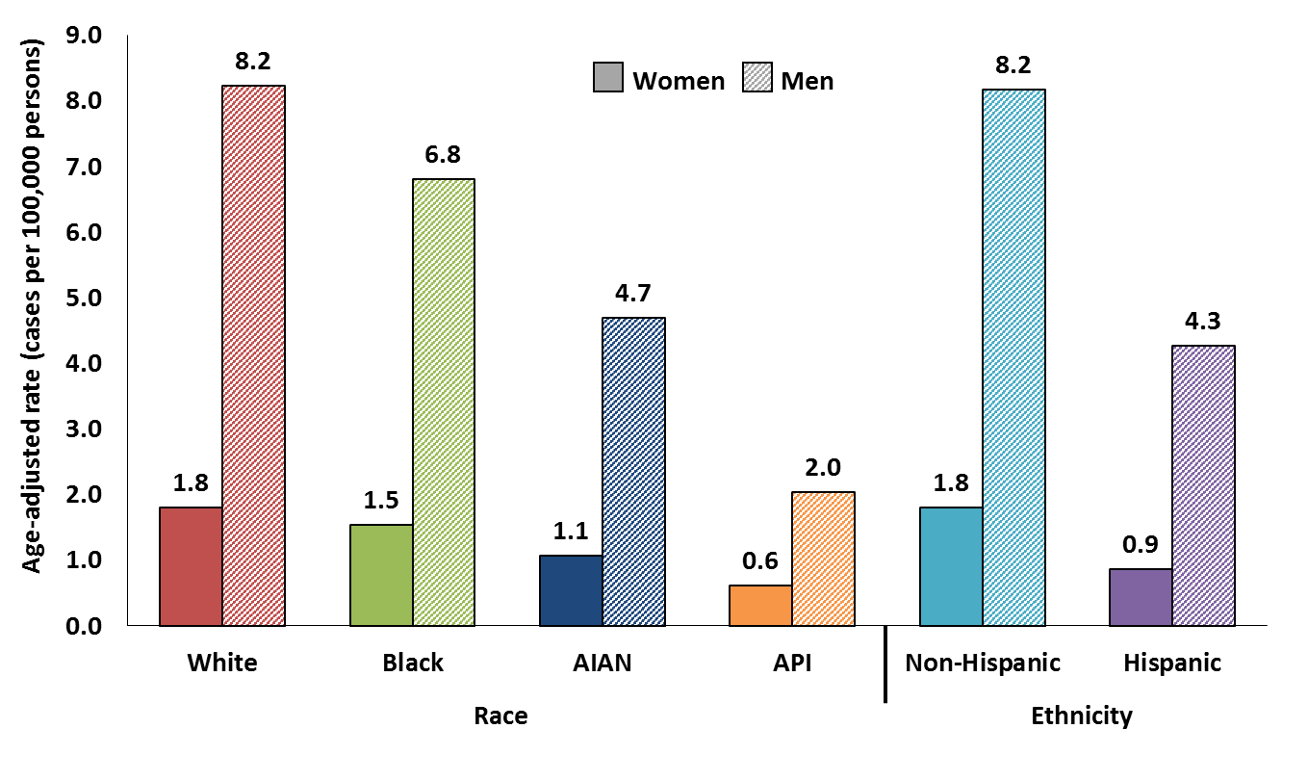
HPV-Associated Oropharyngeal Cancer Rates by Sex, Race and Ethnicity, United States, 2009–2013
Based on Viens et al. MMWR 2016. https://www.cdc.gov/cancer/hpv/statistics
Notes:
Some cancers of the oropharynx, which includes the back of the throat, including the base of the tongue and the tonsils, have been linked with HPV. It is estimated that about 3,200 new cases of HPV-associated oropharyngeal cancers were diagnosed in women and 13,300 were diagnosed in men each year during 2009-2013 in the United States. These numbers are based on cancers in specific areas of the oropharynx and do not include cancers in all areas of the head and neck or oral cavity. Men had higher rates of HPV-associated oropharyngeal cancer than women. Black and Hispanic men and women had lower rates of HPV-associated oropharyngeal cancers than white and non-Hispanic men and women.

Slide 16
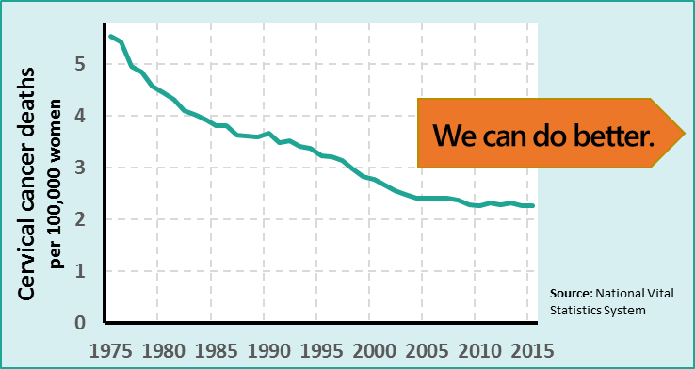
Cervical Cancer
Cervical cancer is the most common HPV-associated cancer among women
528,000 new cases and 266,000 deaths world-wide in 2012
12,000 new cases and 4,000 deaths in the U.S. in 2013
Half of cervical cancers occur in women <50 years
A quarter of cervical cancers occur in women 25-39 years
https://nccd.cdc.gov/uscs/ and http://gco.iarc.fr/today/home
Notes:
Cervical cancer was once the leading cause of cancer death for women in the United States. Now it is the most preventable of all of the female cancers. The Pap test has helped decrease the number of women in the U.S. diagnosed with cervical cancer by about 75% in the past 50 years. However even with an excellent cervical cancer screening program in the U.S., there are still about 12,000 new cases of cervical cancer and 4,000 deaths each year in this country. No women should die of cervical cancer. Worldwide, cervical cancer is the 4th most common cancer among women, and in some countries, it is the most common.
Half of cervical cancer cases in the United States occur in women younger than 50 years, with 1 in 4 of cervical cancer cases among women age 25-39 years, during prime reproductive years. A cervical cancer diagnosis and treatment may be devastating to women and their families for a variety of reasons, including negative effects on their health, welfare, finances, and ability to work. Cervical cancer is treated at minimum with the removal of the cervix but may also include radical hysterectomy, radiation, and/or chemotherapy.

Slide 17
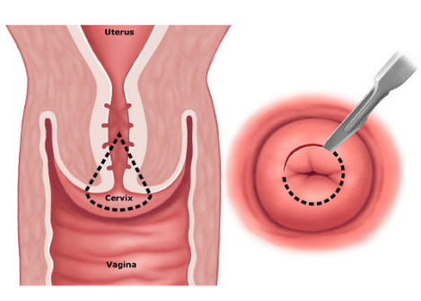
Cervical pre-cancer in U.S. females
1.4 million new cases of low grade cervical dysplasia
330,000 new cases of high grade cervical dysplasia
Koshiol Sex Transm Dis. 2004.
Schiffman Arch Pathol Lab Med. 2003.
Notes:
When some people talk about HPV disease the focus is usually on the 12,000 cases of cervical cancer and the 4,000 deaths. But as you can see in this slide, every year 1.4 million women will be diagnosed with low grade cervical dysplasia. Each of these women was faced with the emotionally trying news of an abnormal pap test, a colposcopy with biopsy that are done without local or general anesthesia, waiting to hear whether or not they have cancer.
More than 300,000 women in the United States are diagnosed with high grade cervical dysplasia, or cervical precancer. To receive this diagnosis each of these women have undergone a colposcopy with biopsies. After receiving the diagnosis many will go on to have a LEEP procedure or a cold-knife cone biopsy of the cervix, which is shown in the image.
Preventing cancer is better than treating it. Preventing the infections that can lead to cancer is even better.

Slide 18
HPV Vaccine
Evidence-Based HPV Disease Prevention
Notes:
This next section will focus on HPV vaccine recommendations.

Slide 19
HPV Vaccine Comparison
Cervarix
Gardasil(4)
Genital warts
63% of cancers in body parts where HPV DNA is often found
10% of cancers in body parts where HPV DNA is often found
Adapted from Petrosky et al. MMWR. 2015.
Notes:
This chart demonstrates the HPV types targeted by each HPV vaccine. Bivalent HPV vaccine target two types of HPV, quadrivalent HPV vaccine targets four types of HPV, and 9-valent HPV vaccine targets nine types of HPV. Bivalent, quadrivalent, and 9-valent HPV vaccine all protect against HPV 16 and 18, the HPV types that cause about 66% of cervical cancers and the majority of other HPV-attributable cancers in the United States. Quadrivalent and 9-valent HPV vaccine also protect against HPV 6 and 11, HPV types that cause anogenital warts. In addition, 9-valent HPV vaccine targets five additional cancer-causing types, which account for another 15% of cervical cancers. The additional five types in 9-valent HPV vaccine account for a higher proportion of HPV-associated cancers in women compared with men, and also cause cervical precancers in women. All three vaccines are still licensed in the United States; however, after the end of 2016, however only 9-valent HPV vaccine is currently being marketed in the United States.
While clinical trial data show HPV vaccine has high efficacy for prevention of several of the HPV associated precancers in addition to cervical precancers, no clinical trial data are available to demonstrate efficacy for prevention of oropharyngeal or penile cancers. However, because many of these are attributable to HPV16, the HPV vaccine is likely to offer protection against these cancers as well.

Slide 20
HPV Vaccination is Recommended at Age 11 or 12 Years
Girls & Boys can start HPV vaccination at age 9
Preteens should finish the HPV vaccine series before their 13th birthday
Plus girls 13-26 years old who haven’t started or finished HPV vaccine series
Plus boys 13-21 years old who haven’t started or finished HPV vaccine series
Meites et al. MMWR. 2016.
Notes:
To recap the HPV vaccine recommendations, both girls and boys can start the HPV vaccine series at age nine. Ideally, preteens should finish the series by their 13th birthday. Girls age 13-26 years old and boys age 13-21 years old who haven’t stared or finished HPV vaccine series should also be vaccinated.

Slide 21
HPV Vaccine Recommendation
CDC recommends routine vaccination
at age 11 or 12 years to prevent HPV cancers
The vaccination series can be started at age 9 years
Two doses of vaccine are recommended
The second dose of the vaccine should be administered 6 to 12 months after the first dose.
21
Meites et al. MMWR. 2016.
Notes:
HPV vaccine is routinely recommended for adolescents at age 11 or 12 years. For girls and boys starting the vaccination series before the 15th birthday, the recommended schedule is two doses of HPV vaccine. The second dose should be given six to twelve months after the first dose.

Slide 22
Dosing Schedules
Starting the vaccine series before the 15th birthday
Starting the vaccine series on or after the 15th birthday*
Recommended schedule is
2 doses of HPV vaccine
Second dose should be administered 6–12 months after the first dose (0, 6–12 month schedule)
Minimum interval between dose one and dose two in a 2-dose schedule is 5 months
Recommended schedule is
3 doses of HPV vaccine
Second dose should be administered 1–2 months after the first dose, and the third dose should be administered 6 months after the first dose (0, 1–2, 6 month schedule)
Minimum interval between dose one and dose three in a 3-dose schedule is 5 months
*and immunocompromised persons 9-26 years
Meites et al. MMWR. 2016.
Notes:
The new recommendations for HPV vaccine dosing schedules are:
For persons initiating vaccination before the 15th birthday, the recommended immunization schedule is 2 doses of HPV vaccine. The second dose should be administered 6–12 months after the first dose (for a 0, 6–12 month schedule).
For persons initiating vaccination on or after the 15th birthday, the recommendation for a 3-dose schedule remains. The second dose should be administered 1–2 months after the first dose, and the third dose should be administered 6 months after the first dose (for a 0, 1–2, 6 month schedule).
For persons who initiated vaccination with nine-valent, quadrivalent or bivalent HPV vaccine before their 15th birthday, and received two doses of any HPV vaccine at the recommended dosing schedule (zero, six to twelve months), or three doses of any HPV vaccine at the recommended dosing schedule (zero, one to two, and six months), are considered adequately vaccinated. Persons who initiated vaccination with nine-valent, quadrivalent or bivalent HPV vaccine on or after their 15th birthday, and received three doses of any HPV vaccine at the recommended dosing schedule, are considered adequately vaccinated. Nine-valent HPV vaccine may be used to continue or complete a vaccination series started with quadrivalent or bivalent HPV vaccine.
For persons who have been adequately vaccinated with quadrivalent or bivalent HPV vaccine, there is no ACIP recommendation regarding additional vaccination with nine-valent HPV vaccine.

Slide 23
HPV Vaccine Safety
Notes:
This next section will focus on HPV vaccine safety.

Slide 24
United States Vaccine Safety System
System | Collaborators | Description
Vaccine Adverse Event Reporting System (VAERS) | CDC and FDA | Frontline spontaneous reporting system to detect potential vaccine safety issues
Vaccine Safety Datalink (VSD) | CDC and 9 Integrated Health Care Systems | Large linked database system used for active surveillance and research ~9.4 million members (~3% of US pop.)
Clinical Immunization Safety Assessment (CISA) Project | CDC and 7 Academic Centers | Expert collaboration that conducts individual clinical vaccine safety assessments and clinical research
Post-Licensure Rapid Immunization Safety Monitoring Program (PRISM) | FDA and 6 partner organizations | Large distributed database system used for active surveillance and research ~170 million individuals
Notes:
All vaccines go though many years of testing and clinical studies before they are licensed for use. CDC and FDA monitor the safety of vaccines after they are licensed. The major systems that monitor and evaluate post-licensure vaccine safety in the United States include: VAERS, VSD, CISA, and PRISM. Safety findings from any of these systems are used to inform health officials, health care providers, and the public.

Slide 25
Over 10 Years of HPV Vaccine Safety Data
HPV vaccine is safe
Reactions after vaccination may include
Injection site reactions: pain, redness, and/or swelling in the arm where the shot was given
Systemic: fever, headaches
HPV vaccines should not be given to anyone who has had a previous allergic reaction to the vaccine or who has an allergy to yeast (Gardasil/Gardasil 9)
Brief fainting spells (syncope) and related symptoms (such as jerking movements) can happen soon after any injection, including HPV vaccine
Patients should be seated (or lie down) during vaccination and remain in that position for 15 minutes
Gee, et al. Hum Vaccin Immunother. 2016.
Notes:
Post licensure HPV vaccine safety data from the United States and other countries over the past 10 years have been robust and reassuring. Based on these data that show the vaccine is safe, what type of side effects do we expect? We know that we can expect HPV vaccination to cause some injection site reactions, possibly fever, and headache. We know that anyone who has any severe allergies, including an allergy to yeast, anyone who has ever had a life-threatening allergic reaction to any component of HPV vaccine or to a previous dose of HPV vaccine, should not be vaccinated. We also know that fainting spells, or syncope, is very common with adolescents when they receive injections. To reduce the risk of syncope patients should be seated while vaccinated and remain in that position or should lay down for 15 minutes.

Slide 26
Evaluating and Monitoring 9-valent HPV Vaccine Safety in the United States
Monitoring of VAERS Reports
Clinical review of deaths and other pre-specified adverse events
Data mining to identify disproportional reporting
Vaccine Safety Datalink
Near real time monitoring of 10 pre-specified outcomes
Evaluation of spontaneous abortion
Sentinel System
Near real time active surveillance and surveillance of serious, unexpected events
Evaluation of spontaneous abortion
Manufacturer post-marketing commitments
Two, 10-year studies to assess long term safety
Observational study to further characterize the safety profile in 10,000 persons
Pregnancy registry
Notes:
9-valent HPV vaccine is similar to quadrivalent HPV vaccine in its manufacturing process and content, and the pre-licensure safety data are reassuring. In the United States, the safety of 9-valent HPV vaccine is currently being monitored through review of spontaneous reports, active surveillance, and special epidemiologic studies as listed on this slide.

Slide 27
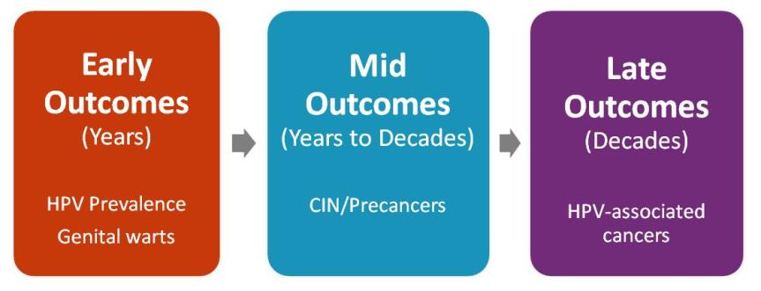
HPV Vaccine Impact
Monitoring Impact of HPV Vaccine Programs on HPV-Associated Outcomes
Notes:
This next section will focus on the impact of HPV vaccine. As you can see in the visual here, impact on early outcomes such as HPV [prevalence and rates of genital warts can be demonstrated in just a few years after vaccine introduction. Because of the delay between infection and pre-cancer and then cancer, it will take longer to see impact on disease.

Slide 28
HPV vaccine impact monitoring
Post licensure evaluations are important to evaluate real world effectiveness of vaccines
Population impact against early and mid outcomes have been reported:
Genital warts
Australia, New Zealand, Denmark, Sweden, Germany, Quebec, US
HPV prevalence
Australia, Norway, Denmark, Sweden, UK, US
Cervical lesions
Australia, British Columbia, Denmark, Sweden, US
Notes:
HPV vaccination impact can be monitored through post-licensure evaluations of the various outcomes of HPV infection, including HPV prevalence, genital warts, and precancerous cervical lesions. Reduction in each of these outcomes have been reported in a number of countries with strong HPV vaccination programs.

Slide 29
Systematic Review and Meta-Analysis: Population-Level Impact of HPV Vaccination
Review of 20 studies in 9 high income countries
In countries with >50% coverage, among 13-19 year olds
HPV 16/18 prevalence decreased at least 68%
Anogenital warts decreased by ~61%
Evidence of herd effects
Some evidence of cross protection against other types
29
Drolet et al. Lancet Infect Dis. 2015
Notes:
These are just two of the studies that have now been published to examine the real-world impact of HPV vaccination. In 2015 a systematic review and meta-analysis of these studies was published which summarized the population-level impact of HPV vaccination. In countries where the HPV vaccine coverage rates were 50% and above among teens, prevalence of infection with HPV 16 and HPV 18 decreased by more than two-thirds and prevalence of anogenital warts decreased by nearly two-thirds. The review found that there is evidence of both herd effects as well as protection with other HPV types not included in the vaccines.

Slide 30
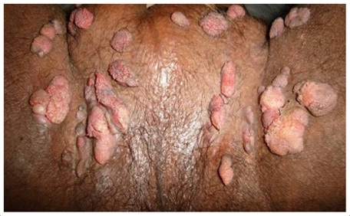
Genital Warts – An Even Better Selling Point?

Slide 31
Adolescent Vaccination Coverage United States, 2006-2015
Reagan-Steiner et al. MMWR 2016.
Notes:
As you can see, the rates of first and third dose of HPV vaccine are not nearly as high as the coverage rates for the other vaccines routinely recommended for 11 and 12 year olds. However, the very important piece of information that this slide provides is that the strong coverage rates for Tdap vaccine demonstrate that not only are most preteens and teens getting to the doctor, but they are also getting at least one of the recommended adolescent vaccines.

Slide 32
Impact of Eliminating Missed Opportunities by Age 13 Years in Girls Born in 2000
Stokley et al. MMWR. 2014.
Notes:
A missed clinical opportunity for HPV vaccination is defined as a healthcare encounter when some, but not all ACIP-recommended vaccines are given. Had HPV vaccine been administered during health care visits when another vaccine was administered, vaccination coverage for at least one 1 dose could have reached 91.3% by age 13 years for adolescent girls born in 2000.
High HPV vaccination coverage with existing infrastructure and health-care utilization is possible in the United States. Taking advantage of every health-care encounter, including acute-care visits, to assess every adolescent’s vaccination status can help minimize missed opportunities. Potential strategies include using vaccination prompts available through electronic health records or checking local and state immunization information systems to assess vaccination needs at every encounter. Series completion also can be promoted through scheduling appointments for second and third doses before patients leave providers’ offices after receipt of their first HPV vaccine doses and with automated reminder-recall systems.

Slide 33
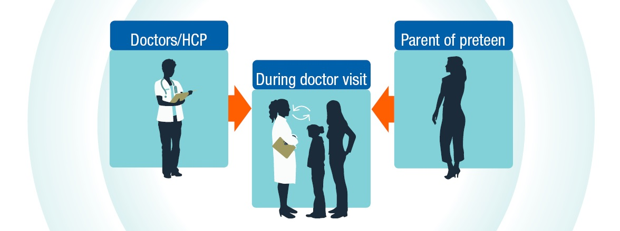
Framing the conversation
Pharmacist/HCP
Parent of preteen
During pharmacy visit
Talking about HPV vaccine
Notes:
This next section focuses on strategies to improve HPV vaccine recommendations and conversations with patients and their parents

Slide 34
Clinicians underestimate the value parents place on HPV vaccine
Adapted from Healy et al. Vaccine. 2014.
Notes:
However, the estimates that clinicians gave for how much value parents place on flu and HPV vaccination are much lower. These clinicians underestimated the value parents place on HPV vaccine. This is evidence of a big disconnect between parents and clinicians.

Slide 35
Reasons parents won’t initiate HPV vaccination for children
Stokley et al. MMWR. 2014.
Notes:
Studies consistently show that a strong recommendation from you is the single best predictor of vaccination for any vaccine, including HPV vaccine. In the 2014 NIS-Teen nearly 15% of parents who said that they would not be getting their child vaccinated against HPV in the next 12 months, identified not receiving a recommendation as one of the top reasons not to vaccinate.

Slide 36
Clinicians Underestimate the Value Parents Place on HPV Vaccine
“The perceived and real concerns of parents influence how the pharmacist or clinician recommends and administers HPV vaccine.”
Adapted from Healy et al. Vaccine. 2014.
Notes:
Whether a parents concerns are real or just perceived by the clinician, it affects the way HPV vaccine is recommended and administered. This changes the conversation between the clinician and the parents regarding HPV vaccine.

Slide 37
Give an Effective Recommendation to Receive HPV Vaccine at Ages 11 or 12
An effective recommendation from you is the main reason parents decide to vaccinate
Many moms in focus groups stated that they trust their child’s doctor and would get the vaccine for their child as long as they received a recommendation from the doctor
Smith et al. Vaccine. 2016. Unpublished CDC data, 2013.
Notes:
A clinician’s recommendation is the number one reason parents decide to protect their children with vaccination. Regardless of the perceived or real concerns of a parent, an effective recommendation for all adolescent vaccines needs to be given. There is a strong evidence base to support the importance of an effective recommendation.

Slide 38
What is an
EFFECTIVE
recommendation
for HPV vaccination?
Notes:
So that begs the question. What IS an effective recommendation for HPV vaccination?

Slide 39
Same Way Same Day
Notes:
The best and most effective recommendation for HPV vaccination is when HPV vaccine is recommended in the same way and on the same day as the other vaccines recommended for girls and boys at ages 11 and 12 years.

Slide 40
Make an Effective Recommendation
Same way: Effective recommendations group all of the adolescent vaccines Recommend HPV vaccination the same way you recommend Tdap & meningococcal vaccines.
Same day: Recommend HPV vaccine today Recommend HPV vaccination the same day you recommend Tdap & meningococcal vaccines.
Brewer at al. Pediatrics. 2017. Unpublished CDC data, 2013.
Notes:
Successful recommendations group all of the adolescent vaccines
Recommend the HPV vaccine series the same way you recommend the other adolescent vaccines

Slide 41
Your preteen not only needs TdaP, but also needs two other vaccines today to protect against meningitis and HPV cancers. .
Brewer at al. Pediatrics. 2017.
Notes:
I want to point out a few things on this slide. The word “today” is especially important because it conveys to the parent that you are recommending that all of these vaccines be given today, not another day.
The order of the vaccine-preventable diseases is also important. We want to sandwich HPV cancers between meningitis, because meningit6is is a disease that parents really want to prevent, and pertussis, because most parents are going to get that vaccine for their child. So meningococcal 1st, HPV cancer 2nd, pertussis 3rd.

Slide 42
Brief Option
Now that Sophia is 11, she is due for three vaccines today. These will help protect her from the infections that can cause meningitis, HPV cancers, and pertussis. I’d recommend we give all three vaccines at the same time, today.
Notes:
So you could say something like “now that Sophia is 11, she is due for three vaccines. These will help protect her from meningitis, HPV cancers, and pertussis. We’ll give those shots at the end of the visit.”

Slide 43
Longer Option
Now that Sophia is 11, she is due today for three important vaccines, not just TdaP. One is to help prevent an infection that can cause meningitis, which is very rare, but potentially deadly. The second is to prevent a very common infection, HPV, that can cause several kinds of cancer. The Tdap, or “tetanus booster” also protects against pertussis, so your child doesn’t get whooping cough, but also to protect babies too young to be vaccinated. I’d suggest we give all those shots here today. Do you have any questions for me?
Notes:
Some of you may feel more comfortable with saying a bit more about each of the vaccines being recommended. Here’s another way to make the bundled recommendation. You can say “Now that your child is 11/12, she is due today for three important vaccines. The first is to help prevent an infection that can cause meningitis, which is very rare, but potentially deadly. The second is to prevent a very common infection—HPV—that can cause several kinds of cancer. The third is the “tetanus booster” which also protects against pertussis, so your child doesn’t get whooping cough, but also to protect babies too young to be vaccinated. We’ll give those shots at the end of the visit. Do you have any questions for me?”

Slide 44
Some Parents Need Reassurance
Many parents simply accept this bundled recommendation. Stop there; don’t apologize.
Some parents may be interested in vaccinating, yet still have questions. Interpret a question as their needing additional reassurance from YOU, the clinician they trust with their child’s health care
Ask parents about their main concern (be sure you are addressing their real concern)
Unpublished CDC data, 2013.
Notes:
Many parents will accept the bundled recommendation without any questions. Other parents may be interested in vaccinating, yet still have questions for you.
A question from a parents about HPV vaccine does not mean they are refusing or delaying. Many parents with questions about HPV vaccine are looking for additional reassurance from you. Taking the time to listen to parents’ questions helps you save time and give an effective response. Be sure to verify that you are addressing the right concern.

Slide 45
Why does my child need HPV vaccine?
Notes:
Some parents may ask, “Why does my child need HPV vaccine?” This question may also sound like “My daughter doesn’t really need THAT vaccine, does she?” Regardless of how parents ask that question we want them to know that this vaccine is very important for cancer prevention.

Slide 46
HPV vaccination is important because it prevents cancer. That’s why I’m recommending that your child start the HPV vaccine series today.
Notes:
You can respond to them by saying, “HPV vaccination is important because it prevents cancer. That’s why I’m recommending that your child start the HPV vaccine series today.”

Slide 47
What cancers are caused by HPV infection?
Notes:
CDC research with parents has shown that many parents aren’t aware of all of the cancers that can be caused by persistent HPV infection, so some parents may ask you about the cancers that are caused by HPV infection.

Slide 48
Certain HPV types can cause cancer of the cervix, vagina, and vulva in females, cancer of the penis in men, and in both females and males, cancers of the anus and the throat.
We can help prevent infection with the HPV types that cause these cancers by starting the HPV vaccine series today.
Notes:
You can tell parents that HPV infection can cause cervical, vaginal, vulvar, penile, anal, and oropharyngeal cancers, but by starting the HPV vaccines series today, we can prevent infection with the HPV types that most commonly cause those cancers.
You could say “Certain HPV types can cause cancer of the cervix, vagina, and vulva in females, cancer of the penis in men, and in both females and males, cancers of the anus and the throat. We can help prevent infection with the HPV types that cause these cancers by starting the HPV vaccine series today.”

Slide 49
Is my child really at risk for HPV?
Notes:
It’s hard for parents to see their 11 or 12 year old as being at risk for HPV infection and they make ask about that risk.

Slide 50
HPV is a very common and widespread virus that infects both females and males. We can help protect your child from the cancers and diseases caused by the virus by starting HPV vaccination today.
Notes:
Focus on how common HPV is and how they can protect their child from cancer by saying something like “HPV is a very common and widespread virus that infects both females and males. We can help protect your child from the cancers and diseases caused by the virus by starting HPV vaccination today.”

Slide 51
Why at 11 or 12 years old?
Notes:
Asking why now, or why at 11 or 12, is another way that parents may say that they think their child is too young for “that” kind of behavior, in other words, sexual activity. Help parent understand the importance of vaccination before exposure and that we don’t wait for exposure to occur, or guess when it will occur, before vaccinating.

Slide 52
When should the bike helmet go on?
Before they get on their bike
When they are riding their bike in the street
When they see the car heading directly at them
After the car hits them
Temte JL. Pediatrics 2014.
Notes:
Most people are familiar with, and endorse the use of bicycle helmets. You could also use seatbelts as an example. Ask parents, “When do you want your children to put on their bike helmets? Make the point that we can’t guess when the bike accident risk may occur so we always have our children put on their helmets before getting on their bikes.

Slide 53
When do we put our seat belts on?
Before turning on car
When leaving driveway
After a near accident
Temte JL. Pediatrics 2014.
Notes:
You could also use seatbelts as an example. Ask parents, “When do we put our seat belts on?”

Slide 54
As with all vaccine-preventable diseases, we want to protect your child early. If we start now, it’s one less thing for you to worry about.
Also, your child will only need two shots of HPV vaccine at this age. If you wait until 15, your child will need three shots.
We’ll give the first shot today and then you’ll need to bring your child back 6 to 12 months from now for the second shot.
Notes:
Or you can just say, “As with all vaccine-preventable diseases, we want to protect your child early. If we start now, it’s one less thing for you to worry about. Also, your child will only need two shots of HPV vaccine at this age. If you wait until 15, your child will need three shots. We’ll give the first shot today and then you’ll need to bring your child back in 6 to 12 months from now for the second shot.”

Slide 55
I’m just worried that my child will perceive this as a green light to have S-E-X.
Notes:
Parents continue to bring concerns about sexual disinhibition following vaccination.

Slide 56
Numerous research studies have shown that getting the HPV vaccine does not make kids more likely to be sexually active or start having sex at a younger age. Starting the HPV vaccine series today will give your child the best protection possible for the future.
Notes:
You can reassure these parents that “Numerous research studies have shown that getting the HPV vaccine does not make kids more likely to be sexually active or start having sex at a younger age. Starting the HPV vaccine series today will give your child the best protection possible for the future.”

Slide 57
“How long can we wait and still give just two doses?”
Notes:
The new two-dose recommendation may cause some parents to think that they can wait another year… or three.

Slide 58
The two-dose schedule is recommended if the series is started before the 15th birthday.
However, I don’t recommend waiting to give this cancer-preventing vaccine. As children get older and have busier schedules, it becomes more difficult to get them back in.
I’d feel best if we started the series today to get your child protected as soon as possible.
Notes:
You can tell these parents, “The two-dose schedule is recommended if the series is started before the 15th birthday. However, I don’t recommend waiting to give this cancer-preventing vaccine. As children get older and have busier schedules, it becomes more difficult to get them back in. I’d feel best if we started the series today to get your child protected as soon as possible.”

Slide 59
I have some concerns about the safety of the vaccine—I keep reading things online that says HPV vaccination isn’t safe.
Do you really know if it’s safe?
Notes:
Naturally, some parents will have questions about HPV vaccine safety.

Slide 60
It sounds like you are generally in support of vaccines, but you have concerns about the safety of HPV. Is that right?
So if you had information that convinced you the HPV vaccine was safe you might consider letting your daughter get it?
I’d like to share with you what I know about the safety of HPV vaccine…
Notes:
You could start with something like, “It sounds like you are generally in support of vaccines, but you have concerns about the safety of HPV. Is that right? So if you had information that convinced you the HPV vaccine was safe you might consider letting your daughter get it? I’d like to share with you what I know about the safety of HPV vaccine…” and then share that specific information with them.

Slide 61
I know there are stories in the media and online about vaccines, and I can see how that could concern you.
However, I want you to know that HPV vaccine has been carefully studied for many years by medical and scientific experts.
Based on all of the data, I believe HPV vaccine is very safe.
Notes:
It is important to acknowledge a parent’s concerns. Try saying something like “I know there are stories in the media and online about vaccines, and I can see how that could concern you. However, I want you to know that HPV vaccine has been carefully studied for many years by medical and scientific experts. Based on all of the data, I believe HPV vaccine is very safe.”

Slide 62
Vaccines, like any medication, can cause side effects. With HPV vaccination this could include pain, swelling, and/or redness where the shot is given, or possibly headache. Sometimes kids faint when they get shots and they could be injured if they fall from fainting. We’ll protect your child by having her stay seated after the shot.
Notes:
If safety concerns are specific to adverse events, explain to parents that “Vaccines, like any medication, can cause side effects. With HPV vaccination this could include pain, swelling, and/or redness where the shot is given, or possibly headache. Sometimes kids faint when they get shots and they could be injured if they fall from fainting. We’ll protect your child by having them stay seated after the shot.”

Slide 63
Could HPV vaccine cause my child to have problems with having a baby later on?
Notes:
Sometimes vaccine safety questions can be very specific.

Slide 64
There are no data suggesting that HPV vaccine will affect future fertility.
On the other hand, women who develop cervical cancer or pre-cancer could require treatment that would limit their ability to have children.
Starting the HPV vaccine series today could prevent that from happening and protect your daughter’s ability to bear children.
Notes:
If you get a question about fertility concerns you can say “There is no data available to suggest that getting HPV vaccine will have an effect on future fertility. However, women who develop cervical cancer could require treatment that would limit their ability to have children. Starting the HPV vaccine series today could prevent that from happening and protect your daughter’s ability to bear children.”

Slide 65
More than a decade of HPV vaccine safety studies have been very reassuring.
To date, we have not observed any signal that shows that HPV vaccination causes
death/ neurologic conditions/ autoimmune conditions/ venous thromboembolism/ postural orthostatic tachycardia syndrome/ complex regional pain syndrome or anything else except protection!
Notes:
If you get questions about other specific safety concerns such as death, neurologic conditions, autoimmune conditions, venous thromboembolism, postural orthostatic tachycardia syndrome, or complex regional pain syndrome you can say, “HPV vaccine safety studies have been very reassuring and date, we have not observed any signal that shows that HPV vaccination causes that health problem.”

Slide 66
How do you know if the vaccine works?
Notes:
Parents may voice concerns about vaccine effectiveness.

Slide 67
Ongoing studies continue to show that HPV vaccination works very well. HPV infections, genital warts, and cervical precancers in young people have all decreased in the years since the vaccine has been available. Starting the vaccine series today will help ensure your child gets the best protection possible.
Notes:
You can let parents know that “Ongoing studies are showing that HPV vaccination works very well and has decreased HPV infection, genital warts, and cervical precancers in young people, in the years since it has been available. Starting the vaccine series today will help ensure your child gets the best protection possible.”

Slide 68
Why do boys need HPV vaccine?
Notes:
As I mentioned previously, many parents are not aware of HPV disease in men and may ask why their male child needs to be vaccination.

Slide 69
HPV infection can cause cancers of the penis, anus, and throat in men, and men are usually the source of the virus that causes
such trouble in women.
HPV infection can also cause genital warts.
Getting HPV vaccine today for your son can help prevent the infection that can lead to these diseases and transmission of the virus to someone he loves.
Notes:
It is important for parents to know that HPV infection causes cancer in men as well. You can say something like “HPV infection can cause cancers of the penis, anus, and throat in men and it can also cause genital warts. Getting HPV vaccine today for your son can help prevent the infection that can lead to these diseases.”

Slide 70
We only want the vaccines needed for school.
Notes:
Occasionally parents will ask you or another person in your medical office if you or they would give HPV vaccine to you/their kids.

Slide 71
All three vaccines are strongly and equally recommended by the CDC.
All three are also recommended by Pediatric, Adolescent, and Family Medicine doctors and groups.
School-entry requirements don’t always reflect the current recommendations for your child’s health.
Notes:
It is important to explain the difference between a recommendation that you are making for the health of your child, versus a legislative decision that is designed to keep kids who may have missed a vaccination from slipping through the cracks. Letting parents know that you, along with CDC and the major medical societies, recommend all of the vaccines equally for their child’s health can help them understand that HPV vaccination is a normal part of adolescent health. You can share with them that “school-entry requirements don’t always reflect the current recommendations for their child’s health.”

Slide 72
Would you get HPV vaccine for your kids?
Notes:
Occasionally parents will ask you or another person in your medical office if you or they would give HPV vaccine to you/their kids.

Slide 73
Yes, I have given HPV vaccine to my child. I believe strongly in the importance of this cancer-preventing vaccine. The American Pharmacists Association, the American Academy of Pediatrics, the American Academy of Family Physicians, NIH cancer centers, and the CDC all agree that getting the HPV vaccine is very important for your child.
Notes:
If you have vaccinated you child, you can share that with parents by saying something to the effect of “Yes, I have given HPV vaccine to my child because I believe in the importance of this cancer-preventing vaccine.” You can also tell them that The American Academy of Pediatrics, the American Academy of Family Physicians, NIH cancer centers, and the CDC, also agree that getting the HPV vaccine is very important for your child.”

Slide 74
I heard there is a new HPV vaccine that works better. Should I be getting that for my child who already was vaccinated?
Notes:
Parents with children who have already started or finished the HPV vaccine series with bivalent or quadrivalent HPV vaccine may ask about 9-valent HPV vaccine.

Slide 75
The current vaccine is the best there is. Currently there is no recommendation for additional vaccination for someone who has already completed an HPV vaccine series with one of the previously available vaccines.
All HPV vaccines protect against the infections that cause most of the cancers.
Notes:
For a parent who ask about having their child receive additional HPV vaccinations, let them know that “Currently there is no recommendation to vaccinate someone with 9-valent HPV vaccine who previously completed the HPV vaccine series. All three HPV vaccines protect against the types that most commonly cause cancer.”

Slide 76
When do we need to come back?
Notes:
A recent study highlighted the need for parents to be told when they need to bring their child in for the remaining doses. Most parents do not know how many shots are in the series or what the intervals are.

Slide 77
Since your child is younger than 15, she will need a second shot in 6 months to a year.
Before you leave, please put a reminder on your phone to come back to the pharmacy in 6 months. (And/Or, I can send you a message to come back
[if the pharmacy can].)

Slide 78
My child is less than 15 years old and has already had two doses, so why does she need a third shot?
Notes:
Some parents may have additional questions about the new dosing schedule.

Slide 79
The recommended schedule is 2 shots given 6 to 12 months apart.
The minimum effective amount of time between those shots is five months.
Because your child received two shots less than five months apart, we’ll need to give your child a third shot to protect her/him fully.
Notes:
Try saying, “The recommended schedule is 2 shots given 6 to 12 months apart. The minimum amount of time between those shots is five months. Because your child received two shots less than five months apart, we’ll need to give your child a third shot.”

Slide 80
Will my child be protected with just two shots?
Notes:
This question is more common for parents with older children who have completed the 3-dose series.

Slide 81
Yes! Studies have shown that just two shots given at least six months apart when kids are between 9 and 14 years worked as well as or better than three shots given to older adolescents and young adults.
Notes:
Reassure those parents that “Yes! Studies have shown that just two shots given at least six months apart when kids are between 9 and 14 years worked as well or better than three shots given to older adolescents and young adults.”

Slide 82
If a parent doesn’t say yes today…
Ask | Clarify & restate their concerns to make sure you understand
Acknowledge | Emphasize it is the parents’ decision Acknowledge risks & conflicting info sources Applaud them for wanting what is best for their child Be clear that you are concerned for the health of their child, not just public health safety
Advise | Allow time to discuss the pros & cons of the vaccine Be willing to discuss parents’ ideas Offer written resources for parents Tailor your advice using this presentation and info at http://www.pharmacist.com/test-sub-domain-page
Adapted from Henrickson Vax Northwest 2014.
Notes:
A few parents will be hesitant. Here’s a detailed approach to the hesitant parent, based on childhood vaccination work by Vax Northwest.
The steps include: Ask, Acknowledge, & Advise. In short…
-Ask about their concern
-Acknowledge that you know they want to keep their child safe and healthy in every way….and so do you.
-And then advise them on why you recommend getting HPV vaccination now.

Slide 83
If a parent declines today…
Declination is not final. The conversation can be revisited, and can be reinforced by the primary care provider.
End the conversation with at least 1 action you both agree on.
Because waiting to vaccinate is the risky choice, many pediatricians ask the parent to sign a Declination Form. Do pharmacists do this?
Notes:
Some parents will not accept your recommendation for their child this year. But that doesn’t mean they won’t ever have their child protected with HPV vaccination. Make sure you leave the door open to revisit the conversation at the following annual visit.

Slide 84
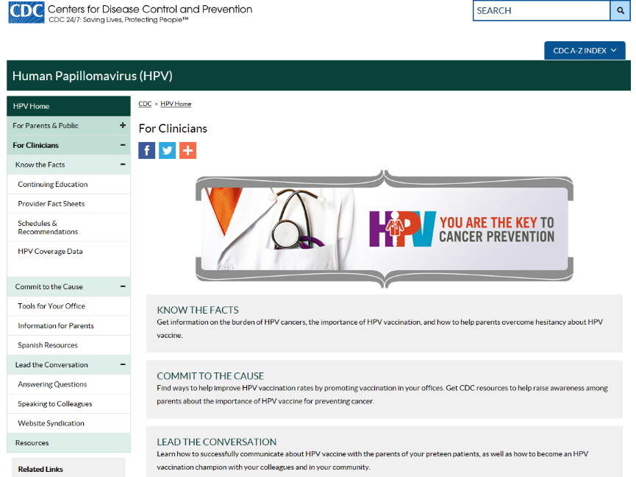
www.cdc.gov/hpv
Notes:
CDC has a variety of resources available to assist clinicians in communicating about HPV vaccine and improving practice to increase immunization rates. Visit CDC.gov slash HPV and click on the section for clinicians.

Slide 85
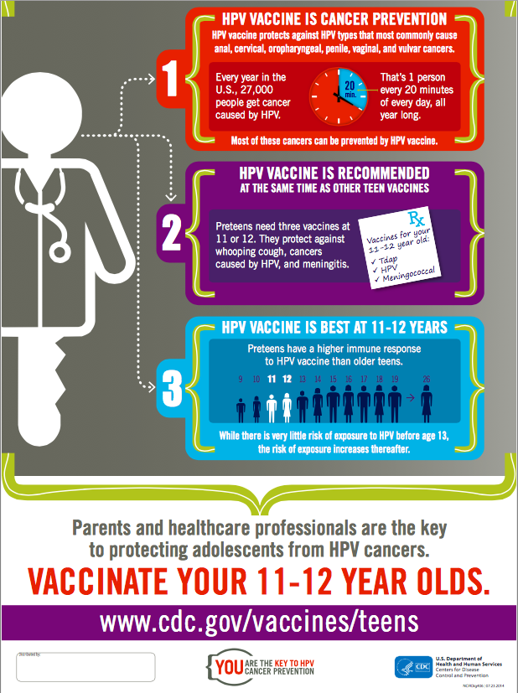
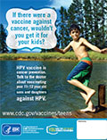
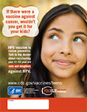
Take Action By:
Displaying free CDC resources including patient videos, posters, flyers, and PSAs in your waiting room and on your website.
Using prepared scripts to record phone hold-line messages or appointment reminders.
Signing up to receive CDC's #PreteenVax newsletter and listening in on our monthly webinars by emailing preteenvaccines@cdc.gov.
Free posters available for ordering in the following sizes: 8.5x11, 11x17, 18x24
https://www.cdc.gov/hpv/hcp/tools-materials.html
https://www.cdc.gov/vaccines/partners/downloads/teens/hpv-cancer-prevention-11x17-p.pdf

Slide 86
HPV VACCINE IS CANCER PREVENTION
And YOU are the key!
Thank you! Lance Chilton
&
The Gynecological Cancer Awareness Project
#WeCanStopHPV

