Slide 1
Management of the Complex Organ Donor Patient

Slide 2
Objectives
Anticipate the pharmacologic needs of the brain injured patient
Diagnose Death by Neurologic Criteria
Appropriately treat electrolyte imbalance

Slide 3
Understanding Brain Death
Can someone who is brain dead breathe without the support of the breathing machine? Yes No Unsure
Can someone who is brain dead ever wake up (recover)? Yes No Unsure
Will someone who is brain dead react (grimace, move away, of blink) if someone touches their eyeball?
Yes No Unsure
Can a person be brain dead even if their heart is beating? Yes No Unsure
Is brain death different from a coma or a vegetative state? Yes No Unsure
Notes:
UNM 4th year Medical Students=39% of all questions.

Slide 4
Uniform Determination of Death Act
An individual who has sustained either
  Irreversible cessation of circulatory and respiratory functions, or
  Irreversible cessation of all functions of the entire brain, including the brain stem, is dead.
A determination of death must be made with accepted medical standards.

Slide 5
AAN Practice Parameter to determine brain death
3 Clinical findings necessary to confirm irreversible cessation of all functions of the entire brain, including the brain stem.
Coma with a known cause
Absence of brainstem reflexes
Apnea

Slide 6
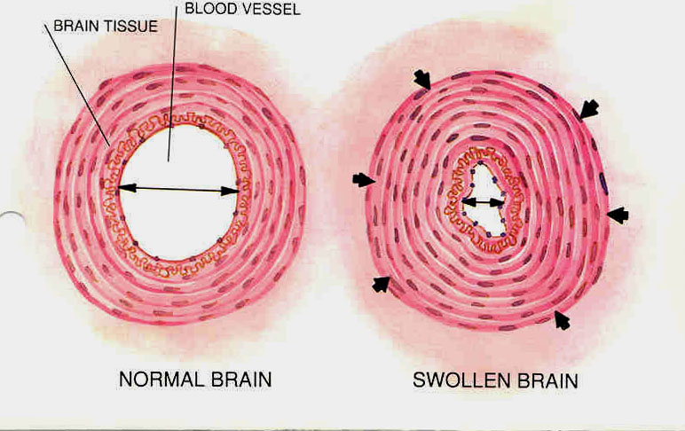
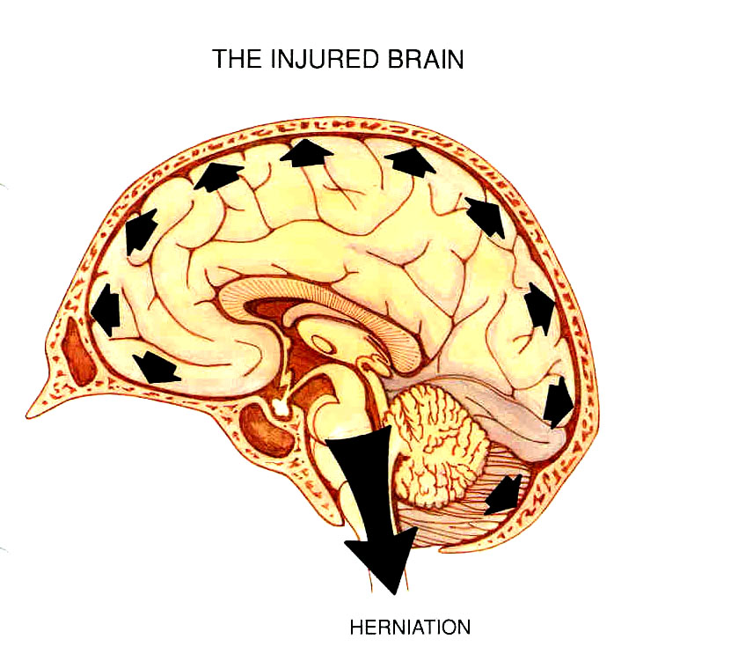
Cerebral Blood Flow

Slide 7
Pathophysiology
Hemodynamic Changes
  Cushing’s Reflex
    Rise in BP & HR as a response to a rise in ICP
    Catecholamine “storm”
      Rise in SVR
      Hypoperfusion, ischemia, hypoxia, metabolic acidosis
      Embarrassment of coronary circulation and resulting ischemia
        Rise in troponin
      Rise then fall of PVR
        Neurogenic pulmonary edema
  Hypotension

Slide 8
Diagnosis of Brain Death
Cerebral Function
  Unresponsive
  No movement
    Spinal reflexes = simple reflex arc in which the impulse is not processed in the brain
Clinical (brain stem) Exam
Confirmatory Test

Slide 9
Clinical Exam
Examination of function of Cranial Nerves II-X
Examination of function of:
  Midbrain
  Pons
  Medulla

Slide 10
Additional Considerations for Coma
Exclude the presence of CNS-depressant drug effect by history, drug screen, calculation of clearance using 5 times the drug’s half-life, or, if available, drug plasma levels below the therapeutic range
The legal alcohol limit for driving is 0.08% which is a practical threshold below which a brain death examination could proceed
There should be no severe electrolyte, acid-base, or endocrine disturbance

Slide 11
Neuroendocrine Imbalance in the Brain Dead Organ Donor

Slide 12

Diabetes Insipidus

Slide 13
Diabetes Insipidus: Etiology
Normally the regulation of urine production occurs in the hypothalamus, which produces arginine vasopressin (or antidiuretic hormone, ADH). After synthesis, ADH is transported to the posterior pituitary where it is stored for release.
When these structures are infarcted after brain death, there is a rapid depletion of ADH leading to diabetes insipidus (DI) in ~60-80% of brain dead organ donors.
Reference: Smith M. Physiologic changes during brain stem death: lessons for management of the organ donor. Journal of Heart and Lung Transplantation. 2004;23:S217-222.

Slide 14
Diabetes Insipidus: Diagnosis
DI is characterized by excessive diuresis, severe hypovolemia, and hypernatremia.
Differential diagnosis of polyuria:
Variable | DI | Mannitol Therapy | Hyperglycemia
Serum Na (mmol/L) | > 150 | > 150 | > 150
Serum Osmo (mOsm) | > 300 | > 300 | > 300
Serum Osmolar Gap (mOsm) | Normal | > 10-15 | > 10-15
Urine Output (ml/h) | > 300 | > 200 | > 200
Urine Na (mmol/L) | < 10 | 50-70 | 50-70
Urine Osmo (mOsm/L) | < 200 | > 300 | > 300
Urine Spec Gravity | < 1.005 | > 1.020 | > 1.020
Urine Glucose | Absent | Absent | Present

Slide 15
Diabetes Insipidus: Complications
Hypotension due to dehydration
Electrolyte abnormalities secondary to free water loss:
  Hypernatremia
  Hypokalemia
  Hypocalcemia
  Hypophosphatemia
Severe dehydration may cause renal cellular swelling that, in turn, can cause capsular rupture of the kidneys

Slide 16
Diabetes Insipidus: Treatment
Correct hypovolemia
  1:1 fluid replacement with D5W
  1:1 fluid replacement with D5 ¼ NS
Correct free water deficit and hypernatremia
  Free water deficit (L) = TBW* x ([serum Na/140] – 1)
      TBW = Total Body Water
      TBW (men) = 0.6 x weight (kg)
      TBW (women) = 0.5 x weight (kg)
  http://www.medcalc.com/freewater.html
Hormone replacement therapy
  0.5 - 2 mcg DDAVP IV Q2h PRN
  0.01 – 0.04 U/min Vasopressin IV gtt
  ??Note: Do not administer within _ hrs of OR??
GOAL: hourly urine output 0.5 – 2 ml/kg

Slide 17

Impaired Thermoregulation

Slide 18
Impaired Thermoregulation: Etiology
Results from the lack of hypothalamic body temperature control
Brain dead patients become poikilothermic, meaning that their core temperature drifts progressively downward towards ambient temperature
The trend towards hypothermia is exacerbated by:
  Administration of large volumes of intravenous fluids at room temperature
  ↓ metabolic rate and loss of muscular activity
  Profound peripheral dilatation

Slide 19
Impaired Thermoregulation: Complications
Hypothermia
Hyperthermia/Rapid rewarming
Vasodilatation and hypotension
↑ metabolic demands, tissue oxygen consumption
Tachycardia
Arterial vasoconstriction
Oxygen-dissociation curve shifts to the left, leading to ↓ tissue oxygen delivery
Temperatures < 34⁰C affect enzymatic processes associated with normal coagulation and platelet function, leading to coagulopathy
Myocardial depression, ↓ CO
Impairs ability of kidneys to maintain tubular concentration gradients, leading to cold diuresis
Temperatures < 28 ⁰C can lead to ventricular irritability and refractory dysrhythmias
Reference: Powner DJ, Reich HS. Regulation of coagulation abnormalities and temperature in organ donors. Progress in Transplantation. 2000;10:146-153

Slide 20
Impaired Thermoregulation: Treatment
Hypothermia
  ↑ ambient room temperature
  Warming blanket
  Use fluid warmer for IV fluids and blood products
Hyperthermia
  ↓ ambient room temperature
  Cooling blanket, ice packs
  Note: Pharmacologic treatment (e.g. Tylenol) is ineffective in the brain dead patient
GOAL*: Core temperature = 35.4 – 37.7 ⁰C (96 – 100⁰ F)
*Reference: Powner DJ, Reich HS. Regulation of coagulation abnormalities and temperature in organ donors. Progress in Transplantation. 2000;10:146-153

Slide 21
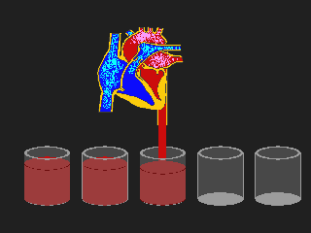
Cardiac Output
Volume of blood pumped by the left ventricle (LV) per minute
Cardiac Output (CO) = Stroke Volume (SV) x Heart Rate (HR)
Measurements:
  CO = SV x HR, normal 4-8 L/min
  Cardiac Index (CI) = CO/BSA, normal 2.5-4 L/min/m²
  Ejection Fraction (EF) = (SV/EDV) x 100%, normal 55-75%
Stroke Volume is determined by:
  Preload
  Afterload
  Contractility

Slide 22
Preload
Stretch on myofibrils, measured as the pressure in the ventricle at the end of diastole
Measurements:
  RV preload = CVP, normal 2-6mmHg
  LV preload = PCWP, normal 4-12mmHg
↑ preload = ↑ myocardial O₂ consumption
 | Increased Preload | Decreased Preload
Causes | Heart failure, hypervolemia, excessive vasoconstriction, mitral/aortic valve insufficiency | Hypovolemia, loss of vasomotor tone, ↑ intrathoracic pressure, cardiac tamponade, RV failure, tachycardia
Treatment | Diuretics, venous vasodilators | Volume/blood replacement
Notes:
Hypovolemia: very common due to
inadequate fluid resucitation
DI
third spacing
hypertonic/dehydration therapies for treatment of cerebral edema
hyperglycemia-induced osmotic diuresis
cold diuresis

Slide 23
Afterload
Pressure against which the ventricle must pump to open semilunar (aortic and pulmonic) valves
Measurements:
  RV afterload: PVR, normal 30-250 dynes/sec/cm⁻⁵
  LV afterload: SVR, normal 900-1400 dynes/sec/cm⁻⁵
↑ afterload = ↑ myocardial O₂ consumption, ↓stroke volume (SV) and cardiac output (CO)
 | Increased Afterload | Decreased Afterload
Causes | HTN, pulmonary HTN, excessive vasoconstriction | Vasodilatation
Treatment | Arterial/pulmonary vasodilators, oxygen | Vasopressors
Notes:
Causes of increased afterload: HTN- thyrotoxicosis
Causes of decreased afterload:
spinal shock, catecholamine depletion, loss of vasomotor control and autoregulation, adrenal insufficiency of trauma and critical illness, sepsis

Slide 24
Contractility
Contractile force of the heart
Measurements:
  RV contractility: RVSWI, normal 7-12 g/m
  LV contractility: LVSWI, normal 35-85 g/m
↑ contractility = ↑ myocardial O₂ consumption, ↑SV and CO (within physiologic limits)
 | Increased Contractility | Decreased Contractility
Causes | SNS stimulation, inotropes, hypercalcemia | Brain death process, trauma, MI, metabolic depression, arrthymias
Treatment | Beta-blockers, calcium-channel blockers | T₄ therapy, inotropes, phosphorus/calcium replacement
Notes:
Causes of decreased contractility:
Brain death process: catecholamine storm, ischemia-reperfusion injury
Trauma: myocardial contusion, pericardial effusion, cardiac tamponade
Metabolic depression: endogenous thyroid hormone depletion, acidosis, hypothermia, hypoxia, hypocalcemia, hypophosphatemia
Arrhythmias: consider hypokalemia, hypomagnesemia

Slide 25
Frank-Starling’s Law of the Heart:
Within physiologic limits, the greater the stretch on the myofibrils (preload), the greater the force of subsequent contraction
Pulmonary Edema
Cardiogenic Shock

Slide 26
EKG Findings, Clinical Implications, and Treatments
Location | Coronary Artery | EKG Findings | Clinical Implications | Specific Treatments
Anteroseptal Wall | LAD | • V₁ through V₄ • Q waves and ST segment elevations | LV failure, significant hemodynamic compromise; CHF, pulmonary edema, cardiogenic shock, intraventricular conduction disturbances | • Vasopressors for BP • coronary artery vasodilators to ↓ afterload, ↑ CO, and ↓ myocardial O₂ consumption • pacemaker
Lateral Wall | L Circumflex | • I, aVL, V₅, V₆ • Q waves and ST segment elevations | Evaluate for posterior wall involvement; some hemodynamic changes, SA/AV dysrhythmias | • cardiac monitoring • pacemaker
Posterior Wall | L Circumflex | • V₁ and V₂ • tall upright R waves with ST segment depression | Evaluate for lateral wall involvement; some hemodynamic changes, SA/AV dysrhythmias | • treatment of bradycardia/heart block • pacemaker
Inferior Wall | RCA | • II, III, aVF • Q waves and ST segment elevation | Evaluate for RV involvement; some hemodynamic changes, potential for significant SA/AV dysrhythmias | • treatment of bradycardia/heart block • fluid restrict/diuretics • Nipride to ↓ afterload • pacemaker
Right Ventricular Wall | RCA | • Right precordial chest leads (RV₁₋₆) • Q waves and ST segment elevations | Evaluate for inferior wall involvement; some hemodynamic changes, potential for significant SA/AV dysrhythmias | • meds to ↑ contractility and ↓ RV afterload • fluids to ↑ preload (to ↑ CO) • pacemaker

Slide 27
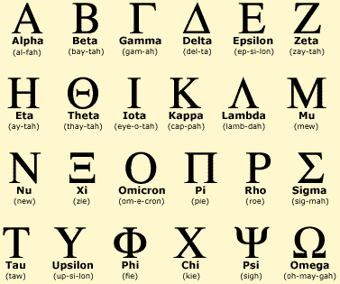
It’s all Greek…
The sympathetic nervous system (SNS) has a
positive chronotropic (↑HR), inotropic (↑ contractility),
and dromotropic (↑conductivity) effects.
SNS (adrenergic) receptors and effects:
Receptor | Location | Effects
Alpha₁ α₁ | Vascular smooth muscle (arterioles and veins) | Systemic vasoconstriction
Alpha₂ α₂ | Vascular smooth muscle (coronary and renal arterioles) | Vasoconstriction of coronary and renal vessels
Beta₁ β₁ | Heart, kidney | ↑HR, ↑ contractility, ↑conductivity
Beta₂ β₂ | Vascular smooth muscle (arterioles), bronchial smooth muscle, liver, AV node | Vasodilatation, bronchodilitation, stimulation of glycogenolysis, ↑conductivity
Dopaminergic | Renal and mesenteric artery bed | Vasodilation

Slide 28
SNS effects of “Pressors” or: Why a Pressor is not always a Pressor
Mechanism of action on the adrenergic receptor:
Drug | Alpha effect | Beta₁ effect | Beta₂ effect
Phenylephrine | ++++ | + | 0
Norepinephrine | ++++ | ++ | 0
Epinephrine | ++++ | ++++ | ++
Dopamine | ++ >5mcg/kg/min +++ >10mcg/kg/min | ++++ <10mcg/kg/min | +
Dobutamine | + | ++++ | ++

Slide 29
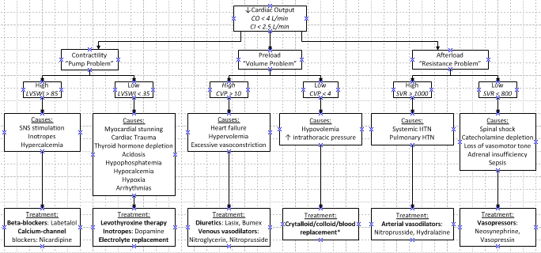
Hemodynamic Treatment Algorithm

Slide 30
Swan Ganz Interpretation
Normal Values
Parameter | Normal Value
Mean Arterial Pressure (MAP) | 60-100 mmHg
Central Venous Pressure (CVP) | 2-6 mmHg
Pulmonary Artery Systolic Pressure (PA_{S}) | 20-30 mmHg
Pulmonary Artery Diastolic Pressure (PA_{D}) | 10-20 mmHg
Pulmonary Artery Mean Pressure(PA_{M}) | 10-15 mmHg
Pulmonary Capillary Wedge Pressure (PCWP) | 4-12 mmHg
Cardiac Output (CO) | 4-8 L/min
Cardiac Index (CI) | 2.5-4 L/min/m²
Stroke Volume (SV) | 60-100 ml/beat
Systemic Vascular Resistance (SVR) | 900-1400 dynes/sec/cm⁻⁵
Pulmonary Vascular Resistance (PVR) | 30-250 dynes/sec/cm⁻⁵
Venous Oxygen Saturation (SVO₂) | 60-80%
Left Ventricular Stroke Work Index (LVSWI) | 35-85 g/m
Right Ventricular Stroke Work Index (RVSWI) | 7-12 g/m

Slide 31
Electrolytes
Where did they go?

Slide 32
Sodium

Slide 33
Hyponatremia
Na⁺ < 125mEq/L
Most Common Etiology:
Hyperglycemia causes shift of water into the extracellular space → dilution of serum sodium. For every 100mg/dL ↑ in glucose, serum sodium ↓ 1.6mEq/L
Excessive DDAVP/Vasopressin administration- effectively mimics SIADH (syndrome of inappropriate antidiuretic hormone)
Others: Cerebral salt wasting, hemorrhage, GI loss, open wounds, adrenal insufficiency, hypothyroidism, renal failure
Most Common Clinical Manifestations:
Most often CNS-related (i.e. cerebral edema, headache, lethargy, depressed reflexes, seizures, coma)… therefore not assessed in the brain dead organ donor!
End-organ effect: intracellular edema

Slide 34
Treatment of Hyponatremia
D/C hypotonic fluid administration (e.g. D5W), including IV medications
D/C administration of DDAVP/Vasopressin
Administer hypertonic fluids¹:
  Calculate sodium deficit:
    Na deficit (mEq) = TBW* x (140 – measured serum Na)
  Calculate effect of treatment:
    1L NS: ∆ serum Na = (154mEq/L – measured serum Na)/(TBW* + 1)
    1L 3% NaCl: ∆ serum Na = (512mEq/L – measured serum Na)/(TBW* + 1)
    (Note: Administer 3% NaCl @ 1-2ml/kg/hr)
    *TBW (men) = 0.6L/kg x weight (kg)
    TBW (women) = 0.5L/kg x weight (kg)
Administer sodium bicarbonate (NaHCO₃) with coexisting acidosis (pH <7.35)
  One amp (50mL) of NaHCO₃ contains 44-54mEq Na
1. Kraft MD, Btaiche IF, Sacks GS, Kudsk KA. Treatment of electrolyte disorders in adult patients in the intensive care unit. American Journal of Health-System Pharmacy. 2005;62: 1663-1682.

Slide 35
Hypernatremia
Na⁺ > 155mEq/L
Most Common Etiology:
Diabetes Insipidus resulting from the rapid depletion of ADH (antidiuretic hormone) after infarction of the hypothalamus and posterior pituitary. DI occurs in 60-80% of brain dead organ donors and results in excessive free water loss.
Administration of hypertonic fluids and/or mannitol for treatment of cerebral edema, or aggressive fluid resuscitation with NS/hypertonic fluids.
Most Common Clinical Manifestations:
Most often CNS-related (i.e. lethargy, irritability, hyperreflexia, seizures, coma)… therefore not assessed in the brain dead organ donor!
End-organ effect: Serum Na⁺ > 155mEq/L has been shown to adversely affect liver graft function outcomes due to intracellular edema and altered function¹.
1. Powner DJ. Factors during donor care that may affect liver transplantation outcome. Progress in Transplantation. 2004;14:241-249.

Slide 36
Treatment of Hypernatremia
D/C hypertonic fluid administration (e.g. 3% NaCl, NS), including IV medications
Treat DI: 1 mcg DDAVP IV Q2h PRN, .01-.04 units/min Vasopressin IV gtt
Administer hypotonic fluids¹:
  Calculate free water deficit:
  Free water deficit (in L) = TBW* x ([serum Na/140] - 1)
  Evaluate volume status to determine IV fluid choice
  Calculate effect of treatment:
1L D5W: ∆ serum Na=(0mEq/L – serum Na)/(TBW*+1)
1L 0.225% NS: ∆ serum Na=(38.5mEq/L – serum Na)/(TBW*+1)
1L 0.45% NS: ∆ serum Na=(77mEq/L – serum Na)/(TBW*+1)
*TBW (men) = 0.5L/kg x weight (kg)
TBW (women) = 0.4L/kg x weight (kg)
For hypervolemic hypernatremia (caused by excessive hypertonic fluid administration, not DI), administer Lasix and D5W
  Lasix alone will aggravate the hypernatremia because a Lasix-induced diuresis is equal to one-half isotonic saline solution
500mL H₂O via NG/OG (clamp x 1hr, then drain)
1. Kraft MD, Btaiche IF, Sacks GS, Kudsk KA. Treatment of electrolyte disorders in adult patients in the intensive care unit. American Journal of Health-System Pharmacy. 2005;62: 1663-1682.
Notes:
If hypovolemic (urine sodium < 10mEq/L), give 0.45% NS
If isovolemic (urine sodium > 20mEq/L), give D5W

Slide 37
Potassium

Slide 38
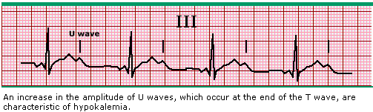
Hypokalemia
K⁺ < 4.0 mEq/L
Most Common Etiology:
Intracellular shifts of potassium due to: metabolic alkalosis, administration of beta-adrenergic agonists (e.g. albuterol, insulin), thyroxine therapy
Increased losses of potassium due to: administration of potassium-wasting diuretics (e.g. Lasix) and corticosteroids, magnesium depletion
Other: alcoholism, chronic malnutrition
Most Common Clinical Manifestations:
EKG changes: T-wave flattening or inversion, U waves, ST-segment depression
Arrhythmias: PACs or PVCs
Notes:
Also: alcoholism, chronic malnutrition

Slide 39
Treatment of Hypokalemia
Correct confounding factors:
  Metabolic alkalosis
  Hypomagnesemia- Mg is important in the regulation of intracellular K. Hypomagnesemia may result in refractory hypokalemia, likely due to accelerated renal K loss or impairment of Na-K pump activity.
Replacement therapy:
  Potassium Chloride (infuse @ 10-40 mEq/hr through central line)
  Potassium acetate with coexisting acidosis (pH < 7.35)
  Potassium Phosphate with coexisting hypophosphatemia (see PO₄ replacement dosing)
K⁺ level | Replacement Dosing
3.5 – 3.9 mEq/L | 20 mEq KCl or K acetate IVPB over 1 hr*
< 3.5 mEq/L | 40 mEq KCl or K acetate IVPB over 1-2 hrs*
* Infuse through central line, otherwise ↓ infusion rate to 10 mEq/hr
1. Kraft MD, Btaiche IF, Sacks GS, Kudsk KA. Treatment of electrolyte disorders in adult patients in the intensive care unit. American Journal of Health-System Pharmacy. 2005;62: 1663-1682.

Slide 40
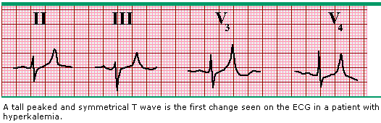
Hyperkalemia
K⁺ > 5.0 mEq/L
Most Common Etiology:
Extracellular shifts of potassium due to: metabolic acidosis, muscular injury (e.g. trauma, rhabdomyolysis), administration of succinylcholine or beta-adrenergic blockers
Impaired potassium excretion due to: acute renal failure, hypoaldosteronism administration of potassium-sparing diuretics, ACE-inhibitors, or NSAIDs
Most Common Clinical Manifestations:
EKG changes: tall, peaked T-waves and shortened QT interval followed by progressive lengthening of QRS complex and PR interval
Arrhythmias: bradycardia, Vfib

Slide 41
Treatment of Hyperkalemia
Correct metabolic acidosis
For symptomatic hyperkalemia, consider pharmacologic options:
Treatment | Effect
1-2g Calcium gluconate IV | Antagonizes cardiac conduction abnormalities
50-100 mEq Sodium bicarbonate IV | Increases serum pH, redistributes K⁺ into cells
5-10 units Insulin, 50mL 50% dextrose IV | Increases insulin release, redistributes K⁺ into cells
20-40mg Lasix IV | Increases renal K⁺ loss
Hemodialysis x 2-4hrs | Removes K⁺ from plasma
1. Kraft MD, Btaiche IF, Sacks GS, Kudsk KA. Treatment of electrolyte disorders in adult patients in the intensive care unit. American Journal of Health-System Pharmacy. 2005;62: 1663-1682.

Slide 42
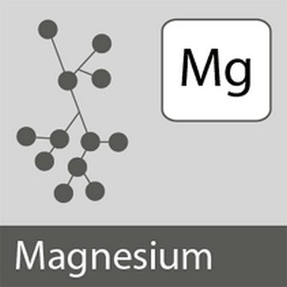
Magnesium

Slide 43
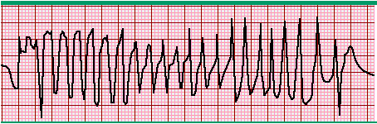
Hypomagnesemia
Mg²⁺ < 2.0 mg/dL
Most Common Etiology:
Hypokalemia often causes concurrent low magnesium secondary to accelerated renal loss or poor Na/K pump function
Massive transfusion of blood products preserved with citrate.
Other: trauma, burns, surgery, sepsis, GI loss, renal loss, malnutrition, alcoholism
Most Common Clinical Manifestations:
EKG changes: prolonged QT and PR interval, widening QRS complex
Arrhythmias: ventricular arrhythmias, torsades de pointes

Slide 44
Treatment of Hypomagnesemia
Replacement therapy
  Magnesium Sulfate (infuse @ 1-2g/hr)
Mg²⁺ level | Replacement Dosing
1.6 – 1.9 mg/dL | 2 g Mag Sulfate IVPB over 1 hr
< 1.6 mg/dL | 4 g Mag Sulfate IVPB over 2 hrs
1. Kraft MD, Btaiche IF, Sacks GS, Kudsk KA. Treatment of electrolyte disorders in adult patients in the intensive care unit. American Journal of Health-System Pharmacy. 2005;62: 1663-1682.

Slide 45
Hypermagnesemia
Mg²⁺ > 4 mg/dL
Most Common Etiology:
Renal insufficiency
Most Common Clinical Manifestations:
Bradycardia and hypotension at levels > 4-6 mg/dL(magnesium acts as a calcium channel blocker)
EKG changes at levels > 6-12mg/dL: widening QRS complex, lengthening of PR and QT intervals, AV block
Complete heart block and cardiac arrest at levels > 18mg/dL

Slide 46
Treatment of Hypermagnesemia
Loop diuretics
Hemodialysis
IV calcium chloride 0.5-1g over 5-10 minutes via central line to reverse the cardiovascular and neuromuscular effects
Rare occurrence during donor management!

Slide 47
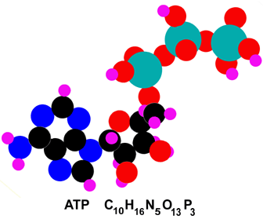
Phosphorus

Slide 48
What’s the big deal?
Phosphorus is the main intracellular anion and has many important functions including:
  bone composition
  cell membrane composition
  nerve conduction
  muscle function
It provides energy-rich bonds in the form of ATP and is required in all physiological, homeostatic, and metabolic functions that require energy, such as:
  ATP synthesis
  2,3-diphosphoglycerate synthesis and function (necessary for oxygen release from hemoglobin and delivery to tissues),
  glucose utilization and glycolysis
  muscular function (especially the myocardium and diaphragm)

Slide 49
Hypophosphatemia
PO₄³⁻ < 2.2 mg/dL
Most Common Etiology:
Depletion of phosphorus stores due to increased cellular demand (hypermetabolism) and malnutrition in the critically ill patient.
Increased uptake stimulated by ↑ circulating levels of insulin, epinephrine, thyroxine therapy
Metabolic/respiratory alkalosis leading to an intracellular shift of phosphorus
Other: hyperparathyroidism, malnutrition, alcoholism, vitamin D deficiency, diabetic ketoacidosis, GI loss, sepsis, burns
Most Common Clinical Manifestations:
Tissue hypoxia, ↓ myocardial contractility, impaired diaphragmatic contractility,
↓ systemic vascular resistance
Decreased function of leukocytes and platelets
End-organ effect: Global tissue hypoxia, poor heart function, increased need for vasopressors

Slide 50
Treatment of Hypophosphatemia
Correct confounding factors: metabolic alkalosis
Replacement Therapy
  If K⁺ < 4.0, use Potassium Phosphate
  If K⁺ > 4.0, Na < 150, use Sodium Phosphate
Monitor for hypocalcemia related to redistribution
Wait at least one hour after infusion to recheck phosphorus level
PO₄³⁻ level | Replacement Dosing
1.5 – 2.2 mg/dL | 0.32 mmol/kg IVPB over 4 hrs
< 1.5 mg/dL | 0.5 mmol/kg IVPB over 4 hrs
1.47 mEq K per 1 mmol KPO₄ (or ~ 44 mEq K in 30 mmol KPO₄) 1.33 mEq Na per 1 mmol NaPO₄ (or ~ 40 mEq Na in 30 mmol NaPO₄)

Slide 51
Hyperphosphatemia
PO₄ > 4.5 mg/dL
Most Common Etiology:
Excess phosphorus stores/decreased secretion due to renal insufficiency
Metabolic/respiratory acidosis leading to extracellular shift of phosphorus
Tissue breakdown during rhabdomyolysis leading to extracellular shift of phosphorus
Other: hypoparathyroidism, vitamin D toxicity, tumor lysis
Most Common Clinical Manifestations:
Hypocalcemia due to calcium-phosphate precipitation
End-organ effect: Precipitation (which occurs when serum Ca x serum Phos > 55-60mg/dL) can lead to Ca-Phos deposits into soft tissues causing organ damage

Slide 52

Treatment of Hyperphosphatemia
Dialysis
Administration of phosphate binders
Not necessary to treat during donor management!

Slide 53
Calcium

Slide 54
Interesting Stuff About Calcium
Calcium functions in bone metabolism, blood coagulation, platelet adhesion, neuromuscular activity, endocrine and exocrine secretory functions, and electrophysiology of the heart and smooth muscles
Approximately 40-50% of calcium in the blood is bound to plasma proteins, primarily albumin. For serum albumin levels < 4g/dL:
  Corrected serum Ca = serum Ca + (0.8 x [4-serum albumin])
Ionized calcium is the biologically active form of calcium and is a better indicator of the functional status of calcium metabolism.

Slide 55
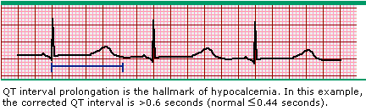
Hypocalcemia iCa²⁺ < 1.10 mmol/L
Most Common Etiology:
Increased intravascular calcium binding: ↑lactate levels, ↑citrate from massive blood transfusions, acute metabolic/respiratory alkalosis , phosphorus replacement
Other: hypoalbuminemia, hypomagnesemia, hyperphosphatemia, pancreatitis, hypoparathyroidism, sepsis
Most Common Clinical Manifestations:
EKG changes: prolonged QT interval
Tetany

Slide 56
Treatment of Hypocalcemia
Correct confounding factors: metabolic alkalosis
Replacement therapy:
  1 g Calcium Chloride IV over 30 minutes
  If CalCl unavailable, use 1 g Calcium Gluconate IV over 30 minutes
Notes:
CaCl has 3x more elemental Ca available

Slide 57
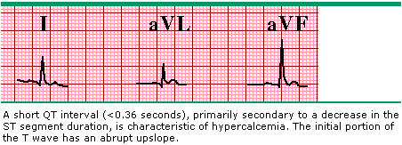
Hypercalcemia iCa²⁺ > 1.40 mmol/L
Most Common Etiology:
Malignancy, hyperparathyroidism, vitamin D toxicity, adrenal insufficiency, rhabdomyolysis, renal failure
Most Common Clinical Manifestations:
EKG changes: shortened QT interval, bradycardia

Slide 58
Treatment of Hypercalcemia
Fluid replacement
Hemodialysis
Rare occurrence during donor management!

Slide 59
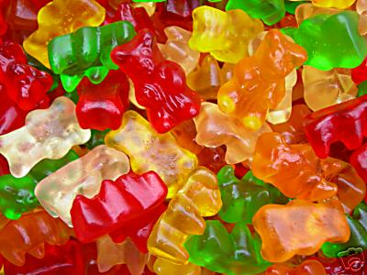
Hyperglycemia

Slide 60
Hyperglycemia: Etiology
Release of glucocorticoids from physiologic stress response
Reduced insulin levels due to catecholamine release or inotrope infusion
  In animal models, insulin levels declined to 50% of normal within 3 hours and 20% of normal within 13 hours after brain death*
Resuscitation with glucose-containing fluids
Administration of steroids
*Reference: Novitzky D, Cooper DKC, Rosendale JD, Kauffman HM. Hormonal therapy of the brain-dead organ donor: experimental and clinical studies. Transplantation. 2006;82:1396-1401.

Slide 61
Hyperglycemia: Complications
Hyperosmolar state → osmotic diuresis → dehydration and extracellular shift of electrolytes
  Hypernatremia
  Hypokalemia
  Hypophosphatemia
  Hypomagnesemia
  Hypocalcemia
Ketosis → metabolic acidosis
Domino effect on donor management and successful organ placement…

Slide 62
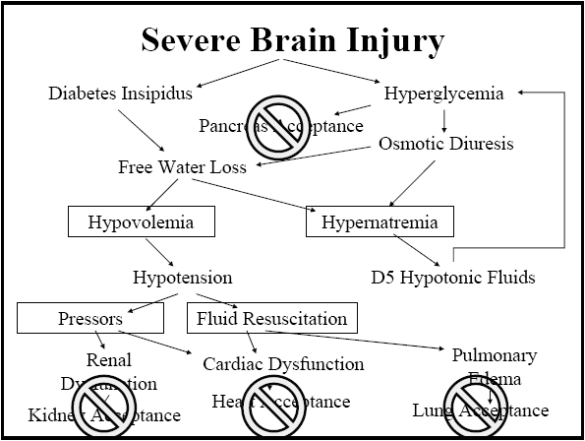
Taken from “How Sweet it is: Intensive Glycemic Control in the ICU,” presentation at NATCO by Michael Marvin, MD (Director of Liver Transplant, University of Louisville Jewish Hospital)

Slide 63
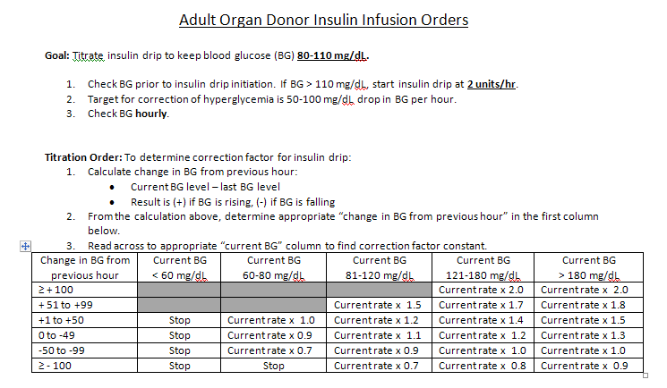
Hyperglycemia: Treatment
Consider changing glucose concentration of IV fluids
Electrolyte replacement
IV Insulin drip
  Refer to Insulin Infusion Orders
GOAL: Blood glucose <150 mg/dL

Slide 64

Thyroid Hormone Replacement

Slide 65
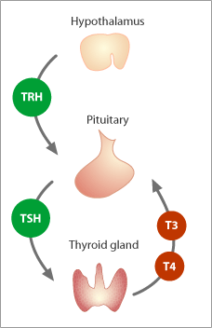
Normal Thyroid Physiology
Hypothalamus produces thyrotropin releasing hormone (TRH)
TRH stimulates the production of thyroid-stimulating hormone (TSH) by the pituitary gland
TSH stimulates the production of tetratraiodothyronine (T₄) by the thyroid gland
T₄ is metabolically converted to triiodothyronine (T₃) in many tissues, especially the liver and kidneys
Reference: Powner DJ, Hernandez M. A review of thyroid hormone administration during adult donor care. Progress in Transplantation. 2005;15:202-207

Slide 66
What does thyroid hormone replacement do?
Normal Physiologic Effects of T₃¹
Proposed benefits of thyroxine ²
↑ basal metabolic rate
↑ myocardial diastolic relaxation, enhanced systolic function, increased expression of beta-adrenergic receptors, increased rates of depolarization and repolarization of the SA node, increased number of beta-adrenergic receptors in the heart, and amplification of catecholamine action at a postreceptor site
In animal models, plasma levels of T₃ and T₄ have been shown to fall 50% within one hour after brain death and become undetectable within 9-16 hrs ³
positive inotropic and chronotropic effects, heightened adrenergic sensitivity
reduced requirement for exogenous catecholamines, which are associated with poor graft function and reduced graft survival
prevention of cardiovascular deterioration, which is associated with a shift of cellular metabolism from aerobic to anaerobic, with resulting depletion of glycogen and myocardial high-energy stores and the accumulation of lactate
References: 1. Gardner DG, Shoback D, eds. Greenspan’s Basic and Clinical Endocrinology, 8th ed.
2. Salim A, Vassiliu P, Velmahos GC, et al. The role of thyroid hormone administration in potential organ donors. Archives of Surgery. 2001;136:1377-1380.
3. Novitzky D, Cooper DKC, Rosendale JD, Kauffman HM. Hormonal therapy of the brain-dead organ donor: experimental and clinical studies. Transplantation. 2006;82:1396-1401.

Slide 67
What does the research say?
Thyroid hormone replacement therapy remains a controversial component of donor management. A limited number of studies have been conducted with human donors, and these show inconsistent results. Those studies which are supportive of T₃/T₄ replacement therapy usually also include administration of steroids, insulin, and vasopressin and propose its benefit as “rescue” treatment for donors who have required higher doses of inotropic or vasopressor medications.
Powner’s article review*:
  The number of appropriately designed interventional studies found was insufficient to allow a formal meta-analysis
  Of the 10 studies reviewed: 5 supported the use of thyroid hormone during some phase of donor care, 4 did not, and 1 was equivocal.
  Hypertension resulting from thyroid administration was noted in 5 patients from 2 studies, necessitating discontinuation of therapy. In all cases, the HTN thereafter resolved and caused no direct organ injury.
  Conclusion: Additional prospective randomized studies are needed and may contribute substantially to future recommendations. Until then, the use of a thyroid hormone replacement protocol and its dosing should be decided by the individual OPO.
*Reference: Powner DJ, Hernandez M. A review of thyroid hormone administration during adult donor care. Progress in Transplantation. 2005;15:202-207

Slide 68
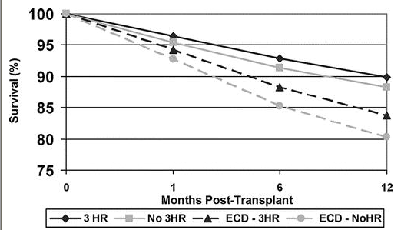
What does the research say?
OPTN/UNOS retrospective analysis from 2000-2001 on use of 3-drug hormonal resuscitation (HR)*
  mean number of organs transplanted per donor 22.5% greater with use of 3-drug HR (3.8 vs. 3.1)
  use of 3-drug HR associated with the following statistically significant increased
  probabilities of an organ being transplanted from a donor: kidney 7.3%, heart 4.7%, liver 4.9%, lung 2.8%, pancreas 6.0%
  one-month graft loss for heart recipients was 3.8% when donor received 3-drug HR compared to 7.9% when they received none
  for heart recipients, analysis showed 46% reduced odds of death within 30 days and a 48% reduced odds of early graft dysfunction when 3-drug HR used
  for kidney recipients, analysis showed significantly improved one-year kidney graft survival with both SCDs and ECDs when the donor received 3-drug HR
  for liver recipients, analysis showed no significant difference in one-year survival
*Reference: Novitzky D, Cooper DKC, Rosendale JD, Kauffman HM. Hormonal therapy of the brain-dead organ donor: experimental and clinical studies. Transplantation. 2006;82:1396-1401.

Slide 69
Thank You
Questions
???

