Slide 1
An Overview of Approaches to Minimize the Risk of Medication Errors
By Tammy J. Butler, Pharm.D

Slide 2
Objectives for Pharmacists
Outline the classification of medication errors.
Discuss examples of the types of medication errors and examine related clinical cases.
Examine approaches to reduce the risk of medication errors.
Review medication error reporting such as internal and external reporting and discuss guidelines to follow when reporting medication errors.
Summarize available resources for pharmacists and healthcare professionals.
Discuss the impact of medication errors and evaluate the related costs.

Slide 3
Objectives for Pharmacy Technicians
Outline the classification of medication errors.
Discuss examples of the types of medication errors and examine related clinical cases.
Examine approaches to reduce the risk of medication errors.
Review medication error reporting such as internal and external reporting and discuss guidelines to follow when reporting medication errors.
Summarize available resources for pharmacy technicians.
Discuss the impact of medication errors and evaluate the related costs.

Slide 4
What is a Medication Error?
"A medication error is any preventable event that may cause or lead to inappropriate medication use or patient harm while the medication is in the control of the health care professional, patient, or consumer. Such events may be related to professional practice, health care products, procedures, and systems, including prescribing, order communication, product labeling, packaging, and nomenclature, compounding, dispensing, distribution, administration, education, monitoring, and use.“
http://www.nccmerp.org/about-medication-errors. Accessed 5/30/2017.

Slide 5
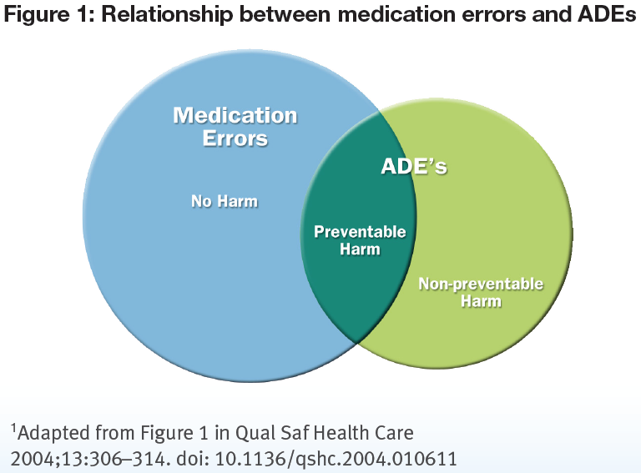
What is a “Medication Error”?
National Coordinating Council for Medication Error Reporting and Prevention. Available at: www.nccmerp.org. Accessed 05/24/2017.

Slide 6
Culture of Safety
“People make errors, which lead to accidents. Accidents lead to deaths. The standard solution is to blame the people involved. If we find out who made the errors and punish them, we solve the problem, right?
Wrong. The problem is seldom the fault of an individual; it is the fault of the system. Change the people without changing the system and the problems will continue.”
Don Norman
The Design of Everyday Things

Slide 7
Classification of Medication Errors

Slide 8
Classification of Medication Errors
On July 16, 1996, the NCC MERP adopted a Medication Error Index that classifies an error according to the severity of the outcome.
The Council realized the need for a standardized categorization of errors.
It is hoped that the index will help health care practitioners and institutions to track medication errors in a consistent, systematic manner.
The index considers factors such as whether the error reached the patient and, if the patient was harmed, and to what degree.
The Council encourages the use of the index in all health care delivery settings and by researchers and vendors of medication error tracking software.
The ISMP Medication Errors Reporting Program has implemented this index for use in its database.

Slide 9
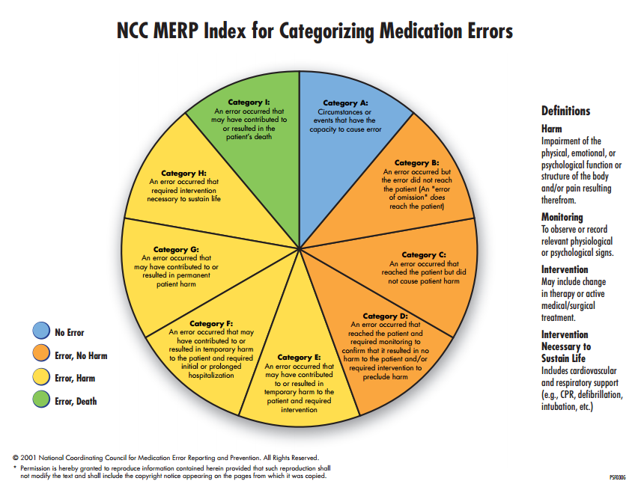

Slide 10
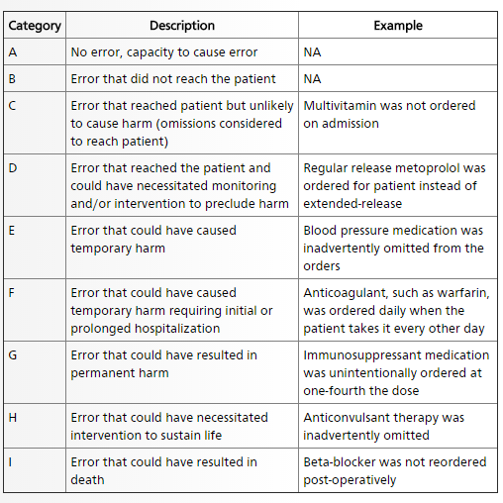
Categories of Medication Error Classification with Examples

Slide 11
Examples of the Types of Medication Errors
What is the most common medication error?
In a study by the FDA that evaluated reports of fatal medication errors from 1993 to 1998, the most common error involving medications as related to administration of an improper dose of medicine, accounting for 41% of fatal medication errors.

Slide 12
Examples of the Types of Medication Errors:
Top Drugs Associated with Medication Errors:
1. insulin
2. albuterol
3. morphine
4. potassium chloride
5. heparin
6. cefazolin
7. warfarin
8. furosemide
9. levofloxacin
10. vancomycin
(MEDMARX USP data report 2003-2006)
11. metoprolol
12. enoxaparin
13. lorazepam
14. acetaminophen
15. ipratropium
16. hydrocodone/acetaminophen
17. oxycodone/acetaminophen
18. meperidine
19. levothyroxine
20. aspirin

Slide 13
Examples of the Types of Medication Errors
Ten most common lethal medication errors in hospitals:
Concentrated potassium chloride injections
Insulin errors
Intravenous calcium and magnesium
EX: calcium chloride contains 13.6 mEq of Ca/gm; calcium gluconate contains 4.65 mEq/gm
Inadvertent administration of 50% dextrose
Known allergy
Miscalculated digoxin dose in pediatrics
Confusing vincristine and vinblastine
EX: max dose of vincristine is 2 mg, while 6 mg/m2 for vinblastine
Concentrated sodium chloride injections
EX: cases where 23.4% sodium chloride was employed to dilute antibiotics
Intravenous opioids
EX: availability of a variety of concentrations
Aminophylline errors
EX: 7.4 mg ordered for an infant, but 7.4 ml (185 mg) administered >> Outcome: Death
(Argo et al, 2000)

Slide 14
Related Clinical Cases

Slide 15
Facts to Keep in Mind
Wrong drug errors represent ~ 8% of medication errors in outpatient pharmacy, and occur in ~ 0.13% of all dispensed prescriptions.
A wrong drug error rate of 0.13% for 3.7 billion prescriptions (2006 U.S. number of outpatient prescriptions) would translate to 4.8 million wrong drug errors.
2008 MEDMARX data report, USP

Slide 16
Related Clinical Cases: Case # 1
Case Description
A 71-year-old female accidentally received thiothixene (Navane), an antipsychotic, instead of her anti-hypertensive medication amlodipine (Norvasc) for 3 months.
She sustained physical and psychological harm including ambulatory dysfunction, tremors, mood swings, and personality changes.
Despite the many opportunities for intervention, multiple health care providers overlooked her symptoms.
https://www.ncbi.nlm.nih.gov/pmc/articles/PMC5016741/. Accessed on 6/1/2017.

Slide 17
Related Clinical Cases: Case # 2
Case Description:
Hydralazine/hydroxyzine – a nurse attempting to order hydralazine through a hospital computer system mistakenly chose hydroxyzine.
The patient received 10 doses of hydroxyzine and developed bowel obstruction and worsening congestive heart failure.
Required transfer to a critical care unit for stabilization.
Selected Findings from MEDMARX USP data report 2003-2006

Slide 18
Related Clinical Cases: Case # 3
Case Description:
Lamictal/lebetalol – a refill for lebetalol 200 mg was mistakenly filled by a pharmacy technician with lamictal 200 mg.
The pharmacist did not catch the error.
Lamictal was stored in a separate shelve at this pharmacy where look alike/sound alike drugs are stored.
The patient took the wrong drug for several weeks before being admitted for nausea/vomiting and elevated BP.
Selected Findings from MEDMARX USP data report 2003-2006

Slide 19
Related Clinical Cases: Case # 4
Case Description:
Fentanyl/sufentanil – a nurse provided a verbal order to pharmacy for fentanyl for an endoscopy procedure.
The pharmacist heard sufentanil instead, which was dispensed.
The patient received the sufentanil at the fentanyl dose and required CPR.
The error was discovered later when the written orders were reviewed in the pharmacy.
Selected Findings from MEDMARX USP data report 2003-2006

Slide 20
Related Clinical Cases: Case # 5 cont.
Brilinta vs. Brintellix Name Confusion:
July 2015: FDA issued a Drug Safety Communication: As of June 2015, the FDA received 50 medication error reports describing brand name confusion with Brintellix (vortioxetine) and Brilinta (ticagrelor). In most cases, Brintellix was mistaken as Brilinta.
Some of the contributing factors to the name confusion included the following: Both brand names begin with the same three letters.
Both brand names are presented when selecting medications in a computerized physician order entry (CPOE) system.
The pharmacist was not familiar with the new medication Brintellix and dispensed Brilinta.

Slide 21
Related Clinical Cases: Case # 5 cont.
Brilinta vs. Brintellix Name Confusion
Since the July 2015 DSC, the FDA received 5 additional cases describing brand name confusion involving Brilinta and Brintellix
Recommended a proprietary name change for Brintellix
FDA Action Taken: May 2016 name change to Trintellix

Slide 22
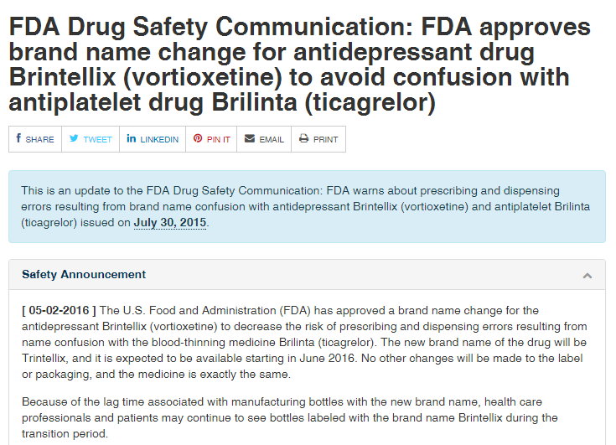
Related Clinical Cases: Case # 5 cont.

Slide 23
Related Clinical Cases: Case # 6 Cont. September, 2007
Fatal 1000-fold error in iv zinc TPN order received with zinc ordered as 300 mcg/100ml
Pharmacist converted this dose to mcg/kg correctly, but entered the final dose in mg (i.e. 330 mg/100ml instead of 330 mcg/100ml) from a pull down menu.
A 2nd pharmacist checked the work but also didn’t notice mg instead of mcg.
The technician prepared the dose, having to replenish the compounder syringe containing the zinc a total of 11 times during the automated preparation (requiring dozens of zinc vials)
Final TPN bag dispensed to the NICU.
A 2nd oncoming technician discovered the error (via a discussion with the preparing technician) and alerted a pharmacist, but by the time the infusion was stopped an antidote (calcium EDTA) was administered, the infant died from cardiac failure due to zinc intoxication.

Slide 24
ISMP Vaccine Errors Reporting Program (ISMP July, 2016)
ISMP Vaccine Errors Reporting Program:
Estimate (based upon spontaneous reports) that errors occur in 27-35% of vaccinations
July newsletter provides summary of 4 yr of vaccination errors based on > 1700 reports/mostly in outpatient settings
Most frequent error types:
Wrong vaccine – 23%
Wrong age for vaccination – 20%
Wrong vaccine dose – 12%
Extra vaccine dose – 9%
Wrong vaccine interval – 7%

Slide 25
Reporting Medication Errors

Slide 26
Medication Error Reporting
Report Medication Errors
ISMP Medication Errors Reporting Program (MERP): https://www.ismp.org/errorReporting/reportErrortoISMP.aspx 1-800-233-7767
U.S. Food and Drug Administration's MedWatch Reporting Program: https://www.fda.gov/Safety/MedWatch 1-800-FDA-1088

Slide 27
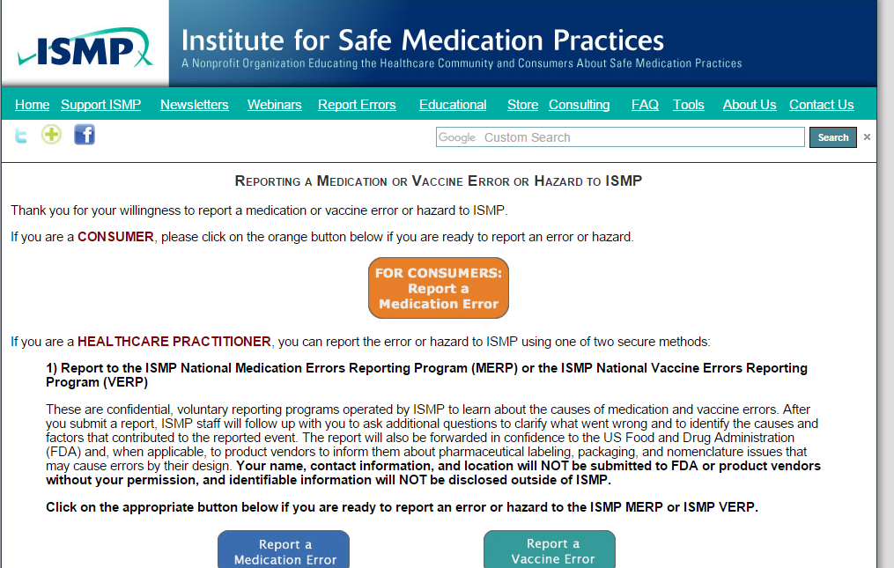
Medication Error Reporting

Slide 28
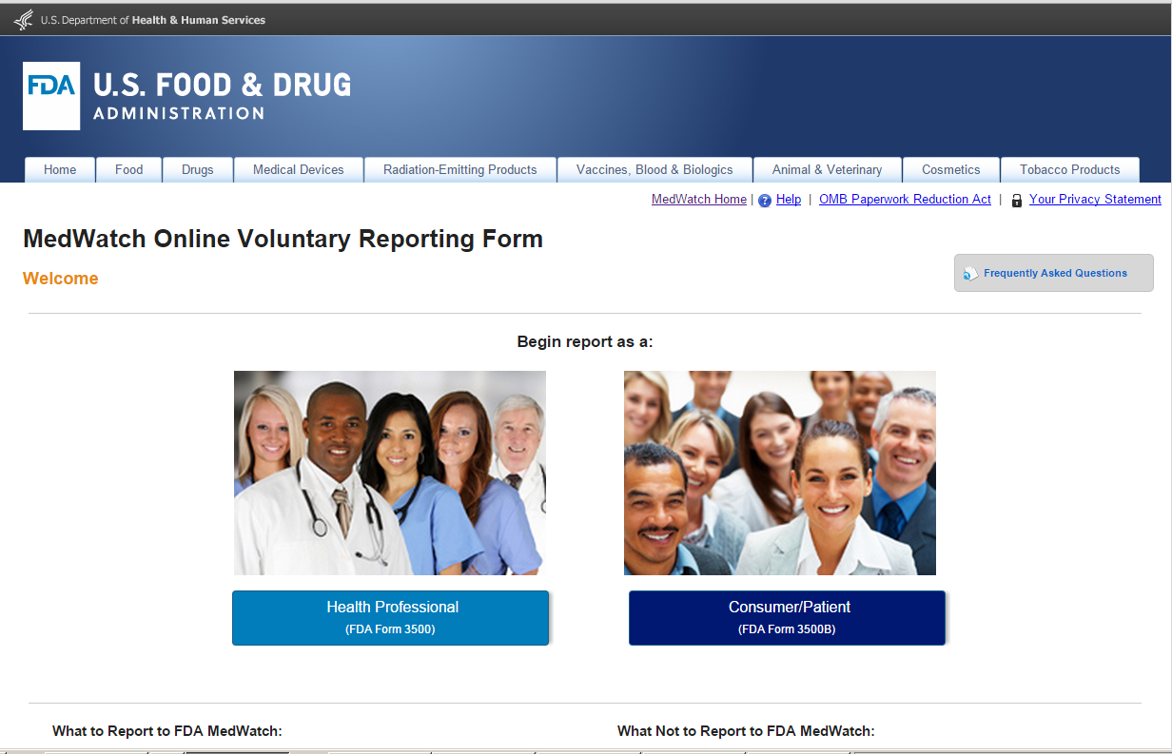
Medication Error Reporting

Slide 29
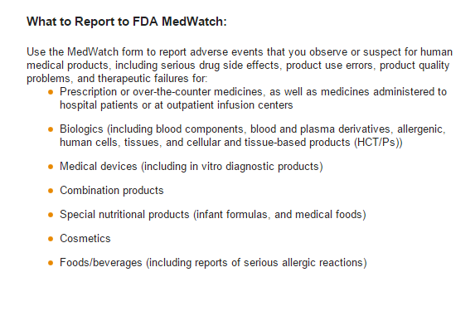
Guidelines to Follow When Reporting Medication Errors

Slide 30
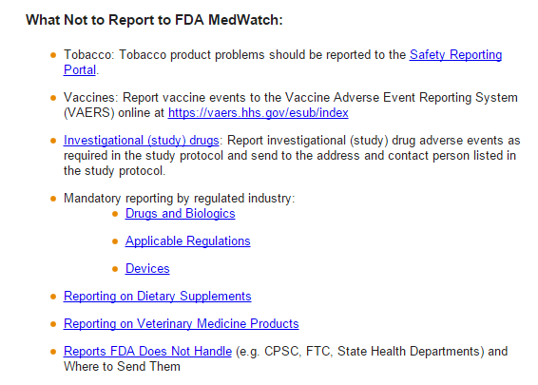
Guidelines to Follow When Reporting Medication Errors

Slide 31
Approaches to Reduce the Risk of Medication Errors

Slide 32
Approaches to Reduce the Risk of Medication Errors
Drug labeling:
Consumers tend to overlook important label information on OTC drugs
The FDA proposed a new format in 2000 to improve prescription drug labeling for physicians, also known as the package insert.
Error tracking and public education:
In December 2003, the USP released an analysis of medication errors captured in 2002 by its anonymous national reporting database, MedMARX.
Of the errors reported to MedMARX, slightly more than one-third reached the patient and involved a geriatric patient.
Many of these medication errors were found to be harmful.
The FDA receives and reviews about 300 medication error reports each month and classifies them to determine the cause and type of error.
Depending on the findings, the FDA can change the way it labels, names, or packages a drug product.
In addition, once a problem is discovered, the FDA educates the public on an ongoing basis to prevent repeat errors.
https://www.fda.gov/drugs/resourcesforyou/consumers/ucm143553.htm

Slide 33
Approaches to Reduce the Risk of Medication Errors
Drug name confusion
Minimize confusion between drug names that look or sound alike
A Regulatory Approach
Bar code label rule
July 2002, the FDA decided to propose a new rule requiring bar codes on certain drug and biological product labels.
FDA mandated drug name change 2004 when the cholesterol-lowering medicine Altocor was being confused with the cholesterol-lowering medicine Advicor. (Now Altocor is called Altoprev, and the agency hasn't received reports of errors since the name change).
After drugs are approved
the FDA tracks reports of errors due to drug name confusion and spreads the word to health professionals, along with recommendations for avoiding future problems.
https://www.fda.gov/drugs/resourcesforyou/consumers/ucm143553.htm

Slide 34
Approaches to Reduce the Risk of Medication Errors
Common Hospital Strategies:
Hospitals and other health care organizations work to reduce medication errors by using technology, improving processes, zeroing in on errors that cause harm, and building a culture of safety.
Here are a couple of examples:
Pharmacy intervention:
To ensure that patients continued taking their regularly prescribed medicines when they entered the hospital.
“Med Rec”
Computerized Physician Order Entry (CPOE):
Studies have shown that CPOE is effective in reducing medication errors.
https://www.fda.gov/drugs/resourcesforyou/consumers/ucm143553.htm

Slide 35
Approaches to Reduce the Risk of Medication Errors
Improving Transition of Care: Opportunities for Community Pharmacists (February 2017, Vol 5, No 2 - Inside Pharmacy):
Transition of care is the transfer of the care of a patient from one setting to another.
In the United States, approximately 20% of 30-day hospital readmissions occur because of uncoordinated transition of care.
Billions of dollars are spent unnecessarily because patients are not receiving proper, coordinated, and consistent care when they are discharged from the hospital into their communities.
In fact, Medicare reports show that more than $17 billion are spent annually on preventable readmissions; a large percentage of patients are readmitted because of improper medication use after discharge.

Slide 36
Approaches to Reduce the Risk of Medication Errors
Improving Transition of Care: Opportunities for Community Pharmacists (cont.)
A systematic review showed that up to 2% of medication discrepancies are life-threatening and lead to death.
Medication discrepancies often occur when patients lack understanding of discharge medication plans, have inadequate literacy to understand the discharge instructions, become nonadherent to a medication regimen, and/or experience adverse drug events.
Expanding community pharmacists’ involvement in post discharge transition of care and improving communication will benefit patients, healthcare providers, and the healthcare system by decreasing hospital readmissions, medication-related adverse events, and financial burdens.
(February 2017, Vol 5, No 2 - Inside Pharmacy)

Slide 37
Improving Transition of Care: Opportunities for Community Pharmacists (cont.)
Barriers:
Despite having community pharmacists readily accessible, many roadblocks discourage care transition services in community pharmacies.
A study published in 2015 assessed community pharmacists’ readiness to participate in care transition.
The primary barrier was the lack of time to offer transition of care services in the community.
The inadequate staffing of pharmacists and technicians prohibits the incorporation of other services, and prohibits pharmacists from providing efficient and/or sufficient care to patients.

Slide 38
Improving Transition of Care: Opportunities for Community Pharmacists (cont.)
Barriers (cont.):
Other obstacles include poor communication between the physicians and pharmacists, and lack of access to the patient’s hospitalization data.
Lack of physician and patient acceptance and lack of reimbursements are also reasons why community pharmacists are hesitant to be more involved in transition of care.
By failing to take a larger role and actively get involved in transition of care, pharmacists may leave patients unaware of the services that community pharmacists are capable of providing.
Once pharmacies are able to get reimbursed for their services, it is likely that more community pharmacies will obtain sufficient resources, including time, and be willing to offer these services.

Slide 39
Approaches to Reduce the Risk of Medication Errors
What Consumers/Patients Can Do?
Recommendations by the FDA:
Know what kind of errors occur.
Find out what drug you're taking and what it's for.
Find out how to take the drug and make sure you understand the directions.
Keep a list of all medications, including OTC drugs, as well as dietary supplements, medicinal herbs, and other substances you take for health reasons, and report it to your health care providers.
If in doubt, ask, ask, ask. Be on the lookout for clues of a problem, such as if your pills look different than normal or if you notice a different drug name or different directions than what you thought.
https://www.fda.gov/drugs/resourcesforyou/consumers/ucm143553.htm

Slide 40
Available Resources

Slide 41
Available Resources for Pharmacists and Healthcare Professionals
Who Tracks Medication Errors?
The Food and Drug Administration
Accepts reports from consumers and health professionals about products regulated by the FDA, including drugs and medical devices, through MedWatch, the FDA's safety information and adverse event reporting program. (800) 332-1088 www.fda.gov/medwatch.htm
Institute for Safe Medication Practices
Accepts reports from consumers and health professionals related to medication. Publishes Safe Medicine, a consumer newsletter on medication errors. 1800 Byberry Road, Suite 810 Huntingdon Valley, PA 19006-3520 (215) 947-7797 www.ismp.org
http://www.ismp.org/tools/default.aspx
U.S. Pharmacopeia
The Medication Errors Reporting (MER) Program, in cooperation with the Institute for Safe Medication Practices, is a voluntary national medication error reporting program. 12601 Twinbrook Parkway Rockville, MD 20852 (800) 23-ERROR (233-7767) www.usp.org
MedMARX
USP's anonymous medication error reporting program used by hospitals. These data are not submitted to the FDA. www.medmarx.com

Slide 42
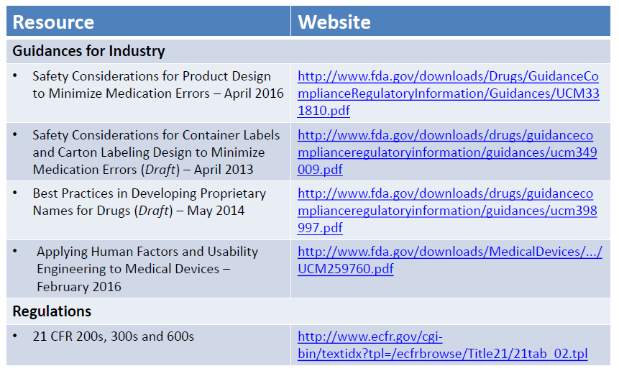

Slide 43
Additional Resources for Pharmacy Technicians
For More Information
Agency for Healthcare Research and Quality Brochures: "20 Tips to Help Prevent Medical Errors" and "20 Tips to Help Prevent Medical Errors in Children" (800) 358-9295
Food and Drug Administration Think it Through: A Guide to Managing the Benefits and Risks of Medicines (888) 878-3256
http://www.ismp.org/tools/default.aspx
https://www.fda.gov/drugs/resourcesforyou

Slide 44
Impact and Related Costs of Medication Errors

Slide 45
Impact and Related Costs of Medication Errors
Economic Impact (United States)
Economic impacts have been inadequately studied.
Medication errors harm an estimated 1.5 million people every year, costing at least $3.5 billion annually.
It is estimated that ADEs affect approximately 2 million hospital stays annually and prolong the length of stay by 1.7–4.6 days .
In 2006, at least 1.5 million preventable ADEs occurred totaling more than $7 billion.
Preventable medication errors impact more than 7 million patients and cost almost $21 billion annually across all care settings .
Spending in the United States for prescription drugs in 2010 was $259.1 billion and is expected to double over the next decade .
Total expenditures on the Medicare Part D program alone in 2012 were $66.9 billion and are projected to reach $165.1 billion by 2022.
https://www.ncbi.nlm.nih.gov/pmc/articles/PMC5016741/

Slide 46
Summary
Errors occurred at multiple care levels, including prescribing, initial pharmacy dispensation, hospitalization, and subsequent outpatient follow-up.
Adverse drug events (ADEs) account for more than 3.5 million physician office visits and 1 million emergency department visits each year.
It is believed that preventable medication errors impact more than 7 million patients and cost almost $21 billion annually across all care settings.
About 30% of hospitalized patients have at least one discrepancy on discharge medication reconciliation.
Medication errors and ADEs are an underreported burden that adversely affects patients, providers, and the economy.

Slide 47
Questions

Slide 48
References
Argo AL, et al. The ten most common lethal medication errors in hospital patients. Hospital Pharmacy 2000; 35:470-4.
MEDMARX USP data report 2003-2006.
National Coordinating Council for Medication Error Reporting and Prevention. Available at: www.nccmerp.org. Accessed 06/01/2017.
https://www.ncbi.nlm.nih.gov/pmc/articles/PMC5016741/. Accessed 05/24/2917.
https://www.fda.gov/drugs/resourcesforyou/consumers/ucm143553.htm. Accessed 04/01/2017
http://www.insidepatientcare.com/issues/2017/february-2017-vol-5-no-2/455-improving-transition-of-care-opportunities-for-community-pharmacists. Accessed 6/5/2017.

