Slide 1
The Hidden Opioid Abuse Problem: Geriatric Opioid Abuse, or is Grandpa Really a Junkie
Ernest J Dole, PharmD, PhC, FASHP, BCPS
Clinical Pharmacist & Asso. Clinical Prof.
University of New Mexico Hospitals & College of Pharmacy
Albuquerque, NM

Slide 2
Learning Objectives
At the end of this presentation, utilizing a case of an older patient on chronic opioid therapy (COT) with the comorbidity of geriatric opioid abuse (GOA) the participant will be able to
Discuss the common presenting signs & symptoms of GOA
Understand why GOA may be difficult to diagnose
Assess the impact of common comorbidities present in older patients on GOA

Slide 3
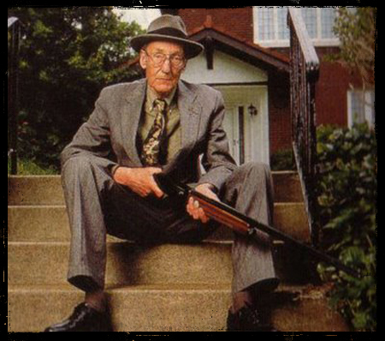
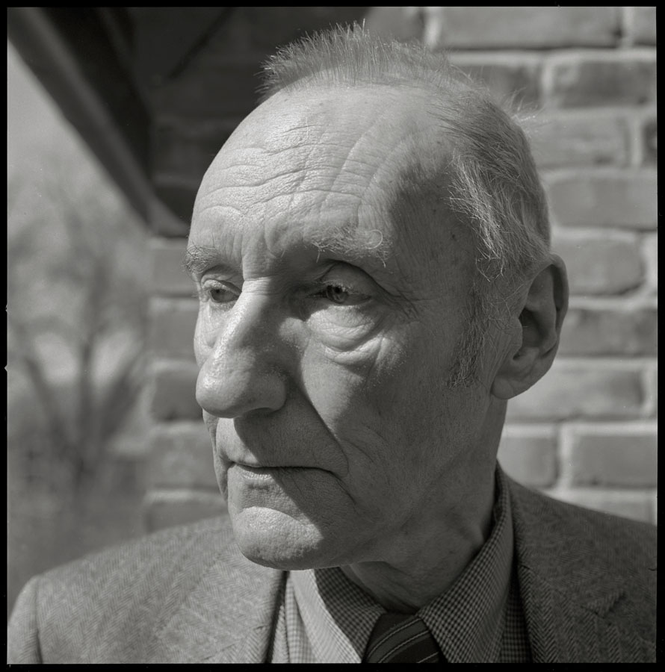
Case Study: WB is a 82 yo male who presents, with his daughter, to your ambulatory care clinic for routine evaluation and refill of his medications

Slide 4
Case Study: WB is a 82 yo male who presents, with his daughter, to your ambulatory care clinic for routine evaluation and refill of his medications
CC:
↑↑ pain, ↓ sleep, “memory”
PMH:
Chronic pain: OA b/l hips & knees, DDD (L4-L5)
Depression
Anxiety
PTSD ; assault , 1987
T2DM
Osteoporosis
FH:
Parents:
Both deceased; father from MI; mother from CVA, father divorced when patient was 11 yo
Divorced:
husband alcoholic, abusive
2 daughters, 1 son:
both daughters w/ +PMH for tx for SUDs

Slide 5
Case Study : Continued
Medications:
Buspirone 10mg tid
Cyclobenzaprine 10mgtid
Duloxetine 20mg bid
Metformin 500mg bid
Morphine 15mg q6h
Mirtazapine 15mg, #1-2 hs
Pregabalin 100mg tid
Ca 500mg tid
VS:
BP: 155/80 Ht: 5’2”
HR: 100 bpm Wt: 105lb
R: 20 QTc: 480ms
Lab
SCr: 1.4
LFTs: WNL
UDM: + morphine, hydromorphone
Other Monitoring
PMP: appropriate for 28 day fill cycle
EHR Rx fill list show early fills for cyclobenzaprine, morphine, pregabalin

Slide 6
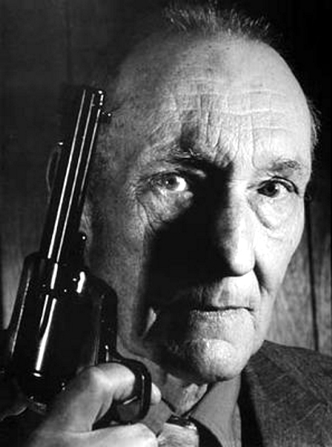
Case Study: Continued
PE:
Well groomed, eye contact diverted at times
Affect is flat, somewhat engaged in conversation, cognition & memory is slow & she has impaired word search, patient is hypervigilant
States his pain is ↑↑, but cannot discern a specific pain driver
He is focused on his cyclobenzaprine, morphine & pregabalin
Motor & neuro exam at baseline

Slide 7
Pre-Test Question 1: In the patient’s case medication list, which medications are at risk for abuse
Buspirone, Cyclobenzaprine
Cyclobenzaprine, Duloxetine
Duloxetine, Morphine
Morphine, Pregabalin
Notes:
Use of buprenorphine for pain and OUD

Slide 8
Pretest Question 2: GOA is often underdiagnosed because
Elderly patients do not abuse drugs
Opioid abuse is a chronic disease of younger patients
Providers rarely look for GOA
Elderly patients rarely present to clinic impaired from GOA
Notes:
Choosing between oxycodone and oxymorphone

Slide 9
Pretest Question 3: Which of the following screening tools for opioid abuse have been validated in an older population
CAGE , ORT, AUDIT
MAST, ASSIST, DARE
None of the above
All of the above
Notes:
Choosing between tramadol and tapentadol

Slide 10
Pretest Question 4: Which screening tools have been recommended for screening for GAO?
CAGE, MAST, AUDIT
ORT, CAGE, MAST
DIRE, ORT, CAGE
DARE, DIRE, ORT
Oral extended-release

Slide 11
Pretest Question 5: Examples of system issues that bias against diagnosis of GAO are
Definition of older adult may vary, grandma deserves one last indulgence
Large study sizes, multiple studies available
A depth of provider education, GOA has been decreasing over time
Most geriatric patients enter the rehab-treatment system via legal avenues, elder patient’s families can’t tell if grandma is abusing opioid medication

Slide 12
GOA: The Hidden Opioid Abuse Epidemic
GOA is a hidden & difficult diagnosis secondary to:
System Issues:
Scope of the problem:
As “baby boomers” start turning 65 yo in 2011, 10,000 people will turn 65 yo daily & will continue at this rate for the next 20 years
All “boomers” will be ≥ 50 yo in 2020, ≥ 65 yo in 2030, & at this time nearly 20% of U.S. residents is expected to be 65 and older
≥65 yo group is projected to ↑ to 88.5 million in 2050, more than doubling the number in 2008 (38.7 million)
Kalapatapu RK, Sullisan MA. Prescription use disorders in older adults. Am J Addict . 2010 ; 19: 515–522. doi:10.1111/j.1521-0391.2010.00080.x.
Kuerbis A, Sacco P, Blazer DG, etal. Substance abuse among older adults. Clin Geriatr Med. 2014 August ; 30(3): 629–654. doi:10.1016/j.cger.2014.04.008.
Center for Substance Abuse Treatment. Substance Abuse Among Older Adults. Rockville (MD): Substance Abuse and Mental Health Services Administration (US); 1998. (Treatment Improvement Protocol (TIP) Series, No. 26.) Available from: https://www.ncbi.nlm.nih.gov/books/NBK64419

Slide 13
GOA: The Hidden Opioid Abuse Epidemic
GOA is a hidden & difficult diagnosis secondary to:
System Issues:
Definition of “older adult” can be 50 yo, or 60 yo, instead of 65 yo due to ↓ in cognitive function, biological factors, psychological factors, and changes in social factors.
Small study sizes & heterogeneous populations
Taylor MH, Grossberg GT. The growing problem of illicit substance abuse in the elderly: a review. Prim Care Companion CNS Disord. 2012; 14: PCC.11r01320
Kalapatapu RK, Sullisan MA. Prescription use disorders in older adults. Am J Addict . 2010 ; 19: 515–522. doi:10.1111/j.1521-0391.2010.00080.x.
Kuerbis A, Sacco P, Blazer DG, etal. Substance abuse among older adults. Clin Geriatr Med. 2014 August ; 30(3): 629–654. doi:10.1016/j.cger.2014.04.008.

Slide 14
GOA: The Hidden Opioid Abuse Epidemic
GOA is a hidden & difficult diagnosis secondary to:
System Issues:
Diagnostic criteria bias:
due to lack of child care responsibilities &/or retirement from work, older patients with GOA may not meet the criterion of a failure to fulfill major role obligations at work or home, as listed in the DSM-IV-TR
changes in pharmacokinetics/dynamics and physiology may appear to ↓ opioid tolerance in elderly persons, which will negate the DSM criteria for ↑ opioid tolerance
Patterson TL, Jeste JV. The potential impact of the baby-boom generation on substance abuse among elderly persons. Psychiatric Services.1999; 50:1184–1188.
Kalapatapu RK, Sullisan MA. Prescription use disorders in older adults. Am J Addict . 2010 ; 19: 515–522. doi:10.1111/j.1521-0391.2010.00080.x.

Slide 15
GOA: The Hidden Opioid Abuse Epidemic
GOA is a hidden & difficult diagnosis secondary to:
System Issues:
Ageism & stereotyping
“grandma’s one last indulgence”
“what difference does it make, she won’t be around much longer”
Provider education
In a crowded curriculum geriatrics accounts for a fraction of that curriculum; opioid abuse far less
Short appointment time
Bardach SH, Rowles GD. Geriatric education in the health professions: are we making a difference. The Gerontologist.2012;52:607-618
Kalapatapu RK, Sullisan MA. Prescription use disorders in older adults. Am J Addict . 2010 ; 19: 515–522. doi:10.1111/j.1521-0391.2010.00080.x.
Kuerbis A, Sacco P, Blazer DG, etal. Substance abuse among older adults. Clin Geriatr Med. 2014 August ; 30(3): 629–654. doi:10.1016/j.cger.2014.04.008.
Patterson TL, Jeste JV. The potential impact of the baby-boom generation on substance abuse among elderly persons. Psychiatric Services.1999; 50:1184–1188.

Slide 16
GOA: The Hidden Opioid Abuse Epidemic
Epidemiology
Prevalence of opioid use
~ 6–9% of community-dwelling older adults use COT for CNCP
70% of nursing home residents with CNCP were prescribed COT
in a community-based study of older adults with CNCP and a mean age of 82 years, 25% of participants reported using COT.
Naples JG, Gallid WF, Hanlom JT. Managing pain in older adults: the role of opioid analgesics. Clin Geriatr Med . 2016 November ; 32: 725–735. doi:10.1016/j.cger.2016.06.006.
Reid MC, Henderson CR, Papaleontiou M. Characteristics of older adults receiving opioids in primary care: treatment duration and outcome. Pain Med . 2010; 11: 1063–1071. doi:10.1111/j.1526-4637.2010.00883.x.

Slide 17
GOA: The Hidden Opioid Abuse Epidemic
Epidemiology
Prevalence of opioid misuse
In 1 study only #4pts/12,000 patients prescribed morphine for self administration became addicted
Recently 1 study reported that 1.4% of adults ≥ 50 yo used prescription opioids nonmedically in the last year
SUD tx in 1992 for prescription opioids was 0.7% for ages 50–54 yo & ≥ 55 yo ; SUD tx in 2005 ↑ to 3.2% for ages 50–54 yo & 2.8% for ≥ 55 yo
Kalapatapu RK, Sullisan MA. Prescription use disorders in older adults. Am J Addict . 2010 ; 19: 515–522. doi:10.1111/j.1521-0391.2010.00080.x.
Center for Substance Abuse Treatment. Substance Abuse Among Older Adults. Rockville (MD): Substance Abuse and Mental Health Services Administration (US); 1998. (Treatment Improvement Protocol (TIP) Series, No. 26.) Available from: https://www.ncbi.nlm.nih.gov/books/NBK64419
Kuerbis A, Sacco P, Blazer DG, etal. Substance abuse among older adults. Clin Geriatr Med. 2014 August ; 30(3): 629–654. doi:10.1016/j.cger.2014.04.008.

Slide 18
GOA: The Hidden Opioid Abuse Epidemic
Demographic's of GOA may be changing
administrative data from New York State licensed drug treatment programs to examine overall age trends and characteristics of older adults in opioid treatment programs in New York City from 1996 to 2012
adults aged 50 and higher becoming the majority treatment population; the majority age group in opioid treatment were those 50–59, with large increases in those over the age of 60.
small but consistent change in the type of pri­mary opioid used, with increased reporting of non-heroin and prescription opioid use since 1996.
Han B, Polydorou S, Blaum CS. Demographic trends of adults in New York city opioid treatment programs-an aging population. Substance Use & Misuse, 50:13, 1660-1667, DOI: 10.3109/10826084.2015.1027929

Slide 19
GOA: The Hidden Opioid Abuse Epidemic
GOAis a hidden & difficult diagnosis secondary to:
Patient issues
Denial, stigma, lack of awareness
↑ isolation; ↓ social support
Chronic pain is a natural part of aging
Effect of aging on physiologic systems
Dopamenergic & serotonergic receptor loss in prefrontal cortex and striatum; NMDA receptor loss in cortex, striatum, and hippocampus
Effect of comorbidities
GOA may present as: dementia, insomnia/sleep apnea, depression, anxiety
Guerriero F. Guidance on opioids prescribing for the management of persistent non-cancer pain in older adults. World J Clin Cases. 2017;5: 73-81
Kalapatapu RK, Sullisan MA. Prescription use disorders in older adults. Am J Addict . 2010 ; 19: 515–522. doi:10.1111/j.1521-0391.2010.00080.x.
Kuerbis A, Sacco P, Blazer DG, etal. Substance abuse among older adults. Clin Geriatr Med. 2014 August ; 30(3): 629–654. doi:10.1016/j.cger.2014.04.008

Slide 20
Assessment of a Hidden Epidemic
Presenting signs & symptoms
Have GOA on your radar screen
Changes in cognition, mood, memory, hygiene, nutrition, and sleep
↑ in depression &/or anxiety
Call from concerned family member &/or friend
Changes in oxygen saturation at clinic visit
Center for Substance Abuse Treatment. Substance Abuse Among Older Adults. Rockville (MD): Substance Abuse and Mental Health Services Administration (US); 1998. (Treatment Improvement Protocol (TIP) Series, No. 26.) Available from: https://www.ncbi.nlm.nih.gov/books/NBK64419
Kalapatapu RK, Sullisan MA. Prescription use disorders in older adults. Am J Addict . 2010 ; 19: 515–522. doi:10.1111/j.1521-0391.2010.00080.x.
Kuerbis A, Sacco P, Blazer DG, etal. Substance abuse among older adults. Clin Geriatr Med. 2014 August ; 30(3): 629–654. doi:10.1016/j.cger.2014.04.008.
Satre DD, Sterling SA, Mackin RS, etal. Patterns of alcohol and drug use among depressed older adults seeking outpatient psychiatric service. Am J Geriatr Psychiatry . 2011; 19: 695–703.

Slide 21
Assessment of a Hidden Epidemic
Screening Tests
There are no validated screening questionnaires for opioid abuse in the elderly
Use of a combination of: CAGE or CAGE-AID, Michigan Alcoholism Screening Test-Geriatrics (MAST-G), and Alcohol Use Disorders Identification Test (AUDIT) has been recommended
Center for Substance Abuse Treatment. Substance Abuse Among Older Adults. Rockville (MD): Substance Abuse and Mental Health Services Administration (US); 1998. (Treatment Improvement Protocol (TIP) Series, No. 26.) Available from: https://www.ncbi.nlm.nih.gov/books/NBK64419
Kalapatapu RK, Sullisan MA. Prescription use disorders in older adults. Am J Addict . 2010 ; 19: 515–522. doi:10.1111/j.1521-0391.2010.00080.x.
Satre DD, Sterling SA, Mackin RS, etal. Patterns of alcohol and drug use among depressed older adults seeking outpatient psychiatric service. Am J Geriatr Psychiatry . 2011; 19: 695–703.

Slide 22
GOA: Risk Factors
Depression
Less physically disabled
Multiple medications
PTSD
+PMH of illicit drug use
Park J, Lavin R. Risk Factors Associated With Opioid Medication Misuse in
Community-dwelling Older Adults With Chronic Pain. Clin J Pain. 2010;26:647–55.
Cochran G, Rosen D, McCarthy RM, etal. Risk factors for symptoms of prescription opioid misuse: do older adults differ from younger adult patients? J Geront Soc Work. 2017;12:1-15.

Slide 23
Assessment of a Hidden Epidemic
Opioid Assessment Tools
Risk Assessment
Not validated in elderly
ORT, DIRE, SOAPP-R
Ongoing Assessment
Not validated in elderly
COMM, ABC, 5-Point Opiate Abuse Checklist
https://www.opioidrisk.com/book/export/html/613. Accessed September, 4, 2017

Slide 24
Assessment of a Hidden Epidemic
Other tools
Use of PMP regulated by individual state’s medical & pharmacy boards
Use of urine drug testing as mandated by individual state’s medical & pharmacy boards

Slide 25
Key Take Aways
1. The number of elderly patients will increase in the coming years. It should be expected that the number of geriatric patients abusing &/or addicted to opioid medications should also increase. So, yes, Grandma could really be a junkie.
2. There are no validated tools to screen for GAO. SAMSHA recommends using: CAGE or CAGE-AID, Michigan Alcoholism Screening Test-Geriatrics (MAST-G), and Alcohol Use Disorders Identification Test (AUDIT) has been recommended.

Slide 26
Key Take Aways
GOA is underdiagnosed because:
absence of validated diagnostic instruments in the geriatric population
the multitude of medical co-morbidities
nonspecific clinical presentation in the elderly
lack of geriatric provider training or awareness of substance abuse disorders
absence of published literature on nonalcohol substance use disorders in this population

Slide 27
Post-Test Question 1: In the patient’s case medication list, which medications are at risk for abuse
Buspirone, Cyclobenzaprine
Cyclobenzaprine, Duloxetine
Duloxetine, Morphine
Morphine, Pregabalin

Slide 28
Pretest Question 2: GOA is often underdiagnosed because
Elderly patients do not abuse drugs
Opioid abuse is a chronic disease of younger patients
Providers rarely look for GOA
Elderly patients rarely present to clinic impaired from GOA

Slide 29
Pretest Question 3: Which of the following screening tools for opioid abuse have been validated in an older population
CAGE , ORT, AUDIT
MAST, ASSIST, DARE
None of the above
All of the above

Slide 30
Pretest Question 4: Which screening tools have been recommended for screening for GOA
CAGE, MAST, AUDIT
ORT, CAGE, MAST
DIRE, ORT, CAGE
DARE, DIRE, ORT

Slide 31
Pretest Question 5: Examples of system issues that bias against diagnosis of GOA are
Definition of older adult may vary, grandma deserves one last indulgence
Large study sizes, multiple studies available
A depth of provider education, GOA has been decreasing over time
Most geriatric patients enter the rehab-treatment system via legal avenues, elder patient’s families can’t tell if grandma is abusing opioid medication

